Slide 1


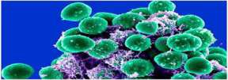
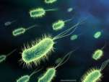
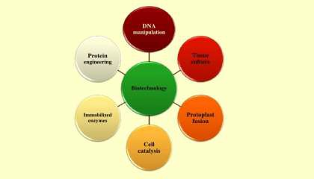
Microbes in Human Welfare
Nithina M
PGT BIOLOGY

Slide 2
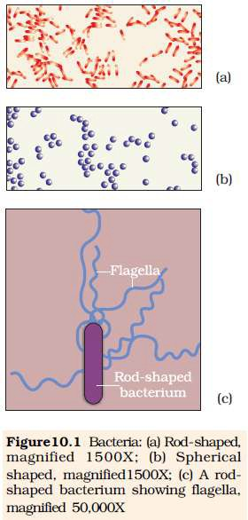
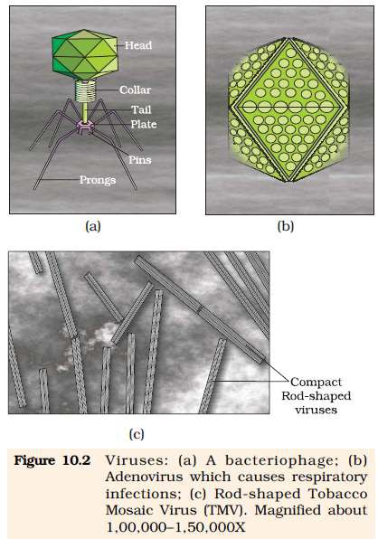
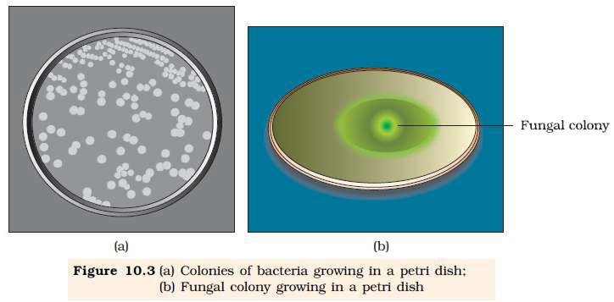

Slide 3
MICROBES IN HOUSEHOLD PRODUCTS
Micro-organisms such as Lactobacillus and others commonly called lactic acid bacteria (LAB) grow in milk and convert it to curd. LAB produce acids that coagulate and partially digest the milk proteins.
It also improves its nutritional quality by increasing vitamin B12. In our stomach too, the LAB play very beneficial role in checking disease causing microbes.

Slide 4
The dosa and idli is also fermented by bacteria.
The dough, which is used for making bread, is fermented using baker’s yeast (Saccharomyces cerevisiae).
A number of traditional drinks and foods are also made by fermentation by the microbes.
‘Toddy’, a traditional drink of some parts of southern India is
made by fermenting sap from palms

Slide 5
Microbes are also used to ferment fish, soyabean and bamboo shoots to make foods.
Cheese, is one of the oldest food items in which microbes were used.
The large holes in ‘Swiss cheese’ are due to production of a large amount of CO2 by a bacterium named Propionibacterium sharmanii.
The ‘Roquefort cheese’ is ripened by growing a specific fungus on them, which gives them a particular flavour

Slide 6
In industry, microbes are used to synthesize a number of products valuable to human beings. Beverages and antibiotics are some examples. Production on an industrial scale requires growing microbes in very
large vessels called fermentors.

Slide 7
MICROBES IN INDUSTRIAL PRODUCTS
Fermented Beverages-
Microbes like yeast are used for the production of beverages like wine, beer, whisky, brandy or rum.
• The same yeast Saccharomyces cerevisiae used for bread- making and commonly called brewer’s yeast is used for fermenting malted cereals and fruit juices, to produce ethanol.
Wine and beer are produced without distillation whereas whisky, brandy and rum are produced by distillation of the fermented broth.

Slide 8
Antibiotics
Anti is a Greek word that means ‘against’, and bio means ‘life’,
together they mean ‘against life’. (in the context of disease causing organisms); whereas with reference to human beings, they are ‘pro life’ and not against
Alexander Fleming while working on Staphylococci bacteria, once observed a mould growing in one of his unwashed culture plates around which Staphylococci could not grow.
He found out that it was due to a chemical produced by the mould
and he named it Penicillin after the mould Penicillium notatum.
Its full potential as an effective antibiotic was established by Ernest Chain and Howard Florey.
This antibiotic was extensively used to treat American soldiers wounded in World War II Fleming, Chain and Florey were awarded the Nobel Prize in 1945, for this discovery.

Slide 9
Chemicals, Enzymes and other Bioactive Molecules
Aspergillus niger (a fungus) produces citric acid,
Acetobacter aceti (a bacterium) produce acetic acid;
Clostridium butylicum (a bacterium) produces butyric acid
Lactobacillus (a bacterium) produces lactic acid.
Yeast (Saccharomyces cerevisiae) is used for commercial production of ethanol.

Slide 10
Enzymes like Lipases are used in detergent formulations and are
helpful in removing oily stains from the laundry.
The bottled juices are clarified by the use of pectinases and proteases.
Streptokinase produced by the bacterium Streptococcus and modified by genetic engineering is used as a ‘clot buster’ for removing clots from the blood vessels of patients who have undergone myocardial infarction leading to heart attack.
Cyclosporin A that is used as an immunosuppressive agent in organ- transplant patients is produced by the fungus Trichoderma polysporum.
Statins produced by the yeast Monascus purpureus have been commercialized as blood-cholesterol lowering agents. It acts by competitively inhibiting the enzyme responsible for synthesis of cholesterol

Slide 11
MICROBES IN SEWAGE TREATMENT-
The municipal waste-water including human excreta is also called sewage. It contains large amounts of organic matter and microbes. Many of which are pathogenic
Primary treatment
Steps of this treatment basically involve physical removal of particles – large and small – from the sewage through filtration and sedimentation. These are removed in stages; initially, floating debris is removed by sequential filtration.
Then the grit (soil and small pebbles) are removed by sedimentation.
All solids that settle form the primary sludge, and the supernatant forms
the effluent.
The effluent from the primary settling tank is taken for secondary treatment

Slide 12
Secondary treatment or Biological treatment
The primary effluent is passed into large aeration tanks where it is constantly agitated mechanically and air is pumped into it.
This allows vigorous growth of useful aerobic microbes into flocs (masses of bacteria associated with fungal filaments to form mesh like structures).
While growing, these microbes consume the major part of
the organic matter in the effluent.
This significantly reduces the BOD (biochemical oxygen
demand) of the effluent.
.

Slide 13
BOD refers to the amount of the oxygen that would be consumed if all the organic matter in one liter of water were oxidised by bacteria.
The sewage water is treated till the BOD is reduced.
The BOD test measures the rate of uptake of oxygen by micro-organisms in a sample of water and thus, indirectly, BOD is a measure of the organic matter present in the water.
The greater the BOD of waste water, more is its
polluting potential

Slide 14
Once the BOD of sewage or waste water is reduced significantly, the effluent is then passed into a
settling tank where the bacterial ‘flocs’ are allowed to sediment.
This sediment is called activated sludge. A small part of the activated sludge is pumped back into the aeration tank to serve as the inoculum.
The remaining major part of the sludge is pumped into large tanks called anaerobic sludge digesters.

Slide 15
Here, other kinds of bacteria, which grow anaerobically, digest the bacteria and the fungi in the sludge. During this digestion, bacteria produce a mixture of gases such as methane, hydrogen sulphide and carbon dioxide.
These gases form biogas and can be used as source of energy as it is inflammable.
The effluent from the secondary treatment plant is generally released into natural water bodies like rivers and streams

Slide 16
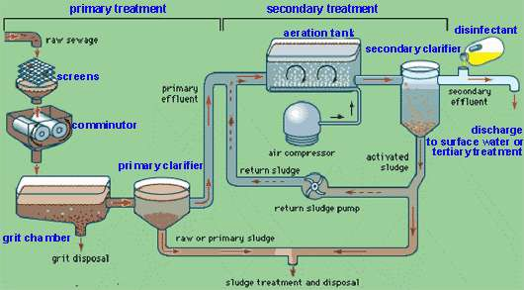
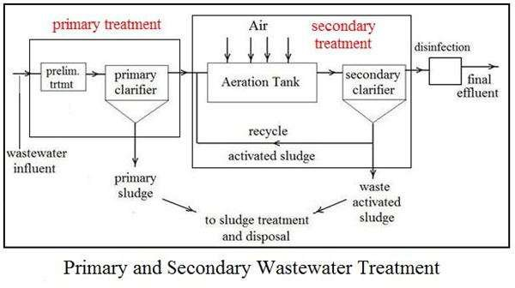

Slide 17
MICROBES IN PRODUCTION OF BIOGAS
Certain bacteria, which grow anaerobically on cellulosic material, produce large amount of methane along with CO2 and H2.These bacteria are collectively called methanogens, and one such common bacterium is Methanobacterium.
These bacteria are commonly found in the anaerobic sludge during sewage treatment.These bacteria are also present in the rumen (a part of stomach) of cattle.
A lot of cellulosic material present in the food of cattle is also present in the rumen. In rumen, these bacteria help in the breakdown of cellulose and play an important role in the nutrition of cattle.
Thus, the excreta (dung) of cattle, commonly called gobar, is rich in these bacteria. Dung can be used for generation of biogas, commonly called gobar gas.

Slide 18
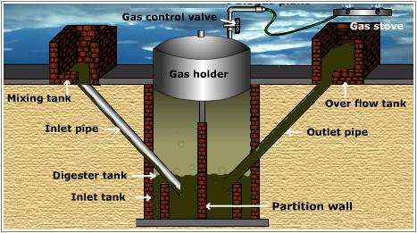
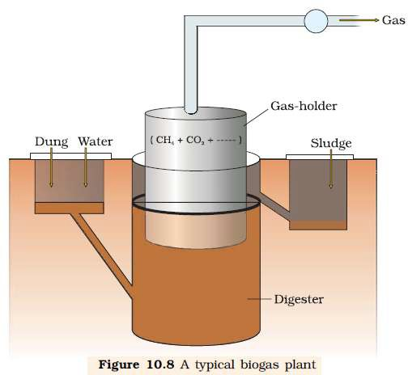
The technology of biogas production was developed in India mainly due to the efforts of Indian Agricultural Research Institute (IARI) and Khadi and Village Industries Commission (KVIC)

Slide 19
MICROBES AS BIOCONTROL AGENTS
Biological control of pests and diseases
The very familiar beetle with red and black markings – the Ladybird, and Dragonflies are useful to get rid of aphids and mosquitoes, respectively.
to control butterfly caterpillars is the bacteria Bacillus thuringiensis in Bt-cotton.
Trichoderma species are free-living fungi that are very common in the root ecosystems.They are effective biocontrol agents of several plant pathogens.
Baculoviruses are pathogens that attack insects and other arthropods. The majority of baculoviruses used as biological control agents are in the genus Nucleopolyhedrovirus.These viruses are excellent candidates for species-specific, narrow spectrum insecticidal applications.They have been shown to have no negative impacts on plants, mammals, birds, fish or even on non-target insects

Slide 20
MICROBES AS BIOFERTILISERS
Biofertilisers are organisms that enrich the nutrient quality of the soil.The main sources of biofertilisers are bacteria, fungi and cyanobacteria
Rhizobium, Azospirillum and Azotobacter – bacteria help in nitrogen fixation
Mycorrhiza as fungi
Cyanobacteria are autotrophic microbes widely distributed in aquatic and terrestrial environments many of which can fix atmospheric nitrogen, e.g. Anabaena, Nostoc, Oscillatoria, etc. In paddy fields, cyanobacteria serve as an important biofertiliser

