Slide 1
Nutrition in amoeba
For Class X
By
Dr Sanjoy Deka, TGT (Science)
Sainik School Goalpara, Assam

Slide 2
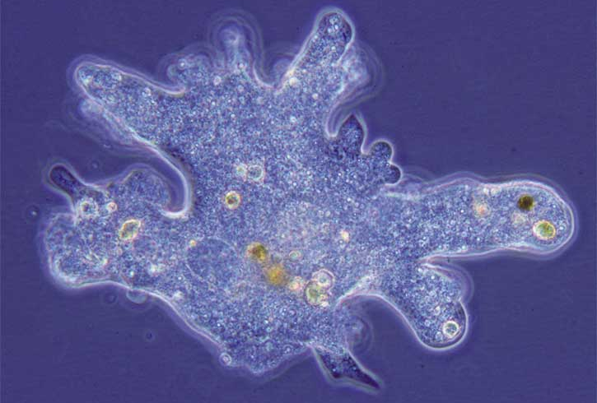
Amoeba under microscope

Slide 3
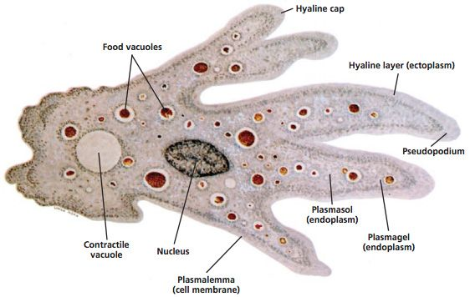
Amoeba Proteus
Movement occurs through the use of pseudopodia, where the cytoplasm pushes the plasma membrane outward or inward, creating blunt, finger-like projections. The cytoplasm can be differentiated into 2 layers – the outer ectoplasm and the inner endoplasm. Endoplasm helps the amoeba with locomotion or movement. Since amoeba move by flowing its cytoplasm over surfaces, flowing the endoplasm in different directions moves the cell along. The ectoplasm steers the direction of the cell by extending itself into a pseudopodium, a gel-like ectoplasmic tube.

Slide 4
Nutrition in amoeba
Heterotrophic Organism:
The organisms which can’t prepare their own food and depends on green plants for their food are called heterotrophic organism.
Heterotrophic nutrition:
The process by which foods are taken inside by heterotrophic organisms and are digested, absorbed and assimilated by the body is called Heterotrophic nutrition.
Holozoic nutrition (Greek: holo-whole ; zoikos-of animals) is a type of heterotrophic nutrition that involves the ingestion of liquid or solid organic material, digestion, absorption and assimilation of it to utilize. Nutrition in amoeba is holozoic.
Nutrition in an amoeba occurs through a process called phagocytosis.
Phagocytosis (from Ancient Greek phagein , meaning 'to eat', and kytos, meaning 'cell') is the process by which a cell uses its plasma membrane to engulf a large particle (≥ 0.5 μm), giving rise to an internal compartment called the phagosome. It is one type of endocytosis.
Digestion in amoeba is called endocytosis (the taking in of matter by a living cell by invagination of its membrane to form a vacuole) too.

Slide 5
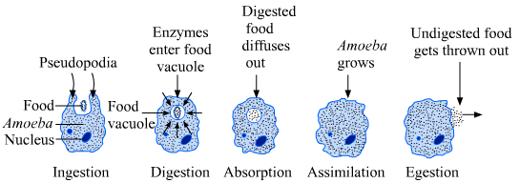
Nutrition in amoeba

Slide 7
Questions ?
Write the scientific name of amoeba.
What is endocytosis?
What do you mean by holozoic nutrition?
Explain various steps of digestion in amoeba.
Draw and label the parts of amoeba.
What is phagocytosis?

