Slide 1


Chapter ; 03
HUMAN REPRODUCTION

Slide 2
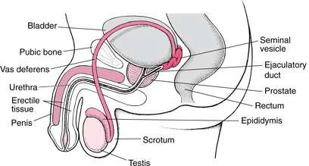
THE MALE REPRODUCTIVE SYSTEM.
Located in the pelvis region.
Male reproductive system includes
  A pair of testes.
  Accessory ducts.
  Accessory glands.
External genitalia

Slide 3
Testes:
Located outside the abdominal cavity within a pouch called scrotum.
Scrotum provides low temperature required for spermatogenesis.
Each testis is about 4 to 5 cm length and 2 to 3 cm width.
Each testis has about 250 compartments called testicular lobules.
Each lobule contains one to three seminiferous tubules.
Seminiferous tubules lined by male germ cells and Sertoli cells.
Male germ cell undergoes meiosis and produce sperm.
Sertoli cells provide nutrition to the germ cell and the sperm.
In between the seminiferous tubule there is interstitial cell or Leydig cell.
Leydig cells produce testicular hormones
called androgen (testosterone).

Slide 4
Accessory ducts:
Includes rete testis, vasa efferentia, epididymis and vas deferens.
Seminiferous tubules open into vasa efferentia through rete
testis.
The vasa efferentia leaves the testis and open into epididymis.
The epididymis leads to vas deferens that ascends to the abdomen through inguinal canal and loops over the urinary bladder.
Vas deferens receives a duct from seminal vesicle and opens into the urethra as the ejaculatory duct.
Urethra originates from the urinary bladder and extends through the penis to its external opening calledurethral meatus.

Slide 5
Accessory glands:
Includes
  Paired seminal vesicle
  A prostate gland
  Paired bulbourethral gland.
Secretion of these glands constitutes the seminal
plasma.
Seminal plasma rich in fructose, calcium, and certain enzyme.
Secretion of bulbo-urethral glands helps in
lubrication of penis.

Slide 6
External genitalia:
Penis is the external genitalia.
It is made of special tissue that helps in erection of the penis to facilitate insemination.
The enlarged end of penis is called glans penis.
Glans penis is covered by a loose fold of skin
called foreskin.

Slide 7
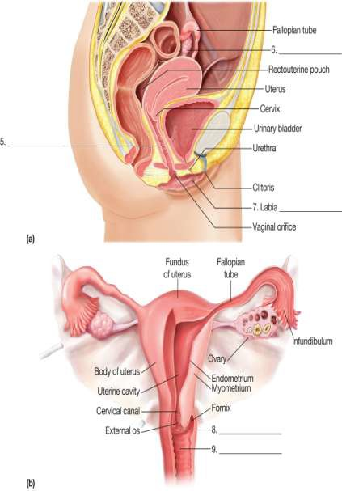
THE FEMALE REPRODUCTIVE SYSTEM
Located in the pelvic region of the
female.
The female reproductive system includes:
  A pair of ovaries
  A pair of oviduct.
  Uterus
  Cervix
  Vagina
  External genitalia.
A pair of mammary gland

Slide 8
Ovaries:
It is the primary female sex organs that produce the female gamete (ovum).
It also produces several steroid hormones.
The ovaries located in the lower abdomen.
Each ovary is about 2-4 cm in length.
Connected to the pelvic wall and uterus by ligaments.
Each ovary is covered by thin epithelium which encloses the ovarian stroma
The ovarian stroma has two zones
  A peripheral cortex.
  An inner medulla.

Slide 9
Oviduct:
Oviducts, uterus and vagina constitute the female accessory ducts.
Each fallopian tube is about 10-12 cm long and extends from the
periphery of each ovary to the uterus.
Close to the ovary the oviduct has a funnel shaped structure called infundibulum?
The edges of the infundibulum possess finger-like projections called fimbriae, which helps in collection of the ovum after ovulation.
The infundibulum leads to a wider part of the oviduct called ampulla.
The last part of the oviduct is called isthmus which joined to uterus.

Slide 10
Uterus:
It is single and is called womb.
It is inverted pear shaped.
Attached the pelvic wall by ligaments.
The uterus opens into vagina through a narrow cervix.
The lumen of cervix is called cervical canal.
Cervical canal along with vagina form the birth canal.
The wall of the uterus has three layers of tissues
  Perimetrium: external thin membranous.
  Myometrium: middle thick layer of smooth muscles
  Endometrium: inner glandular layer.
Endometrium undergoes cyclical changes during menstrual cycle.
Myometrium exhibits strong contraction during delivery of the baby.

Slide 11
External genitalia:
It includes following structure:
  Mons Pubis: cushion of fatty covered by skin and pubic hair.
  Labia majora: fleshy folds of tissue which extends down from the mons pubis and surrounds the vaginal opening.
  Labia minora: are paired folds of tissue under the labia majora.
  Hymen: the opening of vagina is often covered partially by a membrane called hymen.
  Clitoris: a tiny finger-like structure lies at the upper junction of two labia minora above the urethral opening.

Slide 12
Mammary glands:
Mammary gland consists of glandular tissue and fat.
Glandular tissue of each breast divided into 15-20 mammary
lobes.
Mammary lobes contain cluster of cells called alveoli.
The cells of alveoli secrete milk, stored in the lumen of alveoli.
The alveoli open into mammary tubules.
The tubules of each lobe join to form a mammary duct.
Several mammary ducts join to form a wider mammary ampulla.
Mammary ampulla connected to lactiferous duct, through
which milk is sucked out.

Slide 13
GAMETOGENESIS: (formation of gametes)
Spermatogenesis:
Formation of sperm from the germ cell in the testes is spermatogenesis.
The process begins at puberty.
Spermatogonia present in the lining of seminiferous tubules undergo mitotic division to increase their number.
Each spermatogonium is diploid (2n) which contain 46 chromosomes.
Innermost layer of spermatogonial becomes larger called primary spermatocyte.
Primary spermatocyte undergoes meiosis-I to form two equal haploid (n) secondary
spermatocytes (n).
Each secondary spermatocyte undergoes meiosis-II to form two equal, haploid spermatids.
Each primary spermatocyte produces four spermatids.
Spermatids transformed into spermatozoa (sperms) by the process called spermiogenesis.
The sperm head embedded in the Sertoli cell.
Release of sperm from the seminiferous tubule is called spermiation.

Slide 14
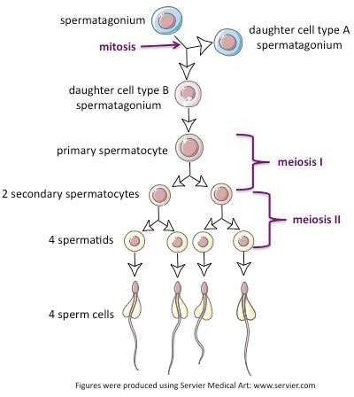
SPERMATOGENESIS PROCESS

Slide 15
Hormonal control of spermatogenesis:
This process is initiated at puberty due to secretion of gonadotrophins releasing hormone (GnRH)
GnRH secreted form hypothalamus and stimulate anterior
pituitary to secrete two gonadotrophins.
  Luteinizing hormone (LH) and
  Follicle stimulating Hormone (FSH)
LH acts on Leydig cells and stimulates synthesis of
androgens.
Androgen stimulates spermatogenesis.
FSH acts on Sertoli cells and stimulates spermatogenesis in other ways.

Slide 16
Structure of sperm:
Ultrastructure of sperm consists of a head, neck, a middle piece and a tail.
Whole body of sperm surrounded by plasma membrane.
The sperm head contain an elongated haploid nucleus.
Above the nucleus a cap like structure present called acrosome.
The acrosome contains enzymes which help in fertilization of ovum.
The middle piece contains mitochondria, which provide energy for movement of tail that facilitate sperm motility.
Human male ejaculates 200-300 million sperms during coitus.
60 percent must have normal shape and size and 40 percent of them must show
vigorous motility.
Sperm released from seminiferous tubules enters into accessory ducts.
On their way fluids from seminal vesicle and prostate gland added which
collectively called as Semen.
The function of male accessory ducts and glands are maintained by testicular hormone androgen.

Slide 17
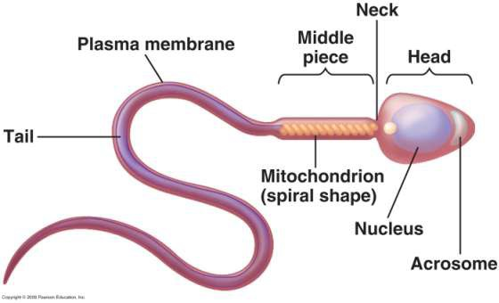
SPERM STRUCTURE

Slide 18
Oogenesis:
Formation of a mature female gamete or ovum is calledoogenesis.
Oogenesis starts during embryonic stage, 25th week of the fetal age.
Germinal epithelium of ovary divided mitotically to produce millions of gamete mother cell or oogonia.
No oogonia formed or added after birth.
Oogonia enters into meiosis-I and proceeds uptodiakinesis of Prophase-I and get suspended, at this stage calledprimary Oocytes.
Each primary oocyte surrounded by layers of granulose cells and then called primary follicle.
At puberty only 60,000 to 80,000 primary oocytes are left in each ovary.
After puberty primary follicles get surrounded by more layers of granulosa cells and
a new theca to formsecondary follicles.
The secondary follicle transformed into tertiary follicle, characterized by a fluid filled cavity calledantrum.
The theca layers organized into an inner theca interna and outer theca externa.
During the growth of primary follicle into tertiary follicle during puberty, the primary oocyte restarts its first meiotic division and completes it within tertiary follicle resulting two unequal haploid cells.
  Large haploid cell is called secondary oocyte.
  A tiny cell called first polar body.

Slide 19
CONT….
The secondary oocyte retains bulk of the nutrient rich cytoplasm of primary oocyte.
The tertiary follicle having secondary oocyte further changes
into Graafian follicle.
The secondary oocyte surrounded by a new membrane, zonapellucida.
The secondary oocyte undergoes second meiotic division continued upto metaphase-II and get suspended until entry of sperm.
At this stage Graafian follicle releases secondary oocyte from the ovary by the process called ovulation.
On entry of a sperm into the secondary oocytes stimulates it to complete meiosis-II and there is formation of a haploid ovum and a second polar body (n).

Slide 20
Menstrual cycle:
Reproductive cycle of female primates is called menstrual cycle.
The first menstruation begins at puberty is called Menarche.
Menstrual cycle repeated at an average interval of
28/29 days.
One ovum is released in the middle of each menstrual cycle.

Slide 21
Menstrual cycle has following phases:
Menstrual phase:
1st phase of menstrual cycle.
Menstrual flow occurs.
Lasts for 3-5 days.
Breakdown of endometrial lining and blood vessel.
Mucus and blood comes out through vagina.
It occurs only when ovum released but no fertilization.
Lack of menstruation is the indication of pregnancy.

Slide 22
Follicular phase:
Menstrual phase followed by follicular phase.
Primary follicle becomes Graafian follicle.
Regeneration and proliferation of uterine endometrium.
LH and FSH level increases gradually in follicular
phase.
Level of estrogen increases as it is secreted from growing follicle.
It lasts for 5-13 days.

Slide 23
Ovulatory phase:
FSH and LH attain peak level in this period (14th day).
This is called LH surge, which induces rupture of Graafian follicle and release of ovum from the ovary called ovulation.

Slide 24
Luteal phase:
Remaining part of Graafian follicle transformed into corpus luteum.
Coupusluteum produces large amount of progesterone.
Progesterone maintains the uterine endometrium, and prepares it for implantation.
Thickness of uterine endometrium increase in many folds, due to proliferation.
If there is fertilization, corpus luteum grows further and
pregnancy continued, menstrual cycle stopped.
In the absence of fertilization corpus luteum degenerates.
Disintegration of endometrium leading to menstruation.
Menstrual cycle ceases around 50 years of age,
called menopause.

Slide 25
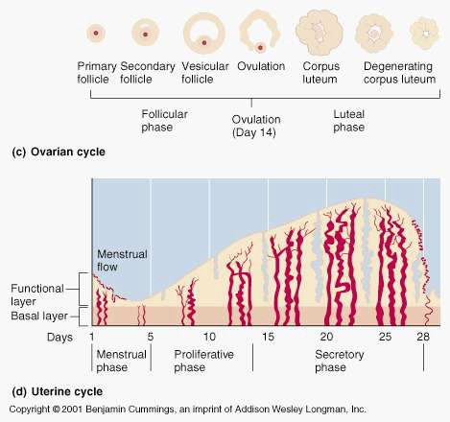

Slide 26
FERTILIZATION AND IMPLANTATION:
During copulation (coitus) semen is released by the penis into the vagina is called insemination.
The motile sperm swim rapidly, pass through cervix, uterus and finally reach the junction of isthmus and ampulla(ammpullary-isthmic junction).
The ovum released from the ovary also transported to ampullary isthmic junction where fertilization takes place.
Fertilization only takes place if both sperm and ovum reach ampullary – isthmic junction simultaneously.
The process of fusion of a sperm and ovum is called fertilization.
Acrosome of sperm secretes enzymes helps in
penetration into the ovum.

Slide 27
CONT…
Once a sperm comes contact with the zonapellucida of ovum and induces the changes in the membrane that blocks the entry of additional sperms.
That ensures monospermy and prevents polyspermy.
Only one sperm fertilize with one ovum.
Entry of sperm into the ovum induces the ovum to complete its second meiotic division of secondary oocyte.
Meiosis-II is also unequal cytokinesis resulting production of one large ovum (ootid) and one small second polar body.
Haploid nucleus of sperm fused with the haploid
nucleus of ovum to form a diploid zygote.

Slide 28
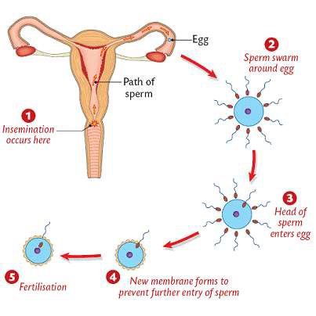

Slide 29
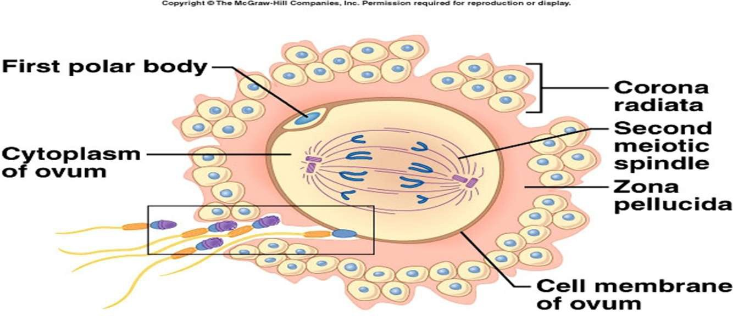

Slide 30
The zygote undergoes a series of mitotic cell divisions called cleavage.
The stages of development are:
Fertilized ovum (zygote)
→2-cell stage
→4-cell stage
→8-cell stage
→Morula
→Blastula
→ Gastrula

Slide 31
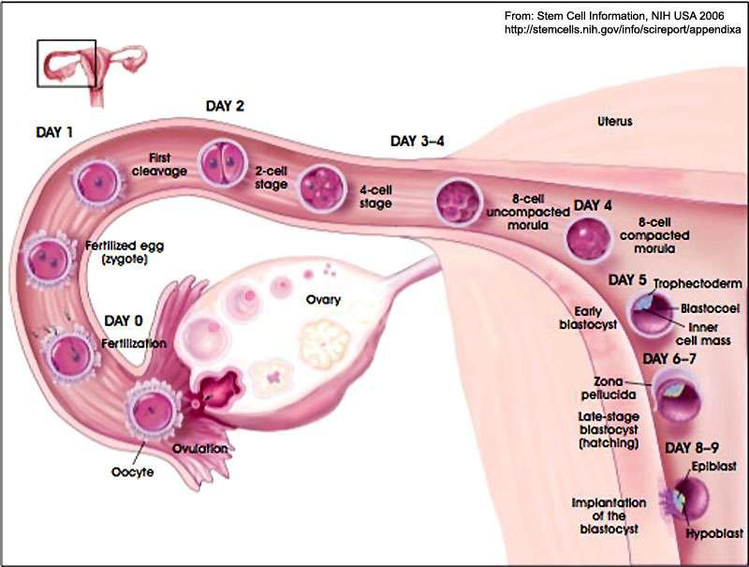

Slide 32
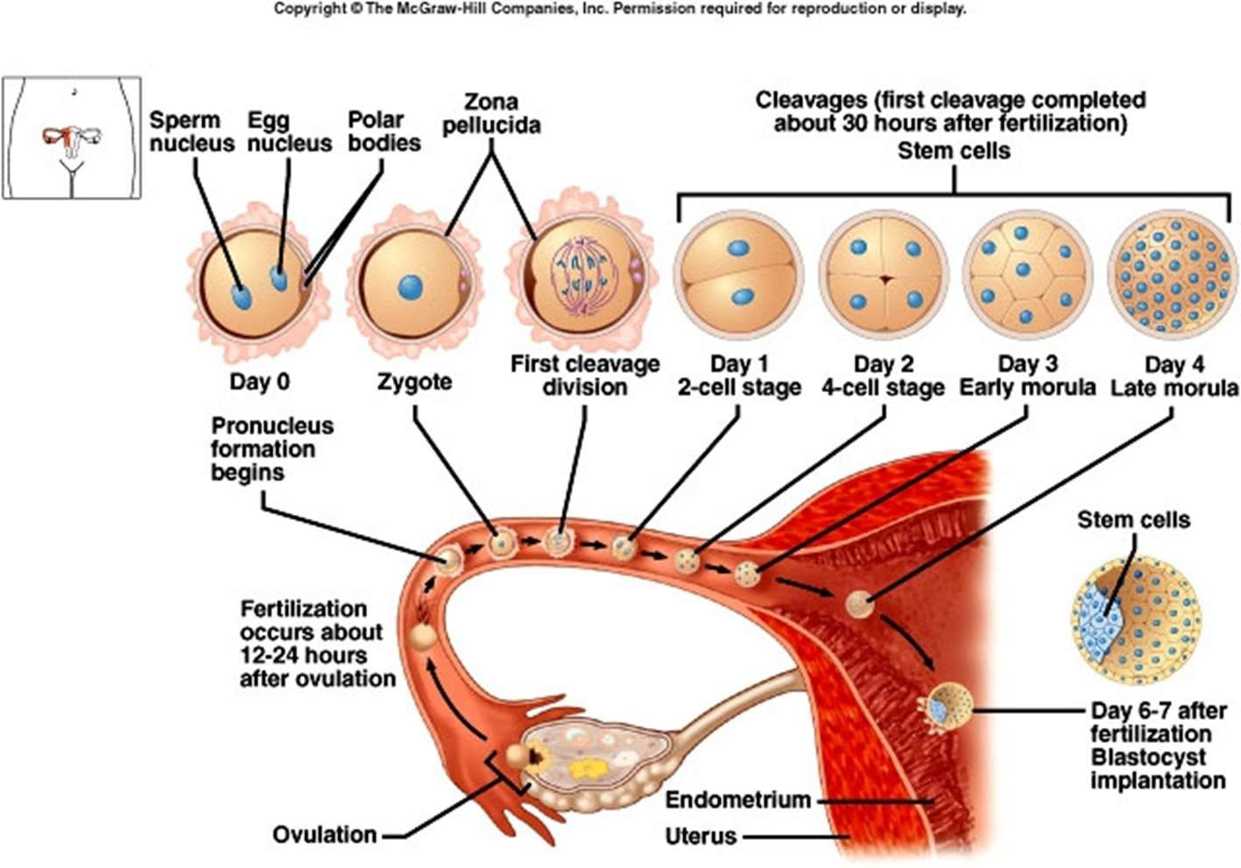

Slide 33
Sex determination:
Sex of a baby has been decided during fertilization and in the zygote.
Sex is determined by the sex-chromosomes present in
gametes.
Human female contain two XX chromosomes.
Human male contain XY chromosomes.
All the female gametes produced with only ‘X’ chromosome.
Sperms produced by male, 50% with ‘X’ and 50 % with ‘Y’ chromosome.
After fertilization zygote either carries XX or XY chromosomes.
Zygote with XX chromosomes develop into female and with
XY chromosome develops into male

Slide 34
Cleavage:
Repeated mitotic division of the zygote without growth resulting a multicellular ball like embryo is calledcleavage.
Cleavage starts soon after fertilization.
Daughter cells produced during cleavage are called blastomeres.
The product of cleavage is called Morula, which is 8 to 16 celled.
The morula continues to divide and grow and transformed into blastocyst.
The blastomeres in blastocyst arranged into an outer layer
called trophoblast and an inner mass of cells attached to trophoblast
called inner cell mass.
Trophoblast cells attached to the endometrium helps development of placenta.
Inner cell mass gets differentiated into the embryo.
After attachment the uterine cells divide rapidly and cover the
blastocyst.
Blastocyst completely embedded in the uterine endometrium. This is called implantation.

Slide 35
Pregnancy and embryonic development:
After implantation, finger like projections appears on the trophoblast called chorionic villi.
Chorionic villi surrounded by uterine tissue and maternal blood.
Temporary association between the fetal tissue (chorionic villi) and maternal tissue (uterine endometrium) is called placenta.

Slide 36
Function of placenta:
The embryo connected to the placenta by umbilical cord, which transports substances to and from the embryo.
Facilitate transport of oxygen and nutrient from mother to embryo.
Removes CO₂ and waste material from the embryo.
Acts as endocrine gland and produces several hormones
like:
  Human chorionic gonadotrophins (hCG)
  Human placental lactogen (hPL)
  Estrogen.
  Progesterone
  Relaxin produced from the ovary in the later stage of
pregnancy.

Slide 37
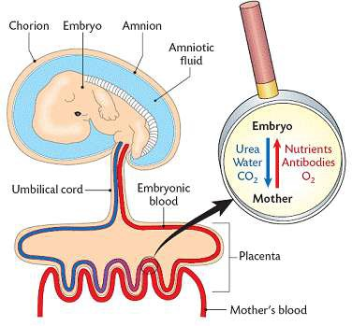

Slide 38
Embryonic development:
After implantation the inner cell mass of blastocyst differentiated into an outer layer
called ectoderm and an inner layer called endoderm.
Mesoderm differentiated in-between ectoderm and
endoderm.
The inner cell mass thus called stem cells, having potency to produce all types of cell, tissues and organs by differentiation.

Slide 39
Organogenesis:
Formation of different organs in the embryo is called organogenesis.
Human pregnancy lasts for 9 months.
After one month of pregnancy heart is formed in the embryo.
By the end of 2nd month the foetus develops limbs and digits.
By the end of 12 weeks (first trimester) most of organ system is formed (limbs and external genitalia are well developed).
First movement of foetus and appearance of hairs observed in 5th
month.
By the end of 24th week (2nd trimesters) the body is covered with fine hairs, eye-lids separate, and eyelashes are formed.
By the end of 9 months the foetus is fully developed and is ready for delivery.

Slide 40
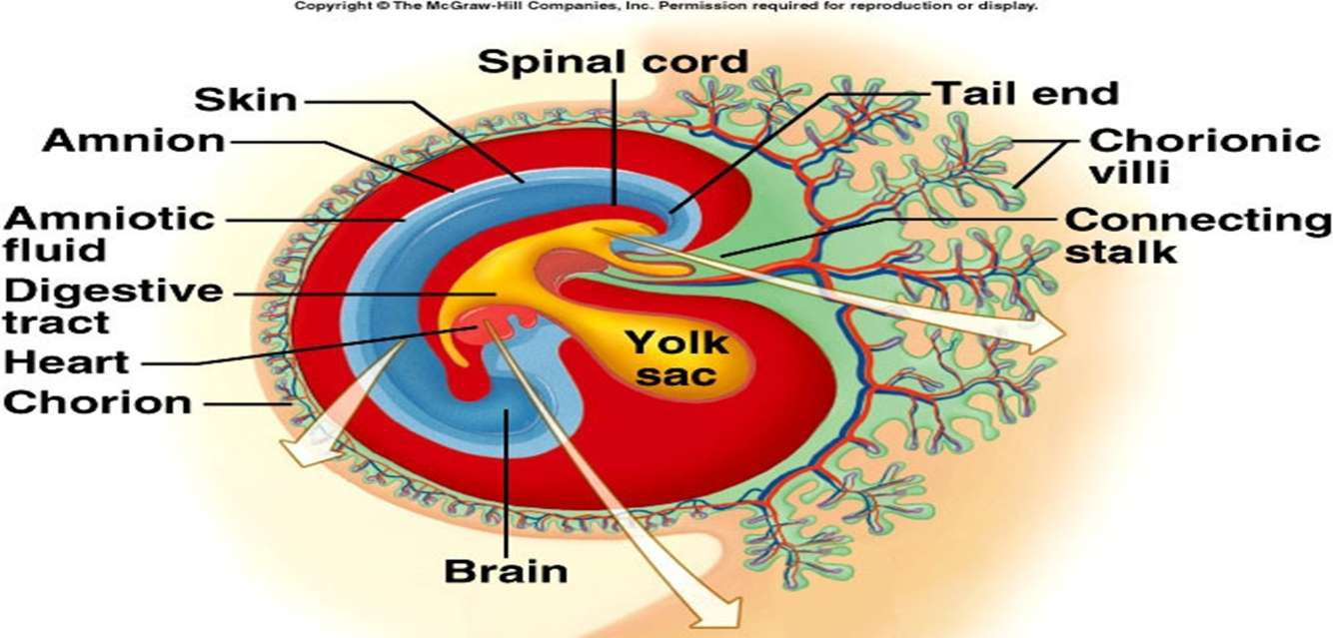

Slide 41
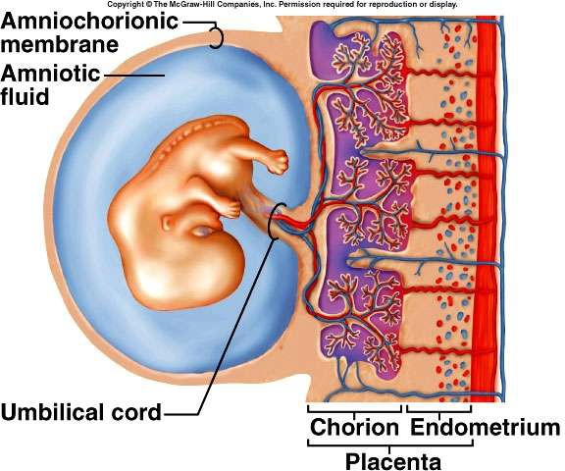

Slide 42
PARTURATION AND LACTATION:
The period of pregnancy is called gestation period. (9 months).
Ejection or expulsion or delivery of foetus is called parturition.
Parturition is due to vigorous contraction of uterine Myometrium.
The signal of parturition is originated from the fully developed foetus and the placenta which induces mild contraction of uterus called fetal ejection reflex.
Fetal ejection reflex triggers the release of Oxytocin from pituitary.
Oxytocin induces stronger contraction of uterine endometrium.
Stimulatory reflex continues stronger contraction leads to
expulsion.
After delivery the placenta is also expelled out of the uterus.

Slide 43
Lactation:
The mammary gland of the female more differentiated during pregnancy,
Mammary gland starts producing milk towards the end of the pregnancy.
Process of milk production in mammary gland is
called lactation.
Milk produced during initial days of lactation is called colostrum.
Colostrum contains several antibodies which
provide immunity to the new born baby.

Slide 44

Thanking you

