Slide 1
Chapter-1
Who Did Patrick’s Homework?

Slide 2
Characters: Patrick Elf Cat Doll

Slide 3
New Words:
Nintendo: a video game Ignoramus: an ignorant person, who lacks education
britches: breeches, or short trousers. The writer here spells it, for fun, to rhyme with the word ‘witch’s’. grabbed :caught tiniest :smallest
Lucky::fortunate problems: difficulties semester:a half or quarter term in school or university
dishcloth: a cloth used for washing dishes hamper: a basket with a lid Grimaced,scowled, pursed his lips:his face had these expressions,showing disgust,anger and disapproval Wrinkled : slight folds on skin because of old age Cursed:ill fated

Slide 4
glitch (an informal word): a fault in a machine that prevents it from working properly; here, hitch or problem elf : a super -natural creature squeaked : cried aloud
shrieked: gave a short, high-pitched cry
slyly: secretively
kid (an informal word): a child chores: work that must be done everyday, often boring attitude: a feeling about someone or something amazed: surprised

Slide 5
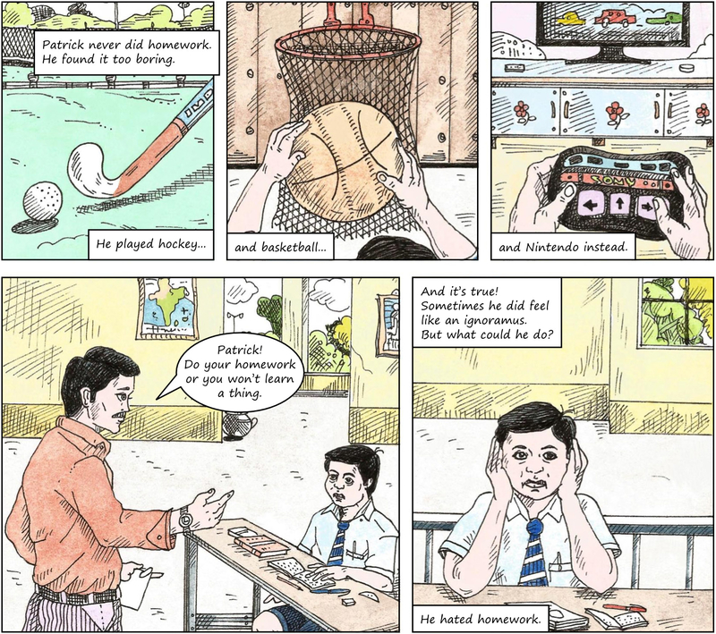

Slide 6
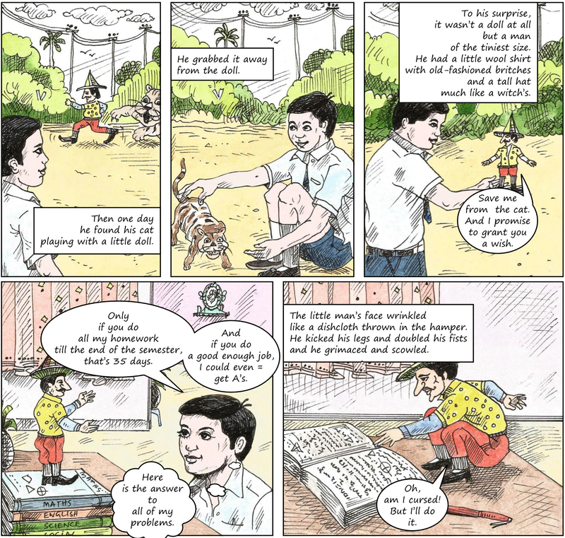

Slide 7
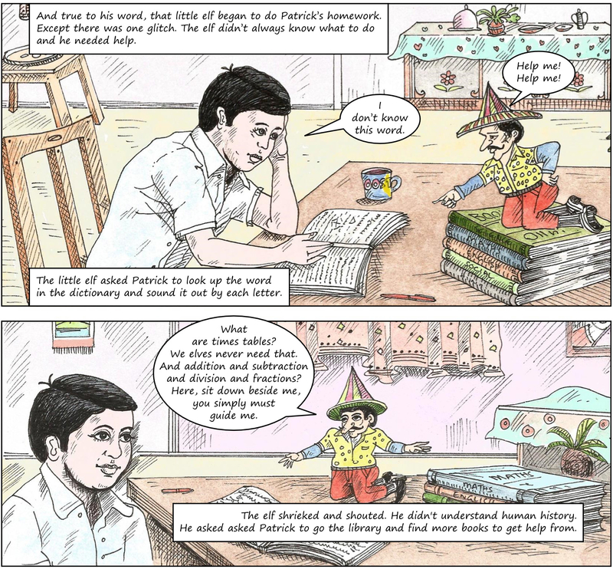

Slide 8
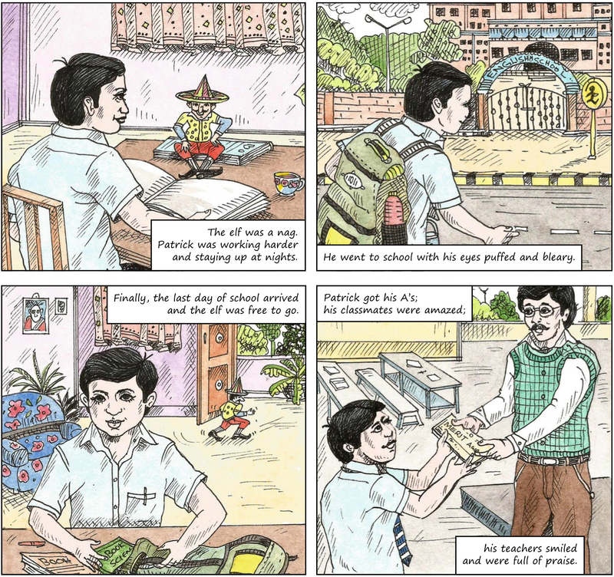

Slide 9
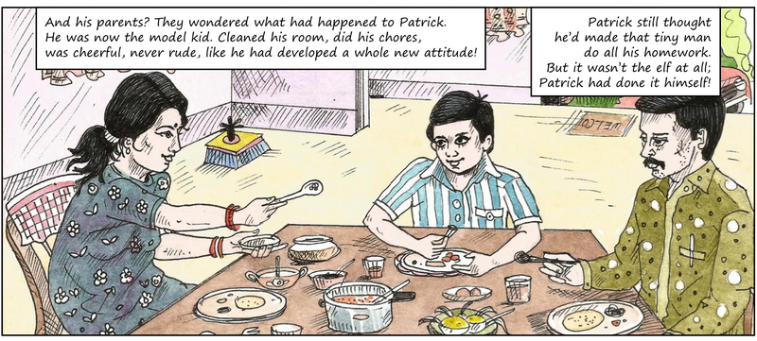

Slide 10
Page 11, Working with the text, Question 1
What did Patrick think his cat was playing with? What was it really?
Patrick thought that his cat was playing with his ball and grabbed it from her but later found that it was a wool ball.
Patrick thought that his cat was playing with a little doll but it wasn't a doll really, it was a man of the tiniest size.
Patrick thought that his cat was playing with his pencil but it was a pen instead.
He thought that his cat was playing with a little doll but it was actually a teddy bear.

Slide 11
Page 11, Working with the text, Question 2
Q1. Why did the little man grant Patrick a wish?
The little man granted Patrick a wish because Patrick was a very good boy.
The little man granted Patrick a wish because it was his birthday.
The little man granted Patrick a wish because he was afraid that the cat might eat him and promised to grant Patrick a wish if Patrick saved him from the cat.
The little man granted Patrick a wish because Patrick had done his homework.

Slide 12
Page 11, Working with the text, Question 3
Q2. What was Patrick’s wish?
1 He asked the little man for a new dress.
2 Patrick asked the little man to do his homework till the end of the semester.
3 Patrick asked the little man to give him a big toy car.
4 Patrick asked the little man to make him invisible for a day.

Slide 13
Page 11, Working with the text, Question 3
Q3. What was Patrick’s wish?
He asked the little man for a new dress.
Patrick asked the little man to do his homework till the end of the semester.
Patrick asked the little man to give him a big toy car.
Patrick asked the little man to make him invisible for a day.

Slide 14
Page 11, Working with the text, Question 5
Q4.How did Patrick help him?
.
Patrick helped the elf make some very good sketches.
Patrick helped him by staying up all night and doing all the homework.
He helped him by giving him his winter clothes.
He helped him in finding a job.

Slide 15
Page 11, Working with the text, Question 6
Q6. Who do you think did Patrick’s homework—the little man, or Patrick himself? Give reasons for your answer.
The little man did Patrick's homework because he stayed up till late in the night to complete all the work.
Patrick himself did his homework because he was a bright student and had promised his parents to work hard that year.
Patrick himself did his homework because the elf did not know everything. He also asked Patrick to get some books from the library and refer the dictionary for hard words. All of this ultimately led Patrick to do his homework himself.
The little man did Patrick's homework because the elf knew everything that was in Patrick's course.

Slide 16
Who Did Patrick’s Homework Question and Answers
1. What did Patrick think his cat was playing with? What was it really?
A.Patrick thought that his cat was playing with a doll. Actually, it was a small man.
2. Why did the little man grant Patrick a wish?
A:The little man granted him a wish because he saved him from the cat.
3. What was Patrick’s wish?
A.His wish was to get his homework done from the elf.
4. In what subjects did the little man need help, to do Patrick’s homework?
A.He needed his help in Maths and history.
5. How did Patrick help him?
A. He helped him by getting books for him,explaining and reading things .
6. Who do you think did Patrick’s homework — the little man,or Patrick himself? Give reasons for your answer.
A. I think Patrick himself did his homework as elf was just propelling him to do things. It was Patrick who was reading,explaining and arranging different things and helping elf as well to understand the things.

Slide 17
out of luck | mystery | true to his word | chores
semester | between you and me | look up

Slide 18
1. Some people find household ———————————— a bore, but I like to help at home. 2. Who stole the diamond is still a ————————————— . 3. This ————————————— we are going to have a class exhibition. 4. —————————————, the elf began to help Patrick. 5. Can you ————————————— this word in the dictionary? 6. I started early to be on time, but I was ———————————. There was a traffic jam! 7. She says she’s got a lot of books, but ————————————
I think most of them are borrowed.
Answers: 1- chores, 2- mystery, 3- semester, 4- true to his word, 5- look up, 6- out of luck, 7-between you and me

Slide 19
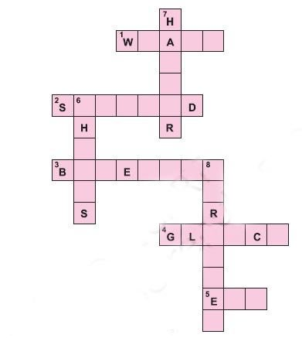
B. Use the clues given below to complete this crossword puzzle. Across

Slide 20
Across 1. very tired 2. had an angry look on the face 3. short trousers 4. a fault in a machine that prevents it from working properly 5. a small and naughty boy-fairy
Down 6. work that must be done everyday, often boring 7. a basket with a lid 8. gave a short, high-pitched cry

Slide 21
Across 1. very tired : WEARY 2. had an angry look on the face :SCOWLED 3. short trousers :BREECHES 4. a fault in a machine that prevents it from working properly : GLITCH 5. a small and naughty boy-fairy : ELF
Down 6. work that must be done everyday, often boring : CHORES 7. a basket with a lid :HAMPER 8. gave a short, high-pitched cry :SHRIEKED

