Slide 1
Chapter-3
Taro’s Reward

Slide 2
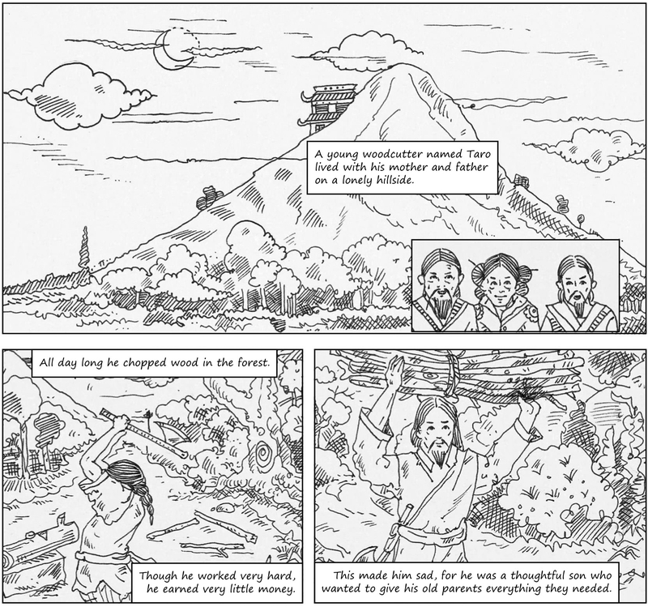

Slide 3
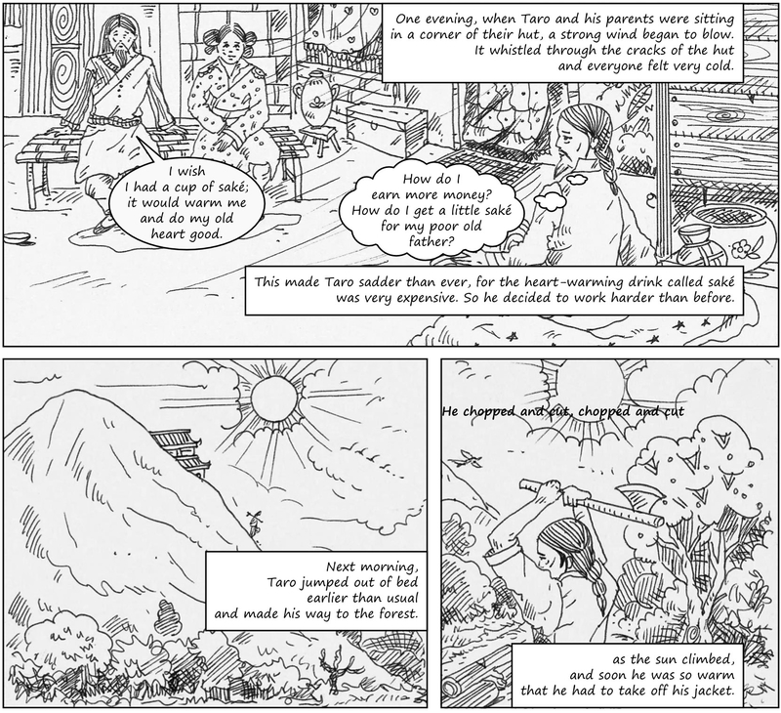

Slide 4
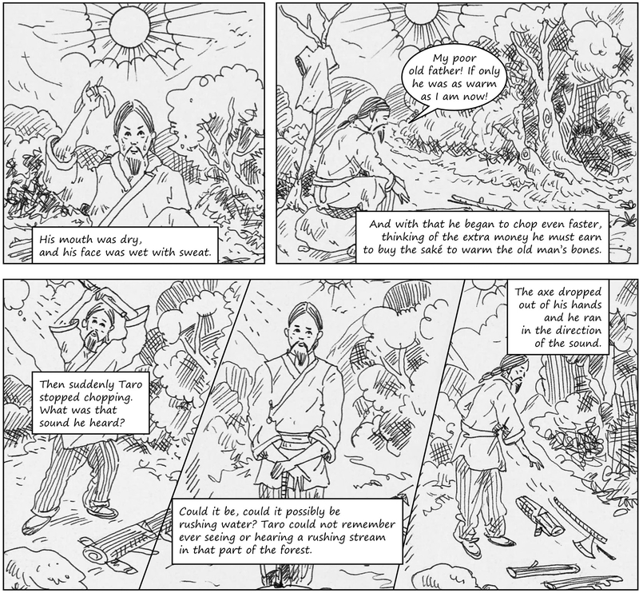

Slide 5
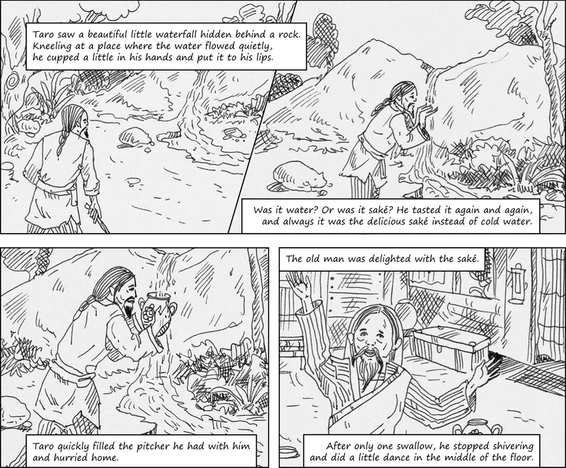

Slide 6
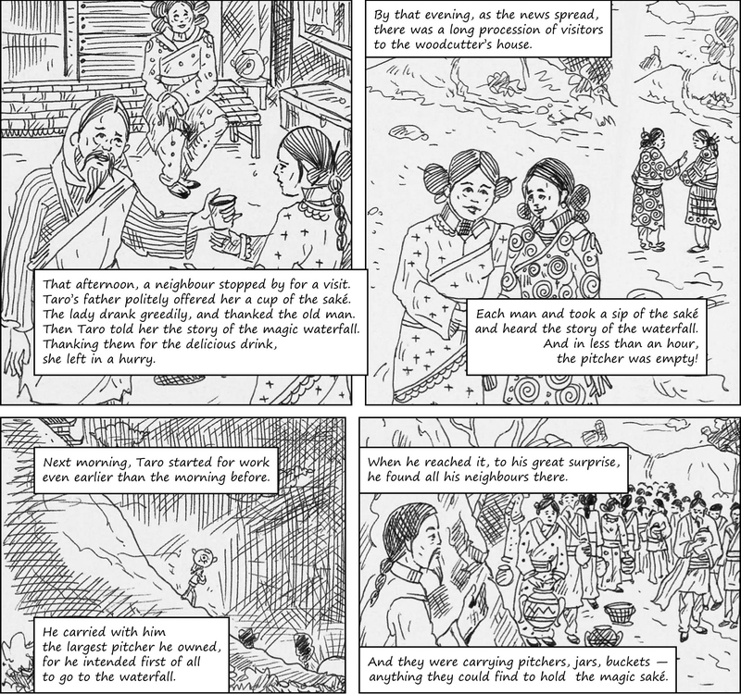

Slide 7
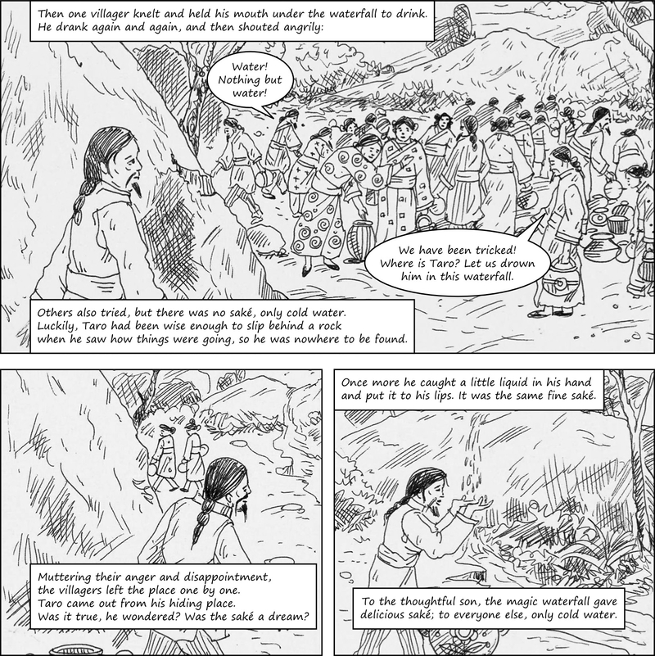

Slide 8
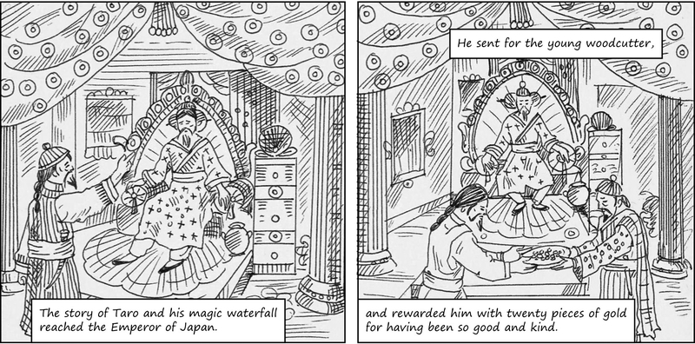

Slide 9
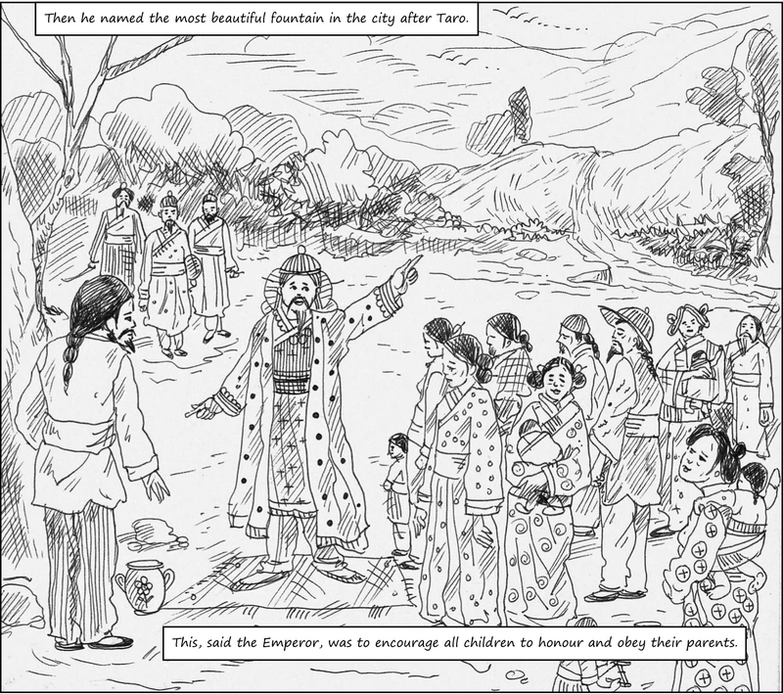

Slide 10
Page 34, Working with the text, Question 1
Why did Taro run in the direction of the stream?
Taro ran in the direction of the stream to wash his clothes.
Taro ran in the direction of the stream to take a bath.
He did so because he had never seen a rushing stream in that part of the forest so he was surprised when he heard the sound of a waterfall.
Taro ran in the direction of the stream to meet an old friend.

Slide 11
QUESTION 2 / 5
Page 34, Working with the text, Question 2
How did Taro’s father show his happiness after drinking saké?
He showed his happiness by buying a new jacket for Taro.
Taro's father showed his happiness by giving him some old coins.
He showed his happiness by singing him a sweet melody.
Taro's father stopped shivering after only one swallow of the saké and it made him happy because he did a little dance in the middle of the floor.

Slide 12
Page 34, Working with the text, Question 3
Why did the waterfall give Taro saké and others water?
The waterfall did that because Taro was a thoughtful son and wanted the sake not for himself but for his old father.
The waterfall gave Taro saké and others water because Taro did not waste water.
The waterfall gave Taro saké and others water because Taro paid the waterfall for the sake.
4The waterfall did so because it did not like the villagers.

Slide 13
Page 34, Working with the text, Question 4
Why did the villagers wanted to drown Taro?
The villagers wanted to drown taro because they felt that Taro had tricked them with a false story about the saké.
The villagers wanted to drown taro because taro had stolen their chopped wood from the forest.
Taro had murdered his parents and the news had spread like wild fire in the entire village. So the villagers decided to punish taro by drowning him.
The villagers wanted to drown taro because they thought that sacrificing his life will bring good fortune to the village.

Slide 14
Page 34, Working with the text, Question 5
Why did the Emperor reward Taro?
The Emperor rewarded taro for saving his life.
The Emperor rewarded taro for writing inspirational stories.
He rewarded Taro for saving his daughter's life.
The Emperor rewarded taro for being good and kind.

