Slide 1
The Atmosphere:
The layer of air that surrounds a planet is called the Atmosphere. The presence of oxygen in the Earth’s atmosphere makes it suitable for life.
Activity: Aim: To show that Air occupies space.
Materials required: A piece of paper, a bowl, water, a glass.
Procedure: (i) Let us crumple a sheet of paper. (ii) Let us stuff the paper ball inside a glass. (iii) Let us invert the glass and push it into a bowl of water. Observation: 1 The paper ball stays dry because air is present between the paper ball and water.
(v) Let us tilt the glass slowly.
Observation:2 The paper ball will be wet because when we tilt the glass, the air present inside the glass escapes allowing the water to come into the glass.
Conclusion: Air occupies space.

Slide 2
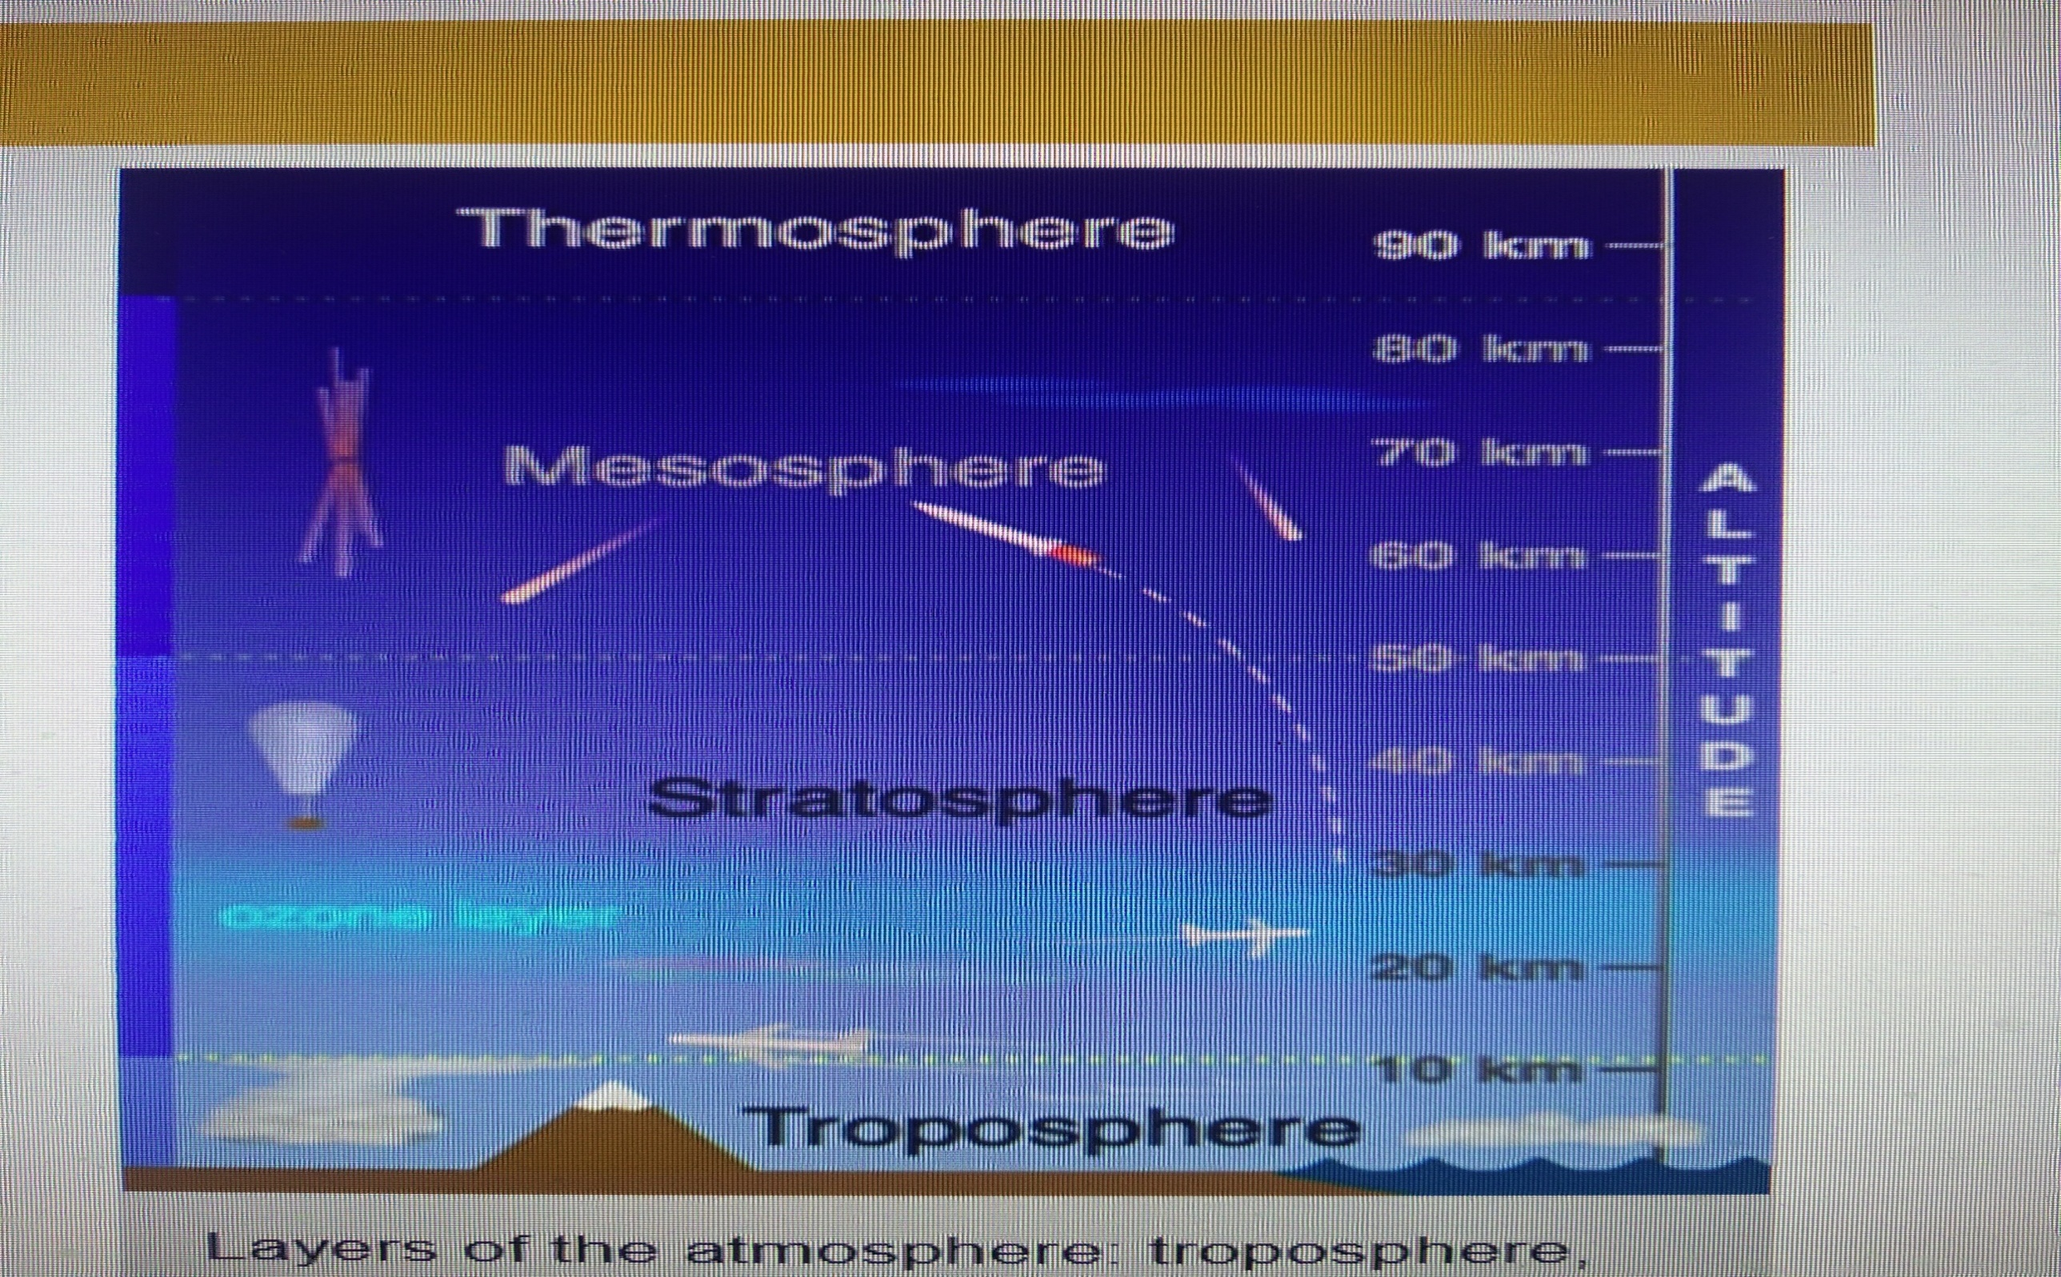

Slide 3
Questions
Why does life become possible on Earth?
Do you see Air?
De we get air everywhere around the earth?
What is Atmosphere?
With the help of an activity show that air occupies space.

Slide 4
To show that Air has mass.
Activity: Aim: To show that Air has mass.
Materials required: A scale, two balloons, thread.
Procedure:
(i) Let us suspend a meter scale parallel to the ground.
(ii) Let us blow up two balloons to the same size and tie them to either end of the scale so that they balance each other.
(iii) Let us prick one of the balloons with a pin.
Observation: The ruler tilts towards the inflated balloon .
Conclusion: The ruler tilts towards the inflated balloon because that side is heavier. This shows that air has mass.

Slide 5
To show that Air exerts pressure
Activity: Aim: To show that Air exerts pressure.
Materials required: A glass, a piece of cardboard, water
Procedure:
(i) Let us fill a rimless glass with water up to the brim.
(ii) Let us slide a piece of smooth cardboard across the mouth of the glass, covering it fully.
(iii) Let us press gently on the cardboard.
(iv) Let us turn the glass upside down.
Observation: The cardboard does not fall of because air pushes against the cardboard .
Conclusion: Air exerts pressure.

Slide 6
Questions
How do objects fly?
Why do the blades of a wind turbine move?
Does air exert force?
With the help of an activity show that air has mass.
With the help of an activity show that air exerts pressure.

Slide 7
Air is essential for life.
Uses of Air : (i) Air is essential for life.
(ii)Air helps Aero planes, Helicopters, Gliders, Kites, Birds, Insects, Bats etc. fly.
(iii) We use air to fill objects such as Tyres and Balloons.
(iv) Moving air helps Boats and Ships to sail.
(v) Moving air moves the blades of wind Turbines, which are used it generate Electricity.
(vi) Many plants depend on the wind for Pollination and for the Dispersal of seeds.
(vii) Wind helps clothes to dry.
(viii) Wind also helps to keep animals and plants cool in the summer.
(ix) The movement of air plays an important role in the Water cycle.

Slide 8
Questions
Who help wet clothes to dry?
Who helps the Windmills to produce Electricity?
Can you imagine life without Oxygen and Carbon-di-Oxide?
Who helps in the motion of the blades of wind turbines.
Mention three uses of Air.
Mention three uses of wind.

Slide 9
The composition of Air
The composition of Air : (i) Nitrogen – 78%
(ii) Oxygen – 20%
(iii) Water Vapour – 1%
(iv) Argon and other gases – 0.97%
(v) Carbon-do-Oxide – 0.03%
Uses:
(i) Nitrogen –
(i) Nitrogen is important to Plants and Animals because Proteins contain Nitrogen.
(ii) Plants cannot use Nitrogen directly to make food. Lightning and some kinds of bacteria change Atmospheric Nitrogen to other forms that Plants can use. This process is Nitrogen Fixation.
(ii) Oxygen – (i) All Plants and Animals use Oxygen for Respiration.
(ii) The Combustion of fuels like Petrol, Coal etc. use Oxygen.
(iii) Oxygen is necessary for Decomposition.

Slide 10
Questions
Will we the animals be able to survive without Oxygen?
What is the importance of Nitrogen for both plants and animals?
From where do we get Oxygen and Nitrogen?
Name the constituents of air with their percentage.
What is Nitrogen Fixation?
Name the gas which helps in Combustion.

Slide 11
The composition of Air.
The composition of Air : (i) Nitrogen – 78%
(ii) Oxygen – 20%
(iii) Water Vapour – 1%
(iv) Argon and other gases – 0.97%
(v) Carbon-do-Oxide – 0.03%
Uses: (i) Water Vapour – (i) The amount of water vapour present in air known as Humidity. Water Vapour condenses to form Clouds.
(ii) Plants send out water vapour through the stomata during Transpiration.
(ii) Carbon-di-Oxide –
(i) Plants use Carbon-di-Oxide in the process of Photosynthesis.
(ii)All Plants and Animals give out Carbon-di-Oxide after Respiration.
(iii) Carbon-di-Oxide helps to extinguish fire.
(iv) Carbon-di-Oxide absorbs heat and makes the Earth warmer. This is called Greenhouse Effect.
(iii) Dust and Smoke – (i) The amount of Dust and Smoke in the atmosphere varies from place to place.
(ii) Dust and Smoke in the air we breathe in are usually filtered by small hairs inside the nose and windpipe.
(iii) People suffer from Respiratory diseases like Cough, Asthma etc.

Slide 12
Questions
What is the role of water vapour in Water Cycle?
Will the plants be able to survive without Carbon-di-Oxide?
What way dust and smoke affect us?
How is Oxygen-Carbon-di-Oxide balance in the atmosphere maintained?
How does water vapour affect the weather of a place?
What are the diseases caused by breathing polluted air?

Slide 13
To show the presence of Air in Soil
Activity: Aim: To show the presence of Air in Soil.
Materials Required: A glass Beaker, Soil, Water
Procedure: (i) Let us take some garden soil in a beaker.
(ii) Let us pour some water slowly into the beaker.
(iii) The air in the soil escapes as bubbles from the soil.
Conclusion: Air is present in Soil.

Slide 14
Activity: Aim: To show the presence of Air in Water
Activity: Aim: To show the presence of Air in Water
Materials Required: A glass bowl, Water, a Bunsen burner, a stand.
Procedure:
(i) Let us pour some water into a bowl.
(ii) Let us heat it gently over a Bunsen burner.
(iii) After a short time, we will see small bubbles of air rise up to the surface of water.
Conclusion: Air is present in Water.

Slide 15
Sea Breeze and Land Breeze
Sea Breeze: Land gets heated faster than water and also cools faster. In coastal regions, the air above the land becomes warm during the day and rises. Cool air from above the sea rushes in to take its place. This causes Sea Breeze.
Land Breeze: Land gets heated faster than water and also cools faster. In Coastal regions, in the evening, the land cools fast, while the sea is still warm. The warm air above the sea rises, while the cool air above the land rushes in. This causes Land Breeze.

Slide 16
Questions
How do earthworms survive in the soil?
How do marine animals survive under water?
Why do we experience wind near sea shore during day time?
With the help of an activity show that air is present in soil.
With the help of an activity show that air is present in water.
Differentiate between Land Breeze and Sea Breeze.

Slide 17
Pollution
Pollution: The process of addition of harmful substances to a pure substances is known as Pollution.
Air pollution: The process of contamination of air by the addition of Dust, Smoke and other harmful substances is called Air Pollution.
Causes: The major causes of air pollution are,
The smoke and harmful gases given out by Vehicles, Factories and Burning Fuels.
Dust particles
Carbon Monoxide
The oxides of Sulphur and Nitrogen
Ground level Ozone etc.

Slide 18
Pollution Control
Pollution Control: We can follow a few practices to control Air Pollution,
Plant more trees. Trees take carbon-di-Oxide and give out Oxygen.
Do not burn garbage. The amount of garbage generated should be segregated at the source and treated properly. Bio-degradable wastes should be used to make Compost. Non-biodegradable garbage should be Reused and Recycled.
Use less Electricity. Electricity is produced by burning fuels. So, using less Electricity will reduce air pollution.
Ride a Bicycle to school if it is not far from your home. Use Trains, Buses etc. to reduce the pollution caused by vehicles.
Bio-degradable wastes should be used to make Compost.

Slide 19
Questions
Have you wiped a dirty surface with a cloth?
How do marine animals survive under water?
Why do we experience wind near sea shore during day time?
What is Air Pollution?
What are the causes of Air Pollution?
Suggest ways to control Air Pollution.

Slide 20
Assignments
A. Multiple Choice questions
1. A balloon is inflated fully and twisted. Which property of air does this show?
A. Air has mass.
B. Air has water vapour.
C. Air cannot be seen but can be felt.
D. Air takes the shape of the balloon.
(a) A only (b) A and B only (c) C only (d) D only
2. Which are the two gases that make up most of air?
(a) Nitrogen and Oxygen (b) Oxygen and Carbon-di-Oxide
(c) Nitrogen and Hydrogen (d) Oxygen and Water Vapour
3. Process: A Plants Humans
Process: B Humans Plants
(a) Respiration and Photosynthesis respectively.
(b) Photosynthesis and Respiration respectively.
(c) Transpiration and Photosynthesis respectively.
(d) Photosynthesis and Transpiration respectively.
4. Two identical jars A and B are filled with Air and Carbon di-oxide respectively. If two candles are
burning in the respective jars, pick out the correct order in which the candles go out.
(a) the candle in A will not go out (b) in B, then A
(c) at the same time (d) in A, then B

Slide 21
Column A | Column B
(i) The layer of air that surrounds a planet | (a) Humidity
(ii This gas forms 0.97% of air | (b) Air Pollutant
(ii The amount of water vapour in air | (c) Atmosphere
(iv The contamination of air by smoke and other harmful gases | (d) Argon
(v) Any material that causes air pollution | (e) Air Pollution

Slide 22
Fill in the Blanks.
(i) Air is a ------------------ of gases.
(ii) As we go higher, the amount of air in the atmosphere ---------------------.
(iii) Lightning converts ---------------------- into forms that plants can use.
(iv) Combustion requires ------------------.
(v) The land cools down faster than the sea at night, causing ----------------- breeze.
Say whether the following statements are True or false.
(i) Air contains dust particles and germs.
(ii) Dust and Smoke cause respiratory problems only in humans.
(iii) Combustion of fossil fuels maintains the oxygen level in the atmosphere.
(iv) The atmosphere helps the Earth to cool down fast at night.
(v) Electricity is produced by burning fuels.

Slide 23
Assignments
Give the definitions of the following:
(i) Atmosphere (ii) Pressure (iii) Nitrogen Fixation
(iv) Respiration (v) Greenhouse Effect (vi) Humidity
(vii) Sea Breeze (viii) Land Breeze (ix) Air Pollution

Slide 24
Two marks questions
1. What is Nitrogen Fixation?
2. List two uses of air.
3. Name two factors in which Humidity depends.
4. List two properties of air.
5. Name the constituents of air.
6. Name two diseases caused by Dust and Smoke in humans.
7. Mention two ways to control Air Pollution.
8. What is Sea Breeze?
9. What is Land Breeze?
10. What is Green House Effect?
11. What is Air Pollution?

Slide 25
Three marks questions
1. With the help of an activity show that air exerts pressure.
2. List three uses of air.
3. With the help of an activity show that air occupies space.
4. Discuss the role of plants in controlling the Green House effect.
5. With the help of an activity show that air has mass.
6. With the help of an activity show that air is present in Soil and Water.
7. Name the gases that make up the atmosphere and write the percentage of each.
8. The Atmosphere acts like a blanket around the Earth. Explain.
9. Mention three ways to control Air Pollution.
10. We can minimize air pollution by using public transport. Comment.

Slide 26
Five marks questions
1. What is Pollution? What is Green House effect? Discuss the role of plants in controlling the Green
House effect.
2. What is Air Pollution? Discuss its causes.
3. How is the Oxygen- Carbon dioxide balance in the atmosphere maintained?
4. What is Humidity? Name two factors in which Humidity depends. How does water vapour affect
the Weather of a place?
5. What is Pollution? What is Air Pollution? What are the processes that use up atmospheric Oxygen
and release Carbon-dioxide into the air?
6. What is Atmosphere? Name the gases that make up the atmosphere and write the percentage of
each.
7. What is Atmosphere? With the help of an activity show that air exerts pressure. State two uses of
Air.
8. What is Sea Breeze? What is Land Breeze? The Atmosphere acts like a blanket around the Earth.
Explain.
9. What is Air Pollution? Mention two causes of Air Pollution. We can minimize air pollution by using
public transport. Comment.
10. Write a note on the composition of Air.

