Slide 1
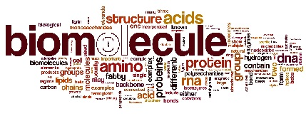
Nirupam Aich

Slide 2
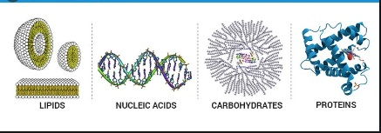
Biomolecules are the organic molecules present in a living organism. They are fundamental building blocks of living organisms as they support the biological processes essential for life. Thus, they build up the living system and are responsible for their growth and maintenance.

Slide 3
Common biomolecules are
• Carbohydrates
• Proteins
• Lipids
• Nucleic acids
• ATP molecules

Slide 4
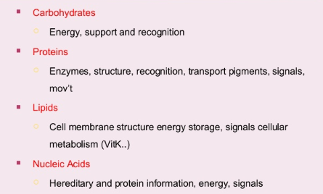
Importance of Biomolecules

Slide 5
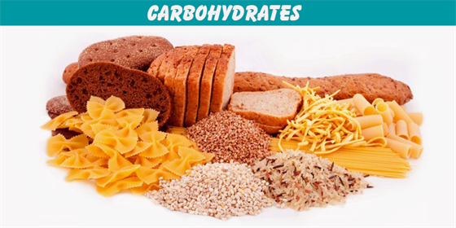

Slide 6
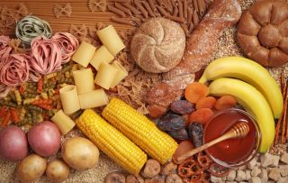
Carbohydrates are essential nutrients which include sugars, fibers, and starches.
They are found in grains, vegetables, fruits, and in milk and other dairy products.
They are the basic food groups which play an important role in a healthy life.
The food containing carbohydrates are converted into glucose or blood sugar during the process of digestion by the digestive system.

Slide 7
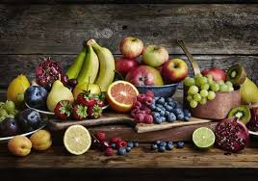
Sources of Carbohydrates
Simple sugars are found in the form of fructose in many fruits.
Galactose is present in all dairy products.
Lactose is abundantly found in milk and other dairy products.
Maltose is present in cereal, beer, potatoes, processed cheese, pasta, etc.
Sucrose is naturally obtained from sugar and honey containing small amounts of vitamins and minerals.

Slide 8
Functions of Carbohydrates
The main function of carbohydrates is to provide energy and food to the body and to the nervous system.
Carbohydrates are known as one of the basic component of food including sugars, starch, and fibre which are abundantly found in grains, fruits, and milk products.
Carbohydrates are also known as starch, simple sugars, complex carbohydrates and so on.
Inhibits the breakdown of proteins for energy as they are the primary source of energy.
An enzyme by name amylase assists in the breakdown of starch into glucose, finally to produce energy for metabolism.

Slide 9
CARBOHYDRATES
Carbohydrates have the general formula C_{x}(H₂O)_{y}.
They are the ultimate source of most of our food.
We dress with cellulose in the form of cotton, linen, and rayon.
We build furniture and houses from cellulose in the form of wood. Let us see the details of carbohydrates and their classification

Slide 10
CARBOHYDRATES
Carbohydrates are polyhydroxy aldehydes or ketones or the compounds which upon hydrolysis produce polyhydroxy aldehydes or ketones.
• They are optically active due to the presence of chiral ‘C’.
• They are also called saccharides
(From Latin word Saccharum = sugar) due to sweet taste.

Slide 11
TYPES OF CARBOHYDRATES

Slide 12
CARBOHYDRATES, in general may be classified into two classes
SUGARS:
These are crystalline substances which are sweet and water soluble.
Example:
Glucose,fructose and cane sugar
NON SUGARS
These are amorphous substances which are tasteless and insoluble in water.
Example:
Starch,cellulose

Slide 13
MonoSaccharides
Mono means One,
Saccharon implies Sugar in Greek.
These are the simplest group of carbohydrates and are referred to as simple sugars as they are sweet.
The compounds are having free aldehyde or ketone group and two or more hydroxyl (-OH) groups.
They cannot be further hydrolyzed into simpler carbohydrates. The general formula of the monosaccharide is C_{n}(H₂O)_{n}.

Slide 14
OligoSaccharides
Oligo means Few in the Greek language.
. These are complex sugars When hydrolyzing these sugars yields 2 to 10 molecules of the same or different monosaccharide molecules.
They are further classified as disaccharides, trisaccharides, tetrasaccharides, etc. based on the number of monosaccharide units.

Slide 15
Disaccharides (Cn(H2O)n-1)
– Sucrose, Maltose, Lactose, Cellulose, Trehalose, Melibiose and Gentiobiose
Trisaccharides (Cn(H2O)n-2)
– Rhamninose, Gentianose, Raffinose, Rabinose, Melezitose
Tetrasaccharides (Cn(H2O)n-3)
– Stachyose, Scorodose

Slide 16
PolySaccharides
These carbohydrates are polymeric and can be hydrolysed to give liberate a large number of monosaccharide molecules .
They are usually amorphous, insoluble in water and tasteless and are called non-sugars

Slide 17
They are again sub-divided into two types. They are homopolysaccharides and heteropolysaccharides.
Homopolysaccharides
They possess only a single type of monosaccharide units.
Examples: Starch, cellulose, and glycogen.
Heteropolysaccharides
They possess two or more types of monosaccharide units. Examples: Heparin and chondroitin sulfate.

Slide 18
Based upon reducing and non-reducing properties, carbohydrates can be divided into the following two categories:
1. Reducing sugars: These are the carbohydrates which contain free aldehydic or ketonic group and reduces Fehling's solution or Tollen's reagent.
For example: Maltose, lactose.
2. Non Reducing Sugars: These are the carbohydrates which do not contain free functional group and do not reduce Fehling’s or Tollen’s reagent.
For example: Sucrose.

Slide 19
Monosaccharides
These are simple sugars.
Monosaccharides are the simplest and smallest carbohydrates.
These are colourless or white, mostly sweet and crystalline solids which are freely soluble in water.
Monosaccharide molecules have the general formula, CnH2nOn or Cn (H2O) n .
They cannot be further hydrolyzed into simpler compounds, but oxidises to CO2 & H2O.
They contain 3 to 7 carbons.
Suffix – Ose is used in their nomenclature.
Examples: Glucose and fructose.

Slide 20
Depending upon the total number of carbon atoms in monosaccharides and aldehyde and ketone functional groups present they are classified using terms shown in the below table.
Carbon atoms | General terms | Aldehydes | Ketones
3 | Triose | Aldotriose | Keto-Triose
4 | Tetrose | Aldotetrose | Ketotetrose
5 | Pentose | AldoPentose | KetoPentose
6 | Hexose | AldoHexose | KetoHexose
7 | Heptose | AldoHeptose | KetoHeptose

Slide 21
On the basis of nature of functional group they are classified in two groups.
(a) Aldoses : They have aldehyde group (–CHO).
(b) Ketoses : They have ketone group (–C=O).
Classification based on number of Carbon atoms.
(i) Trioses :They have 3 carbon atoms, C3H6O3 e.g., dihydroxyacetone and glyceraldehyde.
(ii) Tetroses : Tetroses contain 4 carbon atoms, C4H8O4 e.g. erythrose, erythrulose.
(iii) Pentoses : They contain 5 Carbon atoms, C5H10O5 e.g. ribose, deoxyribose, xylose, ribulose, arabinose (Gum arabic).

Slide 22
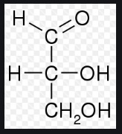
The simplest monosaccharides are trioses such as glyceraldehyde and dihydroxyacetone

Slide 23
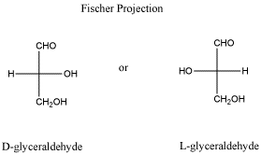
D and L Configurations
The sugars are divided into two families
the D- family and the L-family which has definite configurations.They are represented wrt glyceraldehyde as standard.

Slide 24
Glucose is an example of a carbohydrate monomer or monosaccharide. Other examples of monosaccharides include mannose, galactose, fructose, etc. The structural organization of monosaccharides is as follows:

Slide 25
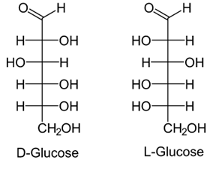
Structure of Glucose:
• Open chain structure (Fisher model):
These two optical isomers differ in configuration around any other C atom other than C₁ atom.
In D-Glucose, −OH group on first chiral `C’ from the bottom is on right hand.
In L-Glucose, −OH group points to the left of chiral carbon.

Slide 26
Glucose
It is a monosaccharide’s with molecular formula C₆H₁₂O₆. It is present in sweet fruits and in honey.
Preparation of Glucose:
(i ) From sucrose, C₁₂H₂₂O₁₁:

Slide 27
(ii ) From starch, C₆H₁₀O₅:

Slide 28
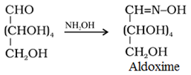
Chemical Reactions of Glucose • Reaction with HI
Reaction with hydroxylamine NH₄OH:

Slide 29
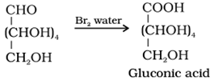
Reaction with bromine water:
Acetylation reaction

Slide 30
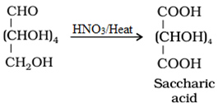
Oxidation:
Reaction with Fehling’s solution:

Slide 31
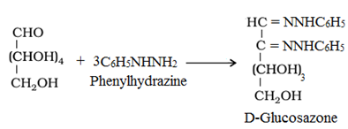
Reaction with Tollen’s reagent:
Reaction with Phenylhydrazine, C₆H₅NHNH₂:

Slide 32
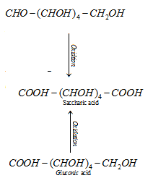
with nitric acid

Slide 33
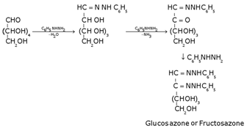
with phenylhydrazine

Slide 34
Presence of ring structure
Glucose does not give Schiff’s test and does not react with sodium bisulphite and NH3. Pentaacetyl glucose does not react with hydroxyl amine. This shows the absence of –CHO group and hence the presence of ring structure.

Slide 35
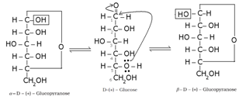
Cyclic structure of glucose:

Slide 36
Haworth representation of glucose:

Slide 37
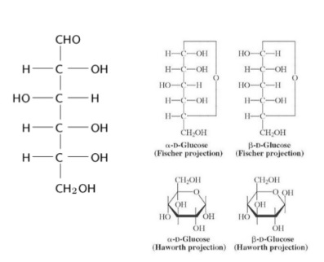

Slide 38
Fructose : It is Levorotatory so it is called “Levulose”. Fructose is a ketose sugar having C=O group. It is found in honey (32-40%) and sweet fruits so it is called as “Fruit Sugar”. Fructose is the sweetest natural sugar.

Slide 39
Cyclic structure of fructose:

Slide 40
Haworth representation of fructose

Slide 41
Disaccharides
Two monosaccharides combine to form a disaccharide. Examples of carbohydrates having two monomers include- Sucrose, Lactose, Maltose, etc.
Sucrose (cane sugar) :
It is obtained from sugar cane and sugar beet, called cane sugar.
Sucrose is a commercial sugar.
It is the storage product of photosynthesis in these plants.
Sucrose is formed by the condensation of one molecule each of glucose and fructose with the removal of one molecule of water. (Alpha-D-Glucose + Beta-D fructose)
1, 2 glycosidic bond is formed between glucose and fructose.

Slide 42
Sucrose:
It is one of the common disaccharides, which on hydrolysis gives equimolar mixture of D (+) -glucose and D (−) fructose.

Slide 43
Sucrose is a non-reducing sugar because the two monosaccharide units are held together by a glycosidic linkage between C1 of α -glucose and C2 of β- fructose.
Since the reducing groups of glucose and fructose are involved in glycosidic bond formation, sucrose is a non-reducing sugar.

Slide 44
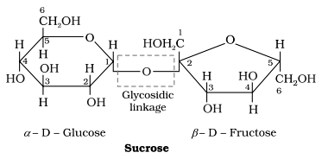
Glycosidic Linkage
The ether linkage combining two monosaccharides is known as glycosidic linkage.
For example: In sucrose, the glycosidic linkage is present between glucose and fructose.

Slide 45
Glycosidic linkage:
The oxide linkage formed by the loss of a water molecule when two monosaccharides are joined together through oxygen atom is called glycosidic linkage.

Slide 46
Sucrose is dextrorotatory but on hydrolysis it gives dextrorotatory & laevorotatory and the mixture is laevorotatory.

Slide 47
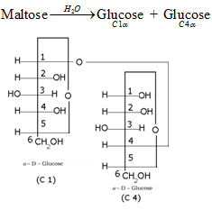
Maltose:
Maltose is composed of two α-D-glucose units in which C1 of one glucose (I) is linked to C4 of another glucose unit (II).

Slide 48
Haworth projection of maltose

Slide 49
Lactose (Milk sugar): It is composed of β-D-galactose and β-D-glucose. The linkage is between C1 of galactose and C4 of glucose. Hence it is also a reducing sugar.

Slide 50
Haworth projection of lactose:

Slide 51
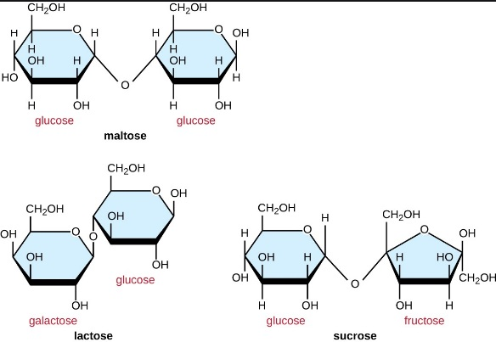

Slide 52
Starch: It is a polymer of -glucose and consists of two components — Amylose and Amylopectin.
Amylose:
It is a water soluble component
It is a long unbranched chain polymer
It contains 200 – 1000 -D-(+)- glucose units held by – glycosidic linkages involving C1 – C4glycosidic linkage
It constitutes about 15-20% of starch
Amylopectin
It is a water insoluble component
It is branched chain polymer
It forms chain by C1 – C4glycosidic linkage whereas branching occurs by C1 – C6glycosidic linkage
It constitutes about 80-85% of starch

Slide 53
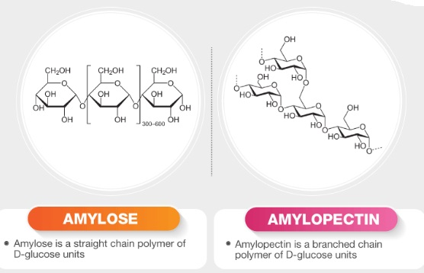

Slide 54
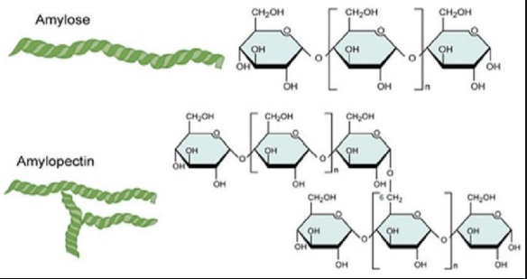

Slide 55
Cellulose
It occurs exclusively in plants.
It is a straight chain polysaccharide composed only of -D-glucose units which are joined by glycosidic linkage between C1 of one glucose unit and C4 of the next glucose unit.

Slide 57
Glycogen
The carbohydrates are stored in animal body as glycogen.
It is also known as animal starch because its structure is similar to Amylopectin.
It is present in liver, muscles and brain.
When the body needs glucose, enzymes break the glycogen down to glucose

Slide 60
Amino acids
Amino acids contain amino (–NH2) and carboxyl
(–COOH) functional groups.
Where R – Any side chain

Slide 62
Most naturally occurring amino acids have L – Config.

Slide 63
Types of amino acids
a). Essential amino acids:
The amino acids which cannot be synthesised in the body and must be obtained through diet, are known as essential amino acids. Examples: Valine, Leucine
b). Non-essential amino acids:
The amino acids, which can be synthesised in the body, are known as non-essential amino acids. Examples: Glycine, Alanine

Slide 64
Zwitterion form of amino acids
Amino acids behave like salts rather than simple amines or carboxylic acids. This behaviour is due to the presence of both acidic (carboxyl group) and basic (amino group) groups in the same molecule. In aqueous solution, the carboxyl group can lose a proton and amino group can accept a proton, giving rise to a dipolar ion known as zwitter ion. This is neutral but contains both positive and negative charges.

Slide 65
In zwitter ionic form, amino acids show amphoteric behaviour as they react both with acids and bases.

Slide 66
Isoelectronic point:
The pH at which the dipolar ion exists as neutral ion and does not migrate to either electrode cathode or anode is called isoelectronic point.

Slide 67
Proteins
Proteins are polymers of α-amino acids. They are essential for growth and maintenance of a living being’s body. They occur naturally in milk, cheese, pulses, peanuts, fish, meat, etc.
Amino acids contain an amino (–NH2) and carboxyl (–COOH) functional groups.
The amino acids can be classified as α, β, γ, δ and so on, on the basis of the relative position of the amino group with respect to the carboxyl group. Eg Glycine, Alanine, etc.

Slide 68
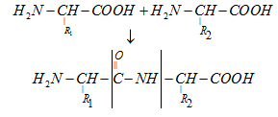
Peptide linkage
Peptide linkage is an amide linkage formed by condensation reaction between –COOH group of one amino acid and –NH2 group of another amino acid.

Slide 69
Primary structure of proteins
The sequence of amino acids is said to be the primary structure of a protein.

Slide 70
Secondary structure of proteins
It refers to the shape in which long polypeptide chain can exist.
Two different types of structures:
α Helix structure
β pleated structure

Slide 71
α Helix structure
It was given by Linus Pauling in 1951
It exists when R- group is large.
Right handed screw with the NH group of each amino acid residue H – bonded to – C = O of adjacent turn of the helix.
Also known as 3.613 helix since each turn of the helix hasapproximately 3.6 amino acids and a 13 – membered ring is formed by H – bonding.
C = O and N – H group of the peptide bonds are trans to each other.
Ramchandran angles ( and ) – angle which makes with N – H and angle which makes with C = O.

Slide 72
β pleated structure
It exists when R group is small.
In this conformation, all peptide chains are stretched out to nearly maximum extension and then laid side by side which are held together by hydrogen bonds.

Slide 73
Tertiary structure of proteins
It represents the overall folding of the polypeptide chain i.e., further folding of the 2° structure.
Types of bonding which stabilize the 3° structure:
Disulphide bridge (-S – S-)
H – bonding – (C = O … H – N)
Salt bridge (COO– … + )
Hydrophobic interactions
van der Waals forces

Slide 74
Two shapes of proteins:
Fibrous proteins a) When the polypeptide chains run parallel and are held together by hydrogen and disulphide bonds, then fibre– like structure is formed. b) These proteins are generally insoluble in water c) Examples: keratin (present in hair, wool, silk) and myosin (present in muscles), etc
Globular proteins a) This structure results when the chains of polypeptides coil around to give a spherical shape. b) These are usually soluble in water. c) Examples: Insulin and albumins

Slide 75
Quaternary structure of proteins
Some of the proteins are composed of two or more polypeptide chains referred to as sub-units.
The spatial arrangement of these subunits with respect to each other is known as quaternary structure of proteins.

Slide 76
Denaturation of proteins
The loss of biological activity of proteins when a protein in its native form, is subjected to physical change like change in temperature or chemical change like change in pH. This is called denaturation of protein.
Example: coagulation of egg white on boiling, curdling of milk.

Slide 77
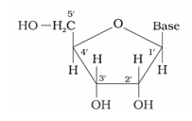
Nucleoside
Base + sugar

Slide 78
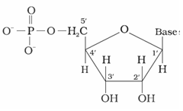
Nucleotide
Base + sugar + phosphate group

Slide 79
Nucleic acids (or polynucletides)
Long chain polymers of nucleotides.
Nucleotides are joined by phosphodiester linkage between 5’ and 3’ C atoms of a pentose sugar.

Slide 80
Two types of nucleic acids
DNA AND RNA
DNA
It has a double stranded -helix structure in which two strands are coiled spirally in opposite directions.
Sugar present is –D–2-deoxyribose
Bases: i) Purine bases: Adenine (A) and Guanine (G) ii) Pyrimidine bases: Thymine (T) and cytosine (C)
It occurs mainly in the nucleus of the cell.
It is responsible for transmission for heredity character

Slide 81
RNA
It has a single stranded -helix structure.
Sugar present is –D–ribose
Bases: i) Purine bases: Adenine (A) and Guanine (G) ii) Pyrimidine bases: Uracil (U) and cytosine (C)
It occurs mainly in the cytoplasm of the cell.
It helps in protein synthesis.

Slide 82
Double helix structure of DNA
It is composed of two right handed helical polynucleotide chains coiled spirally in opposite directions around the same central axis.
Two strands are anti-parallel i.e., their phosphodiester linkage runs in opposite directions.
Bases are stacked inside the helix in planes to the helical axis.
Two strands are held together by H – bonds (A = T, G C).
The two strands are complementary to each other because the hydrogen bonds are formed between specific pairs of bases.
Adenine forms hydrogen bonds with thymine whereas cytosine forms hydrogen bonds with guanine.
Diameter of double helix is 2 nm.
Double helix repeats at intervals of 3.4 nm. (One complete turn)
Total amount of purine (A + G) = Total amount of pyramidine (C + T)

Slide 83
Vitamins
Vitamins are organic compounds required in the diet in small amounts to perform specific biological functions for normal maintenance of optimum growth and health of the organism.

Slide 84
Classification of vitamins
Vitamins are classified into two groups depending upon their solubility in water or fat.
Water soluble vitamins
i) These vitamins are soluble in water. ii) Water soluble vitamins must be supplied regularly in diet because they are readily excreted in urine and cannot be stored (except vitamin B12) in our body. iii) Example: Vitamin C, B group vitamins.
Fat soluble vitamins i) These vitamins are soluble in fat and oils but insoluble in water. ii) They are stored in liver and adipose (fat storing) tissues. iii) Example: Vitamin A, D, E and K

Slide 85
Important vitamins, their sources and their deficiency diseases
Name of vitamins
Sources
Deficiency diseases
Vitamin A
Fish liver oil, carrots, butter and milk
xerophthalmia (hardening of cornea of eye) Night blindness
Vitamin B1 (Thiamine)
Yeast, milk, green vegetables and cereals
Beriberi (loss of appetite, retarded growth)

Slide 86
Vitamin B2 (Riboflavin)
Milk, egg white, liver, kidney
Cheilosis (fissuring at corners of mouth and lips), digestive disorders and burning sensation of the skin.
Vitamin B6 (Pyridoxine)
Yeast, milk, egg yolk, cereals and grams
Convulsions
Vitamin B12
Meat, fish, egg and curd
Pernicious anaemia (RBC deficient in haemoglobin)
Vitamin C (Ascorbic acid)
Citrus fruits, amla and green leafy vegetables
Scurvy (bleeding gums)

