Slide 1
BODY FLUIDS & CIRCULATION

Slide 2
Blood
• A special connective tissue that circulates in principal vascular system of man and other vertebrates consisting of fluid matrix, plasma and formed elements.
Plasma
• The liquid part of blood or lymph which is straw coloured, viscous fluid constituting nearly 55 per cent of blood.
• 90-92 percent of plasma is water and 6-8% proteins.
• Fibrinogen, globulin and albumins are the major protein found in plasma.

Slide 3
Blood
Fibrinogen is required in blood clotting or coagulation of blood.
• Globulins involved in defense mechanism of the body.
• Albumin helps in osmotic balance of blood.
• Plasma also contains small amounts of minerals, glucose, amino acids, lipids etc.
• Plasma without the clotting factors is called serum.

Slide 4
Formed elements
• Erythrocytes :
• Also known as RBC (red blood cells) is the most abundant of all the cells of blood.
• 5 – 5.5 million RBC found per mm-3 of the blood.
• Produced from the red bone marrow in the adult.
• RBCs devoid of nucleus in most of mammals.
• Biconcave in shape

Slide 5
Formed elements
• Red in color due presence of complex conjugated protein called haemoglobin.
• 12-16 gm of haemoglobin present per 100 ml of blood in a healthy adult.
• RBCs have average life span of 120 days after which is destroyed in the spleen.
• Spleen is commonly known as the graveyard of RBCs.

Slide 6
Leukocytes
• Also known as white blood cells (WBC).
• They are colorless due to lack of haemoglobin.
• They are nucleated and relatively lesser in number which averages 6000-8000 mm-3 of blood.
• We have two main category of WBC

Slide 7
Leukocytes
Granulocytes
a. Neutrophils
b. Basophils
c. Eosinophils
Agranulocytes.
a .Lymphocytes
b.Monocytes.

Slide 8
Leukocytes
• Neutrophils (60-65%) of the total WBCs are phogocytic in nature.
• Basophils (0.5-1%), secretes histamine, serotonin and heparin and also involved in inflammatory reactions.
• Eosinophils (2-3 %) resist infection and also associated with allergic reaction.
• Lymphocytes (T cells and B cells) constitute 20-25 percent and involved in the immune response of the body.
• Monocytes (10-15%), becomes macrophages.

Slide 9
Thrombocytes :
• Also known as blood platelets.
• Produced from fragmentation of megakaryocytes.
• Blood normally contain 1, 500, 00 – 3, 500, 00 platelets mm-3.
• Involved in releasing thromboplastin required to initiate blood coagulation.

Slide 10
BLOOD GROUPS
• Two blood grouping mechanisms ABO and Rh system.
ABO grouping :
• ABO grouping is based on the presence or absence of two surface antigens on the RBCs namely A and B.
• Plasma of different individuals contains two natural antibodies, anti ‘A’ and ‘B’.

Slide 11
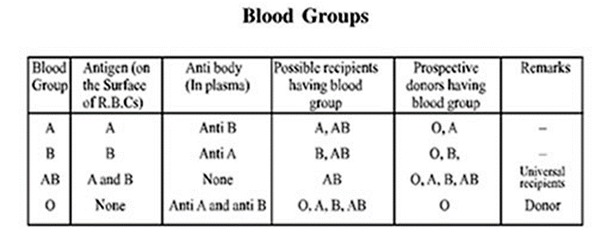
BLOOD GROUPS

Slide 12
BLOOD GROUPS
• In a mismatched transfusion the antigen of the donor reacts with antibody of the recipient to cause a reaction called clumping of agglutination.
• Person with blood group ‘O’ has no antigen hence can donate blood anybody, called universal donor.
• Person with blood group ‘AB’ has no antibody in his plasma hence can receive blood from anybody, called universal recipient.

Slide 13
Rh grouping :
• Another antigen, the Rh antigen similar to one present in Rhesus monkeys (hence Rh), is also observed on the surface of RBCs on majority (nearly 80 %).
• Person with Rh antigen is said to be Rh positive (Rh+).
• Person without Rh antigen is said to be Rh negative (Rh-).
• Person with Rh- blood transfused with Rh+ blood, forms anti Rh antibody and destroy the Rh+ RBCs.
• A special case of Rh incompatibility (mismatching) has been observed between the Rh- bloods of pregnant mother with the Rh+ blood of the foetus.

Slide 14
Rh grouping :
• During parturition the Rh+ foetal blood mixed with the Rh- maternal blood, hence anti Rh antibody formed in mothers blood.
• In successive pregnancy the anti Rh antibody from mother’s blood leaks into the foetal blood and destroy the Rh+ RBCs.
• This caused HDN (haemolytic disease in new born) or Erythroblastosis foetalis.
• This can be prevented by administering anti-Rh antibody to the mother immediately after the delivery of the first child.

Slide 15
COAGULATION OF BLOOD
• Injury to the blood vessel leads to loss of blood called haemorrhage.
• There is an intrinsic mechanism to stop haemorrhage is called haemostasis or coagulation of blood or blood clotting.
• Clot or coagulum is formed mainly of a network of threads called fibrins in which dead and damaged formed elements of blood are trapped or entangled.
• Fibrin is formed by the conversion of inactive fibrinogens in the plasma by an enzyme called thrombin.
• Thrombin formed from inactive prothrombin of the plasma due to presence of enzyme thrombokinase.

Slide 16
COAGULATION OF BLOOD
• All these activation required the initial clotting factor called thromboplastin either released from the injured tissue or platelets.
• Calcium ions play a very important role in the coagulation of blood.

Slide 17
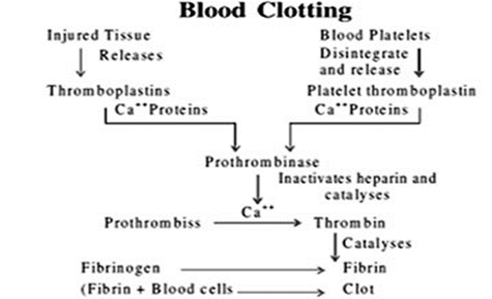
COAGULATION OF BLOOD

Slide 18
Lymph
• The colorless mobile fluid connective tissue drains into the lymphatic capillaries from the intercellular spaces.
Composition :
o It is composed of fluid matrix, plasma, white blood corpuscles or leucocytes.
o Contains less amount of protein than plasma.
o Devoid of RBCs.

Slide 19
Lymph
Functions :
o It drains excess tissue fluid from extra cellular spaces back into the blood.
o It contains lymphocytes and antibodies.
o It transport digested fats.

Slide 20
CIRCULATORY PATHWAYS
Open circulatory system :
Found in arthropods and mollusks.
Blood from the heart pumped into the open spaces in the body cavity called sinuses.
The body cavity remained filled with blood (haemolymph) called haemocoel.

Slide 21
Closed circulatory system :
Found in annelids, echinoderms and all chordates.
Blood from the heart pumped into definite blood vessels.
Blood circulated in a wide network of blood vessel throughout the body.
Blood circulated in a regulated manner.

Slide 22
Heart and circulation in vertebrates :
Fishes: have 2 chambered hearts with one atrium and one ventricle.
Amphibian and reptilian (except crocodile) has three chambered heart with two atria and one ventricle.
Crocodiles, birds and mammals possesses a 4-chambered heart with two atria and two ventricles
In fishes the two chambered heart pumped deoxygenated blood to the gills for oxygenation and then circulated to the body. (singlecirculation)

Slide 23
Heart and circulation in vertebrates :
In amphibians and reptilians the left atrium receives oxygenated blood from the lungs and right atrium receives deoxygenated blood from the body. Blood from the atria pumped into the ventricle from which the mixed blood pumped into the body. (Incomplete double circulation).
In birds and mammals oxygenated and deoxygenated blood received by left and right atria respectively passed into ventricle of their side. The ventricles pump it out without any mixing up. (double circulation)

Slide 24
HUMAN CIRCULATORY SYSTEM
Heart :
Originated from embryonic mesoderm.
Situated in the thoracic cavity, in between two lungs, slightly tilted towards left.
It has the size of the clenched fist.
Heart is covered by a double walled bag, pericardium.
Our heat is four chambered, two relatively smaller upper chamber called atria and two lower larger chamber called ventricles.
Two atria are separated by thin muscular wall called inter-atrial septum.
A thick walled inter-ventricular septum separates two ventricles.
Atrium and ventricle of same side is separated by a thick fibrous tissue called the atrio-ventricular septum.

Slide 25
HUMAN CIRCULATORY SYSTEM
Each of atrio-ventricular septa is provided with an opening through which the atrium and ventricle of same side are connected, called atrio-ventricular opening.
Right atrio-ventricular opening is guarded by tricuspid valve.
Left atrio-ventricular opening is guarded by bicuspid or mitral valve.
The right ventricle opens into systemic aorta and left ventricle opens into pulmonary aorta.
Both the aorta is guarded by semilunar valves.
The valves in the heart allow unidirectional flow of blood i.e. from atria to ventricles and from ventricles to their respective aorta.

Slide 26
Conducting system of human heart :
The entire heart is made of cardiac muscles.
The wall of the ventricle is much thicker than the atria.
A patch of nodal tissue is present in the right upper corner of the right atrium called the Sino-atrial node(S A Node).
Another nodal tissue present in the posterior to the inter-ventricular septum called A V Node (Atrio-ventricular node).

Slide 27
Conducting system of human heart :
A bundle of nodal fibres , atrio-ventricular bundle ( AV bundle) continued as A V bundle through the inter-ventricular septum and divided into right and left A V bundle, also called bundle of His.
The bundle of His gives rise to profuse branches to the wall of the ventricles called perkinji fibres.
S A node generates the force of contraction for auto rhythmicity of heart, hence called pace maker of the heart.
Our heart normally beats 70-75 times in minutes (average of 72 beats per minutes).

Slide 28
Cardiac cycle
The cyclic events takes place in each heart beat is called one cardiac cycle.
Lets starts with all the four chambers of heart are in a relaxed state i.e. in joint diastole.
As the tricuspid and bicuspid valves are open, blood from the pulmonary veins and vena cava flows into the left and right ventricles respectively through left and right atria.
Semilunar valves are closed at this stage.
SAN generates the action potential which stimulates contraction of both atria, called atrial systole.
This increases the blood flow from atria to their respective ventricles by 30 %.

Slide 29
Cardiac cycle
The action potential from SAN passed to AVN and then to perkinji fibres through AV bundles. This initiates ventricular systole. The atria undergo relaxation (diastole).
During ventricular systole the intra-ventricular blood pressure increases that lead to closing of tricuspid and bicuspid valves leads to production of first heart sound called lub sound.
Further increase in pressure leads to opening of semilunar valves.
Oxygenated blood from the left atrium pumped into systemic aorta and deoxygenated blood from the right atrium pumped into the pulmonary aorta.

Slide 30
Cardiac cycle
• Ventricular systole followed by ventricular diastole.
• Intra-ventricular blood pressure decreases leads to closing of semilunar valves causing second heart sound (dub).
• As the ventricular pressure declines further there is opening of bicuspid and tricuspid valves, blood from the atria flows into the ventricles freely.
• The ventricle and atria relaxed simultaneously called joint diastole.
• This sequential event in the heart which cyclically repeated called cardiac cycle.
• The heart beats 72 times per minutes.
• Each cardiac cycle takes 0.8 sec to complete.
• During a cardiac cycle the ventricles pumped 70 ml blood to the aorta called stroke volume.
• Stoke volume multiplied by heart rate (heart beat per min.) gives the cardiac output.
• Cardiac out put for human heart is 5000 ml.

Slide 31
Electrocardiograph (ECG) :
• ECG is a graphical representation of the electrical activity of the heart during a cardiac cycle.
• Each peak in the ECG is identified with a letter from P to T that corresponds to a specific electrical activity of the heart.
• The P-wave represents the electrical excitation (or depolarization) of the atria.
• The QRS complex represents the depolarization of the ventricles.
• The ventricular contraction starts shortly after the Q and marks the beginning of the ventricular systole.
• T-wave represents the ventricular diastole (repolarisation).

Slide 32
Double Circulation
• Pulmonary circulation: Right ventricle (deoxygenated blood) → pulmonary artery → lungs (oxygenation) → pulmonary vein (oxygenated blood) → left atrium.
• Systemic circulation: left ventricle (oxygenated blood) → systemic aorta → body (deoxygenated) →vena cava (deoxygenated blood) → right atrium.
• Portal system: the deoxygenated blood collected from one organ by means of a vein (portal vein) entered into another organ before it is delivered to the systemic circulation.
• Hepatic portal system: the hepatic portal vein carries deoxygenated blood from the intestine to the liver before it is delivered to the systemic circulation by means of hepatic vein.
• Coronary circulation: A special blood vessel (coronary vessel) is present in our body exclusively for the circulation of blood to and from the cardiac musculature.

Slide 33
REGUALTION OF CARDIAC ACTIVITY
• Rhythmicity of human heart is regulated by specialized (nodal tissues), hence the heart is called myogenic.
• A special neural centre in the medulla oblongata can regulate cardiac function moderately.
• Neural signal through sympathetic nerve can increase the heart rate and cardiac output.
• Neural signal through parasympathetic nerve can decrease the heart rate and cardiac output.
• Hormones of adrenal medulla (adrenaline) also increase the cardiac output.

Slide 34
DISORDERS OF CIRCULATORY SYSTEM
Hypertension :
Hypertension is the term for blood pressure that is higher than normal (120/80).
120 mm Hg is the systolic pressure and 80 mm Hg is the diastolic pressure.
Sustained blood pressure of 140/90 or higher is said to be hypertension.
Blood pressure is measured by sphygmomanometer.
High blood pressure leads to heart disease and also affects vital organ like brain and kidney.
Coronary Artery Disease (CAD) :
Often referred as atherosclerosis, affects the blood supply to the heart muscles.
It is caused by deposition of calcium, fat, cholesterol and fibrous tissue which makes the lumen of coronary artery narrower.

Slide 35
DISORDERS OF CIRCULATORY SYSTEM
Angina :
It is also known as ‘angina pectoris’.
Causes acute chest pain due to inadequate oxygen supply to the heart.
It occurs due to blockade to coronary artery.
Heart failure :
It is the state of the heart when it is not pumping blood effectively
Cardiac arrest: the heart stops beating.
Heart attack: heart muscle damaged suddenly by an inadequate blood supply to the heart muscles.

