Slide 1
Chapter -2
Bringing Up Kari
Of
Supplementary Reader

Slide 2
What will I learn in this lesson?
Moral
Animals can be as, or sometimes even more, loving, brave, and sensible than humans.
Quiz
Answer some questions based on the story you read in the form of a comic.
Characters
Kari ( an elephant)
Kari's friend and keeper
Synopsis
This story is about a nine year old boy and five month old elephant, Kari. Both of them grew together. The first thing which Kari did was to save a boy. Kari was like a baby and full of mischief. One day he developed the taste of bananas and since then he took all steps to steal the bananas. The narrator was very annoyed. So he scolded Kari for his mischief.

Slide 3
Objectives
To enable the students to share their personal experiences.
To enable them to express themselves in grammatically correct language.
To enable the learners to create an interest towards story reading.
To sensitise the students to make friendly relationship with the animals.
To enable them to use new words and phrases in their own language.

Slide 4
New Words:
Tiptoe : on the tips of toes
Moving with tiptoe steps
Trumpet : sound of elephant
Elephants are trumpeting.
Sneak in : come in quietly
He sneaked in under cover of darkness.
Whipped : beat
The teacher often whipped the students.
Strewn : spread all around
Dead bodies strewed the ground

Slide 5
KEY POINTS
This is a story of 5 month old baby elephant named Kari.
Kari is not only a playful and mischievous elephant but also a sensitive and helpful baby elephant.
He is fond of ripe bananas.
He is quick learner and his nine years old friend as well as keeper is also a good trainer.
Kari is taught to walk, to sit down, to go fast, to go slow etc.

Slide 6
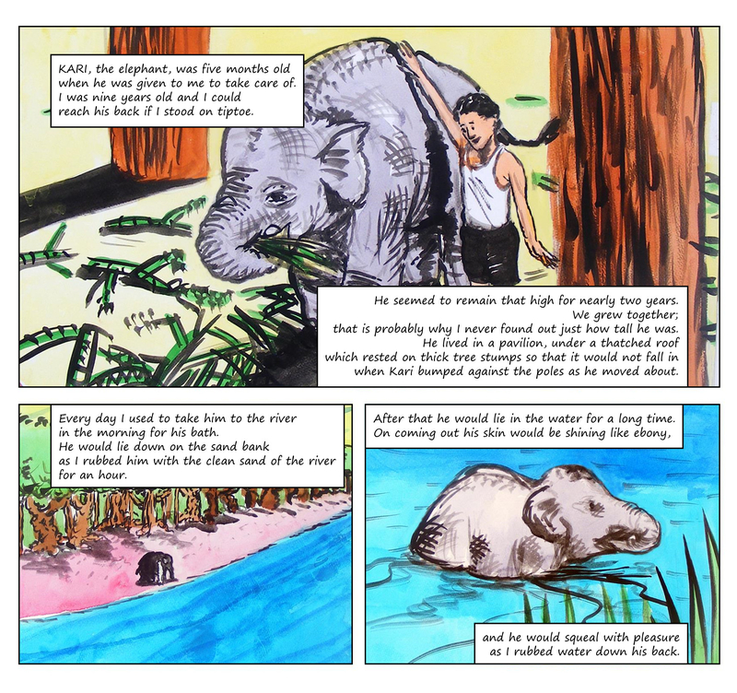

Slide 7
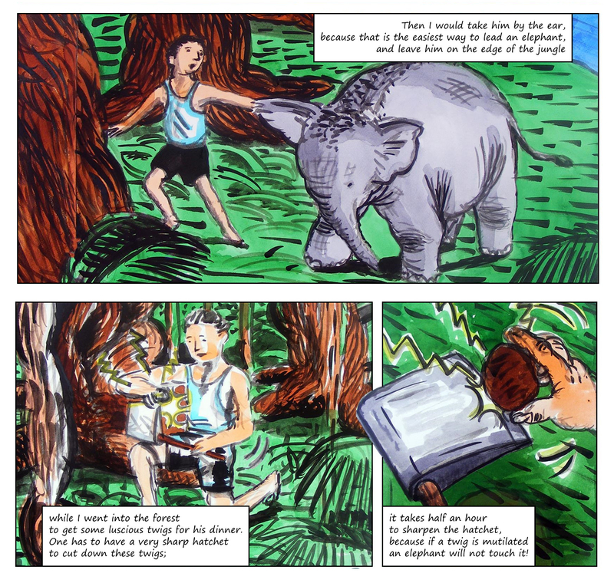

Slide 8
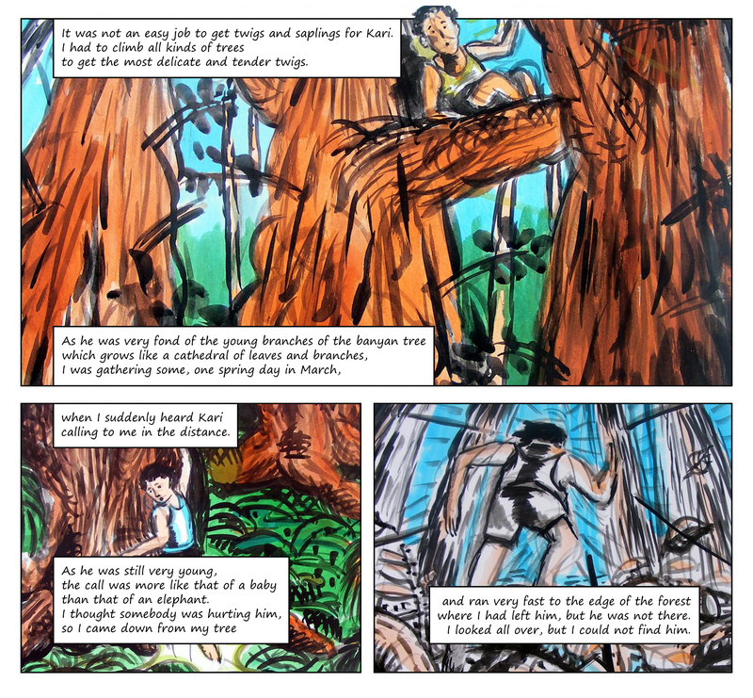

Slide 9
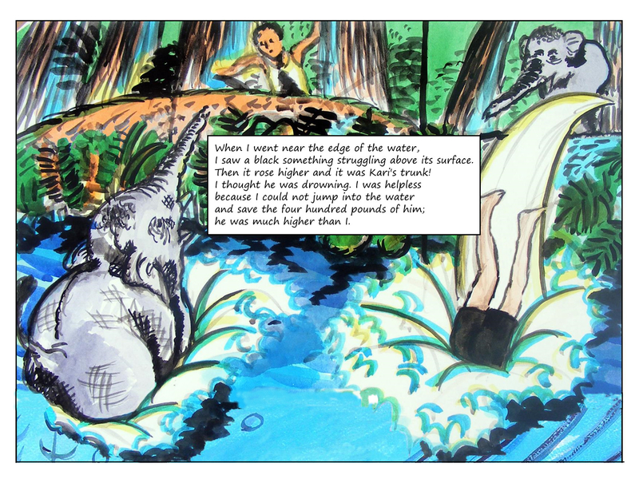

Slide 10
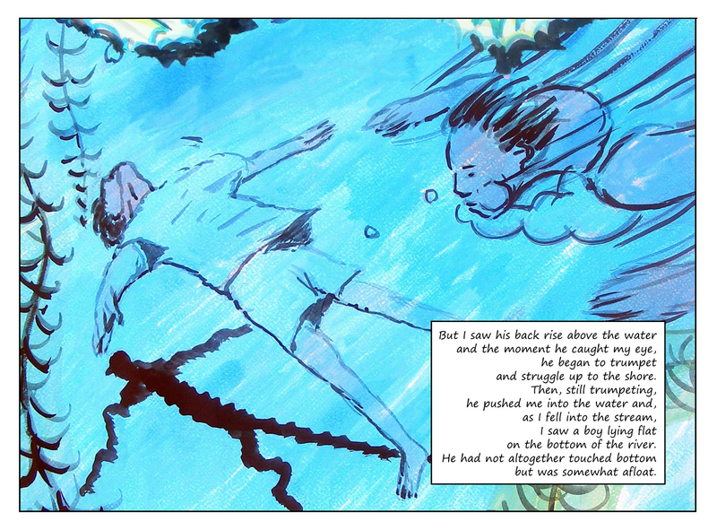

Slide 11
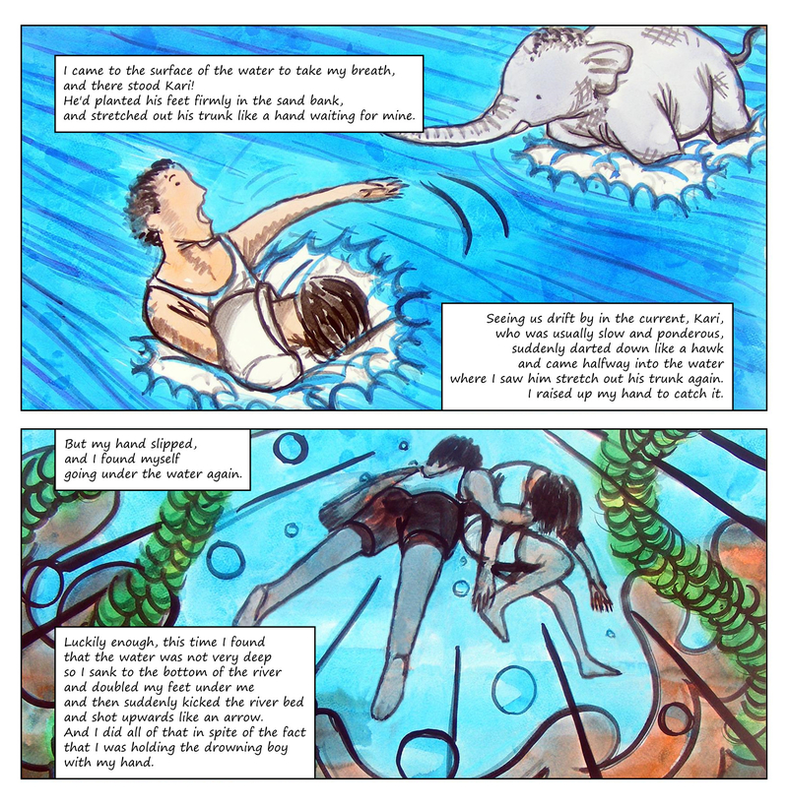

Slide 12
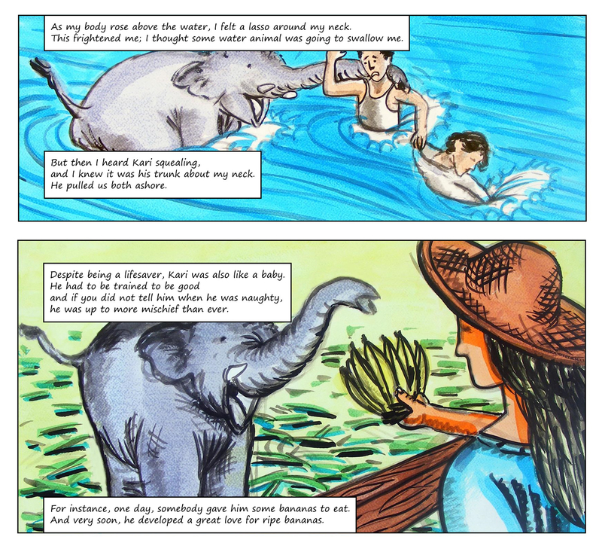

Slide 13
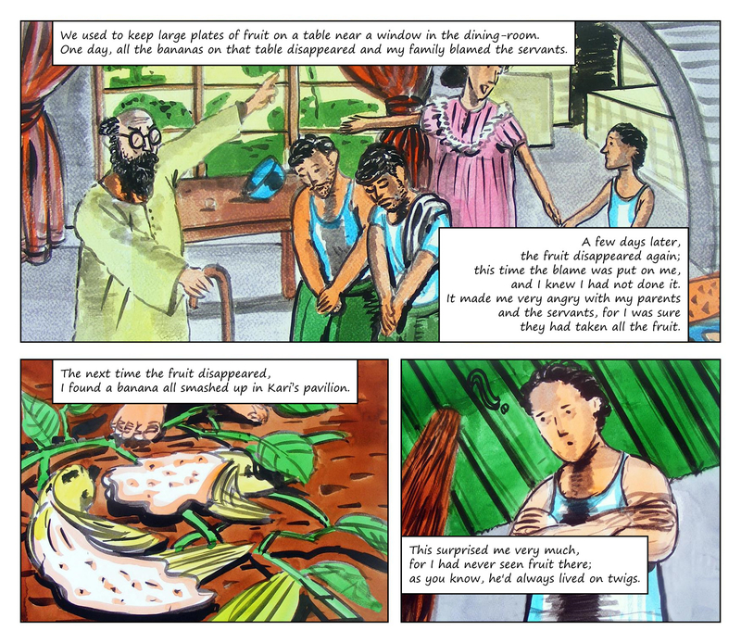

Slide 14
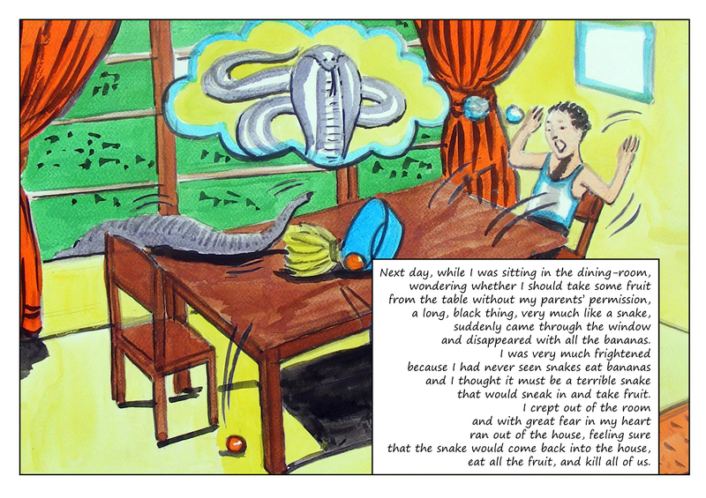
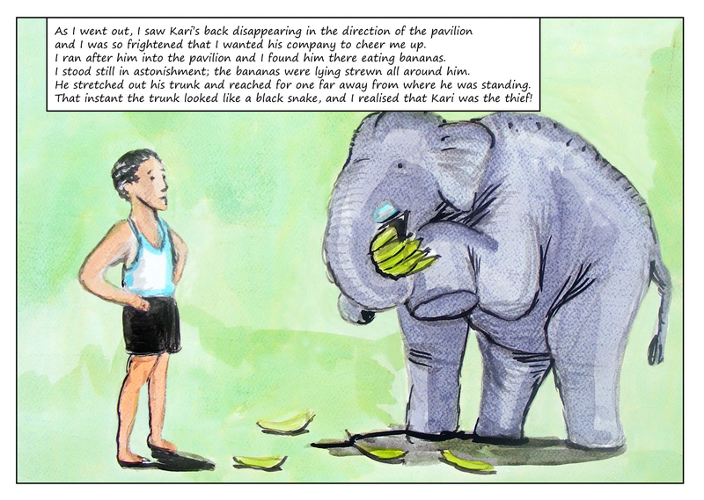

Slide 15
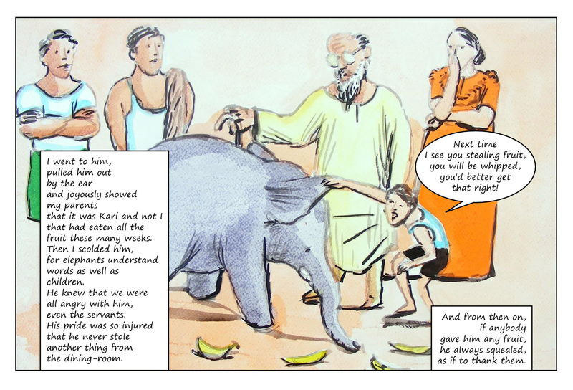
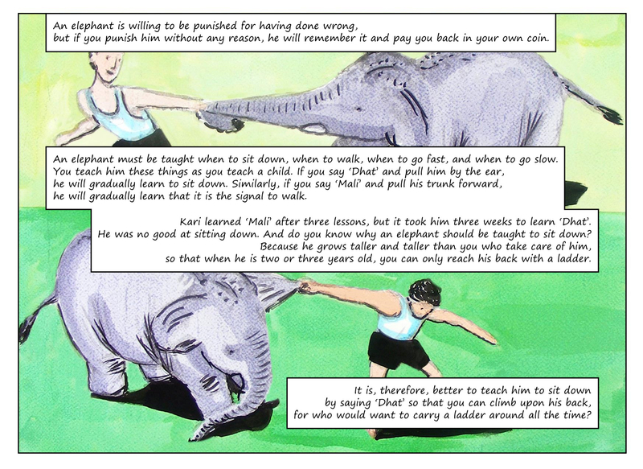

Slide 16
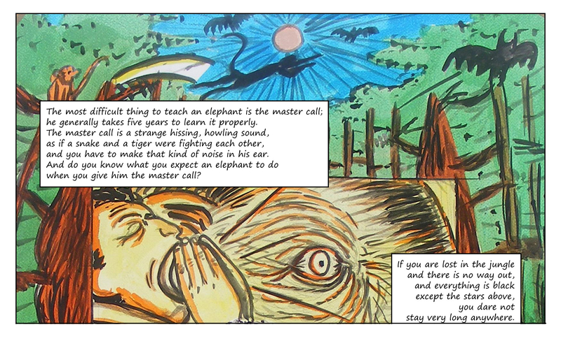
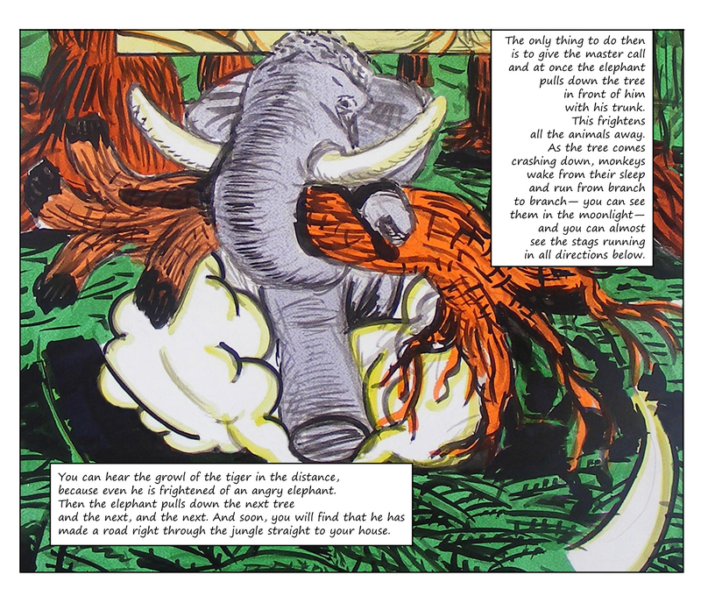

Slide 17
MCQ’S
Q1.The enclosure in which Kari lived had a thatched roof that lay on thick tree stumps. Examine the illustration of Kari’s pavilion on page 8 and say why it was built that way.
a.The enclosure in which Kari lived had a thatched roof that lay on thick tree stumps so that Kari could easily break it.
b.The enclosure in which Kari lived had a thatched roof that lay on thick tree Stumps made the enclosure strong, so that it would not fall when Kari bumped against the poles when he moved about.
c.Kari was very weak and needed a thatched roof that lay on thick tree stumps because Kari was very weak.
d.The narrator played on the thatched roof.
.
Q2.Did Kari enjoy his morning bath in the river?
a. No, Kari did not enjoy his morning bath in the river.
b. Yes, Kari did enjoy his morning bath in the river because he lived at the river bank.
c. No, Kari liked staying dirty and did not enjoy his morning bath in the river.
d. Yes, Kari did enjoy his morning bath in the river. He would lie down on the sand till the narrator rubbed his back and stay in water for a long time.

Slide 18
Q3.Finding good twigs for Kari took a long time. Why?
a.Finding good twigs for Kari took a long time because Kari liked only mutilated twigs.
b.There was no forest in that area from where twigs could be collected.
c.It took a long time to find good twigs for Kari because there were no good trees left.
d.It took a long time to find good twigs for Kari because the narrator had to climb all kinds of trees to get the most delicate and tender twigs.
Q4. Why did Kari push his friend into the stream?
a. Kari pushed his friend into the stream so that he could see the drowning boy who lie flat at the bottom.
b. He pushed his friend into the stream so that they could swim together.
c. Kari wished to play with his friend in water.
d. He did so because he was drowning.

Slide 19
Q5. Kari was like a baby. What are the main points of comparison?
a. Kari was like a baby who had to be taught everything and if not trained well, he could become mischievous.
b. Kari was very small in size.
c. He started crying like a baby when his wishes were not fulfilled.
d. Kari was used to bedtime stories and hence, was like a baby.
Q6. Kari helped himself to all the bananas in the house without anyone noticing it. How did he do it?
a. Kari asked the servants to get him the bananas.
b. Kari went into the kitchen at night time after everyone was asleep.
c. He stretched his trunk and got hold of the bananas through the window without anyone noticing him.
d. The narrator helped Kari get bananas.

Slide 20
Q6. Kari learnt the commands to sit and to walk. What were the instructions for each command?
a.'Dhat' was the common command for all the instructions.
b.'Mali' was the command to sit and 'Dhat' to walk.
c.'Dhat' was the command to sit and 'Mali' to walk.
d.'Mali' was the common command for all the instructions.
Q7. What is “the master call”? Why is it the most important signal for an elephant to learn?
a.The master call is a hissing and howling sound made in the elephant's ear. It is very important because it helps the master to find out the straight way to home if lost in the dark.
b.The master call is a loud cry by the master to show happiness.
c.It is a coded message that only the master and the elephant can understand. It helps in maintaining secrecy.
d.The master call involves beating the drums when the elephant is lost.

Slide 21
ANSWERS OF THE TEXTBOOK
Q1. The enclosure in which Kari lived had a thatched roof that lay on thick tree stumps. Examine the illustration of Kari’s pavilion on page 8 and say why it was built that way?
A: Pavilion was built on a thick tree stem so that would not fall on bumping against the poles.
Q2. Did Kari enjoy his morning bath in the river? Give a reason for your answer?
A: We can say that Kari enjoys his bath as he lay down on the sand bank while the narrator rubbed him with clean sand. When narrator rubbed him with water, he trumpet with pleasure.
Q3. Finding good twigs for Kari took a long time. Why?
A: It took such a long time to find twigs for Kari because if twig is broken, Kari would not touch it. Narrator has to climb all kind of trees to get twigs.
Q4. Why did Kari push his friend into the stream?
A: Kari pushed his into the stream because the boy was lying flat on the bottom of the river. Kari had tried to save the boy but he had not been successful.
Q5. Kari was like a baby. What are the main points of comparison?
A: Kari had to be trained to be good. He did a lot of mischief. Like a child he played pranks,and took away all the fruits kept on the plate.

Slide 22
6. Kari helped himself to all the bananas in the house without anyone noticing it. How did he do it?
A: Kari was quiet a cunning baby elephant . Once when he tasted ripe bananas he developed a taste for eat. Now, very clearly he by making his trunk appear like a black snake, took away all the fruits.
7. Kari learnt the commands to sit and to walk. What were the instructions for each command?
A: Kari was taught to sit down, to walk, go slow etc. for sitting down instruction given was ‘dhat’ and then Kari was pulled by the ear. For walking instruction given was ‘mali’ and his trunk was pulled forward.
8. What is “the master call”? Why is it the most important signal for an elephant to learn?
A: master call is a kind of strange hissing, howling sound. It is a sound of noise as if snake and a tiger are fighting. This call makes elephant pulls down the trees and take you right to your house.

