Slide 1
SAINIK SCHOOL GOALPARA
TOPIC-ELEMENTS OF DEMOCRACY
CHAPTER-4
SOCIAL AND POLITICAL LIFE
CLASS-VI (CIVICS)

Slide 2
POINTS TO DISCUSS
PARTICIPATION
ACCOUNTABILITY
CONFLICT RESOLUTION
CONCERN FOR EQUALITY AND JUSTICE

Slide 3
Participation
It means to take part.
In a democracy every citizen has the right and the means to participate in the decision-making process of the Government.
In a democracy there is a free and fair system of election for choosing representatives to the Government.

Slide 4
PARTICIPATION
ELECTION
STRIKES
PROTEST MARCHES
RALLIES
REFERNDUMS
MEDIA

Slide 5
ACCOUNTABILITY
Accountability means being responsible for one’s action.
Elected representatives are responsible and accountable to the people.
Judiciary(independent) and police take the elected representatives to task if they are dishonest.
Judges cant be influenced because of its independence.
Citizens can register cases.

Slide 6
constitution
Every democracy has a constitution.
It specifies the powers of the Government.
It also safeguards the interest of everyone.
It acts as a check on the misuse of power by the Government.
1975 Indira Gandhi declared state of emergency in India.
She suspended elections and liberties of the people.
Justice Khanna ruled ‘fundamental rights, especially the right to life, cannot be violated even during emergency.
People voted Indira Gandhi out of power in the next election.

Slide 7
Conflict resolution
Demands of resources are increasing so does population leading to conflicts.
There are conflicts in society and interest groups clash over some or the other issue.
In India there are many states which are in conflicts due to sharing of rivers, land people etc.
Conflicts arises because of different religious groups, castes, regions and even between the rich and poor.
Judiciary or the court of law is the main body which deals with conflicts.
Example-Gujarat riots (Hindu-Muslim riots 2002 Bilkis Bano)
Police is another body which deals with conflict resolution.

Slide 8
Concern for equality and justice.
Provision for Equality and justice.
All are equal in the eyes of the law.
Earlier millions had suffered due to ‘untouchability’ and ‘caste system.
Constitution makes special provision for the Dalits and the so-called Untouchables.
Seats are reserved for them in the parliament , educational institutions, and Government undertakings.
Several laws are passed prohibiting the discrimination of people on the basis of caste, creed or colour.
Girls are often treated as second class citizen. Female foetuses are killed.
Birth of a girl child is unwelcomed.
Government had launched projects to prevent female infanticide.
Free schooling, girl parents get paid. Scholarship , reservations etc.

Slide 9
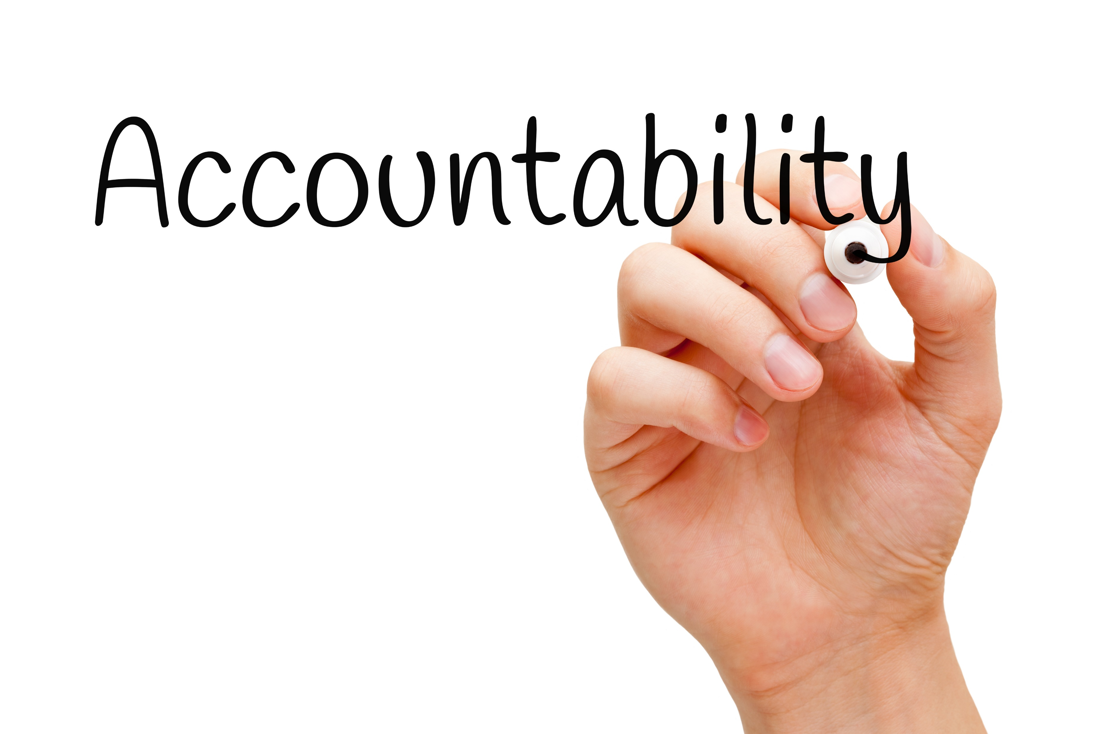

Slide 10
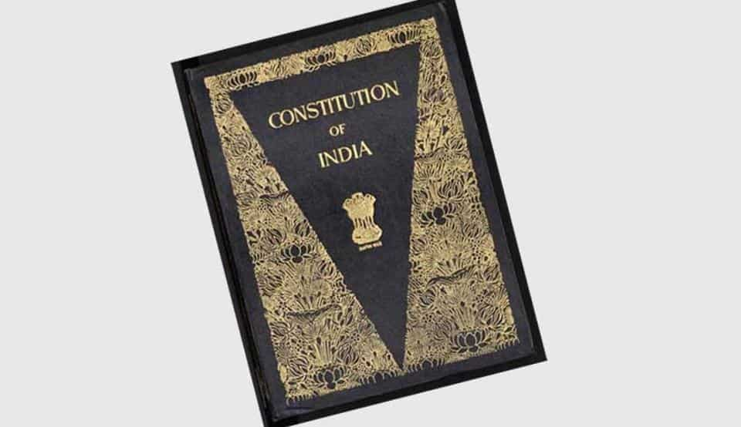

Slide 11
CONFLICT RESOLUTION
JUDICIARY
POLICE

