Slide 1

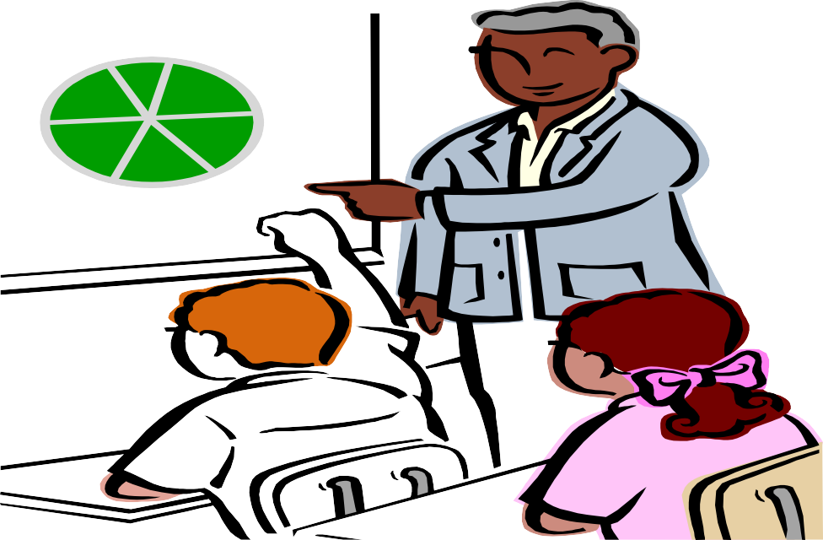

Slide 2
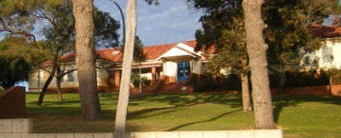








Slide 3

Introduction
Games played in the school
Vocabulary
Recapitulation
Comprehension
Lesson based Activities
Home work
Work cited page

Slide 4
Introduction
This lesson addresses an important social concern for the differently – abled . Its aim is to make our children appreciate and understand misfortune and make them share in misfortune. In this school each term every child has to play different types of game like blind, lame , deaf, dumb and injured .

Slide 5
The real aim of this school is not so much to teach thought as to teach thoughtfulness- Kindness to disabled persons and to make them a responsible citizens of the nation.

Slide 6

Different kinds of game
Blind day
Lame day
Dumb day
Deaf day
Injured day

Slide 7

Blind day
During the blind day students’ eyes are bandaged absolutely and they are instructed not to peep.
The bandage is put on over night so they wake blind. This means that they need help with everything.
Other children are given the duty of helping them and leading them about.
They all learn so much this way – both the blind and the helpers

Slide 8
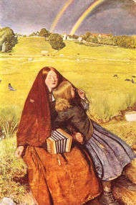
Thus even the thought-less student realizes about the misfortune.
The Students feel awful to be blind because they can not see a thing .
They also feel that they are going to be hit by someone every moment.
It is just a relief to sit down in this game
The blind day is , of course, really the worst day .

Slide 9
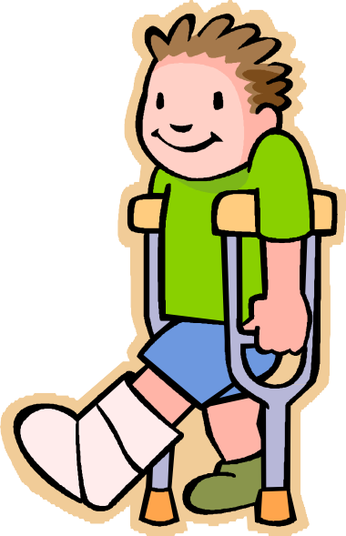

Lame day
Students feel the lame day as a very funny day.
They hop with a leg tied- up.
Sometimes an arm was tied-up but it was a more troublesome, because one can not eat without help.

Slide 10
Dumb day
In this game children’s mouths are bandaged .
They have not to speak even a single word.
Thus they really have to exercise their will- power.
Some children feel that this day is the most difficult game because they can not bandage their mouths.

Slide 11


Deaf day
In this game children’s ears are stuffed with cotton so that they can not listen to their friends’ conversation.
They are bound to understand through the gesture by anyone.
Thus they realize the problem of the deaf person.

Slide 12

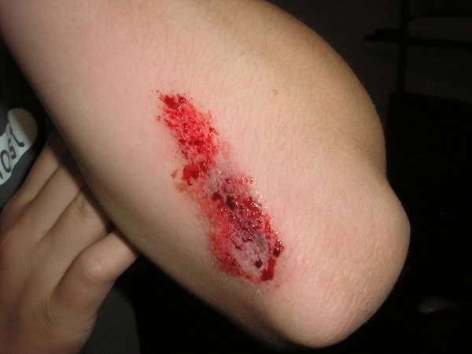
Injured day
On this day the children play a role of an injured person.
They cry for help because of pain.
Thus they feel how to help an injured person.

Slide 13
Vocabulary
Words
Bandage Plump Misfortune Hopeless Absolutely Misery
Meanings
to tie cloth or strip strong /stout
bad-luck without hope completely
difficulty / unpleasant
Thoughtless Awful
careless terrible / bad difficult
supporting stick for a lame person
handicapped or lame person
Troublesome Crutch
Crippled

Slide 14
RECAPITULATION
A special kind of school.
Different kinds of game are being played.
Blind day, deaf day, dumb day, lame day and injured day .
The students learn how to feel problems and miseries faced by grief stricken-people.
They also learn how to help them.
They enjoy these days by playing the games.
The human values are inculcated by this lesson in the students.

Slide 15

Comprehension
No more than……………….no other lesson . (Para 4)
Comprehension questions
What do they learn in this day?
What are the teaching methods there?
Is there any other lesson to teach them?
Write the opposite word of the word ‘interesting’.
5. Write the different meaning of the words ‘ quite and quiet’

Slide 16


Passage No. 2
This is a very……………..the helpers. (Para 9)
Comprehension Questions
What is important part of the school?
Which games do they play?
When are their eyes bandaged?
What are the duties of the other students?
Find out the similar word from the passage for ‘ Completely’.

Slide 17
Matching- Words
Match the following words from column A with their meaning in column B
A
Homesick Misfortune Relief Thoughtless Plump Gradually Exercise Appreciate
B
Stout/ strong careless
Unfortunate condition Understanding the difficulties Wanting to be home
a welcome change Practice
Slowly

Slide 18

Sentence-framing
Frame the sentence with the help of the given words as shown in the example
Example: The story is interesting
Bandage, crutch, middle-aged, multiplying, interesting , Over-night, hundreds of years, kindly, had to live

Slide 19



Short Questions
1. Who was the principal of the school?
2. Who visited the school?
3. Write one game which the students had to play.
4. Which game was the hardest game ?
5. In which game their eyes were bandaged?
6. In which game a crutch was used?

Slide 20



Long Questions
1. Why is the school called a ‘different kind of school’ ?
2. What do the students learn through these games ?
3. Why did the writer visit Miss Beam’s school?

Slide 21
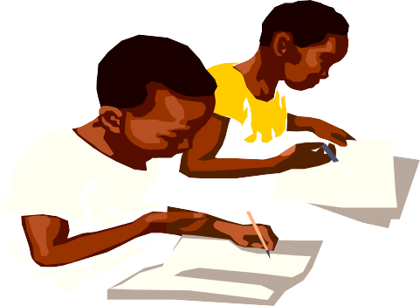
Home work - I
Pick out nouns and verbs from the following sentences.
We can not bandage the children’s mouths, so they really have to exercise their will power.
Make the plural number of the following nouns Child, bandage, crutch, citizen, misfortune,
misery, year, system, time
Write five sentences about your own school.

Slide 22

Home work - II
Arrange the following words to make a meaningful sentence.
  On/she/ crutches/is.
  Lead/somewhere/you/I shall.
  A very important/is / this/ our/ part of / system.
D See/ I / beautiful / very / ground.

Slide 23
Indebted to
DR. (Mrs.) SUDHA SHARMA
Dy. Commissioner, NVS, R.O Lko.
Mr. A. K. SHUKLA
Asst. Commissioner, NVS,R.O Lko.
Dr. U. C. Vajpayee
Ex. Dy. Commissioner, NVS, New Delhi

Slide 24
We are thankful to
Mr. Tej Sagar
Principal, JNV Almora
Mr. Vikram Joshi
Principal, JNV U. S. Nagar
Ms. Veena Rawat
PGT (Eng.), JNV Uttarkashi
Mr. Rajesh Gupta
PGT (Eng.), JNV Almora
And all Staff of JNV, Almora

Slide 25
Prepared by
Rajesh Kumar, TGT Eng, JNV, Barabanki
U.S Pandey, TGT Eng, JNV, Chitrakoot
Manoj Kumar, TGT Eng, JNV, Bahraich
Mujeeb Ahmad, TGT Eng, JNV, Farrukhabad
Sunita Gupta, TGT Eng , JNV, S.K. Nagar

Slide 26
Work-Cited page
Word art
Internet
Clip Art
Book of Class VI prescribed by NCERT

Slide 27


















