Slide 1
Herbs, Shrubs, Trees, Climbers and Creepers.
Plants can be broadly classified into Herbs, Shrubs, Trees, Climbers and Creepers based on the form and size of their stem.
(a) Herbs: Plants that have a soft, green stem are called Herbs. Herbs may have few branches. e.g. Grass, Coriander, Mint, Rice, Wheat etc.
(b) Shrubs: Plants that grow to height of around 3 m and have a short, thin, woody stem with many branches growing from or near the base of the stem are called Shrubs. e.g. Hibiscus, Rose, Lime etc.
(c) Trees: Plants which are tall and have a thick, woody trunk with branches grow from the upper part of the stem are called Trees. e.g. Mango, Gulmohar, Banyan etc.
(d) Climbers: Plants which have weak stem and climb up a support are called Climbers. e.g. Money plant, Pea plant etc.
(e) Creepers: Plants which have weak stem and grow along the ground are called Creepers. e.g. Watermelon, Pumpkin etc.

Slide 2
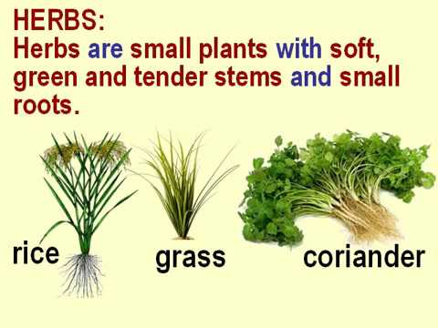
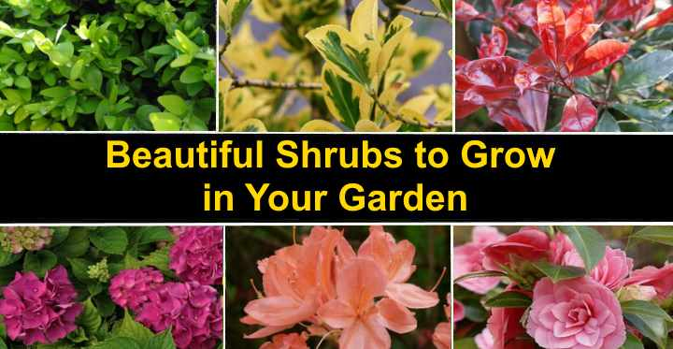
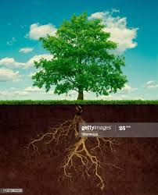
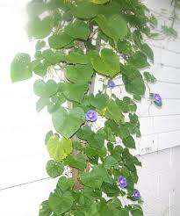
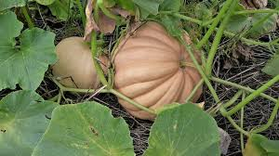
Herbs, Shrubs, Trees, Climbers & Creepers

Slide 3
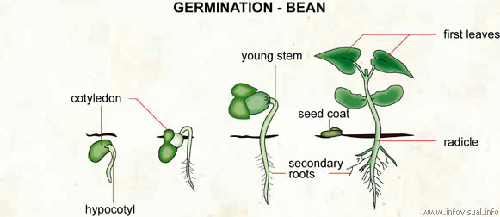
Root System
The parts of the plant that are present under the ground are known as root system.
• When a seed germinates, the root grows first. The small root that develops from a seed is called the Radicle.
• The Radicle forms the Primary root. As the seedling develops, other roots grow forming the root system.
• There are two types of Root Systems
The Taproot System
The Fibrous Root System

Slide 4
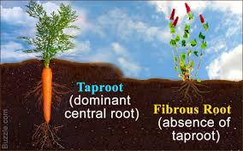
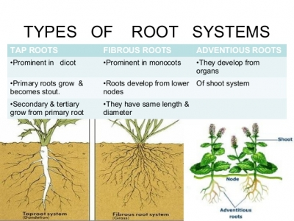
The Taproot system and The Fibrous Root system.

Slide 5
The Taproot system and The Fibrous Root system.
(a) The Taproot System: The main root, the branch root and the root hairs form the taproot system. e.g. Mango, Apple, Plum etc.
Note: In the Taproot system, the radical grows down from the seed and becomes the main Taproot. Smaller roots called Secondary roots, which look like branches, grow from the main taproot.
(b) The Fibrous Root System: The root system in which primary root does not develop any further, a cluster of thin, fibre- like roots develop from a common point at the base of the stem, which are of approximately same length and thickness are called Fibrous Root System. e.g. Grass, Wheat, Bamboo etc.

Slide 6
Functions of Roots
(c) Functions of Roots:
(i) Roots fix the plant to the soil.
(ii) Roots help the plant to absorb water and minerals from the soil.
(iii)Some plants store food in their roots.
(iv) Roots also hold soil and prevent it from being eroded by wind or water.
(v) Some plants reproduce through roots. ,

Slide 7
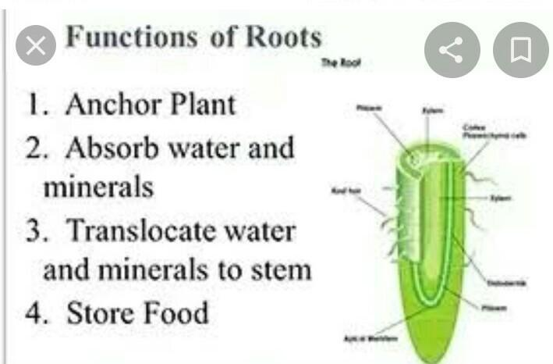
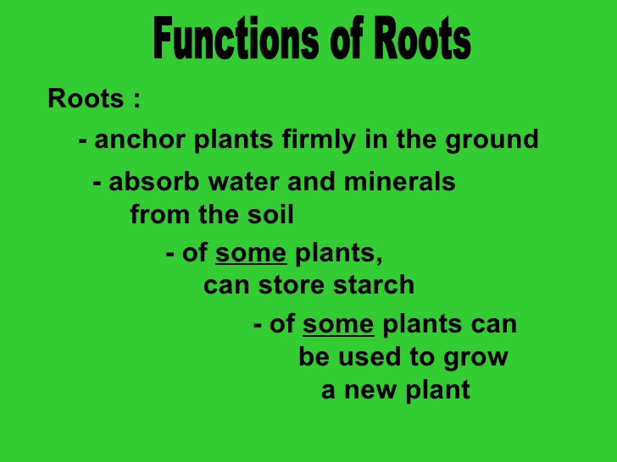
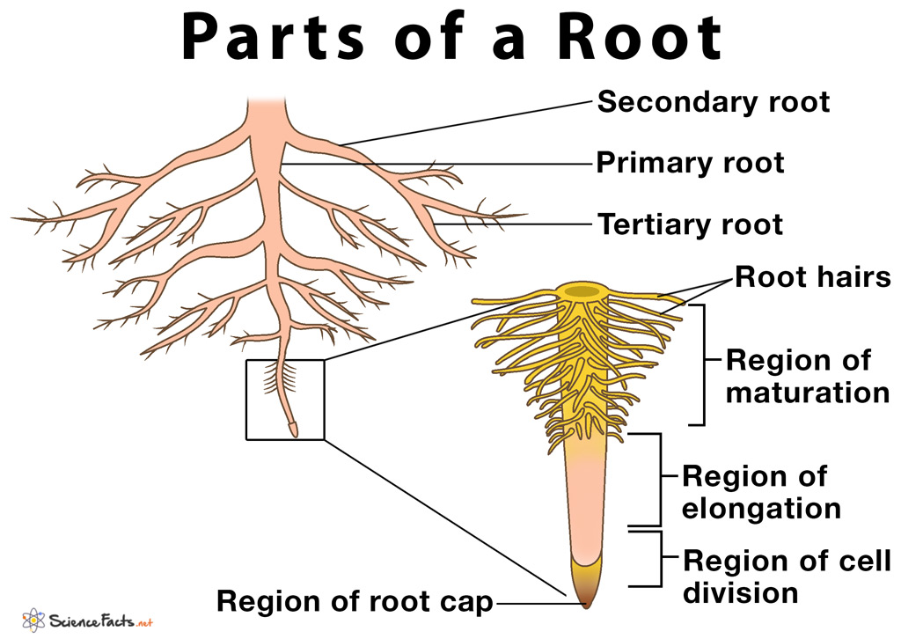
Functions of Roots

Slide 8
Root Modifications
The structure and appearance of the roots are modified in some plants to carry out special functions.
(a) Storing Food: Some roots are modified to store food. These storage roots are fleshy and swollen. e.g. Carrot, Radish, Beetroot, Turnip etc.
(b) Support:
(i) Prop Roots: In some plants, roots grow downwards from the lower parts of the stem for additional support. They prevent the plant from tilting to one side. These supporting roots are called Prop roots. e.g. Sugarcane, Maize etc.
(ii) Clasping Roots: In some plants, roots grow from the stem to provide grip to the plant on the support. e.g. Money plant, Pepper plant etc.

Slide 9
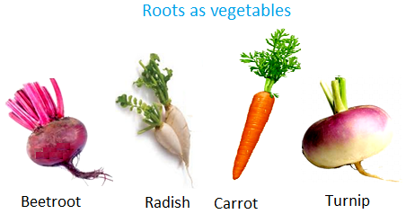
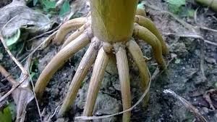
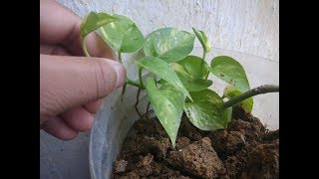
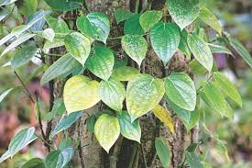
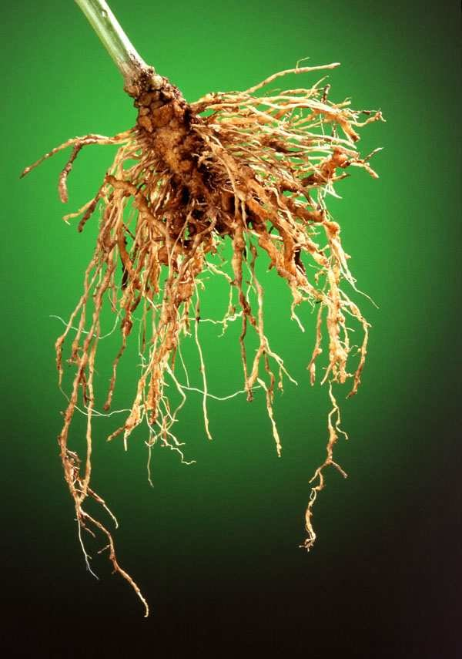
Storing food, Prop roots, Clasping roots.

Slide 10
Root Modifications.
(c) Breathing: Some plants that grow in swamps have branched roots that grow upwards through the soil into the air. The exposed parts of the roots absorb air. Such roots are called pneumatophores, e.g. Mangrove.
(d) Nitrogen Fixation: Some plants have swollen structures called Nodules on their roots. Bacteria in these root nodules convert atmospheric nitrogen into compounds that the plant can use. e.g. Pea, Bean etc.
(e) Reproduction: In some plants, roots send out shoots called Suckers, which can grow into new plants. e.g. cherry, Plum etc.

Slide 11
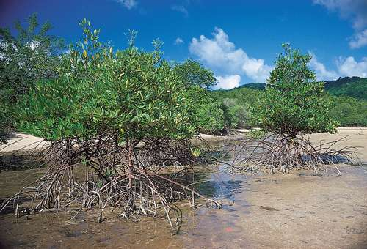
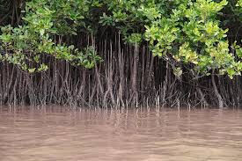
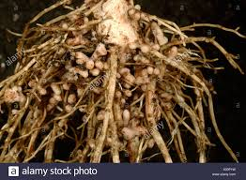
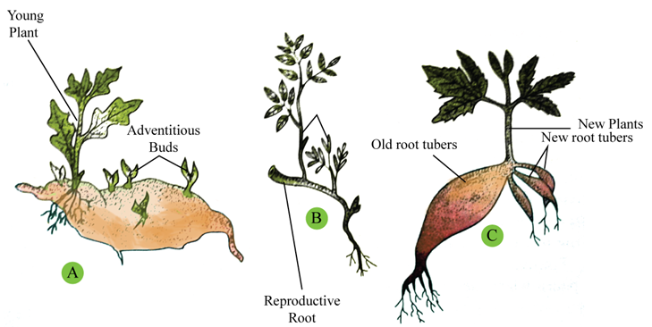
Breathing, Nitrogen Fixation & Reproduction by roots

Slide 12
The Shoot System
The Shoot System: The parts of the plant that grow above the soil form the Shoot System. The shoot system include the Stem, Branches, Leaves, Flowers, Fruits and Seeds.
(a) The Stem: The Plumule is the second part that develops from the germinating seed and grows upwards is termed as Stem.
(I) Functions of the Stem:
(i) The stem stands straight and bears the other parts of the shoot.
(ii)Stem holds the leaves up to the light. It holds the flowers and fruits in positions suitable for pollination and Seed Dispersal.
(iii)The stem transports water and food between the roots and the rest of the plant.
(iv) Some plants store food in the stem.
(v)Some plants reproduce through their stem.

Slide 13
Stem Modifications
(b) Stem Modifications:
(I) Storing Food: Underground stems of some plants can store food. The buds of these underground stems can grow using the stored food. e.g. Ginger, Potato, Turmeric etc.
(II) Support: Some stems develop spirally coiled structures called Tendrils that help the plant to climb. e.g. Cucumber, Grape, Vine etc.
(Ill) Photosynthesis: Some stems contain Chlorophyll and carries out Photosynthesis. e.g. Cactus.
(IV) Reproduction: Some plants have thin, long, weak stems called Runners that creep on the ground. They produce new shoots and roots from points on the stem called Nodes. E.g. Grass, strawberry etc.

Slide 14
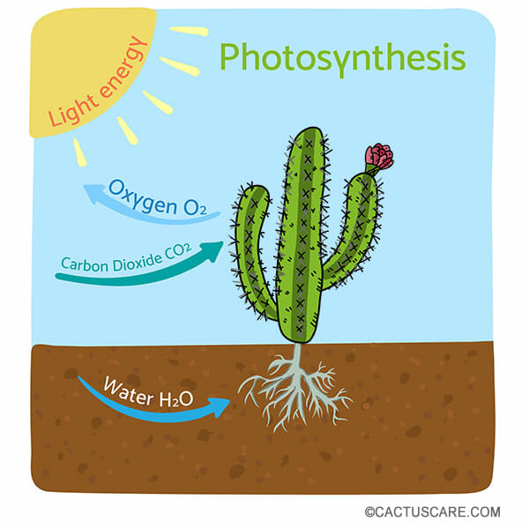
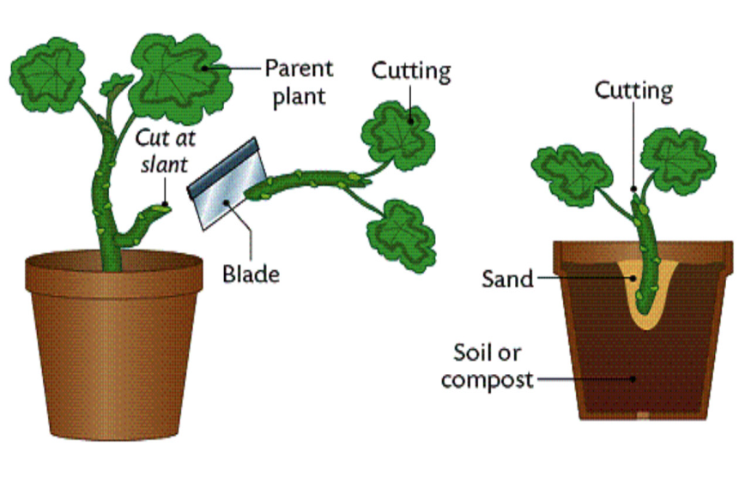
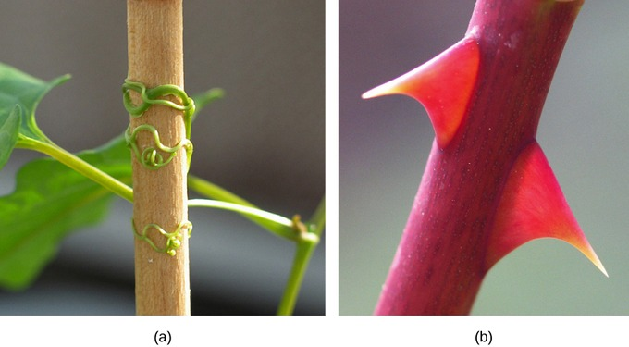
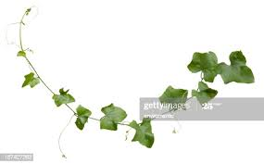
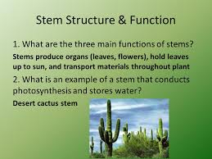
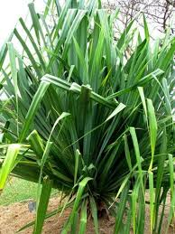
Plumule, reproduction through Stem, Support and Photosynthesis

Slide 15
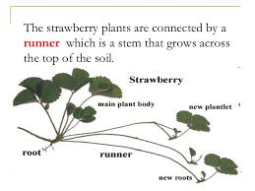
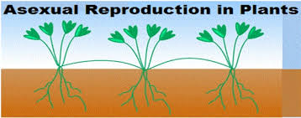
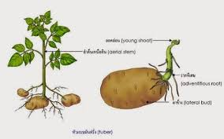
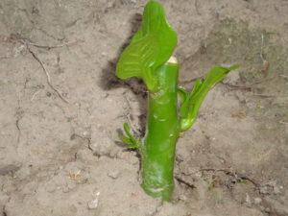
Reproduction by Stem, Storing Food by stems

Slide 16
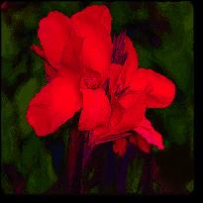
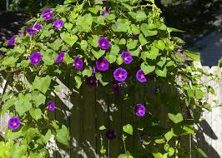
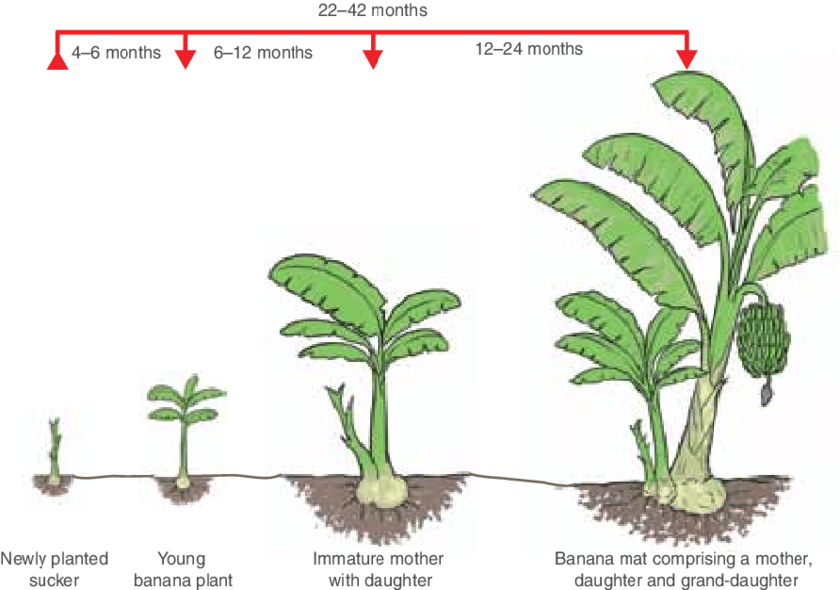
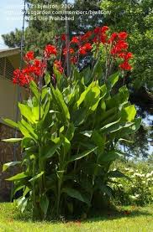
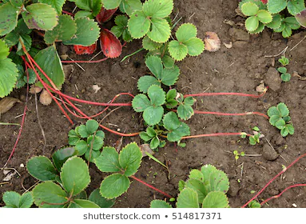
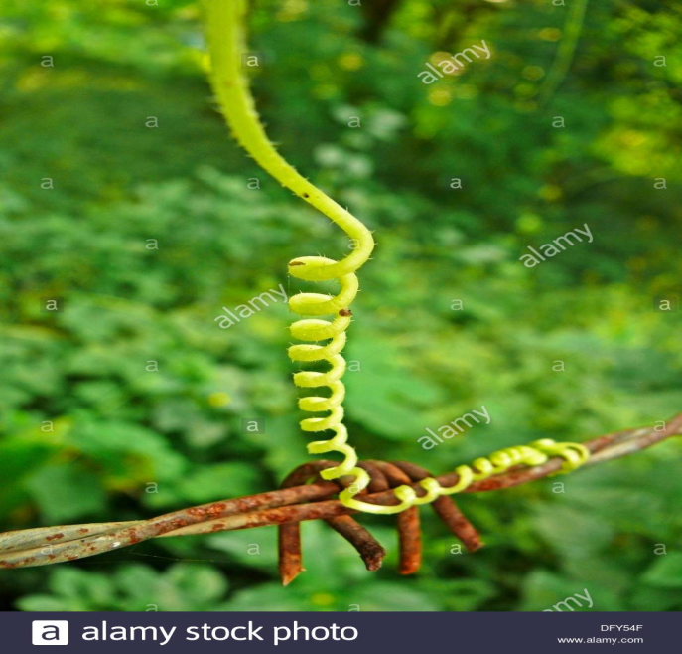
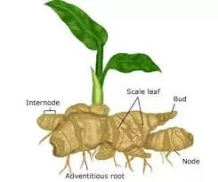
Canna lily. Morning glory, Suckers, Runners, Tendrils, Rhizome

Slide 17
The Leaves
The Leaves:
The parts of the plant that arise from the stem at points called nodes and prepares food for the plants are called leaves.
The Structure of a Leaf:
The broad, flat portion of the leaf is the lamina or leaf Blade.
The lamina is attached to the stem by the Petiole or Leaf Stalk. A Leaf Bud is present where the swollen end of the leaf stalk joins the stem.
The leaf tip is known as Apex and the edge of the lamina is called the leaf Margin.
The petiole extends into the leaf passing through the center of the lamina as the Midrib or the Main Vein.

Slide 18
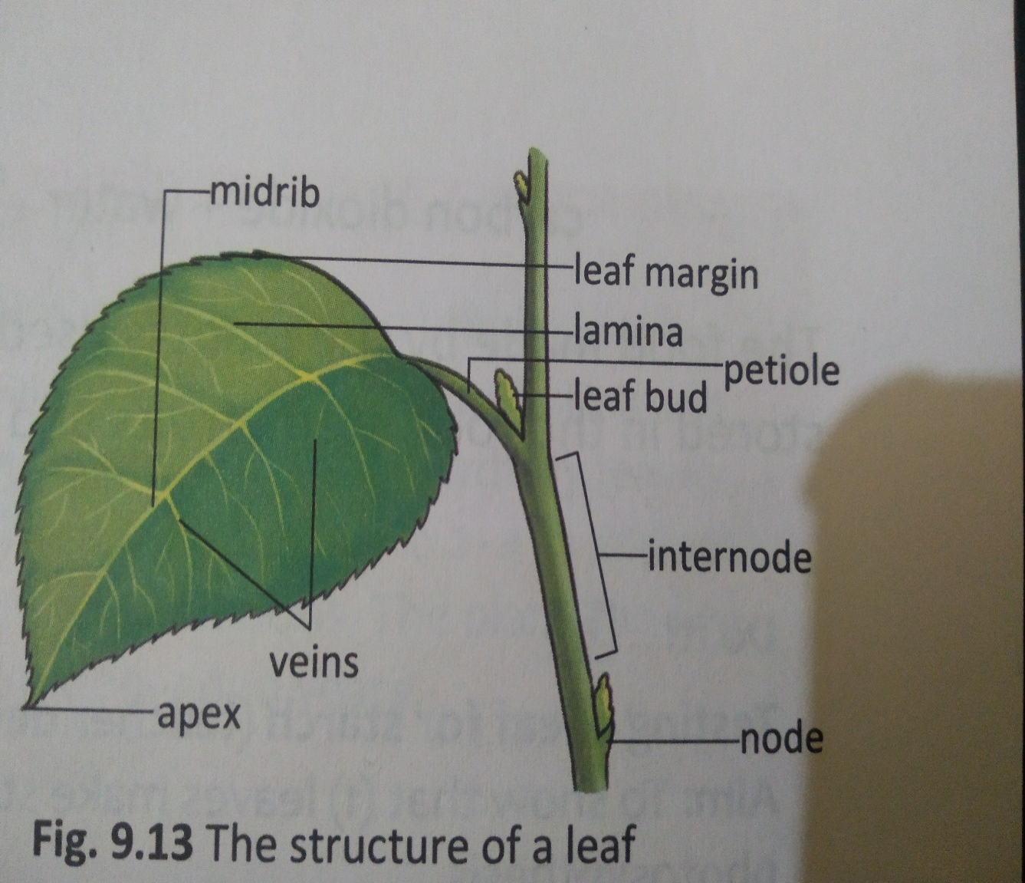
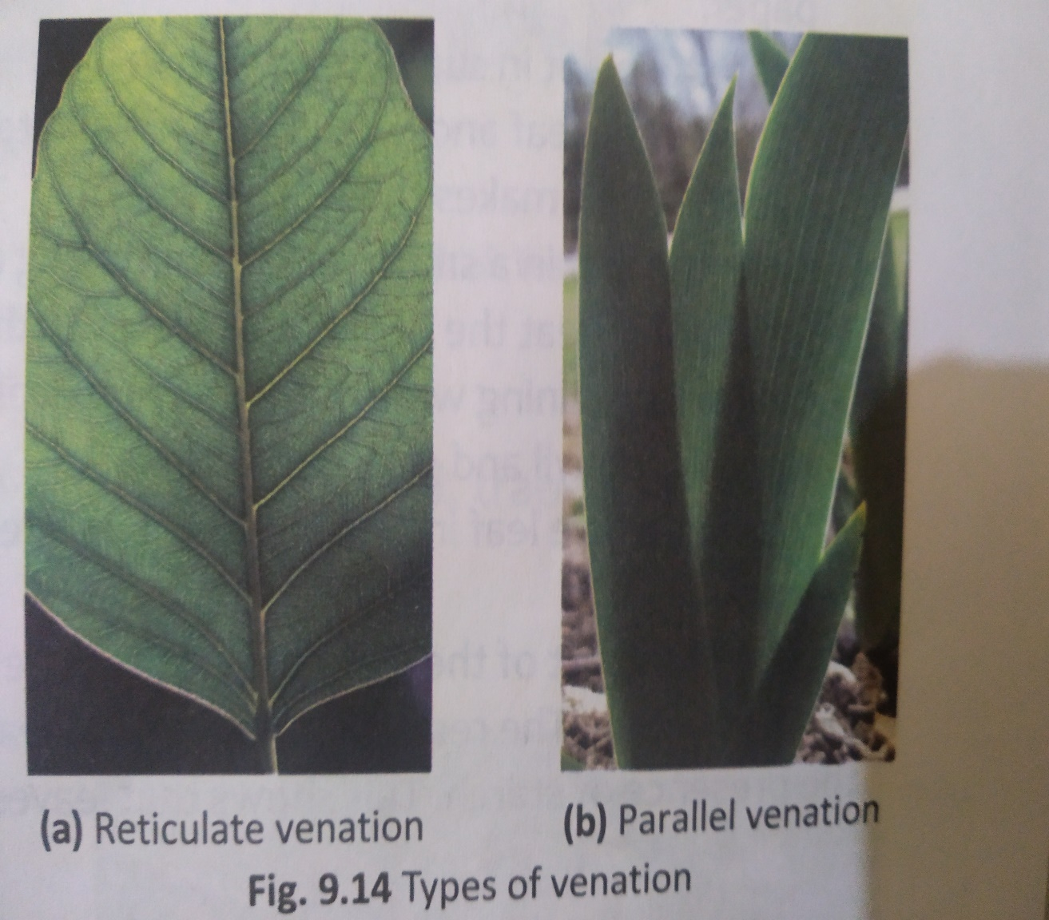

Slide 19
The Leaves
Venation:
The arrangement of veins in the leaf is known as the venation of the leaf.
(i) Reticulate venation: The network of veins in a leaf where all the veins are connected to the midrib at different points is known as Reticulate venation. e.g Mango, Jackfruit etc.
(ii) Parallel Venation: The network of veins in a leaf where all the veins run parallel to each other is known as Parallel Venation. e.g. Banana, Grass, Maize etc.
Note:
(i) Reticulate venation is seen in the leaves of plants that have Taproot.
(ii) Parallel venation is seen in the leaves of plants that have Fibrous root.

Slide 20
Functions of Leaves:
Functions of Leaves: The leaves carry out three main functions; (i) Photosynthesis (ii) Respiration and (iii) Transpiration.
(i) Photosynthesis: The process in which plants make their food from Carbon-di-Oxide and Water in the presence of Sunlight using Chlorophyll is called Photosynthesis.
Carbon-di-Oxide + Water--------- Food ( Chemical Energy) + Oxygen
(ii) Respiration: The process in which plant cells produce energy from the food prepared by the leaves is known as Respiration.
Food + Oxygen------------------→ Carbon-di-Oxide + Energy + Water
Note: Respiration takes throughout the day in every part of the plant. Photosynthesis takes place only during the day and only in the parts of the plants that have Chlorophyll
(iii) Transpiration: The process by which plants get rid of excess water in the form of water vapour through the stomata in leaves is called transpiration. Note: Transpiration helps in the absorption and movement of water through the plant. It keeps the plant cool. Transpiration also helps in the formation of clouds.

Slide 21
Modification of Leaves.
The leaves in some plants are modified to give support, store food, trap food, reproduce or defend the plant.
(i) Support: In some plants, either the entire leaf or a part of the leaf is modified into thin, delicate, closely coiled structures called tendrils that help the plant to climb. e.g. Gloriosa Lily, Wild Pea.
(ii) Storing Food: Leaves of some plants store food and water. e.g. Onion, Bryophyllum, Aloe Vera etc.
(iii) Trapping Food: Some insectivorous plants have leaves modified to catch insects. e.g. The Pitcher of the Pitcher plant is a modified leaf.
(iv) Reproduction: Some plants reproduce using their leaves. Small plants develop at the leaf margins, fall to the ground and grow into new plants. e.g. Bryophyllum.
(v) Self-Defence: The leaves of some plants are modified into spines. The spines protect the plant from being eaten by animals. e.g. Cactus.

Slide 22
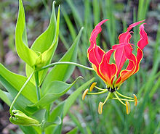
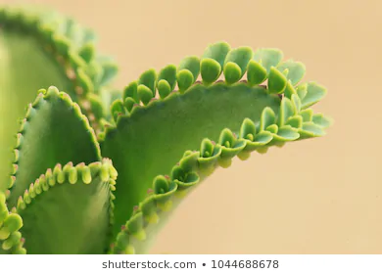
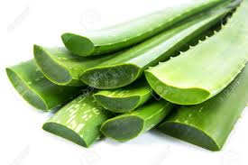

Slide 23
The flower
The flower is often the most attractive part of a plant. Some flowers have pleasant smell. The Colours and Scent of a flower help it to carry out its main function, namely, reproduction.
(i) Pedicel: The stalk of a flower is called pedicel. It has a swollen end to which the other parts of the flower are attached in layers.
(ii) Sepals: The outermost layer consists of small, green, leaf-like structures called Sepals. The sepals cover and protect the flower when it is a bud.
(iii) Petals: The colourful parts of a flower are called Petals. Petals are present inside the sepals.

Slide 24
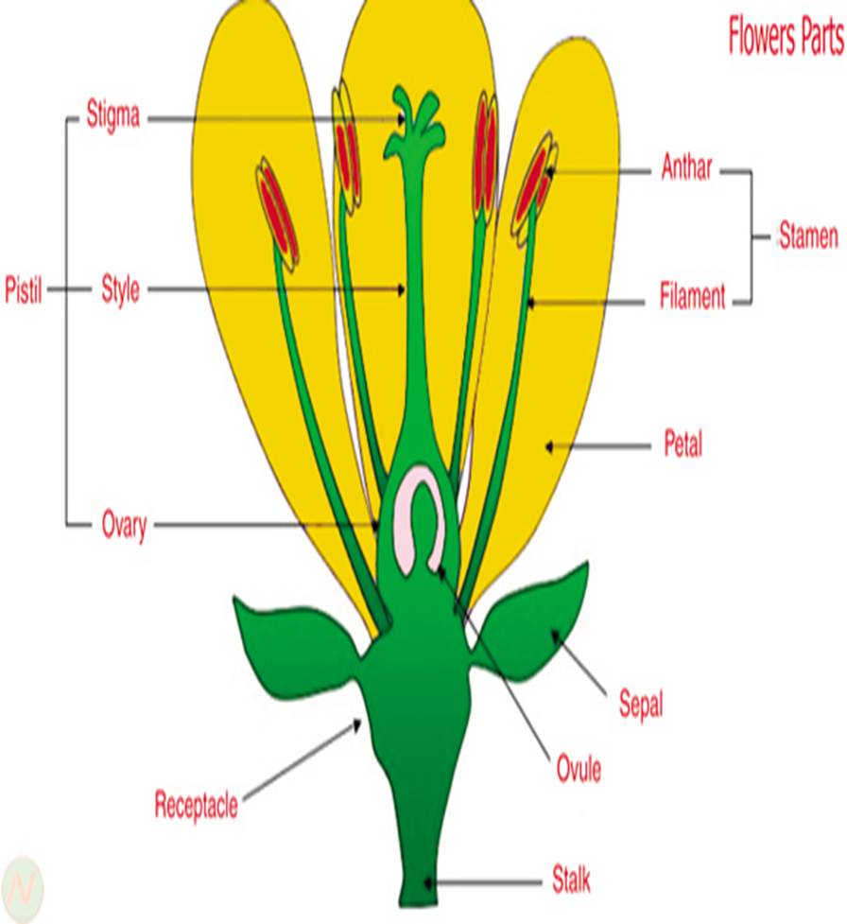
The flower
The flower is often the most attractive part of a plant. Some flowers have pleasant smell. The Colours and Scent of a flower help it to carry out its main function, namely, reproduction.
(i) Pedicel: The stalk of a flower is called pedicel. It has a swollen end to which the other parts of the flower are attached in layers.
(ii) Sepals: The outermost layer consists of small, green, leaf-like structures called Sepals. The sepals cover and protect the flower when it is a bud.
(iii) Petals: The colourful parts of a flower are called Petals. Petals are present inside the sepals.

Slide 25

Parts of Flower
(iv) Stamens: The male parts of a flower are called Stamens. Each stamen has a stalk called the Filament, with a box —like structure on top called the Anther. The anther contains powdery particles called pollen Grains.
(v) Pistil: The female part of the flower is called Pistil. The pistil has three parts. The Ovary is attached to the base of the flower and contains the Egg Cells or Ovules. The top of the pistil is the Stigma, which is sticky. The ovary and the stigma are connected through a tube-like structure called the Style.

Slide 26
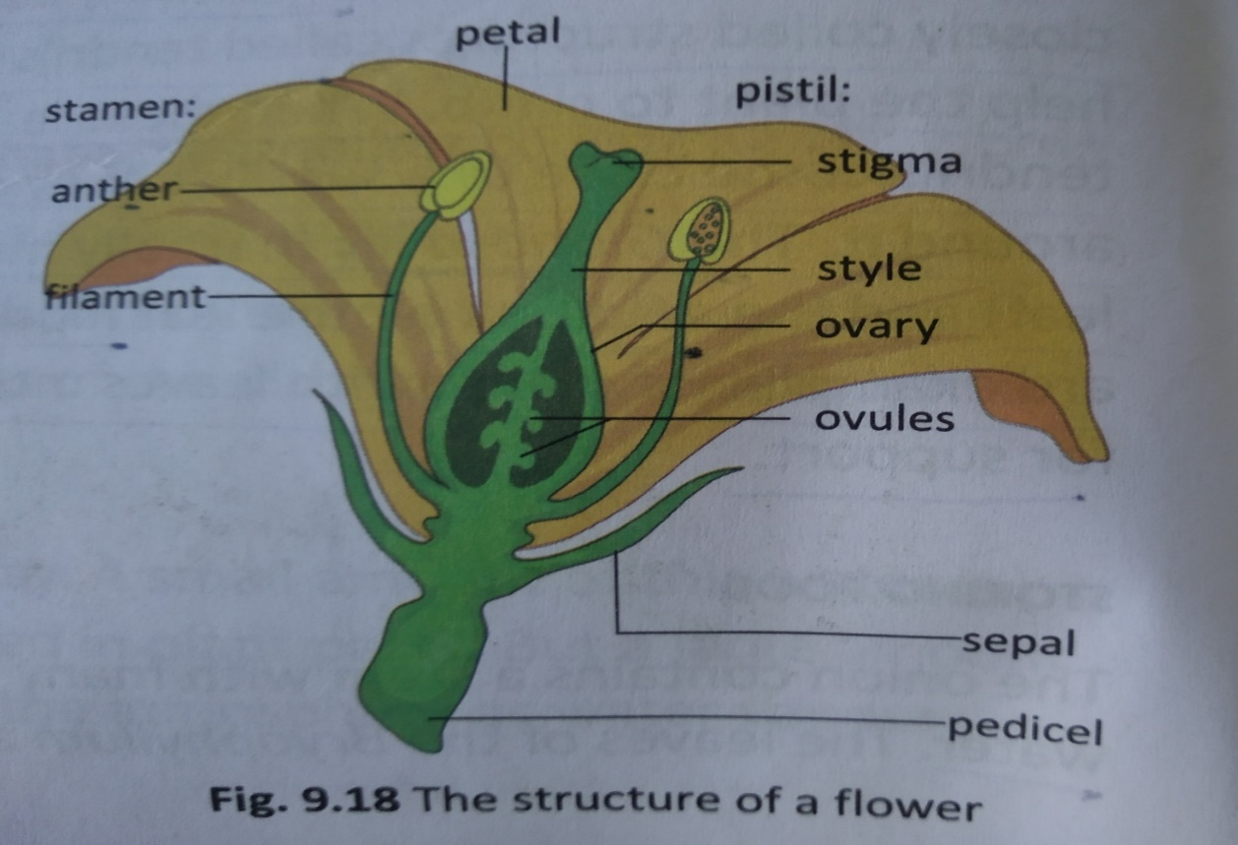
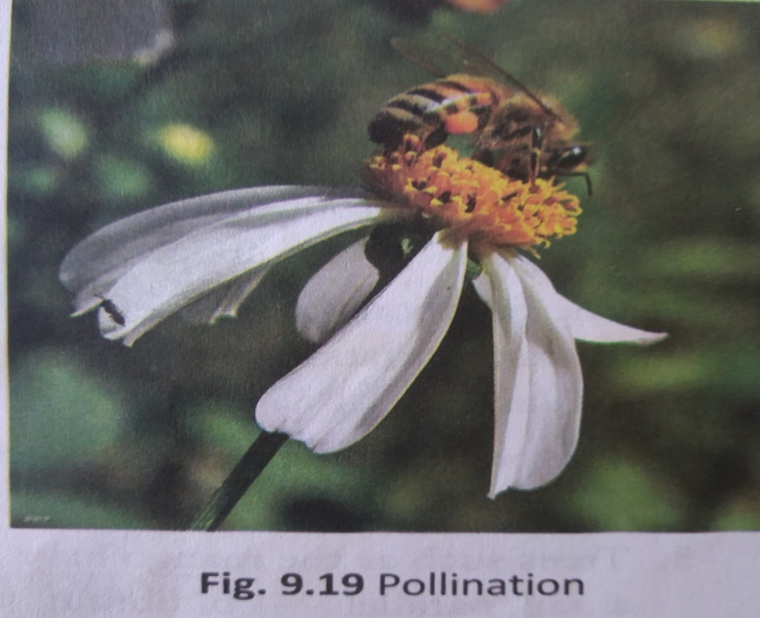
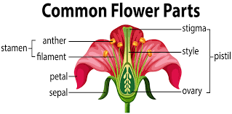

Slide 27
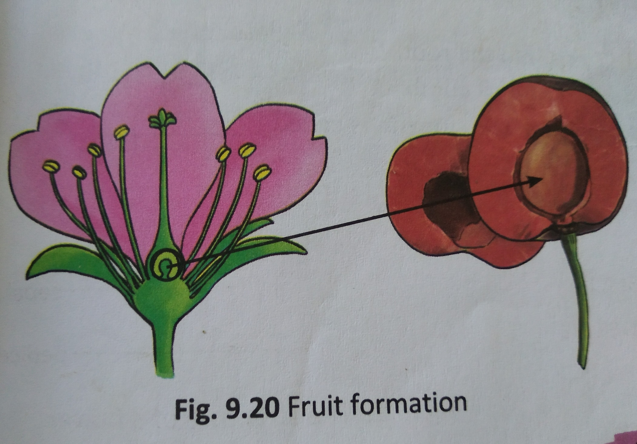

Slide 28
Pollination:
Pollination: The transfer of pollen grains from the anther to the stigma is called Pollination.
(I) Self-Pollination: The pollination in which the pollen grains are transferred from the anther to the stigma of the same flower or another flower of the same plant is known as self-pollination.
(ii) Cross-Pollination: The pollination in which the pollen grains are transferred from the anther of one flower in one plant to the stigma of another flower in another plant of same kind is known as Cross-Pollination.
Fruit Formation: After pollination, the ovules develop and become seeds. The sepals, petals and stamens fall off. The ovary starts to store food and swells up to form the fruit. The fruit protects the seeds and helps in their dispersal. Fruits may be fleshy or dry, they may have one seed or many seeds. Under favorable conditions, the seed germinates into a seedling.

Slide 29
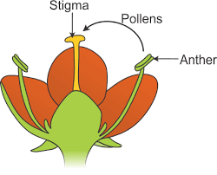
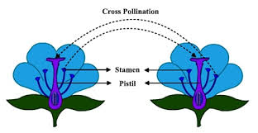
Self Pollination & Cross Pollination
(I) Self-Pollination: The pollination in which the pollen grains are transferred from the anther to the stigma of the same flower or another flower of the same plant is known as self-pollination.
(ii) Cross-Pollination: The pollination in which the pollen grains are transferred from the anther of one flower from one plant to the stigma of another flower in another plant of same kind is known as Cross-Pollination.

Slide 30
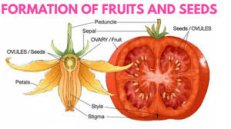
Fruit Formation
Fruit Formation: After pollination, the ovules develop and become seeds. The sepals, petals and stamens fall off. The ovary starts to store food and swells up to form the fruit. The fruit protects the seeds and helps in their dispersal. Fruits may be fleshy or dry, they may have one seed or many seeds. Under favorable conditions, the seed germinates into a seedling.

Slide 31




Slide 32


Slide 34
B. Very Short answer Questions
1. Fill in the blanks
(i) The ------------------- of the germinating seed develops into the root.
(ii) The ------------------ is a coiled structure that helps a plant to climb.
(iii) The process by which leaves send out water through the stomata is called -------------
(iv) The ------------ protect the bud
(v) The -------------- swells into the fruit after pollination.
Place the words in the correct column.
Water, Carbon-di-oxide, Energy, Oxygen, Food, Sunlight
Process | What is needed | What is formed
Photosynthesis
Respiration

Slide 35
C. Short answer Questions
1. Pick the odd one out in each case. Give reasons for your answers.
(i) Turnip, Ginger, Radish, Sweet Potato
(ii) Spines, Suckers, Pneumatophores, Nodules
(iii) petals, sepals, Chlorophyll, Pistil
2. Give the definitions of the following:
(i) Shrubs (ii) Climbers (iii) Radicle
(iv) Taproot system (v) Shoot system (vi) Fibrous root system
(vii) Prop root (viii) Clasping roots (ix) Pneumatophores
(x) Plumule (xi) Tendrils (xii) Venation
(xiii) Reticulate venation (xiv) Photosynthesis (xv) Parallel venation
(xvi) Respiration (xvii) Pollination (xviii) Transpiration
(xix) Self Pollination (xx) Cross Pollination (xxi) Herbs
(xxii) Trees (xxiii) Creepers.

Slide 36
Two marks questions
1. Give reasons as to why the Banyan tree has Prop roots?
2. Give reasons as to why the Cucumber tree has Clasping roots?
3. State the function of Prop roots.
4. State the function of clasping roots.
5. What is a Tendril?
6. Why Transpiration is useful?
7. What is the importance of Photosynthesis?
8. Why do plants respire?
9. What are Sepals?
10. What is the function of sepals?
11. From which part of the plant can a Tendril arise?

Slide 37
Three marks questions
1. Describe the structure of the male part of the flower.
2. Describe the structure of the female part of the flower.
3. What is Pollination? Mention the role of Insects in the process of Pollination.
4. Differentiate between Self Pollination and Cross Pollination.
5. Differentiate between Respiration and Transpiration.
6. Describe the process of formation of a fruit.
7. Describe the self defence system in Cactus.
8. What do you mean by Leaf modification? Mention two leaf modifications.
9. What is Photosynthesis? Write its chemical equation.
10. What is respiration? Give its Chemical equation.
11. Differentiate between Parallel venation and reticulate venation.
12. Differentiate between Taproot system and Fibrous root system.
13. State three functions of stem.
14. What are Roots? State two functions of Root system.

Slide 38
Five marks questions
1. Describe two different kinds of root systems.
2. How will you show that roots absorb water and transport it up the stem?
3. Describe different stem modifications seen in plants.
4. Explain the functions of leaf.
5. Describe the structure of a flower with a neatly labeled diagram.
6. Draw a neatly labeled diagram of a leaf.
7. What is pollination? Why is it necessary?
8. What is Pollination? What are Self Pollination and Cross pollination?

Slide 39


Slide 40


