Slide 1
EXCRETORY PRODUCTS AND THEIR ELIMINATION

Slide 2
Ammonotelic: elimination of nitrogenous waste in the form of ammonia.(fish)
Ureotelic: elimination of nitrogenous waste in the form of urea.(Amphibia and mammalian)
Uricotelic: elimination nitrogenous waste in the form of uric acid. (Reptilia, bird and insects)

Slide 3
Excretory organs
• Protonephridia or flame cells – Platyhelminthes (Planaria), rotifers, some annelids and cephalochordates (Amphioxus)
• Nephridia: annelid.
• Malpighian tubules – insects
• Antennal gland or green glands – crustacean like prawn.

Slide 4
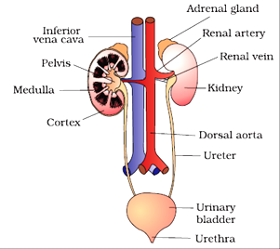
HUMAN EXCRETORY SYSTEM
Human excretory system consists of
A pair of kidney
A pair of ureters
A urinary bladder
A urethra
thoracic vertebra close to dorsal inner wall of the abdominal cavity.
Each kidney measures 10-12 cm in length, 5-7 cm in width, 2-3 cm in thickness.
Towards the centre of inner concave surface is a notch, called hilum through which ureters, blood vessel and nerves enter into the kidney.

Slide 5
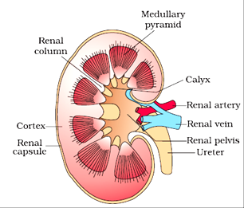
HUMAN EXCRETORY SYSTEM
Inner to hilum is a broad funnel shaped space
called renal pelvis with projections called calyces.
The outer wall of kidney is a tough capsule.
Internally the kidney is differentiated into outer cortex and inner medulla.
The medulla is divided into a few conical masses called medullary pyramids.
Pyramids projected into the calyces.
The cortex extended in-between the medullary pyramids as renal columns called columns of Bertini.

Slide 6
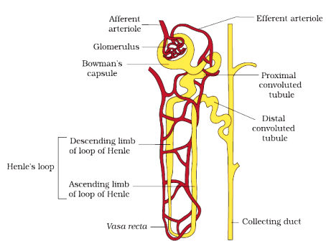
HUMAN EXCRETORY SYSTEM
Each kidney has nearly one million
complex tubular structures called nephrons.
Structural and functional unit of kidney is called nephron or uriniferous tubule.
Each nephron has two parts:
Glomerulus
Renal tubule.
Glomerulus is a tuft of capillaries formed by the afferent renal arteriole (a branch of renal artery).
Blood from the Glomerulus is collected by efferent renal arteriole.

Slide 7
HUMAN EXCRETORY SYSTEM
The renal tubule begins with a double
walled cup-like structure called
Bowman’s capsule, which encloses the Glomerulus.
Glomerulus along with Bowman’s capsule is called Malpighian body or renal corpuscles.
Bowman’s capsule followed by highly coiled proximal convoluted tubule (PCT).
PCT followed by hairpin shaped Henle’s loop with ascending and descending limb.
The ascending limb followed by another coiled tubular region called distal convoluted tubule (DCT).

Slide 8
HUMAN EXCRETORY SYSTEM
DCT of many nephron opens into a straight tube
called collecting duct.
All the collecting duct converges and opens
into renal pelvis through medullary pyramids
in the calyces.
The malpighian corpuscles, PCT and DCT of the nephron are located in the cortex but the loop of Henle dips into the upper medulla.
In some of the nephron, the loop of the Henle is very long and runs deep into the inner medulla. These nephrons are called juxta medullary nephrons.

Slide 9
HUMAN EXCRETORY SYSTEM
The efferent renal arteriole emerging from the
Glomerulus forms a fine capillary network
around the renal tubule called the peritubular
capillaries.
A minute vessel of this network runs parallel
to the loop of Henle forming‘U’ shaped vasa recta.
Vasa recta are absent or reduced in cortical nephron.
The juxta medullary nephron has juxta-glomerular apparatus, in which the DCT run close to the afferent renal arteriole.

Slide 10
MECHANISM OF URINE FORMATION :
Urine formation involves three main processes –
Glomerular filtration
Selective reabsorption
Tubular secretion.

Slide 11
Glomerular filtration or ultra filtration :
On an average 1120-1200 ml blood is filtered by the kidneys per minute.
The glomerular capillary blood pressure caused filtration of through filtration membrane.
The filtration membrane is formed by –
Endothelium of glomerular blood vessel.
The epithelium of Bowman’s capsule (podocytes)
Basement membrane of these two layers.

Slide 12
Glomerular filtration or ultra filtration :
The epithelial cells of Bowman’s capsule called podocytes are arranged in an intricate manner so as to leave some minute spaces called filtration slit or slit pores.
All constituent of plasma pass the filtration membrane except protein, hence it is called ultra filtration.
The amount of filtrate formed by the kidneys per minute is called glomerular filtration rate (GFR).
GFR is about 125 ml/min. i.e. 180 liters per day.

Slide 13
Selective reabsorption :
Out of 180 liters of filtrate formed every day 178.5 liters along with useful materials reabsorbed into the blood through peritubular capillaries leaving 1.5 liters excreted in the form of urine.
The tubular epithelial cells of different segments of nephron perform these either active or passive mechanisms.
Substance like glucose, amino acids Na+ absorbed actively.
Nitrogenous wastes are absorbed by passive transport.
Reabsorption of water also occurs passively in the initial segments of the nephron.

Slide 14
Tubular secretion :
The tubular cells adds substances like H⁺ , K⁺ and ammonia to the filtrate from the peritubular capillaries.
Tubular secretion maintains ionic and acid base balance of the body fluids.

Slide 15
FUNCTION OF THE TUBULES :
Proximal convoluted tubule (PCT) :
PCT is lined by simple Cuboidal brush border epithelium which increases the surface area for absorption.
All essential nutrients and 70-80% of the electrolytes and water are reabsorbed by this segment.
PCT also maintain the pH and ionic balance of the body fluids by selective secretion of H⁺, K⁺ and ammonia into the filtrate and by absorption of HCO₃-.

Slide 16
Henle’s Loop :
This region plays important role in maintenance of high osmolarity of medullary interstitial fluid.
The descending limb is permeable to water but impermeable to electrolytes. This concentrates the filtrates as it moves down.
The ascending limb is permeable to electrolytes but impermeable to electrolytes. Therefore as the concentrated filtrate pass upward, it gets diluted due to active or passive transport of electrolytes to the medullary fluid.

Slide 17
Distal convoluted tubules :
Selectable reabsorption of Na+ and water takes place in this segment.
DCT also capable of reabsorption of HCO₃- and selective secretion of H⁺, K⁺, and NH₃ to maintain the pH and sodium-potassium level in blood.
Collecting duct :
This duct extends from cortex to inner part of the medulla.
Large amount of water could be reabsorbed from this region to produce concentrated urine.
This segment allow small amount of urea into the medullary interstitium to keep up the osmolarity.

Slide 18
MECHANISM OF CONCENTRATION OF FILTRATE :
Mammals have the ability to produce concentrated urine.
The Henle’s loop and vasa recta plays significant role in concentrating urine.
The flow of filtrate in two limb of Henle’s loop and blood flow in two limbs of vasa recta are in opposite direction hence form counter current.
The proximity between the Henle’s loop and vasa recta, as well as the counter current in them help in maintain an increasing osmolarity towards the inner medullary interstitium, i.e. from 300 mOsmolL-1 in the cortex to about 1200 mOsmolL-1 in the inner medulla.

Slide 19
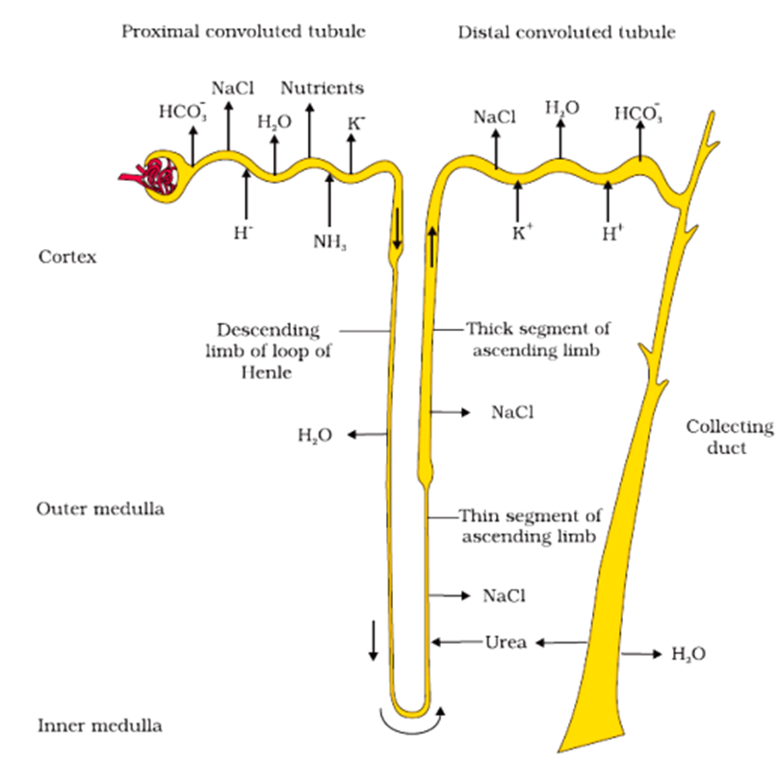

Slide 20
MECHANISM OF CONCENTRATION OF FILTRATE :
The gradient is mainly due to NaCl and urea.
The NaCl actively transported from the ascending limb of Henle’s loop is exchanged by the ascending portion of the vasa recta.
NaCl is returned to the interstitium by the ascending portion of vasa recta.
Small amount of urea enters the thin segment of ascending limb of Henle’s loop which is transported back to the interstitium by the collecting tubule.
This above described transport of substances facilitated by the special arrangement of Henle’s loop and vasa recta is called the counter current mechanism.
This mechanism helps to maintain a concentration gradient in the medullary interstitium, that promote easy passage of water from the collecting duct, leads to formation of concentrated urine.

Slide 21
REGULATION OF KIDNEY FUNCTION :
Regulation by ADH :
Osmoreceptors present in the hypothalamus are activated by the change of blood volume, body fluid volume and ionic concentration.
An excessive loss of body fluid activates the Osmoreceptors of hypothalamus to release antidiuretic hormone (ADH) or vasopressin from the neurohypophysis.
ADH facilitates active reabsorption of water from the DCT, preventing dieresis.
An increase in body fluid volume can switch off the Osmoreceptors and suppress the release of ADH, promoting dilute urine formation.
ADH also constricts the afferent renal arteriole in increase the blood pressure in the other hand to maintain the GFR.

Slide 22
REGULATION OF KIDNEY FUNCTION :
Regulation by JGA (Juxta Glomerular Apparatus) :
A fall in glomerular blood flow/glomerular blood pressure/GFR can activate the Juxta Glomerular cells to release renin.
Renin converts angiotensinogen in blood to angiotensin I and further to angiotensin II.
Angiotensin II constricts afferent renal arteriole to increase glomerular blood pressure and thereby GFR.
Angiotensin II also stimulates adrenal cortex to release aldosterone.
Aldosterone cause active reabsorption of Na+ and water from the distal part of the tubule, this increase in blood volume and GFR.
This complex mechanism is called RAAS (Renin angiotensin aldosterone system).

Slide 23
REGULATION OF KIDNEY FUNCTION
Regulation by ANF :
An increase in blood flow to the atria of the heart due RAAS cause the release of Atrial Natriuretic Factor (ANF).
ANF can cause vasodilation (afferent renal arteriole) and thereby decrease the blood pressure.
ANF also stop the release of renin hence stops RAAS.

Slide 24
MICTURITION :
The expulsion of urine from the urinary bladder. It is a reflex process but can be controlled voluntarily to some extent in grown up children and adults.
The CNS (Central Nervous System) sends the signal which causes the stretching of the urinary bladder when it gets filled with urine.
In response, the stretch receptors on the walls of the bladder send signals to the CNS. The CNS passes on motor massage to initiate the contraction of smooth muscles of the bladder and simultaneous relaxation of the urethral sphincter causing the release of urine.
An adult human excretes on an average 1 to 1.5 liters of urine per day.
On an average 25-30 gram of urea is excreted out per day.
Presence of Glucose is called Glycosuria.
Presence of Ketone bodies in urine called Ketoneuria.
Glycosuria and Ketoneuria are the indication of Diabetes mellitus.

Slide 25
Role of other organs in excretion :
Lungs - removes CO₂ (18L/day) and water.
Liver - secretes bilirubin, biliverdin etc. helps to eliminate these substances along with cholesterol, vitamins, drugs and degraded steroid hormones through digestive wastes.
Sweat and sebaceous glands - These glands of skin help to eliminate small amount of urea, NaCl and lactic acid etc. through sweat while sebaceous glands help to eliminate some substances like steroids, hydrocarbons and waxes through sebum.
Saliva - It can help to eliminate small amount of nitrogenous wastes.

Slide 26
Disorders of Excretory system :
Uremia - The accumulation of urea in blood due to malfunctioning of kidney.
Hemodialysis - The process of removal of urea from the blood artificially. In this process the blood from an artery is passed into dialysing unit after adding an anticoagulant like heparin. The blood passes through coiled cellophane tube surrounding by dialysing fluid. The nitrogenous wastes from the concentration gradient and the blood become clear. This blood is pumped back to the body through vein after adding anti-heparin to it.
Renal calculi - The formation of insoluble mass of crystallised salts (oxalates or phosphates of calcium.
Glomerulonephritis - Inflammation of glomeruli of kidney.

