Slide 1
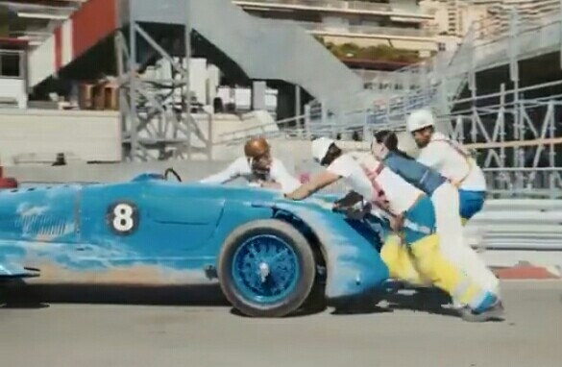
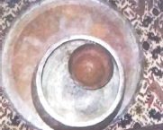
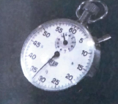
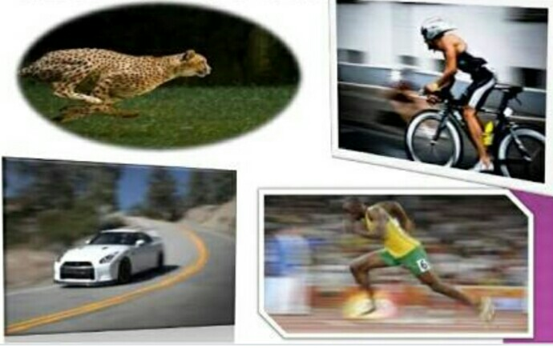
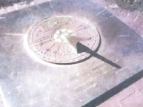
Chapter- 13
Time and
Motion

Slide 2
Period-1

Slide 3
Introduction:
As time passed humans made
devices such as Sundials, Candle
Clocks, Oil Lamps, Water Clocks and Sand Clocks to measure time. While these instruments made measuring time easier, they were not accurate.
All of us need to be able to tell the time and track time intervals so that we can be on time for events and know how long it takes to do something.
In ancient times, humans observed events like the movement of the Sun, Moon, Stars and Planets to keep track of time.
They also noticed changes in the length of shadows as the day progressed.
They noticed changes in their environment like seasonal winds, rain, the flowering of trees and the falling of leaves at different times of the year. They observed that these events occurred at regular intervals of time .

Slide 4
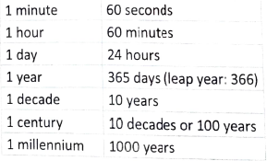
Introduction:
Units of Time:
The SI unit of time is the second (s).
Today, we have complex clocks that can tell us the time very accurately.
We also have stopwatches to time
specific events and alarm clocks that can be set and reset to ring at a
particular time.

Slide 5
Extra Information:
Expressing a Measurable Quantity:
A measurable quantity is expressed with the help of (a) Magnitude and (b) Unit and sometimes (c) Direction also.
e.g. 5 kg Dal, 500 ml Mustard Oil, 2 km towards North direction etc.
Scalar Quantity:
A measurable quantity which can be expressed with the help of magnitude and unit is known as Scalar quantity.
e.g. 5 kg Dal, 2 l Mustard Oil.
Vector Quantity:
A measurable quantity which can be expressed with the help of magnitude, unit and direction is known as Vector quantity.
e.g. 2 km towards North direction, 10 m towards South direction etc.

Slide 6
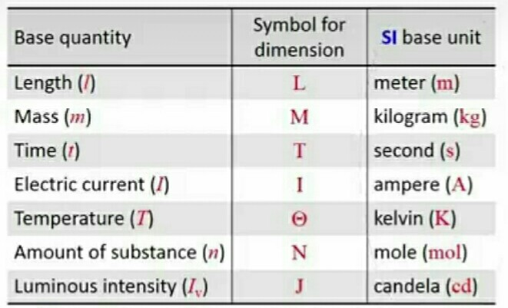
Extra Information:
Standard International (SI) system of unit of measurement:
Systems of units of measurement:
CGS, MKS & FPS systems of units of measurement:

Slide 7
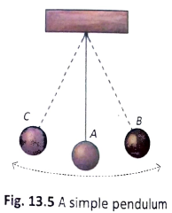
The Simple Pendulum:
Periodic Motion:
The motion which repeats after regular interval of time is known as Periodic Motion.
e.g. The Earth takes around 365 days to complete a revolution of the Sun. This action repeats itself every 365 days and is therefore an example of periodic motion.
The motion of a Swing.
The Simple Pendulum:
A simple Pendulum is a small mass hung from a fixed point such that it can swing freely under the influence of gravity.
The to and fro motion of a pendulum is an example of periodic motion. Most simple pendulums consist of a small metallic ball called a Bob hung on a string or wire.

Slide 8
The Simple Pendulum:
The Simple Pendulum:
Length of Pendulum:
The distance between the point from which the thread is hung and the centre of the bob is the length of the pendulum. Length of the pendulum is denoted by L or l.
Mean Position:
The position of the pendulum when it is not moving is called its Mean Position .
Oscillation:
One complete to-and-fro movement of the pendulum is called an Oscillation.
The pendulum in Fig. 13.5 completes
one oscillation when the bob starts from point A, moves to point B and then to point C at the other end and finally comes back to point A.
Time Period :
The time taken by a pendulum to complete one oscillation is called its Time Period. Time Period is denoted by T.

Slide 9
Self Assessment-1
1. Mention the SI unit of time?
2. What is a Scalar Quantity?
3. What is a Vector Quantity?
4. What is CGS system of unit of measurement?
5. What is MKS system of unit of measurement?
6. What is FPS system of unit of measurement?
7. What is a Periodic Motion?
8. What is Length of Pendulum?
9. What is Mean Position of a Simple Pendulum?
10. What is an Oscillation?
11. What is Time Period?
12. State the formula of Time Period of a Simple Pendulum.
13. On what factors does the Time Period of a Simple Pendulum depend?
14. How will the time period of a simple pendulum change if the mass of the Bob is doubled?

Slide 10
Period-2

Slide 11
The Simple Pendulum:
The Simple Pendulum:
The time period of a pendulum remains the same for 10, 20 and 30 oscillations.
The time period of a simple pendulum of a fixed length remains constant.
When the length of the string of a simple pendulum is increased, the time period of the simple pendulum also increases.
The time period of a simple pendulum does not depend upon the mass of the bob of the pendulum.
The value of the time period of same simple pendulum varies from place to place on the surface of the Earth.
The time period of a simple pendulum, T can be mathematically expressed as
T = 2π Square Root (l/g)
Where, l = Length of the Pendulum
g = Acceleration due to gravity of
Earth

Slide 12
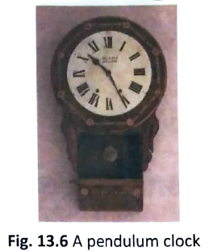
The Simple Pendulum:
The length of a simple pendulum can be altered to get a certain time period. This property of a pendulum is used to make pendulum clocks.
Modern clocks also work on the principle of oscillation.
We now use electronic clocks that contains a material called quartz.
Quartz crystals vibrate periodically. These vibrations or oscillations are used to measure time very accurately.
Atomic clocks are used for extremely accurate timekeeping. They use the vibrations of atoms to keep time.
A simple pendulum whose time period is exactly 2 s is called a second pendulum. The length of pendulum of a second pendulum is approximately 100 cm.

Slide 13
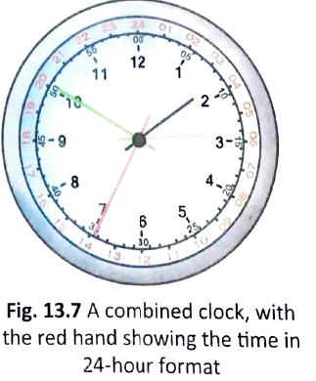
The 12 Hour Clock and 24 Hour Clock:
A day is divided into 24 hours, but a regular clock shows only 12 hours.
The suffix 'a.m.' is added to indicate a time in the morning and 'p.m.' is added to indicate a time in the evening.
For a more precise and universal way of telling time, the 24-hour clock is used. In this clock, time is indicated in hours and minutes, with a colon between the numbers. In the 24-hour format, 12.00 a.m. (midnight) is considered to be 00:00 (hours).

Slide 14
The 12 Hour Clock and 24 Hour Clock:
Any time between 12 a.m. and 12.59 a.m. can be denoted by replacing the 12 by 00. For example, 12.30 a.m. is written as 00:30.
Any time between 1 a.m. and 12.59 p.m. can be denoted as it is, adding a zero before single-digit numbers. For example, 3 a.m. is written as 03 :00 and 12.10 p.m. is written as 12:10.
Any time after 12.59 p.m. is denoted by adding 12 to the number of hours. For example 3 p.m. is written as 15:00 and 6 p.m. is written as 18:00.

Slide 15
Self Assessment-2
1. State the formula of Time Period of a Simple Pendulum.
2. On what factors does the Time Period of a Simple Pendulum depend?
3. How will the time period of a simple pendulum change if the mass of the Bob is doubled?
4 How will the time period of a simple pendulum change if the length of the pendulum is doubled?
5. Name the property of a pendulum used to make pendulum clocks.
6. Name the material present in Electronic Clocks.
7. What is a second pendulum?
8. What is the approximate length of pendulum of a second pendulum.
9. What is a 12 Hour Clock?
10. What is a 24 Hour Clock?
11. What are the uses of a.m. and p.m. in a 12 Hour Clock?
12. Express 3:30 p.m. in 24 Hour Clock.
13. Express 15:00 hour in 12 Hour Clock.
14. Express 12:00 a.m. in 24 Hour Clock.
15. Express 12:00 p.m. in 24 Hour Clock.

Slide 16
Period-3

Slide 17
Motion and Speed:
Motion:
A person looking out of a window observes a flying bird to be moving but a tree to be stationary. This is because the position of the bird changes with respect to the person whereas the position of the tree does not change.
An object is said to be in motion if its position changes with respect to a reference point.
Some objects move faster than others . For example, an aeroplane is faster than a car or motorboat, which are faster than a cycle. However, the fastest aeroplane is 30 times slower than the Earth moving around the Sun!
Speed:
Speed is a measure of how fast or slow
an object is moving.
The speed of an object is the distance it travels in a unit of time .
Speed is calculated by dividing the distance travelled by the object by the time it takes to travel the distance.
For example, if an aeroplane travels 2400 km in 3 hours, the speed of the plane can be expressed as
Speed = Distance/ Time
= 2400 / 3
= 800 km/h (kilo metres per hour) .
The MKS/SI unit of speed is metres per second (m/s).

Slide 18
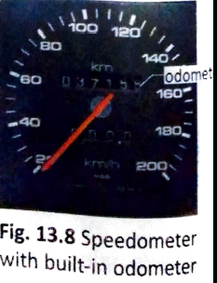
Speed:
The speed of moving vehicles is recorded and displayed using an instrument called the speedometer.
The distance covered by a moving vehicle is recorded and displayed using an instrument called the Odometer.
The speedometers of most modern vehicles have built- in odometers.
To convert the unit of speed from m/s to km/h, we must convert metres to kilometres and seconds to hours. We use the following formula:
To convert the unit of speed from km/h to m/s, we must convert kilometres to metres and hours to seconds. We use the following formula:

Slide 19
Average Speed:
An object may not move at the same speed throughout its entire journey. For example, it can move at a speed of 100 km/h for the first hour of a journey and 30 km/h for the rest of the journey.
When the speed of an object moving along a straight line keeps on changing, its motion is said to be Non-Uniform.
If an object moving along a straight line covers equal distances in equal intervals of time, it is Uniform Motion. The speed of the object remains the same throughout the journey.
When we say that a car moves at a speed of 50 km/h, we do not mean that its speed is uniform throughout its journey; it starts, speeds up or slows down depending on the
traffic, and then comes to a stop at the end of the journey. We mean that the average speed of the car is 50 km/h
Average speed is calculated by dividing the total distance travelled by the total time taken.
If an object is in uniform motion, then its average speed is the same as its actual speed .

Slide 20
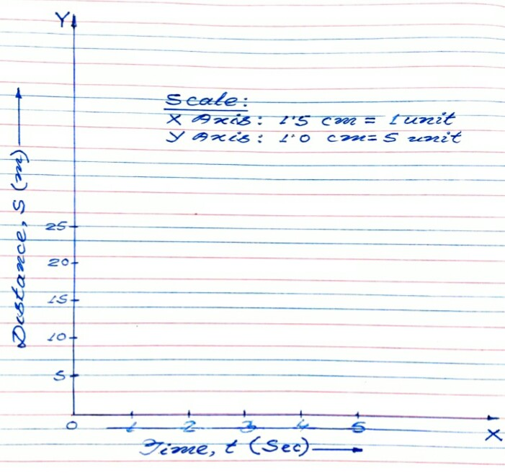
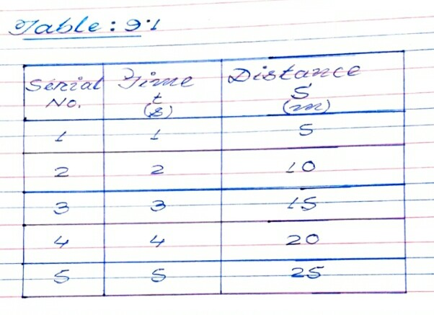
Distance-Time Graph:
Let us consider an object moving along a straight line.
Let it travel 5 m in the first second, 5 m more in the next second, 5 m in the third second and 5 m in the fourth second.
In this case, the object covers 5 m in each
second.

Slide 21
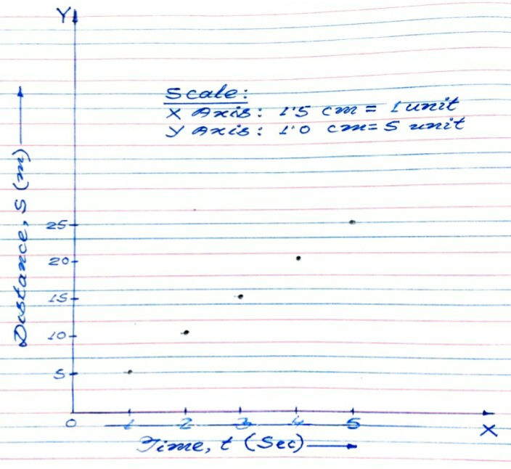
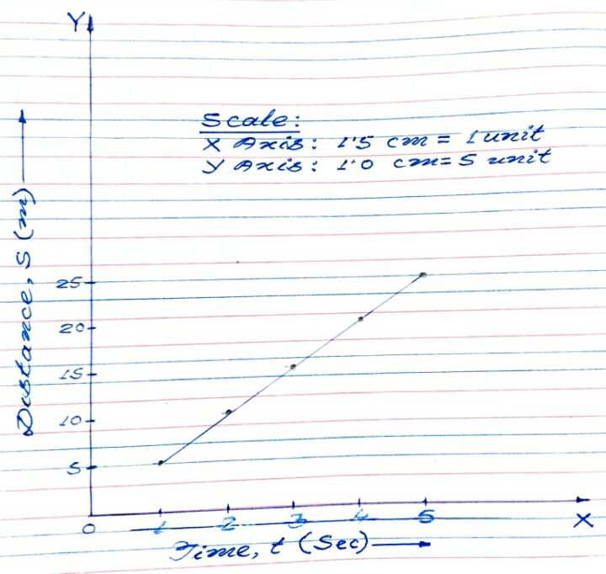
Distance-Time Graph:

Slide 22
Self Assessment-3
1. What is Motion?
2. What is Speed?
3. What is the CGS unit of measurement of Speed?
4. What is the MKS/SI unit of measurement of Speed?
5. What is Uniform Speed?
6. What is Non-Uniform Speed?
7. Why is it not possible for an object to continuously move in Uniform Motion?
8. Convert 1 m/s into km/h.
9. Convert 1 km/h into m/s.
10. What is a Speedometer?
11. What is an Odometer?
12. What is a Distance-Time Graph?
13. Justify whether Speed is a Scalar Quantity or a Vector Quantity?
14. What is Average Speed?

Slide 23
Period-4

Slide 24
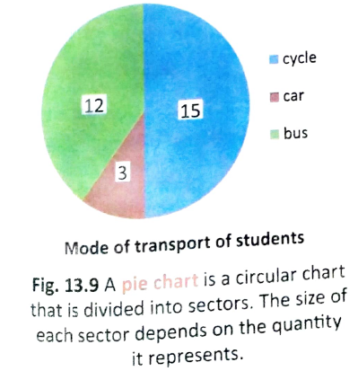
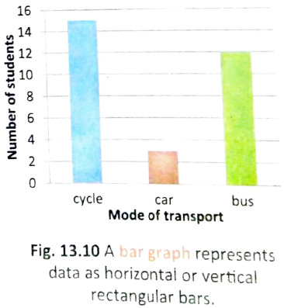
Graphical Representation of Data:
Data can be presented in various ways to make the numbers easy to understand for the reader.
There can be two or more different ways of representing the same data.
Bar Graph, Pie Chart and Line Graph are few ways by which we can represent a set of data graphically.
Line graph is an effective way to understand the motion of an object. The distance travelled is compared to the time taken by the object to travel that distance . This helps us t o find out the speed of the object

Slide 25
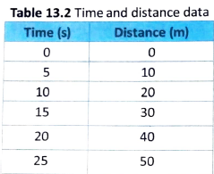
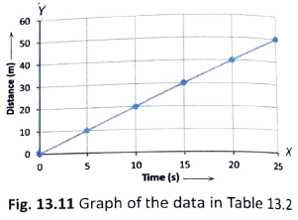
Distance-Time Graph:
Drawing a Line Graph:
A Line graph has a horizontal X-axis and a Vertical Y-axis.
In a Line graph representing a motion of an object where the Distance and time required to be plotted, Time is commonly represented on the X-axis and Distance on the Y-axis.
The point at which the two axes meet is the Origin or Reference Point.
A point on the graph indicates both a point in time (represented by the corresponding reading on the X-axis) and the distance covered at that time (represented by the corresponding reading on the Y-axis).
For the given Table:13.2, Six points with co-ordinates (0,0), (5,10), (10,20), (15, 30), (20, 40), (25, 50) are plotted.

Slide 26
Distance-Time Graph:
Drawing a Line Graph:
The set of points can be connected to form a line that shows the relationship between the Distance and Time.
The Line Graph representing the motion executed by an object is a straight line.

Slide 27
Distance-Time Graph:
Drawing a Distance-Time Graph:
If we have a set of data for distance covered over time (as shown in Table 13.2), we can construct a graph using the data.
Looking at the data in Table 13.2, we have observed that the object has travelled 10 m in 5 s.
Let us look for the point on the X-axis that represents 5 s.
Let us draw a line parallel to the Y-axis through this point (see Fig. 13.11).
Next, look for the point on the Y-axis that represents 10 m.
Draw a line parallel to the X-axis through this point.
The two lines intersect at a point. This point represents the first set of values on the graph.
Let us do this for all the values for time and distance. We will get a point for each different set of values.
These points can be connected to form a line. This line is called a distance-time graph. If the line is a straight line, the object is said to be in uniform motion . The data given in Table 13.2 represent uniform motion.

Slide 28
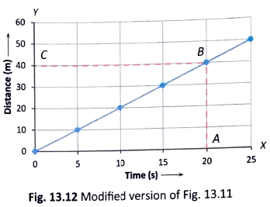
Distance-Time Graph:
Let us draw a line parallel to the Y-axis (or perpendicular to the X-axis) through this point. Let this line intersect the graph at point B.
Let us draw a line parallel to the X-axis through point B. Let it intersect the Y-axis at point C.
The value on the Y-axis at point C is the distance travelled by the object. In 20 s, the object would have travelled 40 m.
Reading a Distance-Time Graph:
It is easy to understand the motion of an object from a graph.
Table 13.2 only tells us the distance by which the object has moved in certain time intervals. But a graph can help us to find out where the object is at any point in time if its motion is Uniform.
For example, let us try to find the distance covered by the object in 20 s without referring to Table 13.2. Let us refer to Fig. 13.12 which is a modified version of Fig. 13.11.
Let us find the point on the X-axis that represents 20 s. Let this point be A.

Slide 29
Self Assessment-4
1. Name three modes of graphical representation of data?
2. What is a Bar Graph?
3. What is Pi Chart?
4. Name the parameters required to represent a motion graphically.
5. What is a Line Graph?
6. List the steps followed while drawing a Line Graph.
7. What is a Distance-Time Graph?
8. Name the quantity that is plotted along X-axis in a Distance-Time Graph.
9. Name the quantity that is plotted along Y-axis in a Distance-Time Graph.
10. List the steps followed while drawing a Distance-Time Graph.
11. How can we read a Distance-Time Graph?
12. What is the importance of scaling in drawing a graph?

Slide 30
Period-5

Slide 31
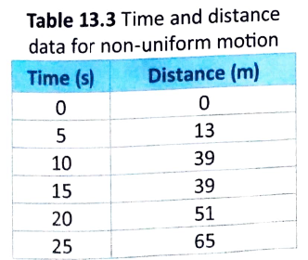
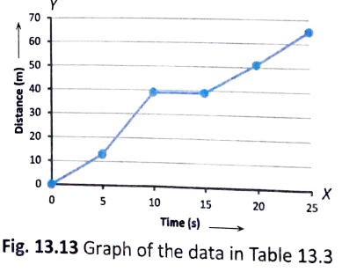
Distance-Time Graph for Non Uniform Motion:
If an object moving along a straight line covers unequal distances in equal intervals of time then the motion of the object is known as Non Uniform Motion.
The Time and Distance data for the motion executed by an object is listed in Table:13.3. If we look at the table, we will be able to observe that unequal distances are covered in equal intervals of time.
Let us draw a Line Graph to represent the motion executed by the object.
Time measured in seconds is selected to be plotted along X-Axis with proper scale.
Distance measured in meters is selected to be plotted along Y-Axis with proper scale.

Slide 32
Distance-Time Graph for Non Uniform Motion:
Six points with co-ordinates (0,0), (5,13), (10,39), (15, 39), (20, 51), (25, 65) are plotted.
The plotted points are joined to get the Distance-Time Graph (Fig. 13.13).
The Distance-Time Graph representing the motion executed by an object is not a straight line.
If an object does not move, the distance travelled by it does not change. The distance time graph for a stationary object is a line parallel to the axis that represents time.
In this case, it is parallel to the X-axis, as seen between 10 s and 15 s.
We can conclude that Distance-Time Graph of an object executing Non Uniform Motion is a Curve line.

Slide 33
Self Assessment- 5
1. What is Non Uniform Motion?
2. Draw a Distance-Time Graph for the following tables.
Time, t (sec) | Distance, s (m)
0 | 5
4 | 15
8 | 25
6 | 35
12 | 45
Time, t (sec) | Distance, s (m)
0 | 0
3 | 10
6 | 30
9 | 30
12 | 50

