Slide 1
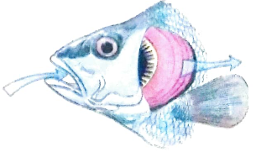
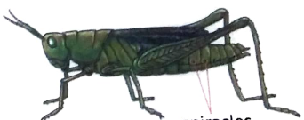
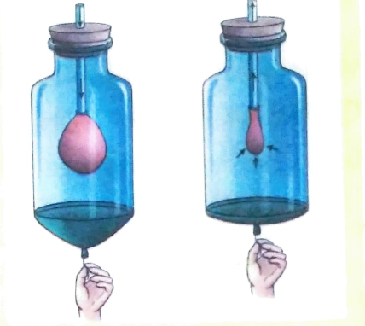
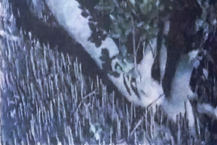
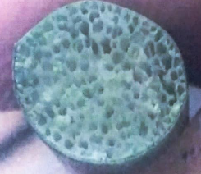
Chapter-10
Respiration: The Path to Energy

Slide 2
Period:1

Slide 3
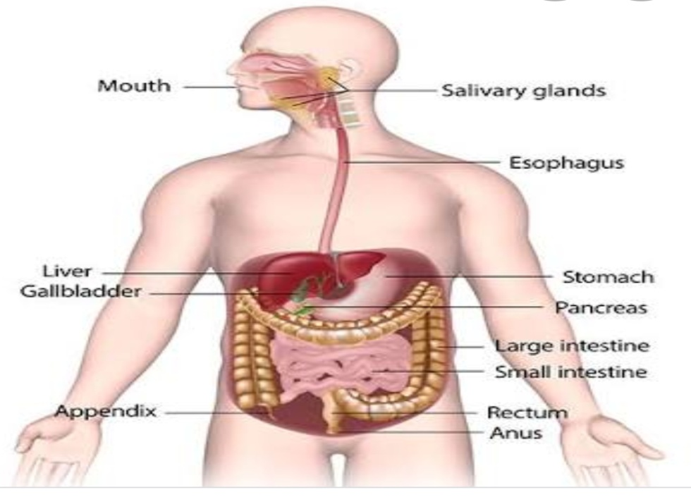
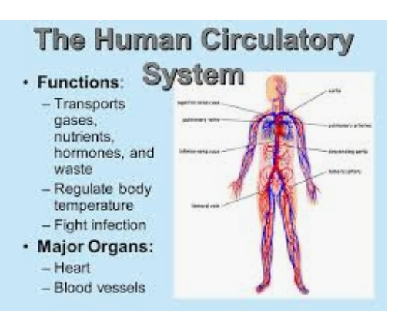
Introduction:
Nutrients get separated from the food during the process of digestion.
We require energy to carry out different day to day life activities.
Can we get energy from the nutrients extracted from food?
How and where does our body produce energy from the absorbed nutrients?

Slide 4
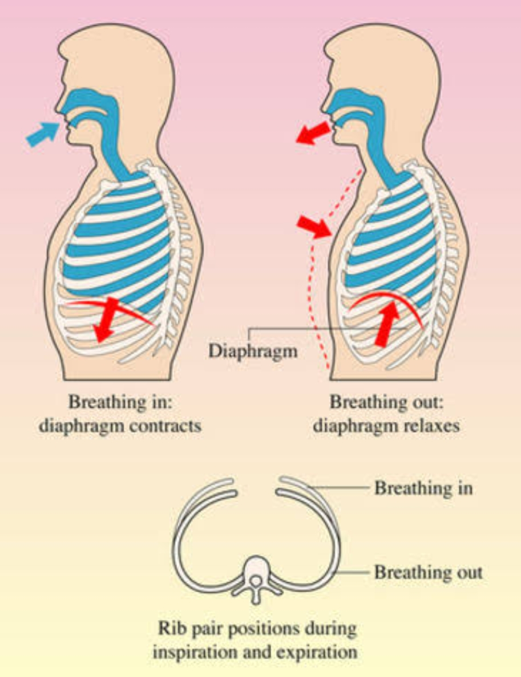
How do we get Energy
The number of times an organism breathes in a minute is called its Breathing Rate or Respiratory Rate.
The average Breathing Rate of an adult human at rest is 12-30 times a minute.
All the energy that our body needs comes from the food we eat.
After food is digested, nutrients (the products of digestion) are carried to all the cells in the body by blood.

Slide 5
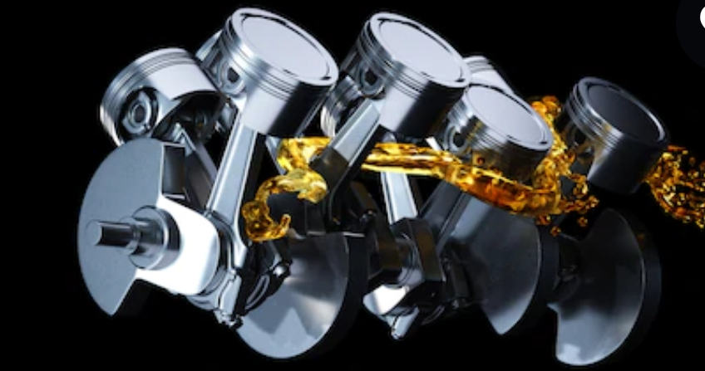
How do we get Energy
These nutrients (such as glucose) are broken down in the cells, using oxygen that we get by breathing, into carbon dioxide and water, releasing energy.
The life process which is involved in the release of energy from food is called Respiration .
Just as the combustion of fuels like petrol gives energy to run vehicles, respiration gives us energy to live.

Slide 6
The process of Respiration involves two steps:
The first step is Breathing, which is the physical process of inhaling or taking in oxygen-rich air and exhaling or sending out air that is rich in carbon dioxide.
The second step is Cellular Respiration, which is the process that releases energy by breaking down the food molecules (nutrients).

Slide 7
Self Assessment-1
1. Name the process of obtaining nutrients from ingested food.
2. What is Breathing Rate or Respiratory Rate?
3. What is the average Breathing Rate of an adult human at rest ?
4. What is Respiration?
5. In which part of the body does Respiration take place?
6. What is Combustion?
7. Differentiate between Respiration and Combustion.
8. Name the two steps involved in the process of Respiration.

Slide 8
Period:2

Slide 9
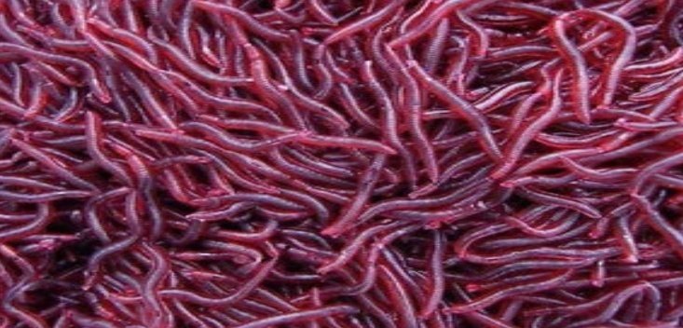
Respiratory System in Animals
Different organisms have different kind of respiratory systems to obtain oxygen.
Terrestrial animals get oxygen from air and aquatic animals use oxygen that is dissolved in water.
Since the percentage of oxygen in air (21%) is much higher than the percentage of oxygen dissolved in water (0.5% at about 30⁰C), aquatic animals breathe faster than land animals.

Slide 10
Respiratory System in Animals
Gills:
Many aquatic animals respire through special organs called gills.
In most fish, the gills are present on the side of the body and are covered by a flap.
When a fish opens its mouth, it takes in water with dissolved oxygen.
When it closes it mouth, it forces this water over the gills , which are richly supplied with blood vessels called Capillaries.
These capillaries absorb oxygen from the water and send out carbon dioxide into the water.

Slide 11
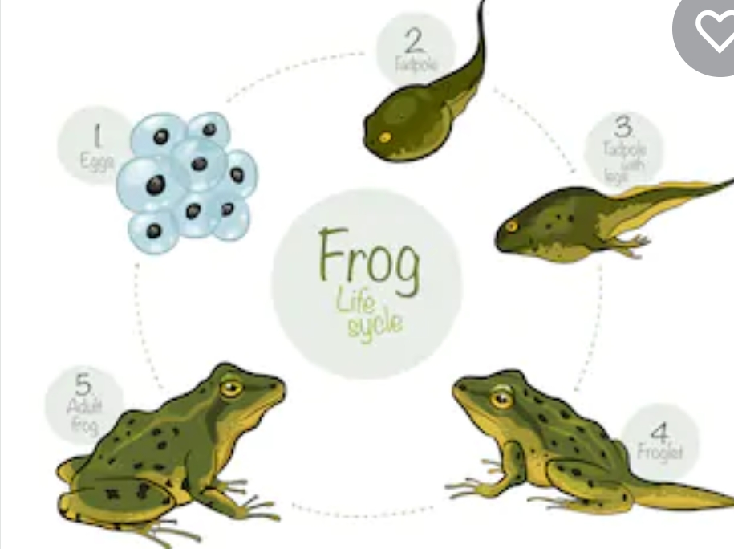
Respiratory System in Animals
(c) Lungs:
All mammals, birds, reptiles and amphibians breathe using lungs.
Tadpoles breathe through gills, but adult frogs have lungs that help them to breathe on land.
Lungfish are a type of fish that have lungs. They swim up to the water's surface, open their mouth and suck in air from above the water. These fish can live in oxygen-poor water.
(b) Skin:
Animals like Earthworms and Leeches take up oxygen using the slimy and moist surface of their skin.
Amphibians like frogs and newts use their lungs to breathe on land and their moist skin to breathe in water.
The skin is richly supplied with capillaries.

Slide 12
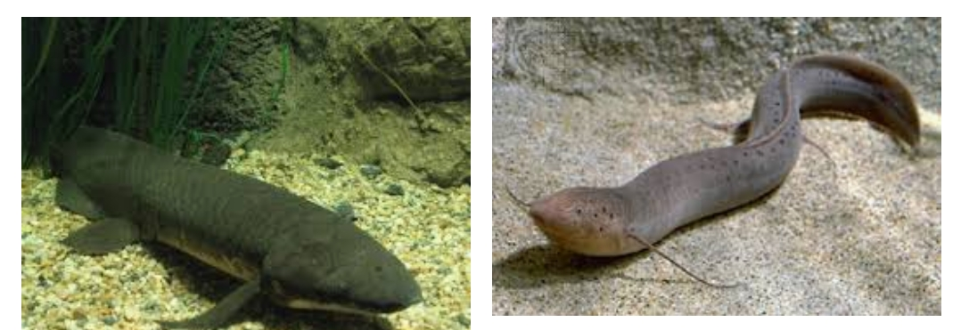
Respiratory System in Animals
(d) Spiracles:
Insects have small holes called Spiracles on the sides of their body.
These Spiracles are connected to a network of thin tubes called Tracheas.
Oxygen-rich air enters the body through the spiracles.
The inhaled air reaches different parts of the insect's body through the tracheal tubes and the oxygen is used up.
Air rich in carbon dioxide is then sent out through the spiracles.

Slide 13
Self Assessment-2
1. Where from do the Terrestrial animals get oxygen from?
2. Where from do the Aquatic animals get oxygen from?
3. Why do Aquatic animals breathe faster than land animals?
4. What is the percentage of oxygen in air?
5. What is the percentage of dissolved oxygen in water?
6. Name the organ used by fishes for respiration.
7. Name the organ used by earthworms for respiration.
8. Name the organ used by insects for respiration
9. What are Spiracles?
10. What are Tracheas?
11. How can Lungfish live in oxygen-poor water?
12. Name the organ used by Tadpoles for breathing.
13. Name the organ used by adult frogs for breathing on land.

Slide 14
Period:3

Slide 15
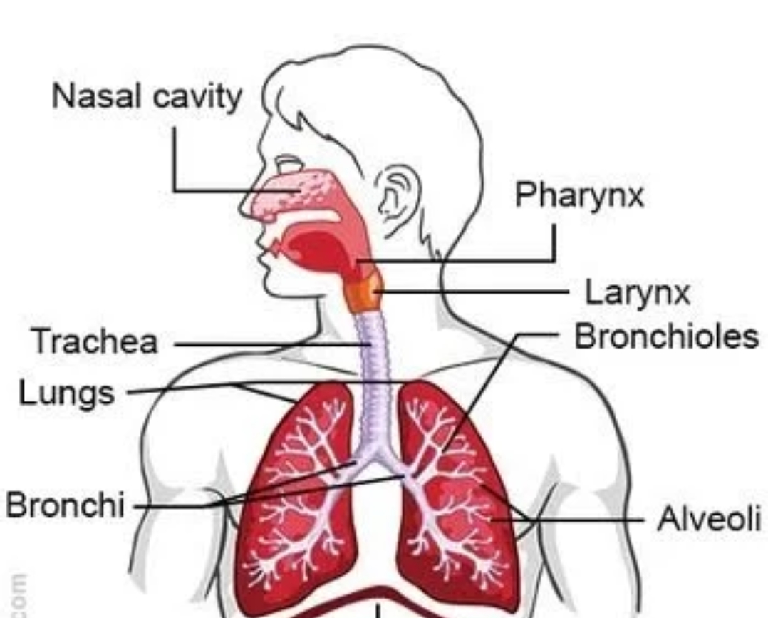
The Respiratory System in Humans:
Organs of Respiratory System:
Humans inhale and exhale air with the help of their lungs.
The lungs are two sac-like structure that lie in the chest cavity, also called the Thoracic cavity.
The lungs are protected by the ribcage.
Air is inhaled through the nostrils.
The inhaled air enters the nasal cavity.
The nasal cavity is lined with mucus and tiny hairs. They trap the dust particles present in inhaled air, so that clean air reaches the lungs.
This is why we should breathe through the nose and not through the mouth.

Slide 16
The Respiratory System in Humans:
Organs of Respiratory System:
From the nasal cavity, air passes into an organ called the Pharynx, which has two openings: (a) the Oesophagus (Food Pipe) and the Windpipe or the Trachea.
The trachea branches into two smaller tubes called Bronchi (Singular: Bronchus).
Each bronchus opens into a lung, the bronchus divides into many thin tubes called Bronchioles.
These Bronchioles enter small air sacs called Alveoli (Singular: Alveolus).
There are more than 300 million alveoli in each human lung. The alveoli are richly supplied with blood through a network of blood capillaries.

Slide 17
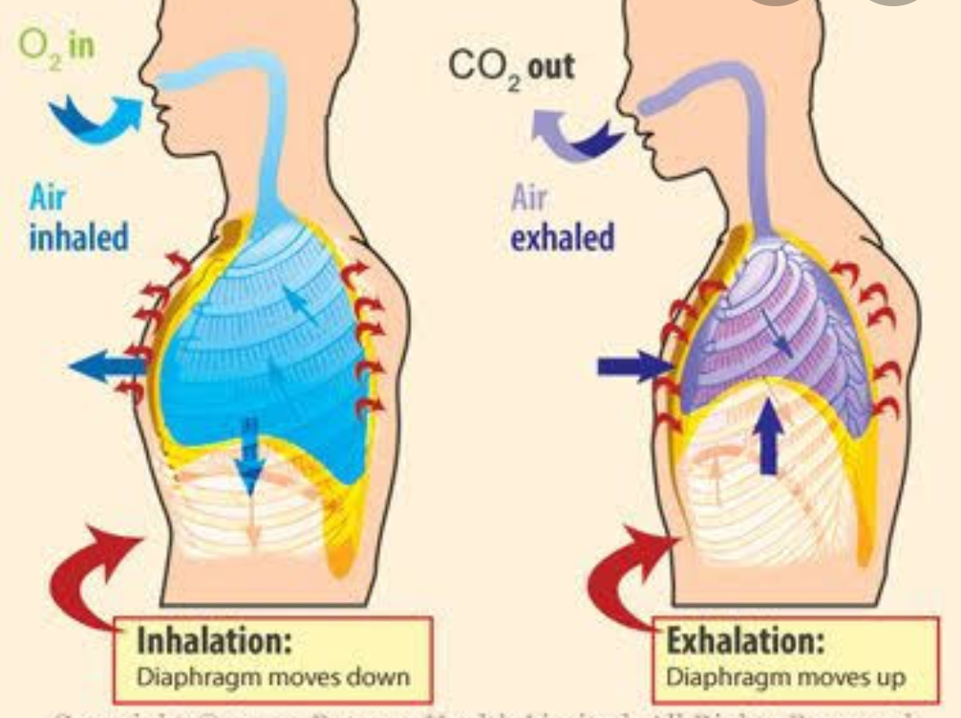
How Air Enters the Lungs:
Just beneath the lungs is a thin sheet of muscle called Diaphragm.
Inhalation:
During inhalation, the diaphragm contracts and moves down.
The muscles attached to the ribs contract and pulls the ribs outward.
As a result, the size of the chest cavity increases and the lungs expand.
Oxygen-rich air is inhaled into the lungs at this stage.

Slide 18
How Air Enters the Lungs:
Exhalation:
During exhalation, the diaphragm relaxes and moves up.
The muscles attached to the ribs relax and pulls the ribs move inwards.
As a result, the size of the chest cavity decreases and the lungs contract.
Air rich in carbon dioxide is exhaled from the body.

Slide 19
Self Assessment-3
1. What is Thoracic Cavity?
2. Who protects the lungs?
3. What is the function of mucus and tiny hairs present in the nasal cavity?
4. Why should we breathe through the nose and not through the mouth?
5. Name the openings of Pharynx.
6. What are Bronchi?
7. What are Bronchioles?
8. What are Alveoli ?
9. What are Spiracles?
10. What are Tracheas?
11. Briefly describe the process of Inhalation and exhalation.
12.

Slide 20
Period:4

Slide 21
Do It:
Let us pull the rubber sheet down and let it go.
Observation:
We will see that the balloon fills with air when the rubber sheet is pulled down.
We will also see that the balloon deflates when the rubber sheet is released.
Conclusion:
Movement of the diaphragm helps air enter the lungs.
Aim: To show that the movement of the
diaphragm helps air enter the lungs.
Materials required: A Bell Jar, A Balloon, A
Straw, A Rubber Sheet, a One hole
Stopper and Thread.
Procedure:
Let us tie the rubber sheet to the bottom of the jar.
The jar represents the chest cavity and the rubber sheet represents the diaphragm.
Let us fix a deflated balloon to the end of the straw. The balloon represents a lung.
Let us insert the straw with the balloon into the jar.
Let us close the mouth of the jar with the stopper.

Slide 22
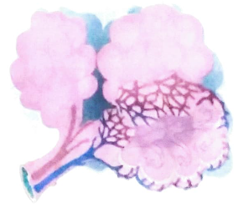
The Exchange of Gases:
The alveoli increase the surface area for the exchange of gases.
The air in the alveoli has more oxygen than the air in the capillaries. The oxygen from air moves into the blood capillaries.
The process by which a substance moves from an area of higher concentration to an area of lower concentration is called Diffusion.
Blood contains a compound called Haemoglobin, which combines with oxygen to form Oxy-Haemoglobin.
Blood carries Oxy-Haemoglobin to every cell in the body. Blood also carries the carbon dioxide formed during respiration from the cells to the lungs.
The carbon dioxide in the blood diffuses from the capillaries into the alveoli and is exhaled through the nostrils.
Niblet:
The unborn baby has lungs, but gets oxygen (along with nutrients) from the mother through the umbilical cord.
It is with the first cry after birth that the baby’s lung become functional.

Slide 23
The Exchange of Gases:
Cellular respiration is the stage in which food molecules are broken down to release energy. This step involves chemical reactions that take place in every cell in the body.
Chemical substances called enzymes, which are produced by the organism, help in speeding up the reactions. Some of the energy produced in cellular respiration is released by the body as heat.

Slide 24
Self Assessment-4
1. With the help of an activity show that the movement of the diaphragm helps air enter the
lungs.
2. What is Diffusion?
3. Name the compound formed when Haemoglobin reacts with Oxygen.
4. Why does the first cry is important for a new born baby?
5. What are Enzymes?
6. What is an Intracellular Process?
7. What is an Extracellular Process?
8. Differentiate between Breathing and Cellular Respiration.
9. Mention the role of Alveoli.

Slide 25
Period:5

Slide 26
Types of Respiration:
Aerobic Respiration:
Respiration that takes place in the presence of oxygen is known as Aerobic Respiration.
Aerobic respiration results in the formation of carbon dioxide and water and releases energy.
Glucose completely breaks down in this process.
All animals and plants carry out aerobic respiration.
Aerobic respiration can be represented by the equation given below:
glucose (sugar) + oxygen➔ carbon dioxide + water+ energy
Aerobic Respiration is a type of oxidation reaction .

Slide 27
Types of Respiration:
Anaerobic Respiration:
The respiration that take place in the absence of oxygen is known as Anaerobic Respiration.
Anaerobic Respiration results in the formation of ethyl alcohol along with carbon dioxide and energy is released.
Thus, glucose does not break down completely in this process.
Organisms like bacteria and yeast carry out anaerobic respiration.
Anaerobic respiration can be represented by the equation given below:
glucose (sugar) ( in the absence of oxygen) ➔ ethyl alcohol + carbon dioxide + energy
The amount of energy released during anaerobic respiration is less than that produced during aerobic respiration .

Slide 28
Anaerobic respiration in Human Muscle Cells:
Anaerobic respiration can occur in human muscle cells too.
Sometimes, when we exercise heavily, the body cannot supply enough oxygen to the muscles to completely break down sugars into carbon dioxide and water. At such times, the muscle cells respire anaerobically.
Glucose is broken down into lactic acid and energy is released in the absence of oxygen
glucose (sugar) ( in the absence of oxygen) ➔ Lactic acid+ energy
When we do heavy exercise, muscles respire anaerobically and lactic acid is accumulated in muscle cells.
If the blood supply is increased in the cells, the lactic acid can be removed from the muscles.
Massaging the affected area or having a hot bath increases blood circulation, which helps to remove lactic acid.
The lactic acid is then broken down in the presence of oxygen in the liver or other tissues.

Slide 30
Self Assessment-5
1. What is Aerobic Respiration?
2. Write the chemical equation of Aerobic Respiration.
3. Name the products formed in Aerobic Respiration.
4. What is Anaerobic Respiration?
5. Write the chemical equation of Anaerobic Respiration.
6. Name the products formed in Anaerobic Respiration.
7. Why does less energy produced in Anaerobic Respiration than Aerobic Respiration?
8. Why does anaerobic Respiration take place in humans?
9. What is the reason behind the formation of Lactic Acid in muscles of human?
10. Write the chemical equation of the anaerobic respiration that take place in muscles of human.

Slide 31
Period:6

Slide 32
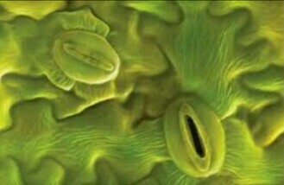
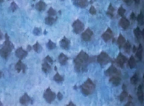
Respiration in Plants:
Plants use a number of organs for gas exchange.
Stomata:
Exchange of gases in green plants takes place through Stomata on leaf surfaces.
Each stoma is guarded by two Guard cells, which control its opening and closing.
Lenticels:
The woody bark of large trees has openings called Lenticels for breathing.
Animals need energy to move around in search of food, shelter etc.
Plants too need energy to transport materials within the body, repair tissues, replace worn out cells, grow and reproduce.
Plants get energy from the oxidation of food molecules.
Plants respire all the time but can only make food in the presence of Sunlight.
During the day both Photosynthesis and Respiration takes place, with Photosynthesis being the major activity.
At night, only Respiration takes place. The rate of Respiration is much slower in plants than it is in animals.

Slide 33
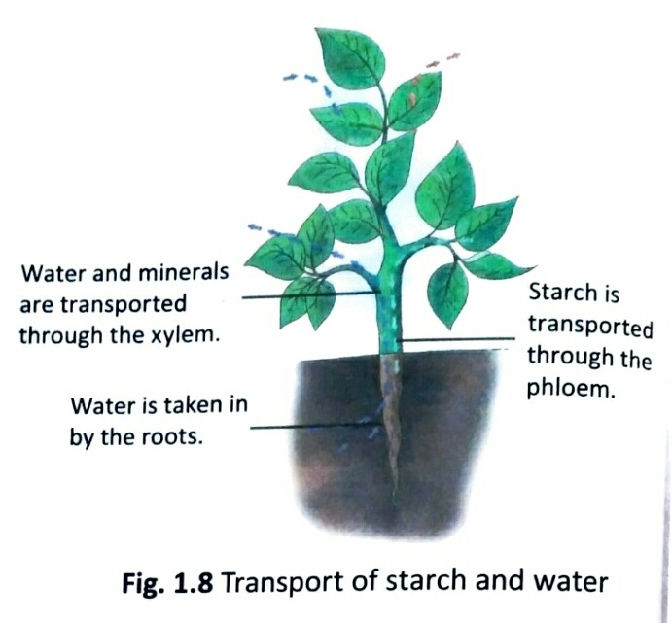
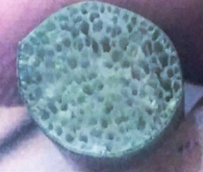
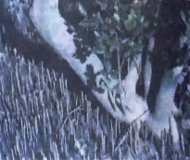
Respiration in Plants:
Submerged plants do not have Stomata.
Gas exchange takes place directly between leaf cells and water.
Many aquatic plants have air spaces in the leaves and stem to store and transport oxygen. These air spaces help some aquatic plants to float
(c) Roots:
The roots also need oxygen.
Root hairs take in oxygen from the air spaces present between soil particles.
Overwatering plants can kill Root hairs because the air spaces between the soil particles get filled with water and the roots cannot breathe.
Mangrove trees, which grow in marshy areas, do not get air from soil. They have Aerial roots that help them to take in air.
(d) Stomata (Aquatic Plants):
In floating plants, the Stomata are on the upper surface of the leaves.

Slide 34
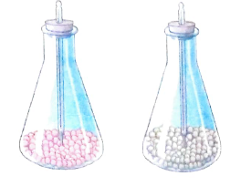
Activity:
Let us leave the flasks undisturbed for 24 hours and note the temperatures again.
Observation:
We will notice that there is a rise in temperature in the flask with the germinating seeds and not in the one with the beads.
This shows that seeds respire and that heat is released during respiration.
If the gas in the flask with germinating seeds are collected and passed through lime water, the lime water turns milky, indicating the presence of carbon dioxide.
Aim:
To show that heat is released during
plant respiration.
Materials Needed:
Peas, Beads, Two Conical Flasks, Clinical
Thermometers, Two one hole stoppers
Procedure:
Let us sprinkle some water on the seeds so that they can germinate.
Let us place the germinated seeds in a conical flask.
Let us place the beads in the other flask.
Let us insert clinical thermometers in both stoppers.
Let us close the flasks with the stoppers and note the temperatures.

Slide 35
Self Assessment-6
1. Name the process by which plants respire?
2. Why do plants need energy?
3. When can plants make food?
4. When can plants produce energy?
5. Mention the role of Stomata in plants.
6. What are Lenticels?
7. What is the function of root hairs?
8. What will happen to the root hairs in case of water logging?
9. How do Mangrove trees take in air?
10. How do floating plants exchange gases?
11. How do submerged plants exchange gases?
12. How do air spaces in the leaves and stem help aquatic plants?
13. With the help of an activity show that heat is released during plant respiration.

