Slide 1
Honey Comb Chapter -3 Gopal And The Hilsa Fish

Slide 2
Objectives
To introduce students a comic story to be understood through pictures with strips of text for support
TO make learning easy and enjoyable.
To enhance English reading.
To acquaint students with ‘Reported speech under the shade of a comic story having dialogues.

Slide 3
Temper: state of mind. Ex: Gopal loses his temper after a quarrel with friend.
Crazy: foolish. Ex: Navjeet’s behavior shows he is a crazy boy.
Ridiculous : causing mocking. Ex: Ansu cracks ridiculous jokes.
Achieve : succeed in doing by effort. Ex: Sudarshan achieved a great success against Garry in chess.
Think of : take into account. Ex: Students must think of sincere stud.

Slide 4
Key Points
Hilsa fish season.
Talk on Hilsa fish only.
King’s order in the court.
Gopal accepts the challenge.
Gopal’s preparations about Hilsa fish.
Gopal’s journey to palace with Hilsa fish.
People’s reaction to see Gopal.
Gopal’s efforts to get entry in the palace.
Nobody asks about Hilsa fish in the palace.
Courtier’s reactions about Gopal.
King asks about Gopal’s appearance.
Gopal’s reminder about Hilsa fish.
Congratulations to Gopal.

Slide 5
Moral People talk about whatever new there is to talk about.
Quiz Answer some questions based on the story you read in the form of a comic
Characters
Gopal
Gopal’s wife
The KingA
The courtiers
Synopsis
The season of Hilsa fish was going on everywhere as we have season of mangoes in summer. People were talking about Hilsa fish and nothing else. Even the court was not an exception. The king was tired of this. He made and announcement to buy a Hilsa fish and to bring it to the palace without anyone asking a word about it. Gopal, one of the courtiers accepts the challenge. He makes preparation. Half shaves himself, smears with ash and wear torn clothes. Then, set out to the palace with a big Hilsa fish. Throughout the way every body talks and laughs on his face and strange appearance, but nobody says about Hilsa fish. Finally Gopal reaches to palace where the guards stop him to enter. Gopal starts singing so loudly that king allows the stranger to come in. inside the palace even no one asks about Hilsa fish accept appearance. even the king asks about Gopal’s dressing and not Hilsa fish. In the ends Gopal reminds the king about the challenge. The king congratulates Gopal for achieving the impossible task.

Slide 6
Summary
The season of Hilsa fish was going on everywhere as we have season of mangoes in summer.
People were talking about Hilsa fish and nothing else. Even the court was not an exception.
The king was tired of this. He made and announcement to buy a Hilsa fish and to bring it to the palace without anyone asking a word about it.
Gopal, one of the courtiers accepts the challenge. He makes preparation. Half shaves himself, smears with ash and wear torn clothes.
Then, set out to the palace with a big Hilsa fish. Throughout the way every body talks and laughs on his face and strange appearance, but nobody says about Hilsa fish.
Finally Gopal reaches to palace where the guards stop him to enter. Gopal starts singing so loudly that king allows the stranger to come in.
Inside the palace even no one asks about Hilsa fish accept appearance. even the king asks about Gopal’s dressing and not Hilsa fish. In the ends Gopal reminds the king about the challenge. The king congratulates Gopal for achieving the impossible task.

Slide 7
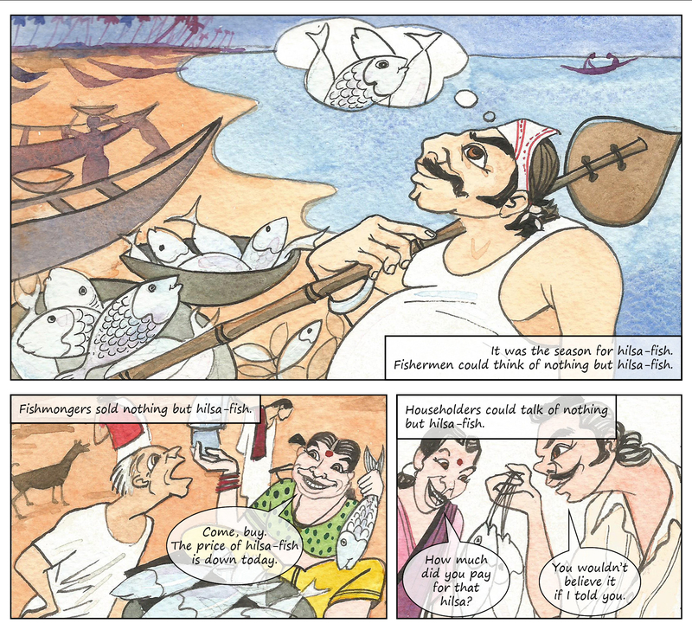

Slide 8
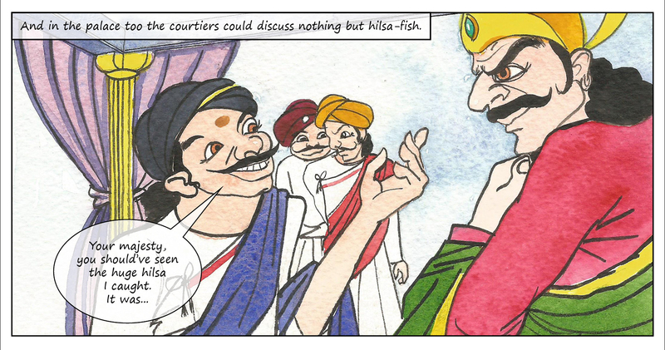

Slide 9
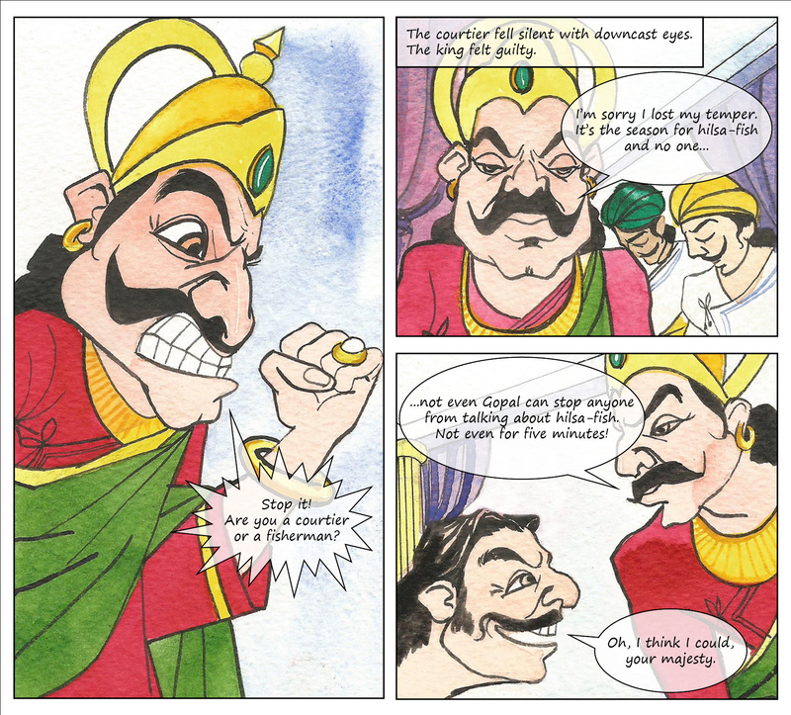

Slide 10
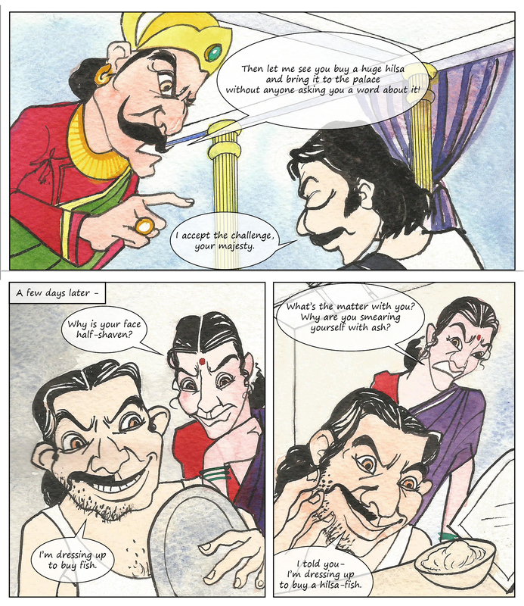

Slide 11
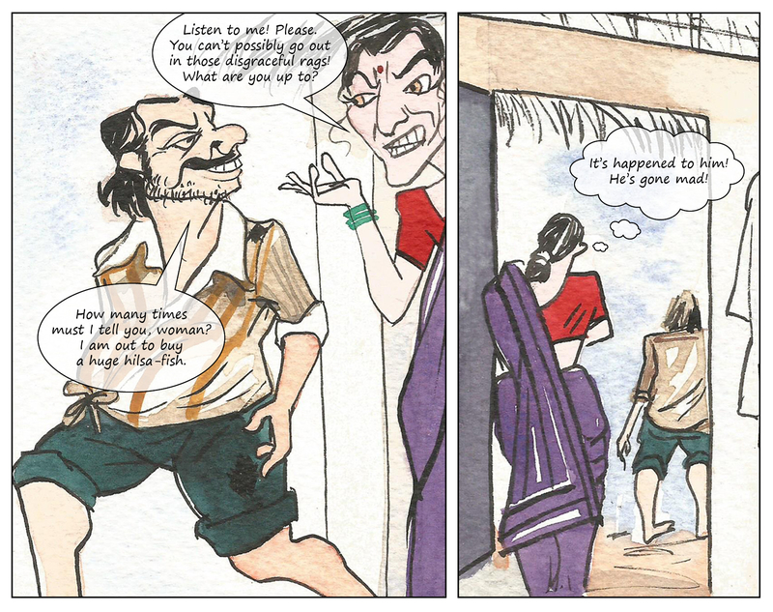

Slide 12
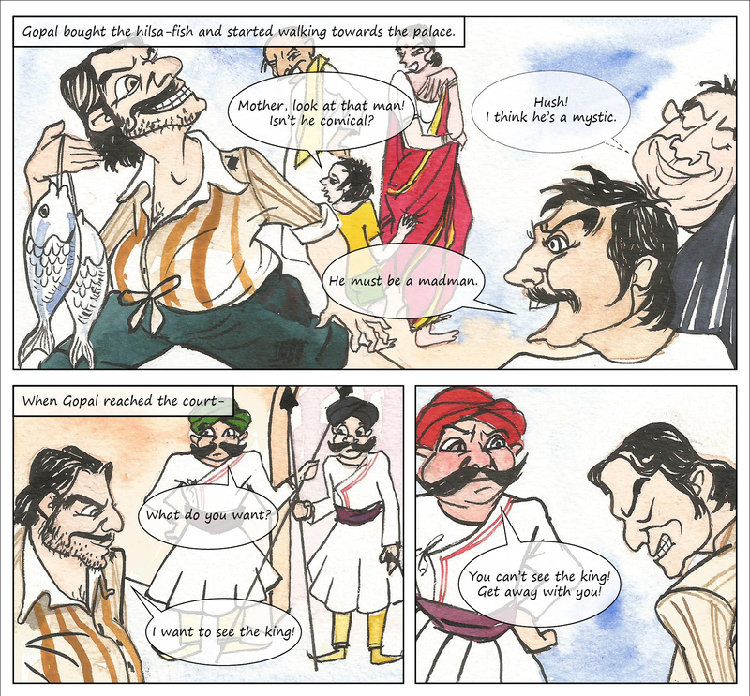

Slide 13
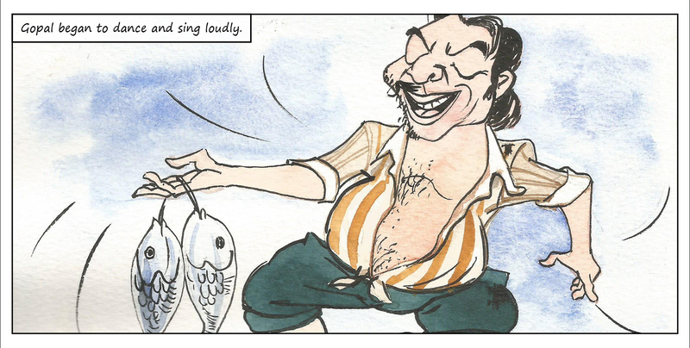

Slide 14
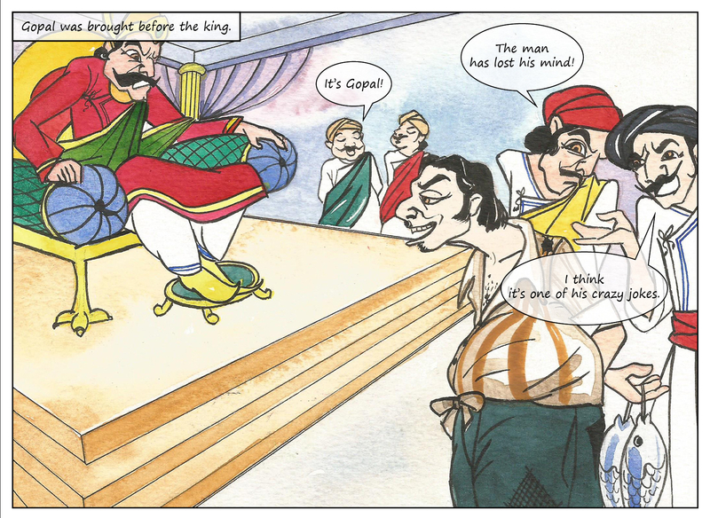

Slide 15
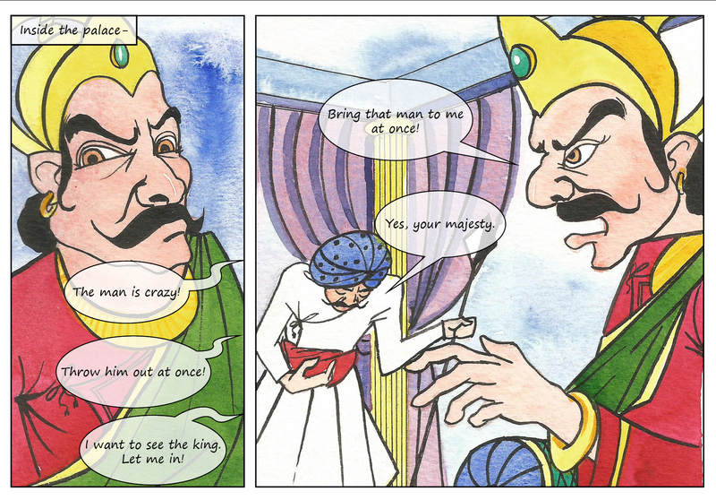

Slide 16
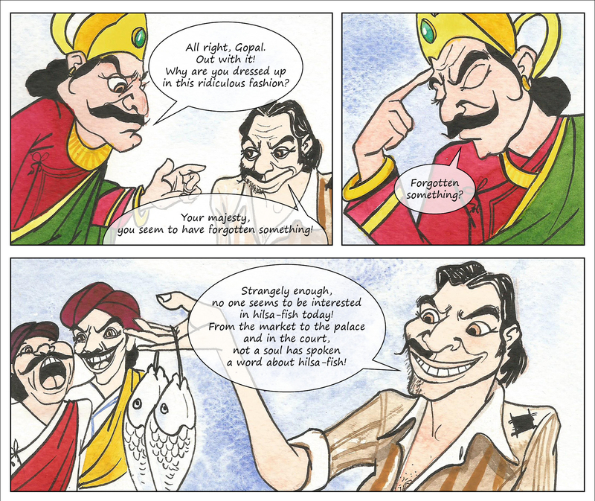

Slide 17
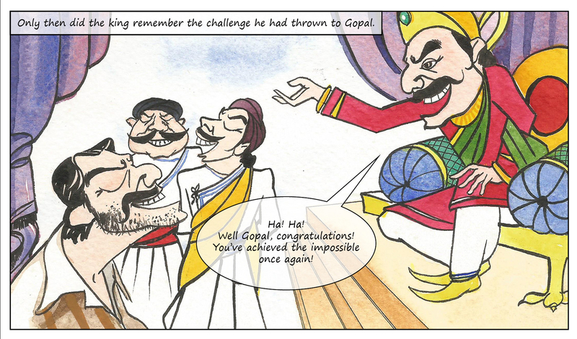

Slide 18
Short Questions
Q1: What season is referred in this story ?
Ans: Season for Hilsa fish is referred in this story.
Q2: What where the fisher men doing ?
Ans: The fisher men were selling only Hilsa fish.
Q3: What did the courtier ask the king?
Ans: The courtier asked the king to see huge Hilsa he caught.
Q4: Who accepted the challenge?
Ans: Gopal accepted the challenge.
Q5: What did the king ask Gopal to do?
Ans: The King asked Gopal to bring the Hilsa fish to the palace without anyone asking about it .
Q6: What did Gopal’s wife ask him?
Ans: Gopal’s wife asked him why his face half shaven.
Q7: What did Gopal answer to his wife?
Ans: Gopal answered that he was dressing up to buy a Hilsa fish .
Q8: Where was Gopal going along with the Hilsa fish?
Ans: Gopal was going towards the palace .

Slide 19
Q9: What did the child on the road say about Gopal to his mother?
Ans: The child on the road said that the man was comical .
Q10: How did the people on the road react about Gopal?
Ans: Some people said to him a madman , others said him mystic.
Q11: What did the kings guards asks Gopal?
Ans: The kings guards asked him what he wanted.
Q12: What did Gopal begin to do near the palace?
Ans: Gopal began to dance and sing loudly.
Q13: What did the king hear inside the palace?
Ans: The king heard that the man was crazy and throw him out.
Q14: What did the king order to his guard?
Ans: The king ordered his guard to bring that man to him at once.
Q15: What did the courtiers say the moment Gopal was brought before the king?
Ans: The courtiers said that it was Gopal.

Slide 20
Q16: How did the courtiers react about Gopal?
Ans: The courtiers said that the man had lost his mind and it was his crazy joke.
Q17: What did the king ask Gopal?
Ans: The king asked him why he was dressed up in that ridiculous fashion.
Q18: What did Gopal answer to the kings question?
Ans: Gopal answered that the king had forgotten something.
Q19: How did the king remember the challenge he had thrown to Gopal?
Ans: When Gopal said that no one seemed to be interested in Hilsa fish that day.
Q20: How did the king react on Gopal’s success?
Ans: The king congratulated him and told him that he had achieved the impossible once again.

Slide 21
Answers of the Textbook Questions
Q1: Why did the king want know more talk about the Hilsa fish?
Ans: The king wanted know more talk about the Hilsa fish because he did not want to waste the time of court.
Q2: What did the king ask Gopal to do to prove that he was clever?
Ans: The king asked Gopal to buy a Hilsa fish and bring it to palace. He also should see that no body should ask him a word about it.
Q3. What three things did Gopal do before he went to buy his Hilsa fish?
Ans: Gopal followed three things
1. Half shaved his face.
2. Smeared himself with ash.
3. Worn torn cloths.
Q4. How did Gopal get inside the palace to see the king after he had bought the fish?
Ans: Gopal got inside the palace in the following way-
1. Began to dance- when guards did not allow Gopal to enter the palace he began to dance.
2. Began to sing- Gopal also started to sing . The king quickly ordered the guard to bring Gopal before him .
Q5. Explain why no one seem to be interested in talking about the Hilsa fish which Gopal had bought?
Ans: Gopal’s half shaven face, smeared with ash, torn clothes attracted people’s attention. Therefore, nobody talked about the Hilsa fish bought by him.

