Slide 1
INDUSTRIAL POLLUTION AND ENVIRONMENTAL DEGRADATION

Slide 2
Although industries contribute significantly
to India’s economic growth and development,
the increase in pollution of land, water, air,
noise and resulting degradation of
environment that they have caused, cannot
be overlooked. Industries are responsible for
four types of pollution:
Water
Air
Thermal
Noise

Slide 3
AIR POLLUTION
Air pollution:-is caused by the presence of
high proportion of undesirable gases, such
as scuhure dioxide and carbon monoxide. Air-
borne particulate materials contain both solid
and liquid particles like dust, sprays mist
and smoke.

Slide 4
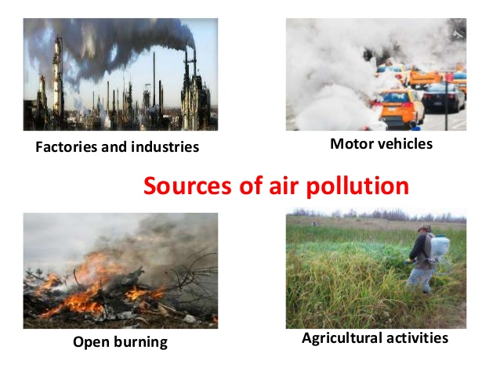

Slide 5
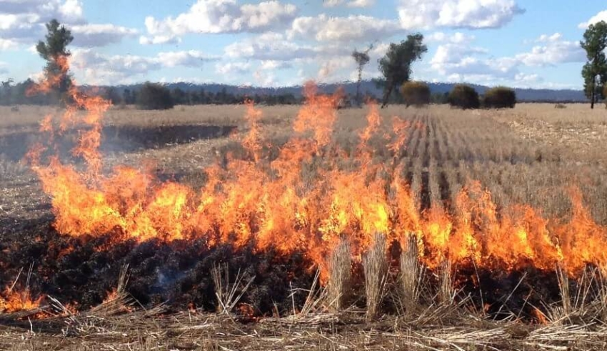

Slide 6
You would have seen or read how the pollution mess has affected the capital. As per a few reports, stubble burning in Punjab, Haryana and other parts of north India contributes to 70% of Delhi’s air pollution.

Slide 7


Slide 8
Bhopal Gas Tragedy
The Bhopal disaster, also referred to as the Bhopal gas tragedy, was a gas leak incident on the night of 2–3 December 1984 at the Union Carbide India Limited (UCIL) pesticide plant in Bhopal, Madhya Pradesh, India. It is considered among the world's worst industrial disasters. Over 500,000 people were exposed to methyl isocyanate (MIC) gas.

Slide 9
Smoke is emitted by chemical and paper factories, brick kilns, refineries and
smelting plants, and burning of fossil fuels
in big and small factories that ignore pollution
norms. Toxic gas leaks can be very hazardous
with long-term effects.

Slide 10
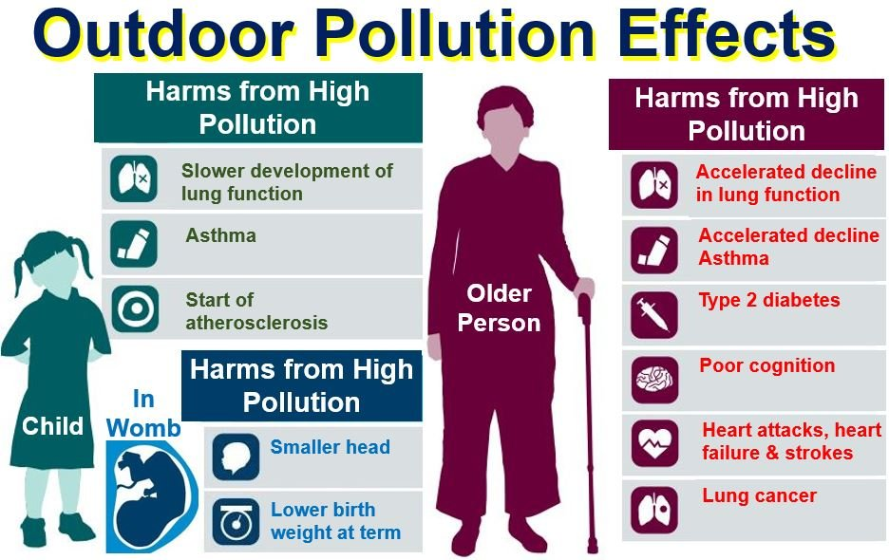

Slide 11
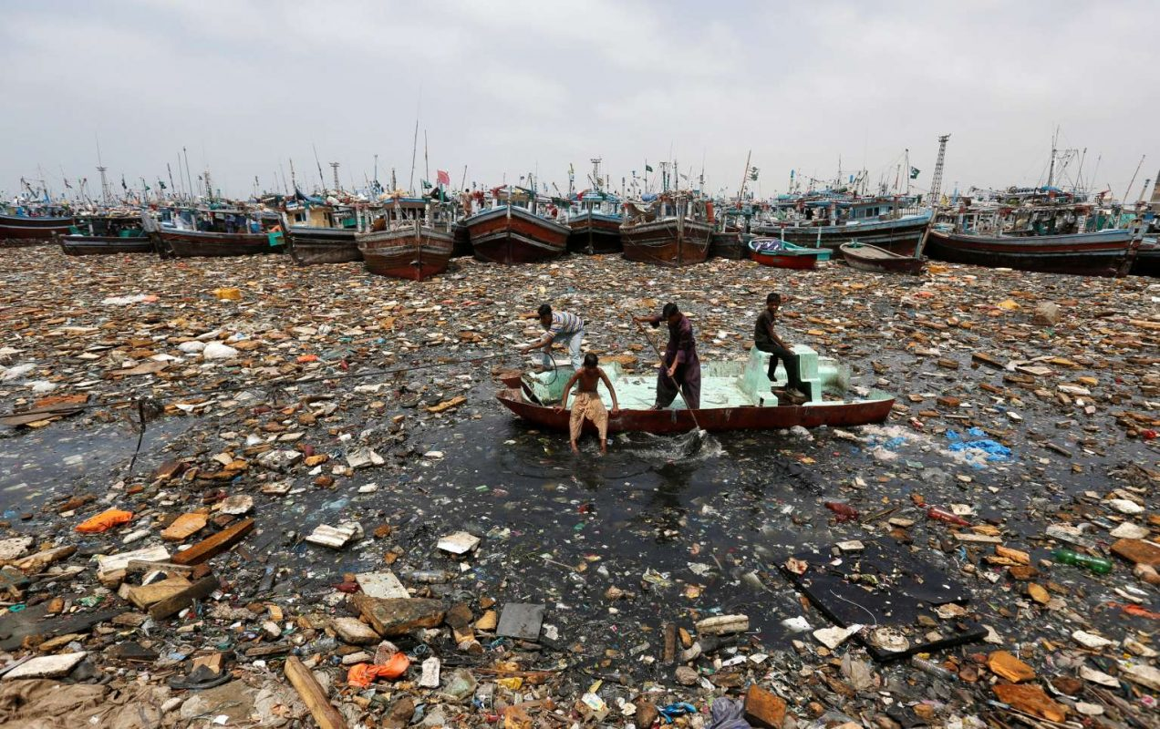

Slide 12
Water Pollution
Water pollution is caused by organic and inorganic industrial wastes and affluents discharged .The main culprits in this regard are paper, pulp, chemical, textile and dyeing, petroleum refineries, tanneries and ectroplating industries that let out dyes,detergents, acids, salts and heavy metals like lead and mercury pesticides, fertilisers,synthetic chemicals with carbon, plastics and rubber, etc. into the water bodies.nto rivers.

Slide 13
THERMAL POLLUTION
Thermal pollution of water occurs when hot
water from factories and thermal plants is
drained into rivers and ponds before cooling.

Slide 14
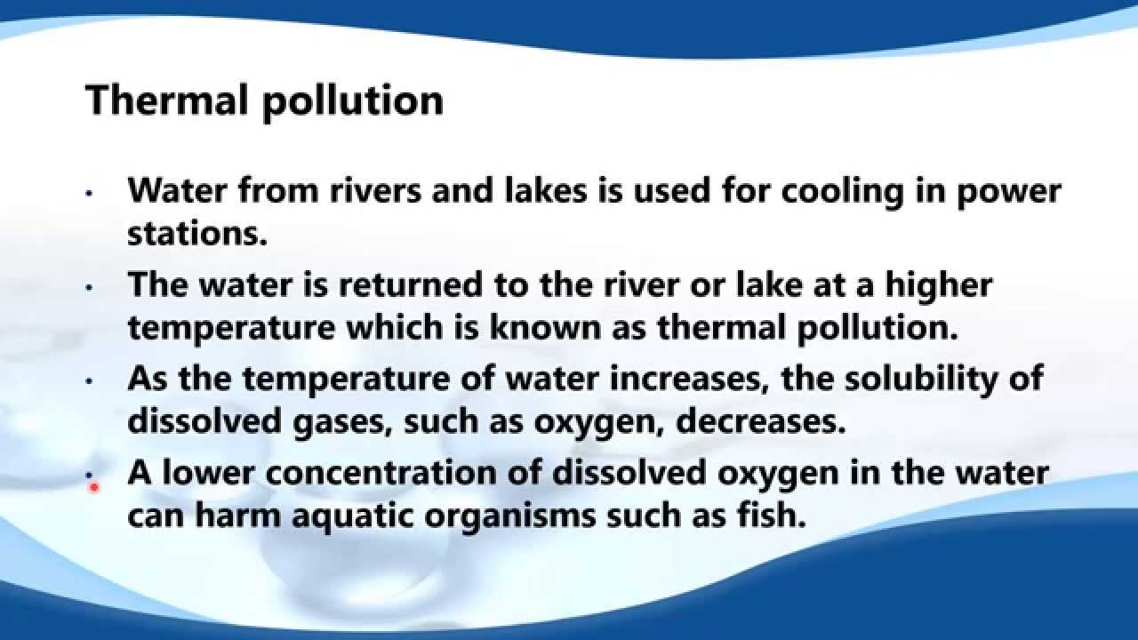

Slide 15
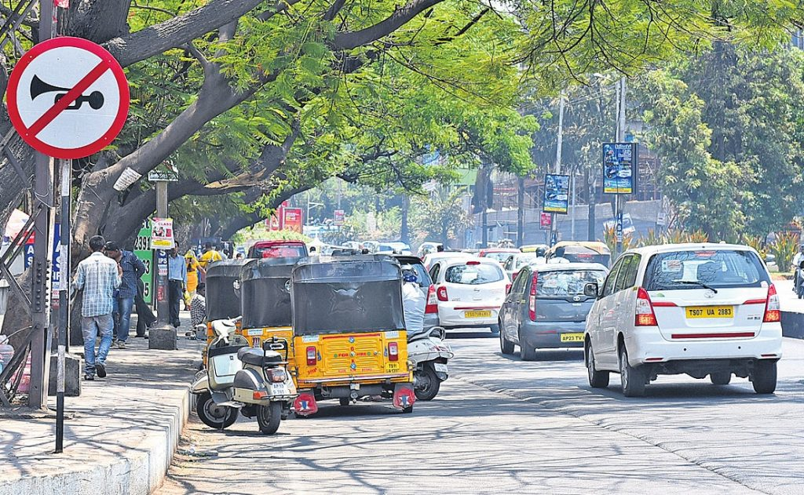

Slide 16
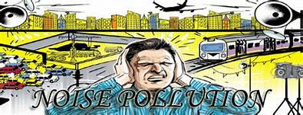

Slide 17
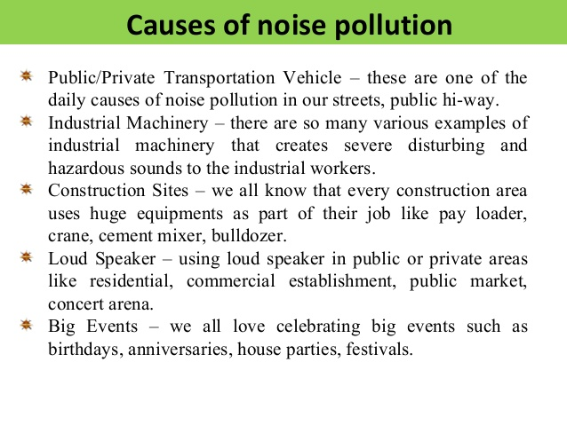

Slide 18
NOISE POLLUTION
Noise pollution not only results in irritation
and anger, it can also cause hearing
impairment, increased heart rate and blood
pressure among other physiological effects.
Unwanted sound is an irritant and a source
of stress. Industrial and construction
activities, machinery, factory equipment,
generators, saws and pneumatic and electric
drills also make a lot of noise.

Slide 19
Wastes from nuclear power plants, nuclear and weapon production facilities cause cancers, birth defects and miscarriages. Soil and water pollution are closely related.Dumping of wastes specially glass, harmful chemicals, industrial effluents, packaging,salts and garbage renders the soil useless.Rain water percolates to the soil carrying the pollutants to the ground and the ground water also gets contaminated.

Slide 20
Important Questions:-
How does Industry Pollute Environment?
Air Pollution: It happens due to the high proportion of poisonous gases in the air like carbon monoxide. Air-borne particulate matters, smoke, toxic gas leaks etc. cause pollution. It affects humans, animals, plants, and atmosphere as a whole too.
2. Water Pollution: Organic and inorganic industrial wastes and affluent that are dumped into water bodies cause water pollution. Some main factories that cause it are paper. chemical. textile etc. Harmful substances include dyes, acids, fly ash etc.
3. Thermal Pollution: It happens when hot water is released into rivers and ponds without cooling. It adversely affects the aquatic life.
4. Land pollution: Solid waste material like glass, packaging and renders reduce the quality of the soil. Rain water carries the chemicals underground and pollutes ground water too.
5. Noise Pollution: Industrial work, construction process, machinery and various equipments create a lot of noise. It can be a cause of irritation and stress. It can also create health problems like increased heart rate and blood pressure.

Slide 21
Student activity
Why are most of the jute mills located on the banks of the River Hugli? Explain.
Why is there a tendency for the sugar mills to concentrate in the southern and
western states of India? Explain any three reasons.
Manufacturing industry is considered the backbone of economic development
of India.” Give three reasons.
Trace the Contribution of IT Industry.

