Slide 1
CONCEPT MAPPING INVERSE TRIGONOMETRIC FUNCTIONS
Trigonometric Functions
Inverse Trigonometric Functions
Properties
Restricted Domain
Graph
Domain & Range
Principal Value Branch
Cot & its inverse
sin & its inverse
cos & its inverse
tan & its inverse
Cosec & its inverse
Sec & its Inverse

Slide 6
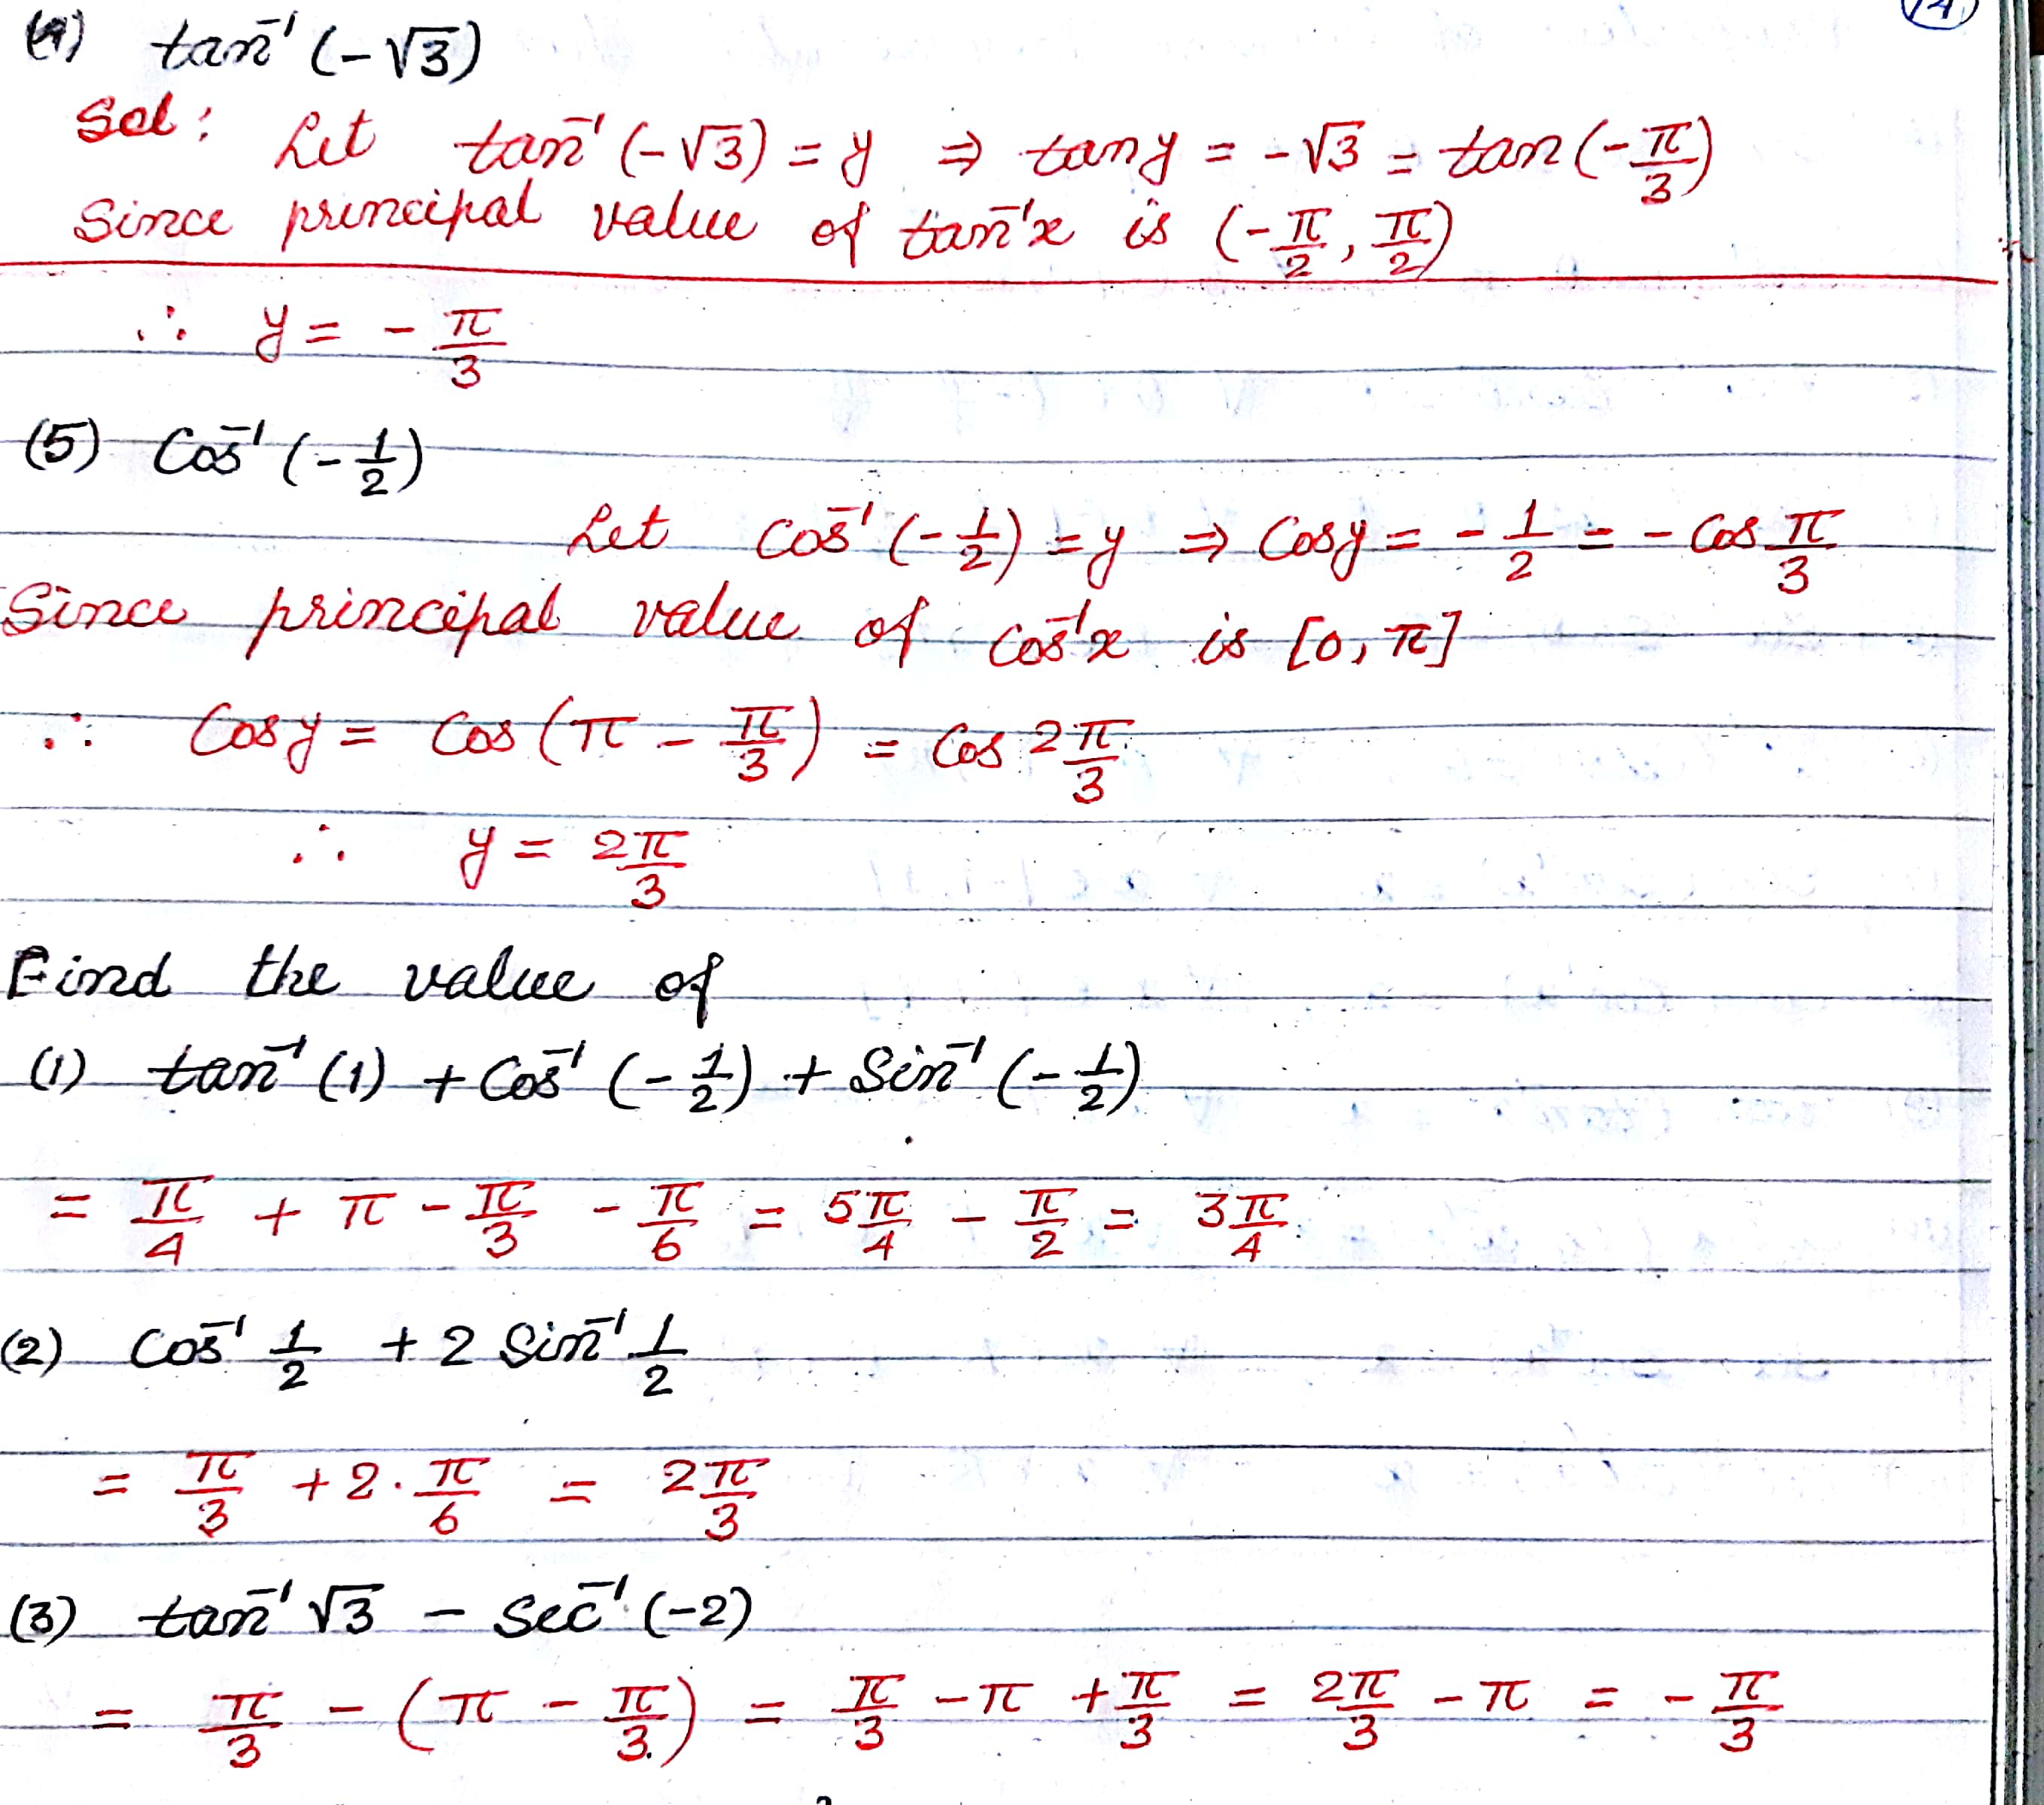

Slide 7
