Slide 1
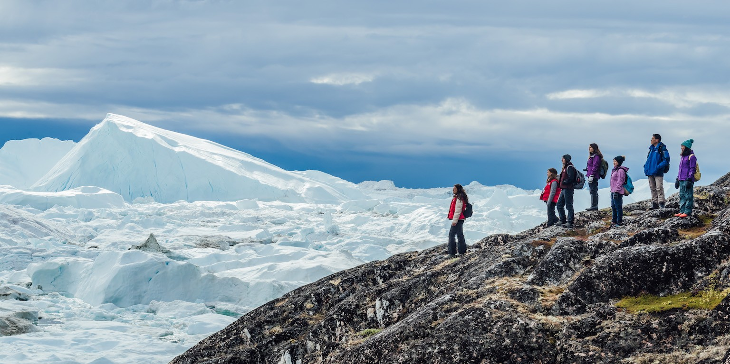
Journey to the End of the Earth
Tishani Doshi
(1975)
INDEX
About the Author
Theme, Sub-theme
Characters
Summary
Key-Points
Vocabulary
Points to Ponder
Assignments

Slide 2
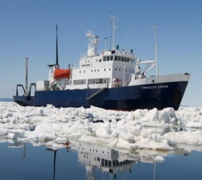
Journey to the End of the Earth
Tishani Doshi
(1975)
About the Author :
Tishani Doshi is a writer and dancer of Welsh-Gujarati origin. She was born in Madras, India. She studied Business Administration and Communications at Queens College, North Carolina and gained a Masters degree in Creative Writing from the Johns Hopkins University, Baltimore. She moved to London in 1999, becoming assistant to the advertising department of Harper's and Queen magazine. In 2001, she returned to India and became a dancer with the choreographer Chandralekha. She also works as a freelance journalist, contributing to various newspapers. Her first book of poetry, Countries of the Body (2006), won the Forward Poetry Prize (Best First Collection) in 2006. Her first novel, The Pleasure Seekers, was published in 2010.

Slide 3
Journey to the End of the Earth
Tishani Doshi
INTRODUCTION
The lesson highlights how geological phenomena enable us to trace the history of mankind. It also tells us about the way in which landmasses and countries are formed. The writer emphasises the impact of human endeavour to dominate nature. It should be realised that exploration of this landmass under the ice cap will certainly reveal valuable information on the theory of birth and evolution of our planet and its association with the solar system and the galactic evolution. The challenge to the ecology of the world makes the Antarctica (with the simple eco-system and lack of biodiversity) a crucial place for study. The ‘Students on Ice’ programme provides inspiring educational opportunities which help to foster an understanding and respect for our planet. The objective of taking children to Antarctica to teach them the importance of protecting the Earth’s environment is laudable.

Slide 4
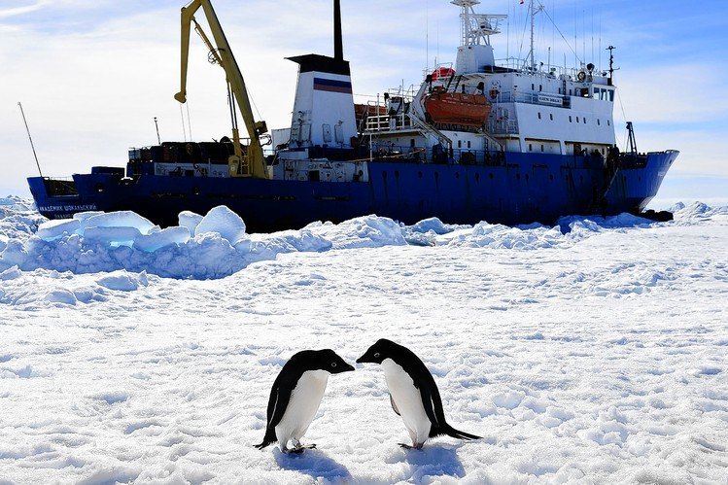
Journey to the End of the Earth
Theme – Antarctica as the best place to study the Earth’s
past, present and future
Sub-Theme – Our responsibility towards safeguarding the
planet
Characters :
Narrator – the author herself
Geoff Green – A Canadian
Designed by : R Shrama Courtesy : various sites for pics & info

Slide 5
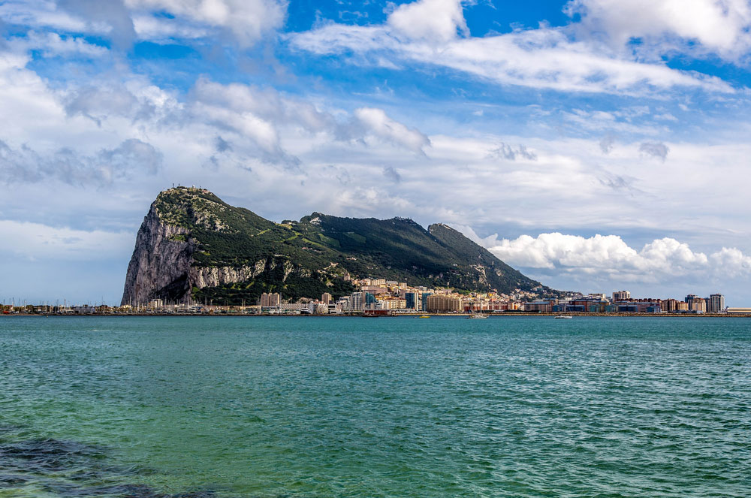
JOURNEY TO THE END OF THE EARTH -down the memory lane..

Slide 6
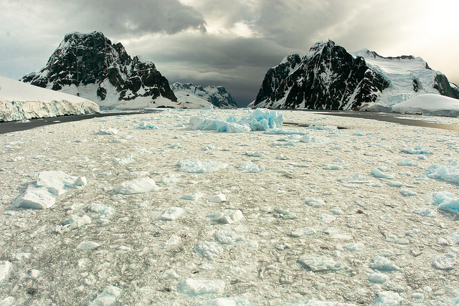
JOURNEY TO THE END OF THE EARTH -down the memory lane..

Slide 7
JOURNEY TO THE END OF THE EARTH -down the memory lane..

Slide 8
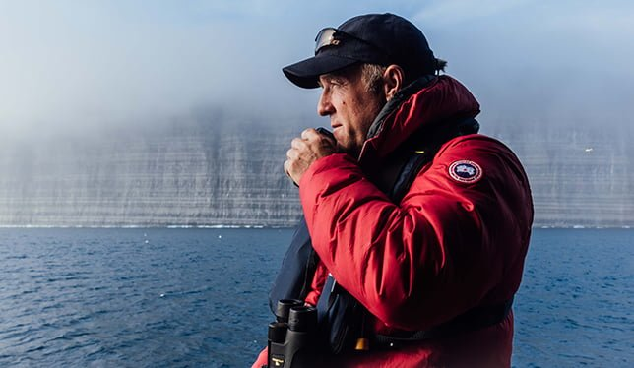
JOURNEY TO THE END OF THE EARTH -down the memory lane..

Slide 9
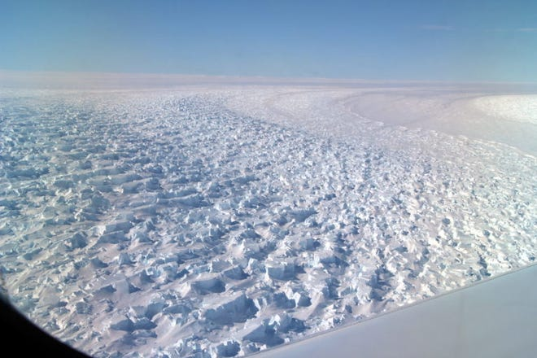
JOURNEY TO THE END OF THE EARTH -down the memory lane..

Slide 10
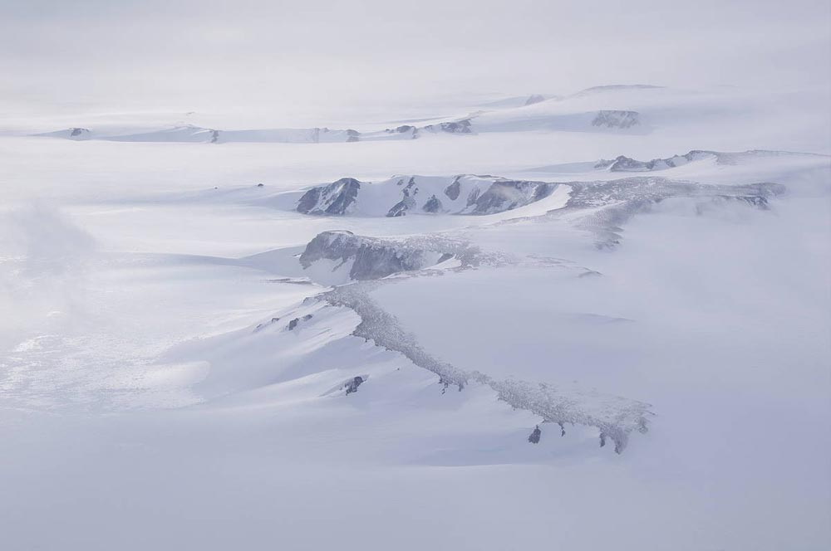
JOURNEY TO THE END OF THE EARTH -down the memory lane..

Slide 11
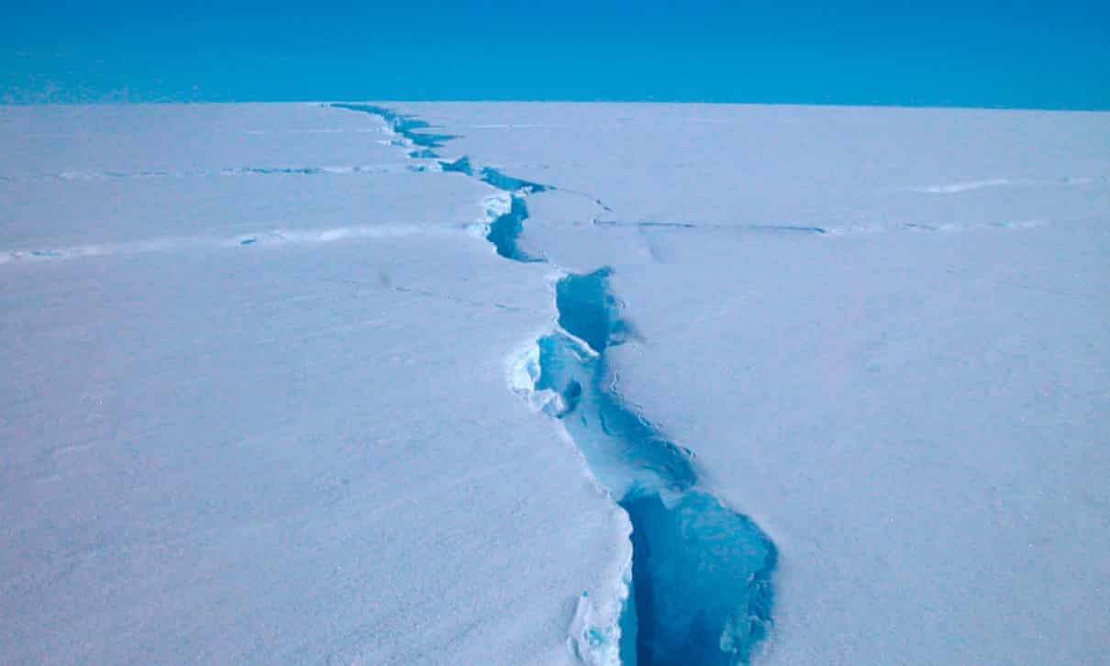
JOURNEY TO THE END OF THE EARTH -down the memory lane..

Slide 12
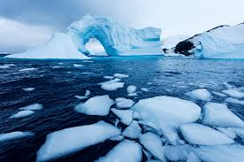
JOURNEY TO THE END OF THE EARTH -down the memory lane..

Slide 13
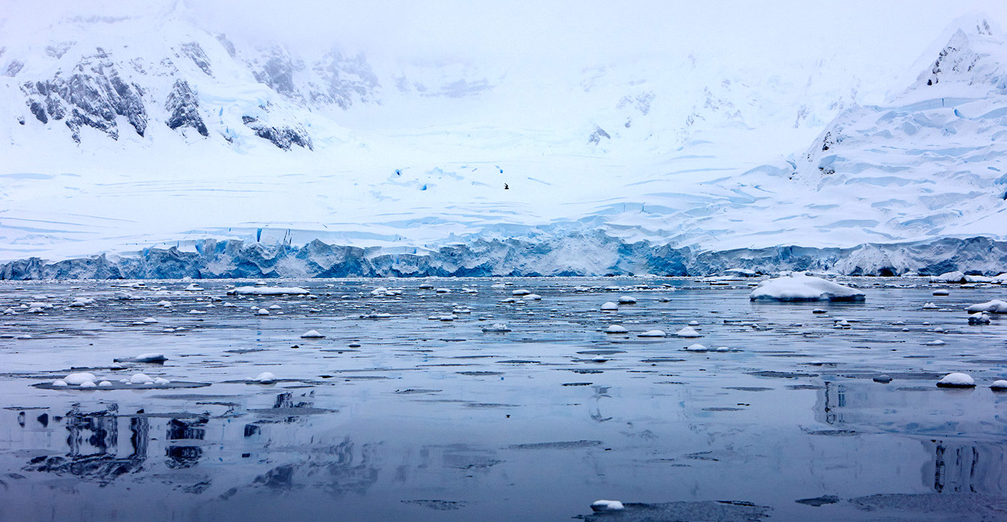
JOURNEY TO THE END OF THE EARTH -down the memory lane..

Slide 14
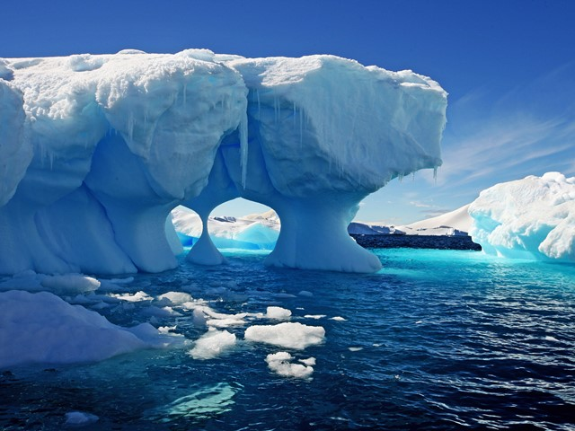
JOURNEY TO THE END OF THE EARTH -down the memory lane..

Slide 15
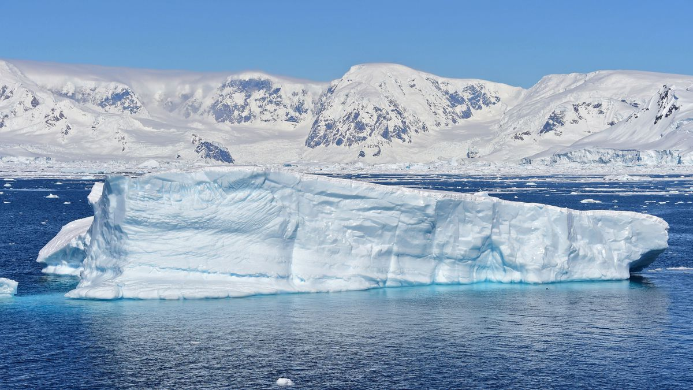
JOURNEY TO THE END OF THE EARTH -down the memory lane..

Slide 16
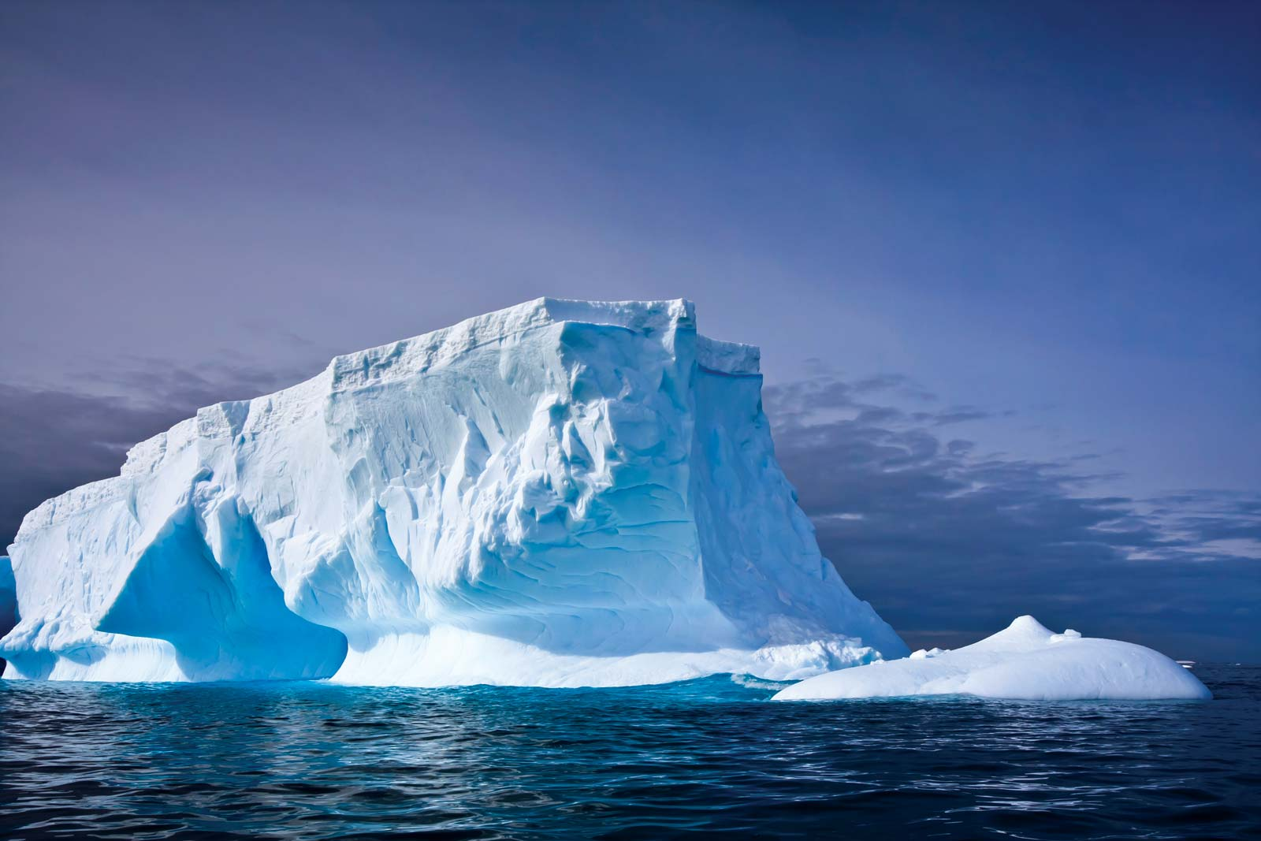
JOURNEY TO THE END OF THE EARTH -down the memory lane..

Slide 17
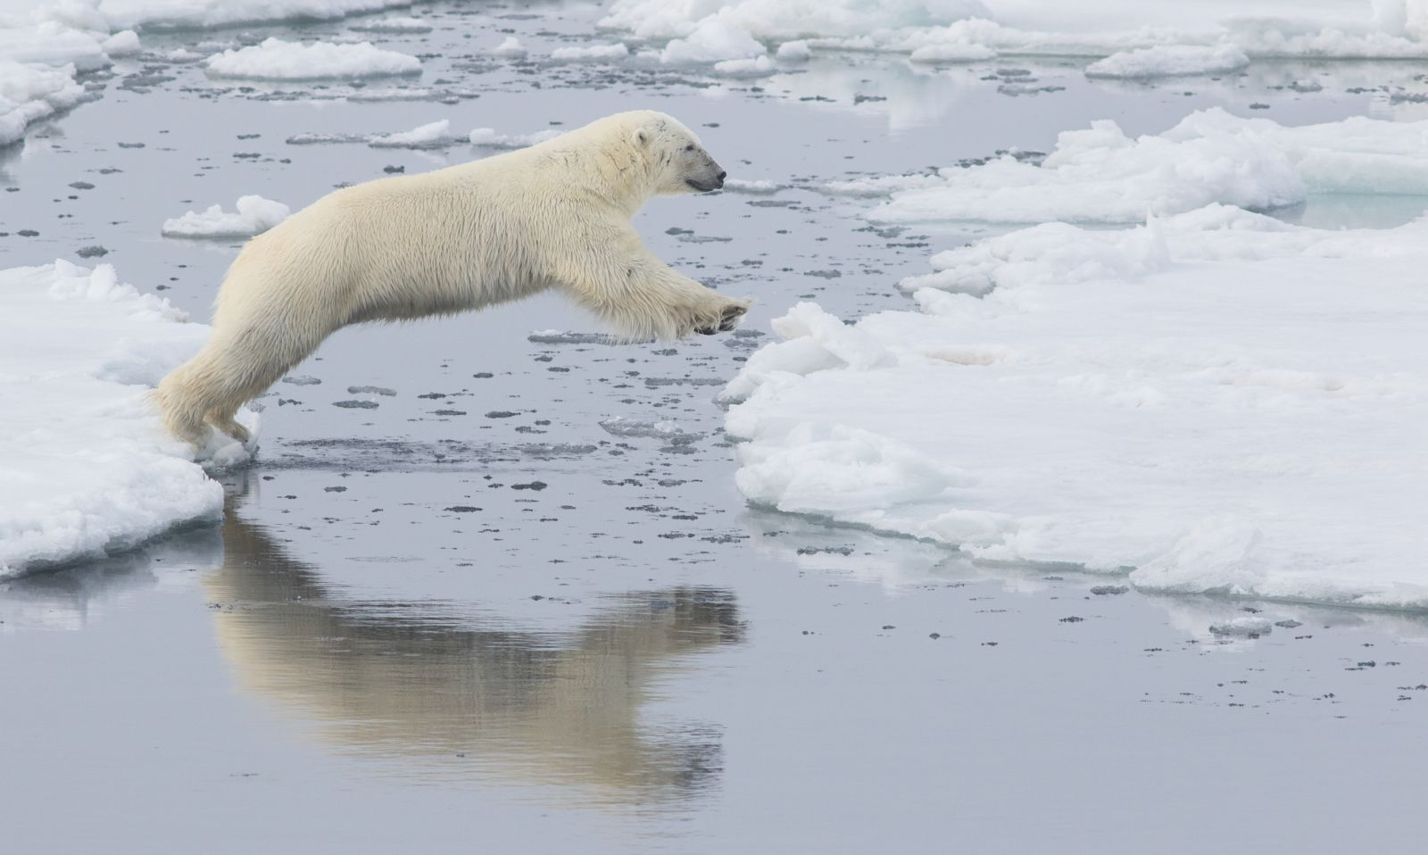
JOURNEY TO THE END OF THE EARTH -down the memory lane..

Slide 18
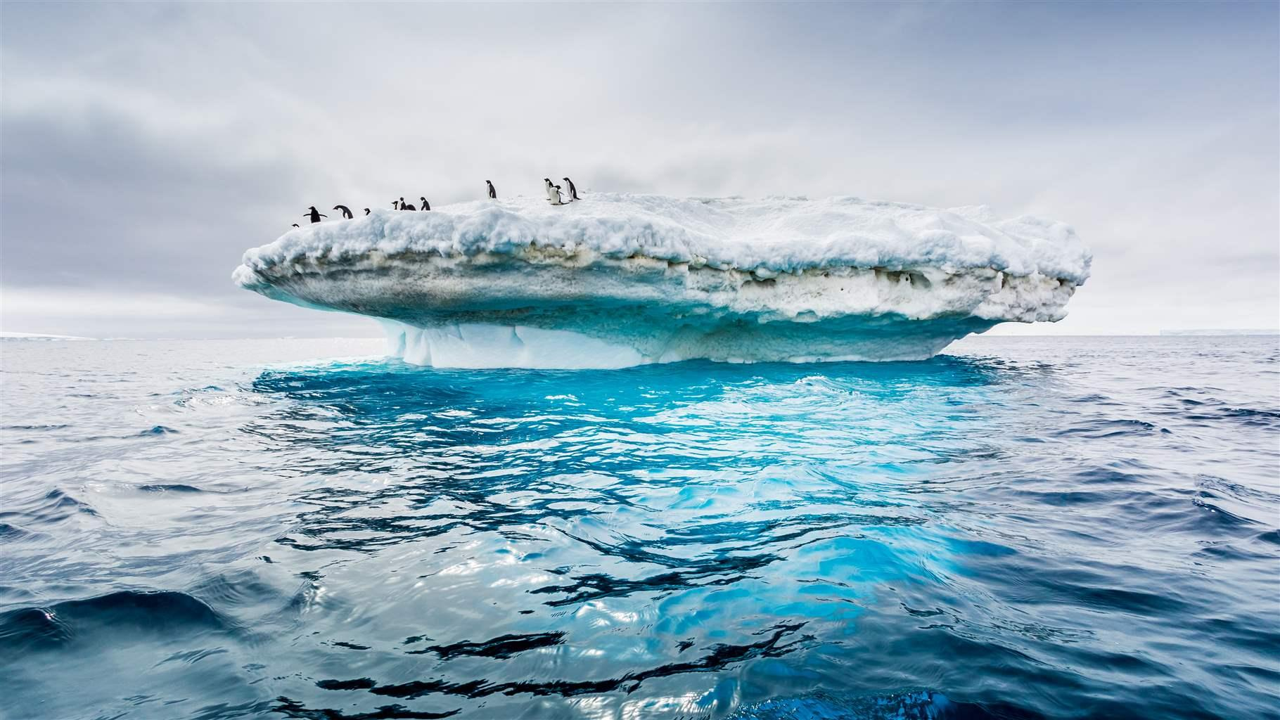
JOURNEY TO THE END OF THE EARTH -down the memory lane..

Slide 19
JOURNEY TO THE END OF THE EARTH -down the memory lane..

Slide 20
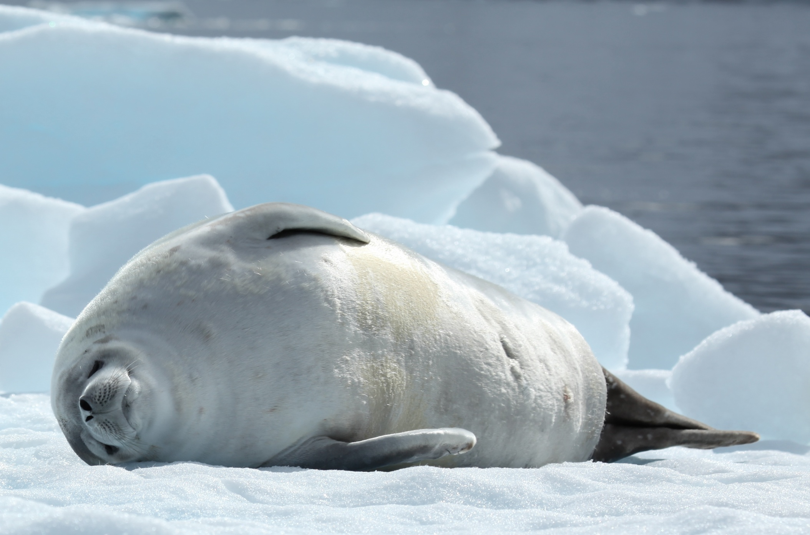
JOURNEY TO THE END OF THE EARTH -down the memory lane..

Slide 21
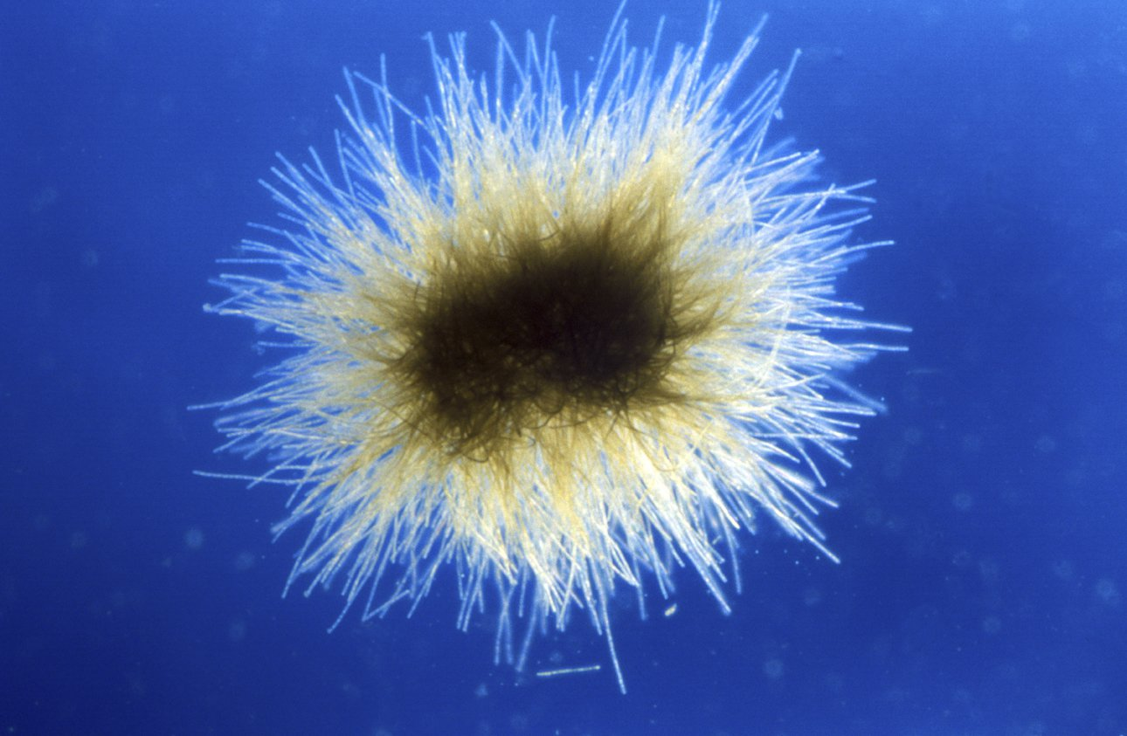
JOURNEY TO THE END OF THE EARTH -down the memory lane..

Slide 22
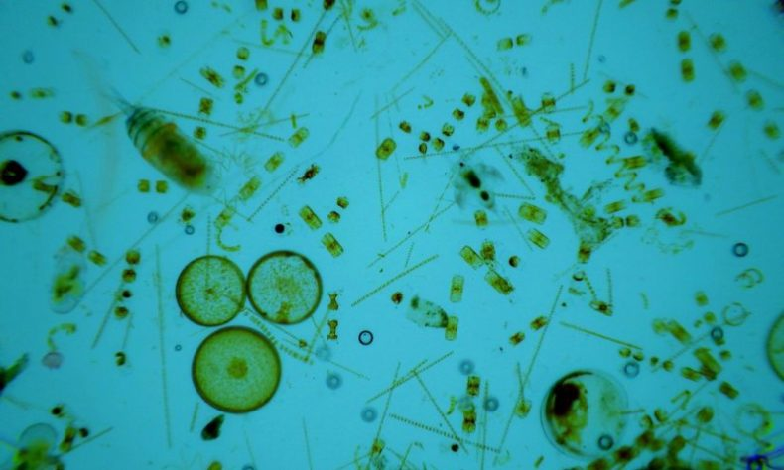
JOURNEY TO THE END OF THE EARTH -down the memory lane..

Slide 23
Journey to the End of the Earth
SUMMARY
The lesson begins with the author on a journey in a Russian research
vessel — the Akademik Shokalskiy. It was headed towards Antarctica. We learn that the author has travelled about 100 hours in a car, aeroplane as well as the ship. The main objective of this trip is to learn everything in detail about Antarctica. Further, we learn about her two-week stay there and what all is present there. The place stores 90% of the earth’s total ice volumes with no trees, buildings or anything. It has 24-hour austral summer light. Moreover, it is covered in silence. This makes the author wonder about the time when India and Antarctica were the same landmass’s part. We learn about the existence of a southern supercontinent, Gondwana. It existed for six hundred and fifty million years ago. We learn that the climate back then was much warmer and sustained a huge variety of flora and fauna. All this was before the arrival of human beings. Moreover, for 500 million years, Gondwana flourished. Thus, after the extinction of dinosaurs, the landmass separated into continents, as we know today. Moreover, we also learn about the reality of climate change. The author believes that to study the impact closely, one must make a visit to Antarctica.

Slide 24
Journey to the End of the Earth
SUMMARY
After that, we learn about Antarctica’s ecosystem and how it lacks biodiversity. Moreover, it is the place to observe if you wish to see what consequences a little action can bring about in the environment. If the ozone layer keeps depleting at the present rate, it will impact the lives of the inhabitants of the area viz. the sea-animals and birds. Moreover, it will also impact the global carbon cycle. We learn about the contributors to climate change, like the burning of fossil fuels. All this is damaging the quality of Antarctica and this may cause immense danger to human life. Moreover, we also learn about it through examples of phytoplankton. Finally, the story ends with the author observing some seals sunbathing on ice. It makes her wonder whether this beauty will be reserved for the years to come, or will the future be catastrophic.
To sum up, we learn in detail about climate change and how it is impacting our lives as well as other living beings dangerously. It serves as a wakeup call to start working to make the planet a healthier place.

Slide 25
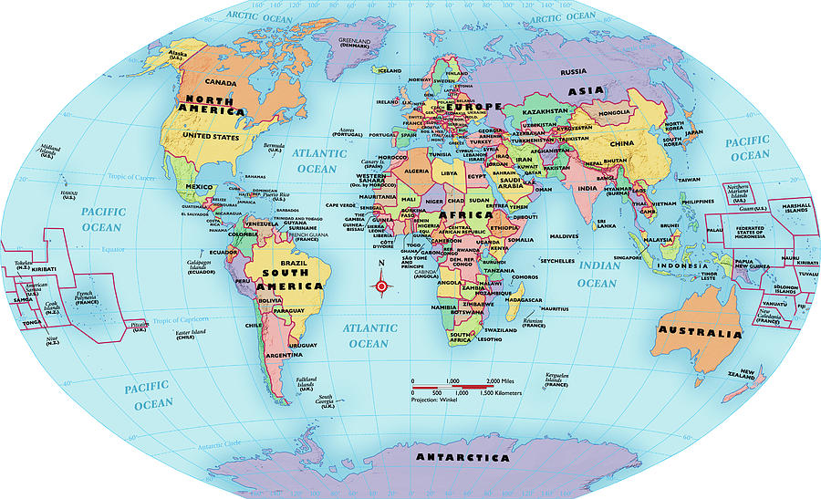

Slide 26
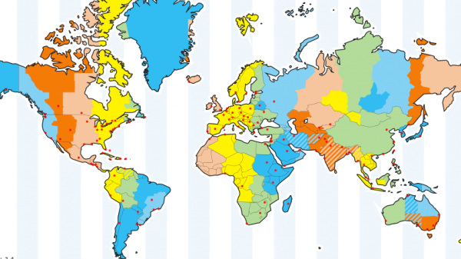
TIME ZONES
The scientists studied Earth's movements after which they came up with 24 time zones which are theoretically drawn on the world map. If each time zone is 1 hour apart, there would be 24 in the world. However, the International Date Line (IDL) creates 3 more. Also, several time zones are only 30 or 45 minutes apart, increasing the total number of standard time zones even further.
TIME ZONES FROM EAST TO WEST :
Atlantic Standard Time (AST)
Eastern Standard Time (EST)
Central Standard Time (CST),
Mountain Standard Time (MST)
Pacific Standard Time (PST)
Alaskan Standard Time (AKST)
Hawaii-Aleutian Standard Time (HST)
Samoa standard time (UTC-11)
Chamorro Standard Time (UTC+10)

Slide 27
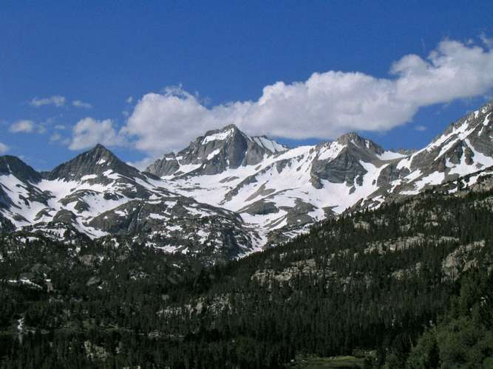
CORDILLERA - An extensive chain of mountains or mountain ranges, especially in the Americas.
The American Cordillera is a chain of mountain ranges (cordilleras) that consists of an almost continuous sequence of mountain ranges that form the western "backbone" of North America, South America and Central America. It is also the backbone of the volcanic arc that forms the eastern half of the Pacific Ring of Fire.
Since the Cordillera is known for its large forests and trees, forestry is a huge part of the economy and will continue to benefit the region. Lastly, the Cordillera is rich in lots of minerals making mining a successful industry.

Slide 28
THE PRECAMBRIAN ERA : The name means "before the Cambrian period." This old, but still common term was originally used to refer to the whole period of earth's history before the formation of the oldest rocks with recognisable fossils in them.
PRE-CAMBRIAN GRANITE SHIELDS : Cambria is the medieval name of Wales Precambrian time covers the vast bulk of the Earth's history, starting with the planet's creation about 4.5 billion years ago and ending with the emergence of complex, multicelled life-forms almost four billion years later.
Where are Pre-Cambrian rocks found?
Carbon found in 3.8 billion-year-old rocks from islands off western Greenland may be of organic origin.
Pre-Cambrian Organism - The first life is believed to be the Eubacteria (i.e., bacteria), single-celled prokaryotic organisms with no DNA-containing Nucleus. The most prevalent theory is that the Eubacteria are ancestral to the Archaea, only identified as a distinct domain of life in the 1970's.

Slide 29
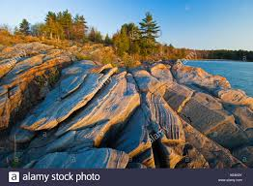
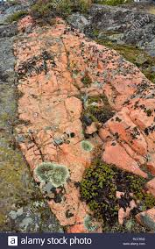
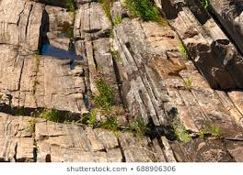
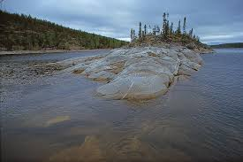
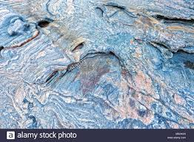
PRE-CAMBRIAN GRANITE SHIELDS

Slide 30
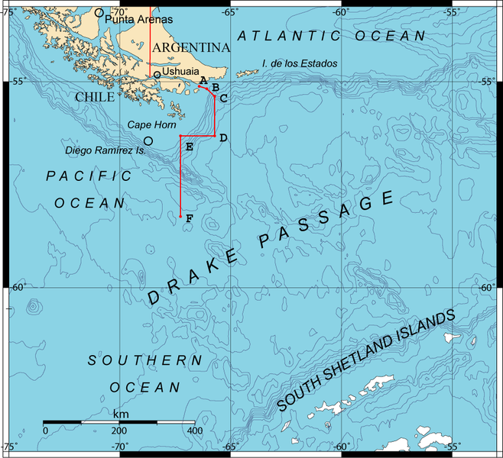
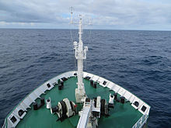
DRAKE PASSAGE : The body of water between South America’s Cape Horn, Chile and the South Shetland Islands of Antarctica. It connects the southwestern part of the Atlantic Ocean with the southeastern part of the Pacific Ocean and extends into the Southern Ocean.
Tourist expedition ship sailing across the Drake Passage to Antarctica

Slide 31
Journey to the End of the Earth - Key Points & Sequence

Slide 32
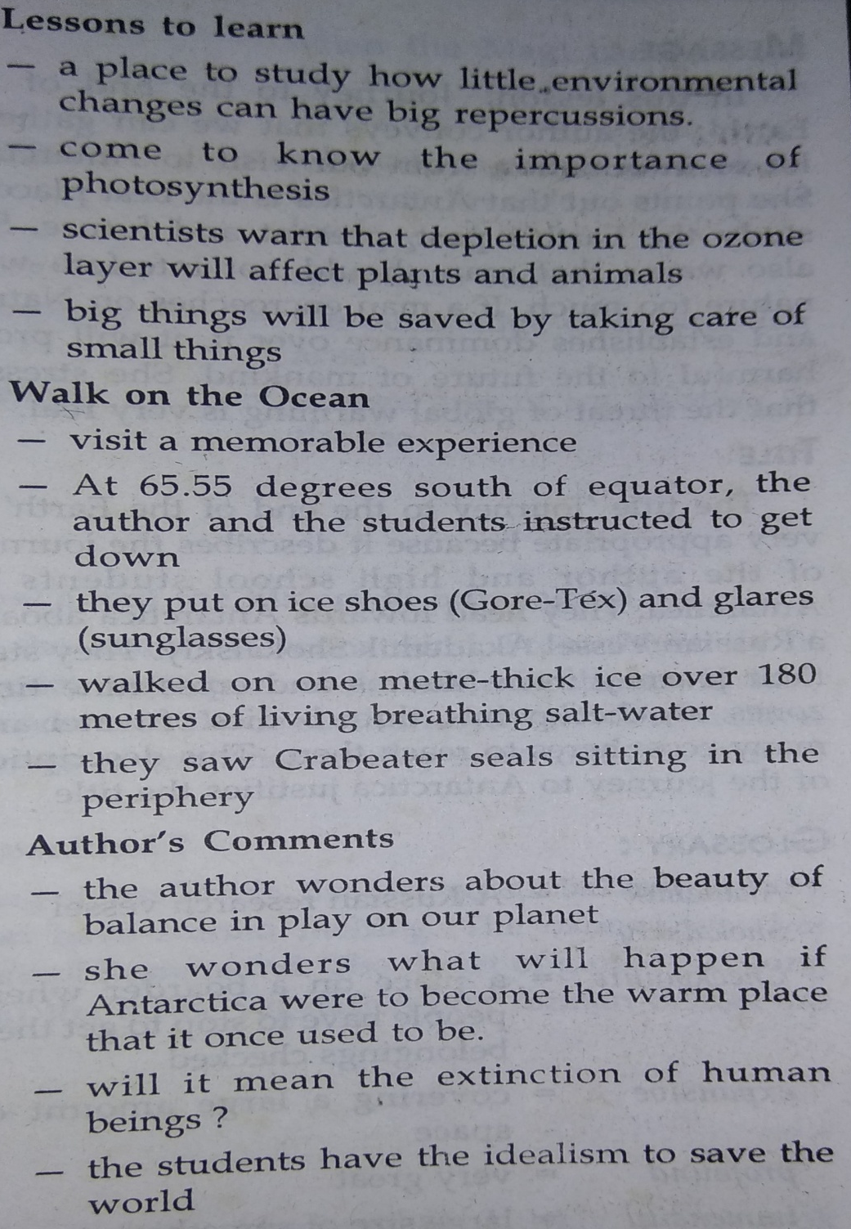
Journey to the End of the Earth - Key Points & Sequence

Slide 33
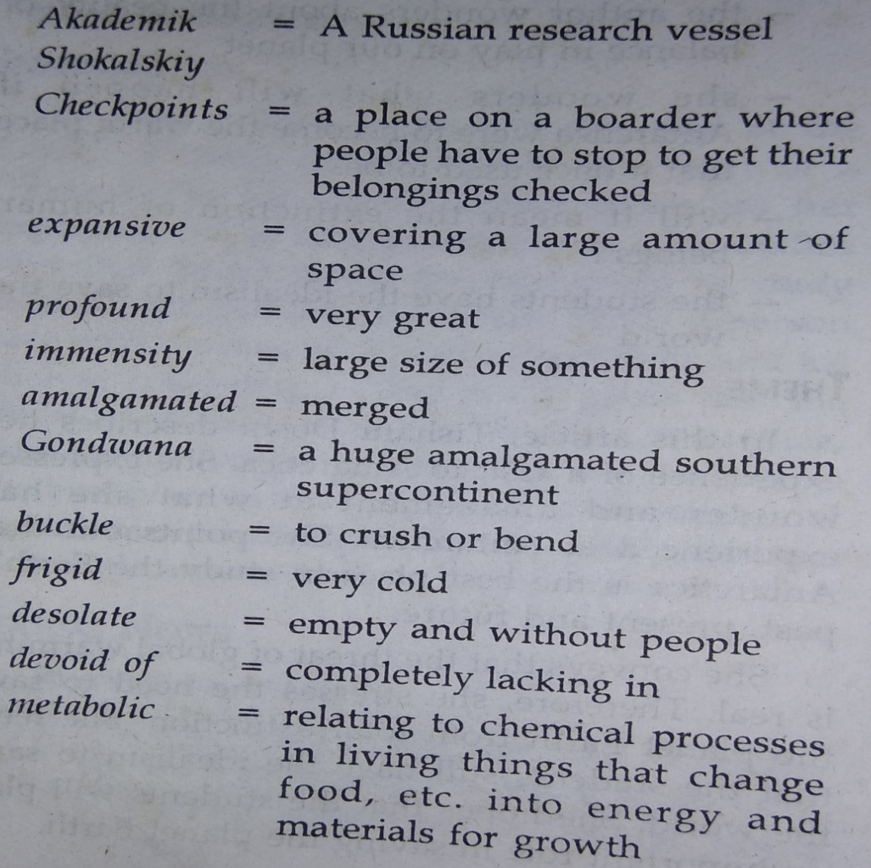
Journey to the End of the Earth - Vocabulary

Slide 34
Journey to the End of the Earth - Vocabulary
Cordilleran folds - an extensive chain of mountains or mountain ranges Precambrian granite shields - large areas of relatively low elevation that forms part
of continental masses Mind-boggling - overwhelming; startling Thrived - prosper; flourish
Calving - split and shed Immersion - submerge Prognosis - a forecast of the likely outcome of a situation

Slide 35
JOURNEY TO THE END OF THE EARTH
“If you want to know more about the planet’s past, present and future, the Antarctica is the place to go to”

Slide 36
JOURNEY TO THE END OF THE EARTH
Points to Ponder
Author’s journey to Antarctica & her feelings & emotions on reaching there
Part of History – Geological aspects- time, Gondwana – uniqueness & lives in
Antarctica
Human impact – climate change, melting of ice, premonition & the prognosis
Study of the Past (carbon reservoir- evolution), Present (ongoing changes- global
warming-melting if ice) and Future (humans may be wiped out the way dinosaurs &
mammoths were
Parable of the phytoplankton
Metaphor for existence: take care of the small things and the big things will fall into
place
Walk on the ocean
Students on the ice programme - Canadian Geoff Green and his decision to cart students rather than celebrities and retired, rich, curiosity-seekers to Antarctica - students are the future policy makers, at their age they are ready to absorb, learn, and most importantly, act.

Slide 37
JOURNEY TO THE END OF THE EARTH
ASSIGNMENT : QUESTIONS TO TEST COMPREHENSION
Short Answer Questions (30-40 words)
1. What are Geoff Green’s reasons for including high school students in the “Students on Ice” expedition?
2. “Take care of small things and the big things will take care of themselves.” Comment.
3. What are the indications for the future of mankind?
4. How does the writer feel on reaching Antarctica and why?
Long Answer Questions (125-150 words) :
1. How can a visit to Antarctica help us know about our past, present and future?
2. Describe the writer’s varied experiences, impressions and feelings regarding Antarctica during her sojourn there.
3. “You lose all Earthly sense of time and perspective here.” Describe the feelings and experiences of the writer in Antarctica.

