Slide 1
Magnetism and Matter

Slide 2
History of magnets

Slide 3
Facts about magnet

Slide 4
Magnetic field lines

Slide 5
Circular Current Loop

Slide 6
Solenoid as a Bar Magnet

Slide 7
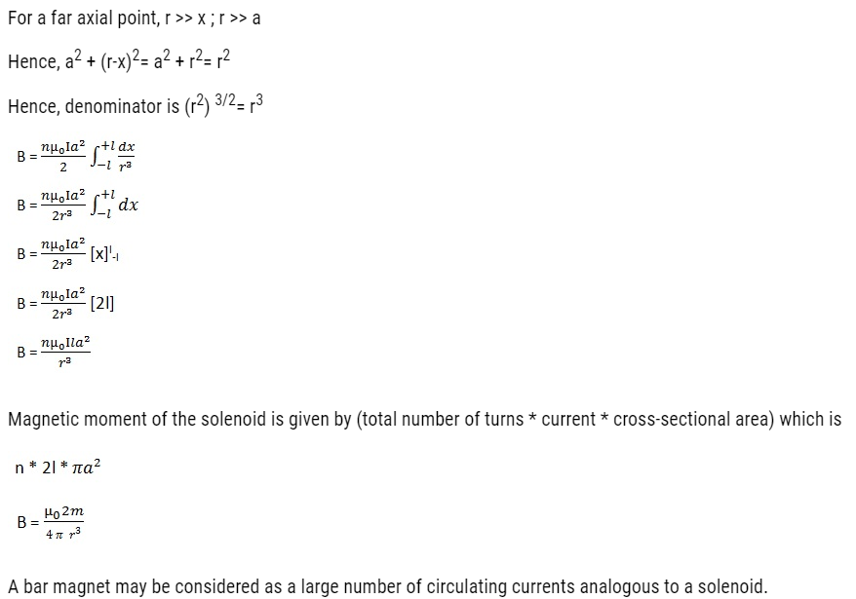

Slide 8
Analogy of Bar Magnet and Solenoid

Slide 9
Dipole in a uniform magnetic field

Slide 10
Expression for magnetic potential energy

Slide 15
Gauss’s law in magnetism

Slide 16
Earth’s Magnetism

Slide 19
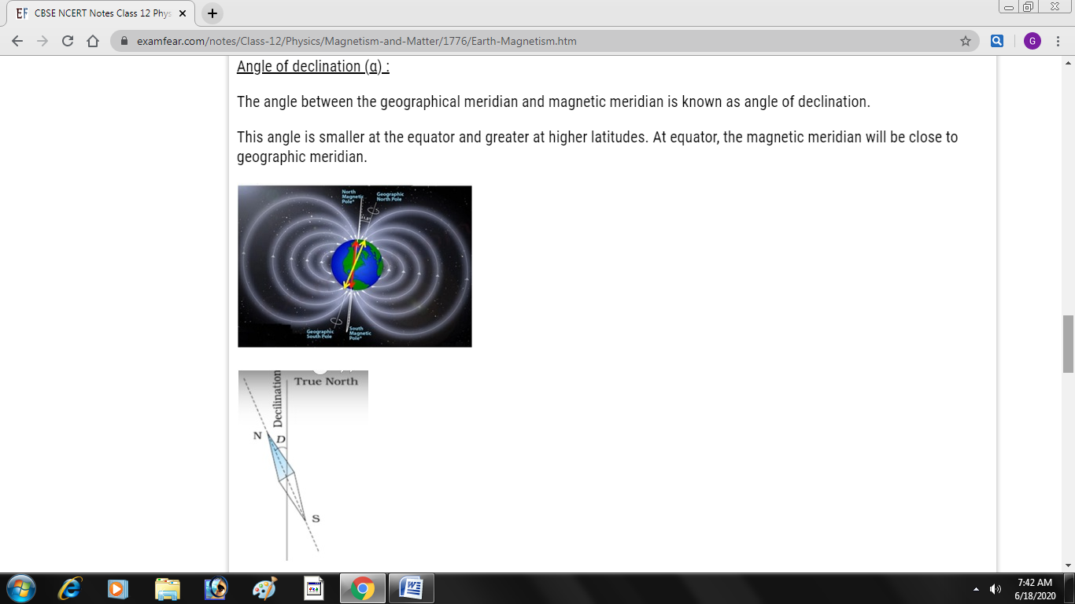
Elements of earth’s magnetic field

Slide 21
Terms used in magnetism

Slide 24
Magnetic materials

Slide 29
Key effects of magnetism

Slide 30
Key effects of magnetism

Slide 31
Types of Ferro magnets

Slide 32
Hysterisis

Slide 33
Hysterisis

Slide 34
Permanent magnets and Electromagnets

Slide 35
Permanent magnets and Electromagnets

