Slide 1
CONCEPT MAPPING
CONCEPT MAPPING ON RELATION
Domain and Range
of Relation
Reflexive
Symmetric
Equivalence Relation
Types of Relation
Transitive
RELATIONRE
Empty
Universal

Slide 2
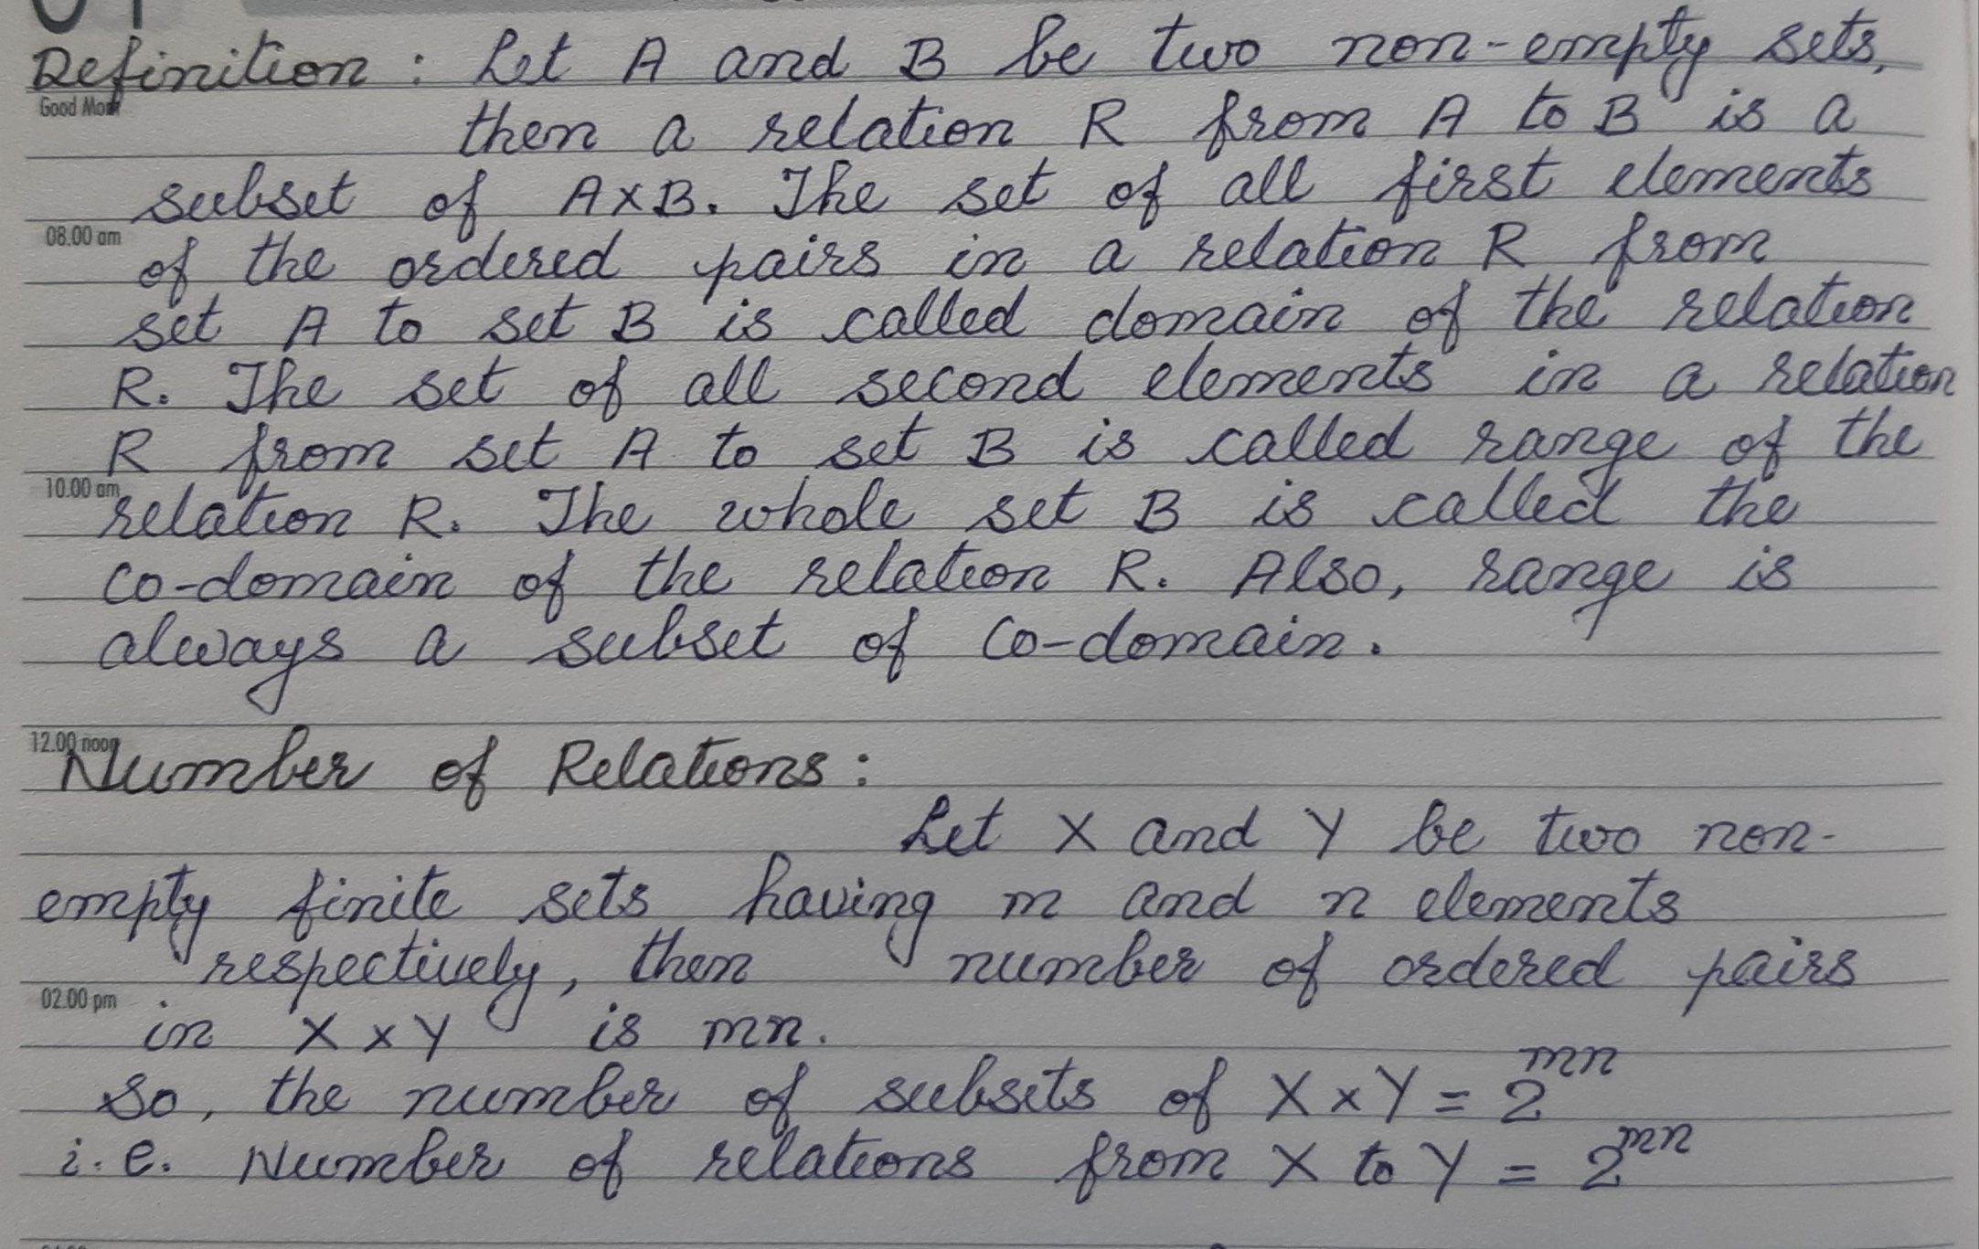

Slide 4
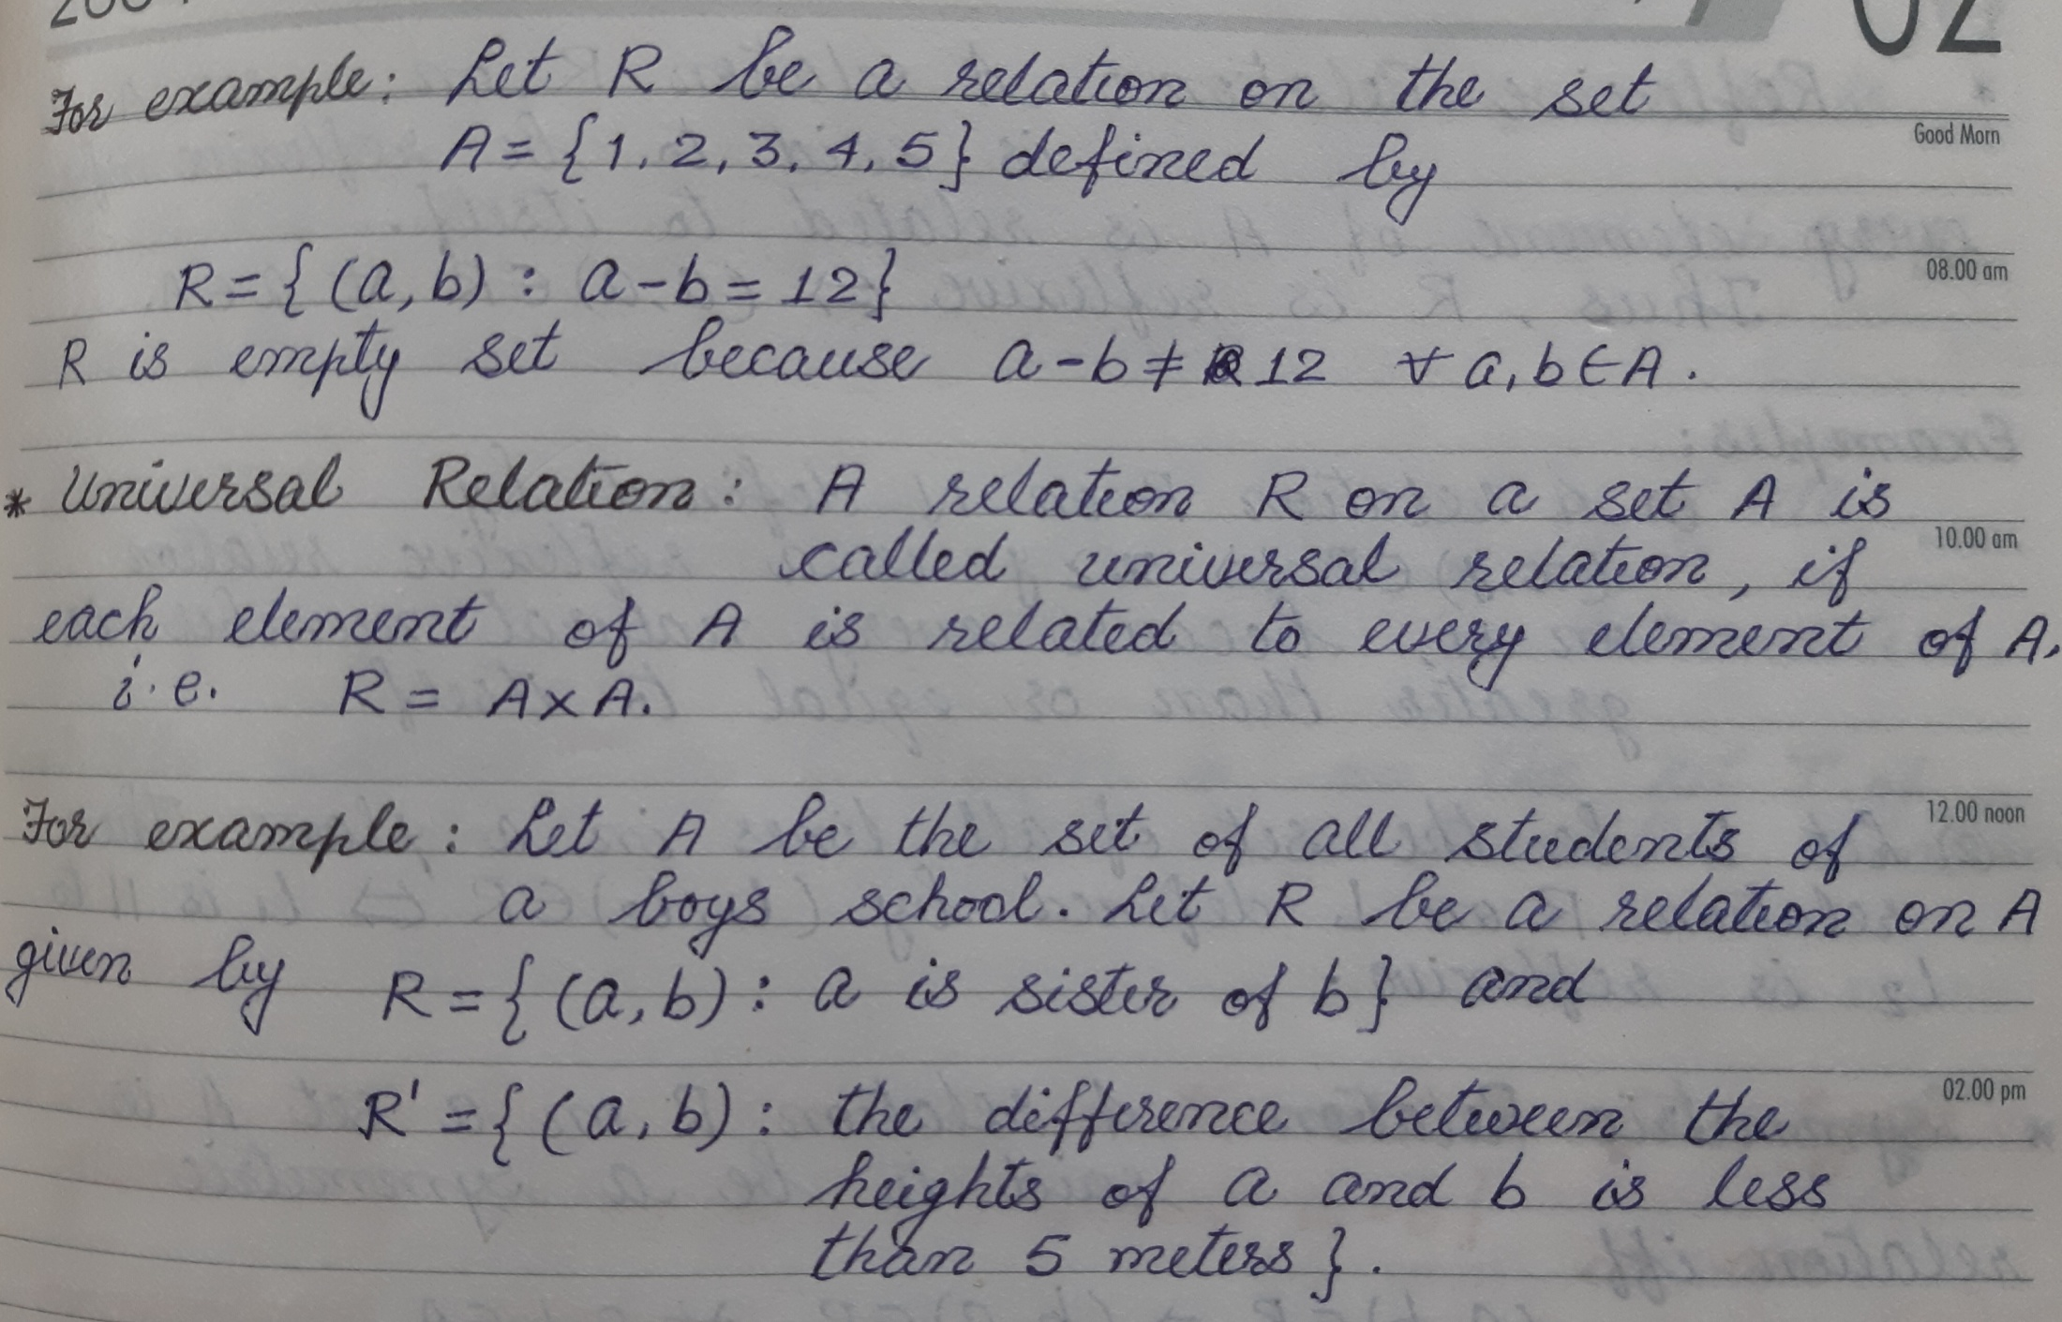

Slide 5
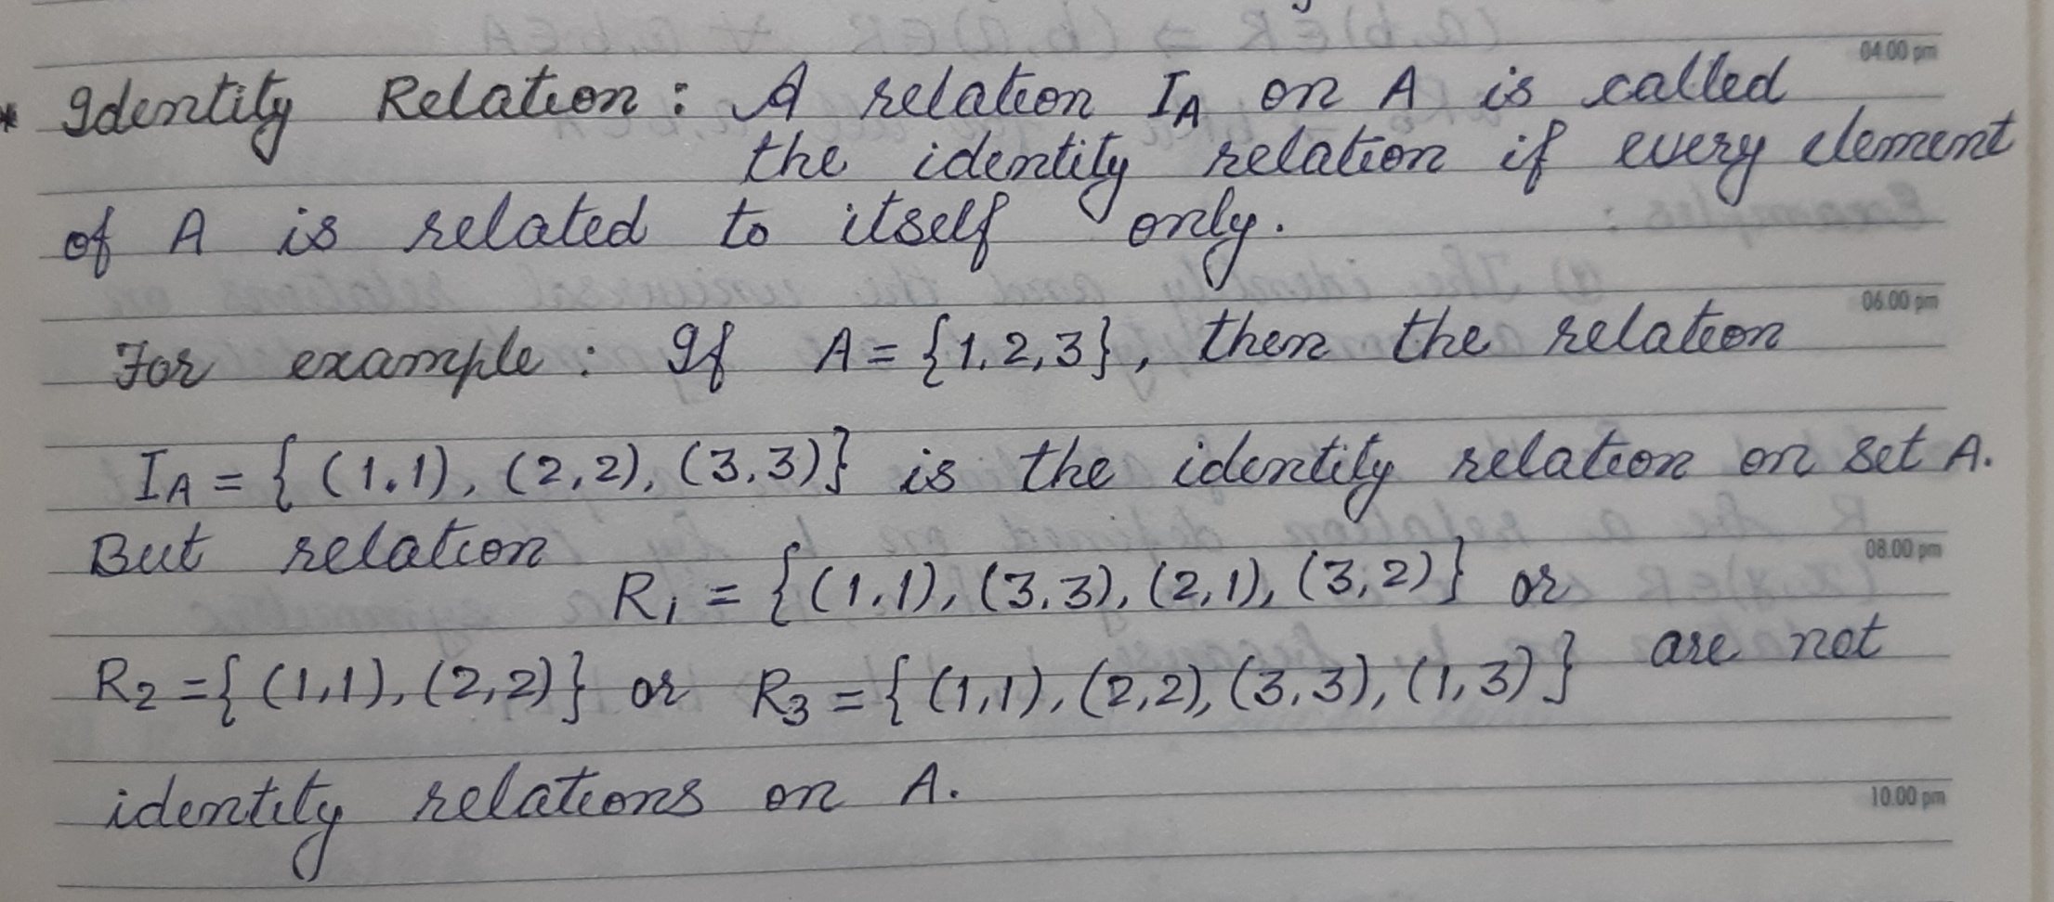

Slide 6
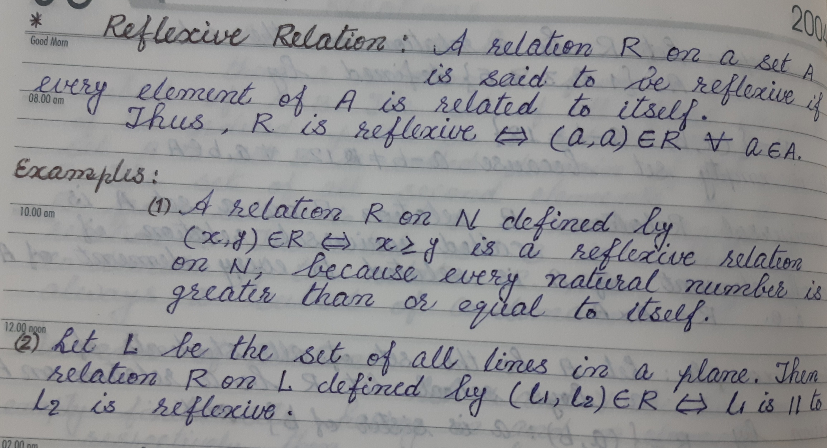

Slide 7
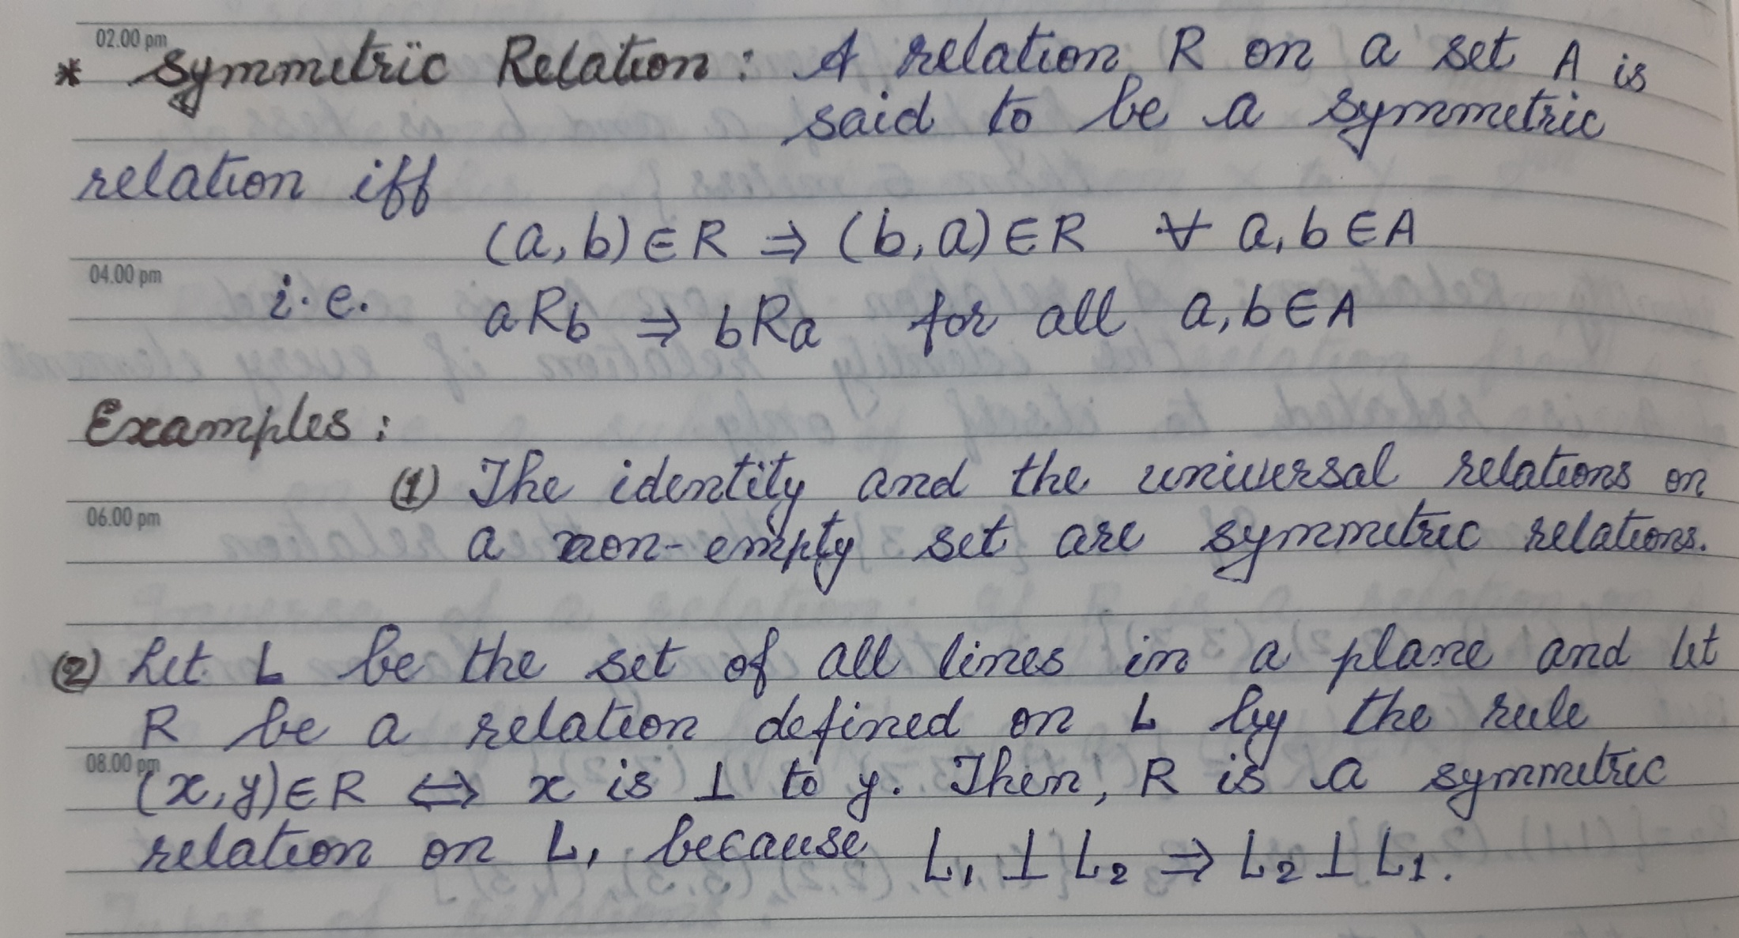

Slide 8
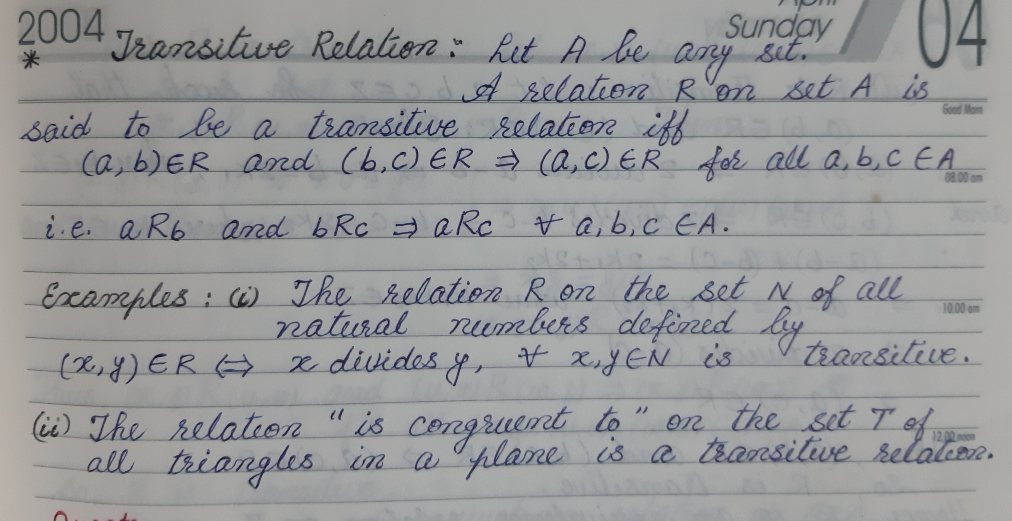

Slide 9
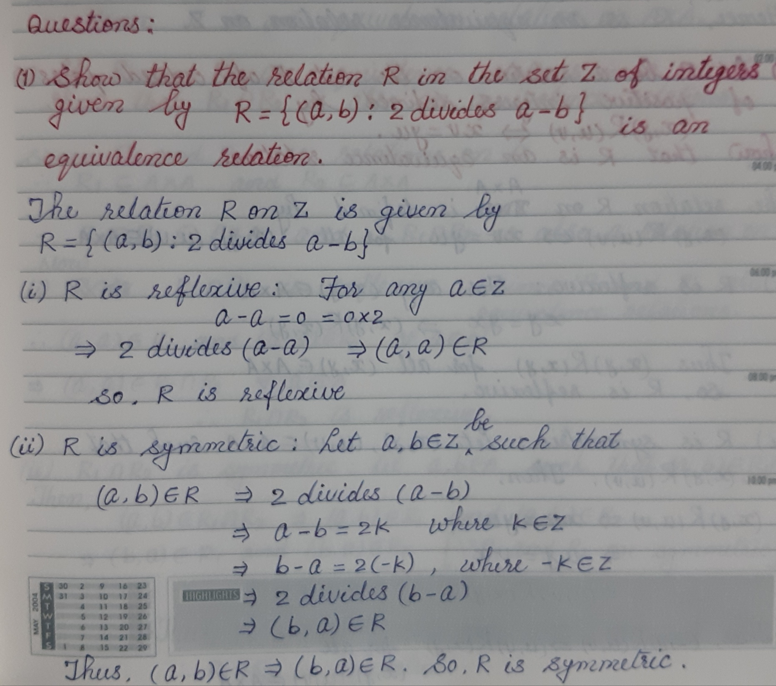

Slide 10
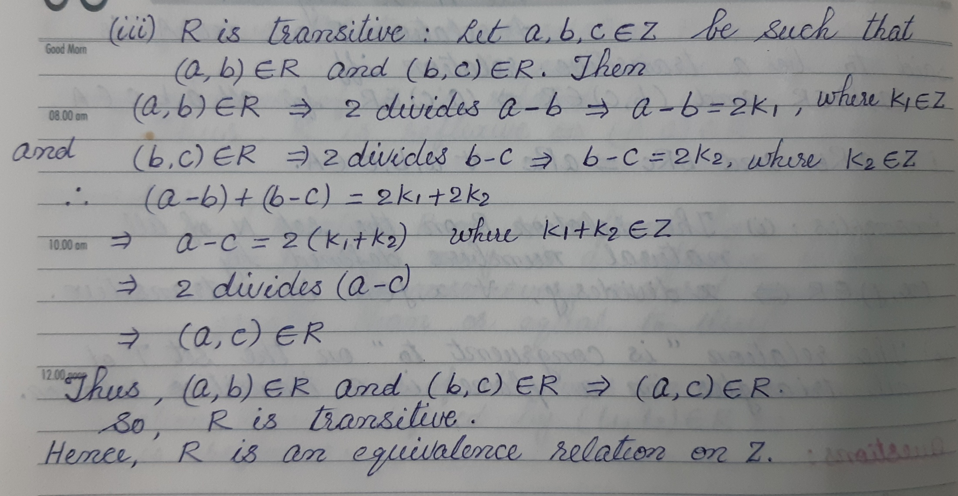

Slide 11
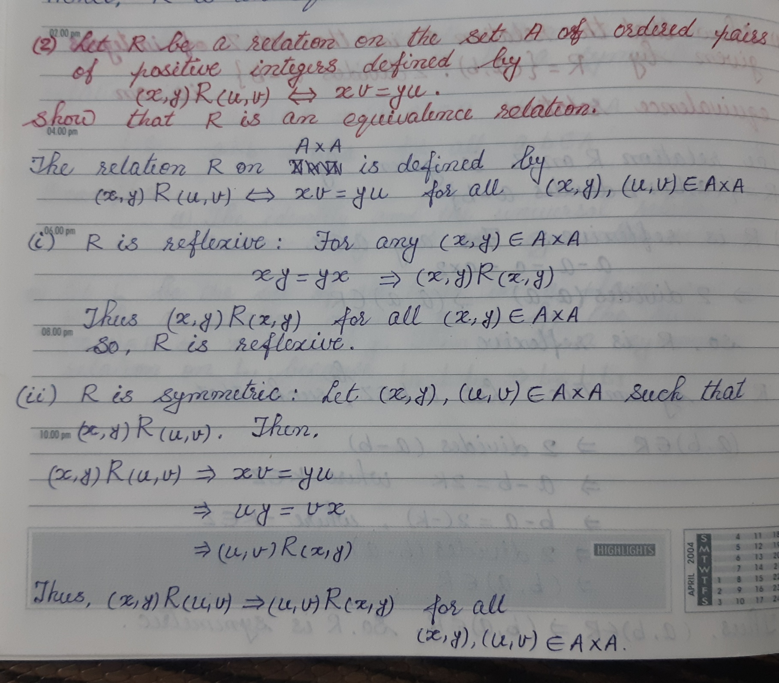

Slide 12
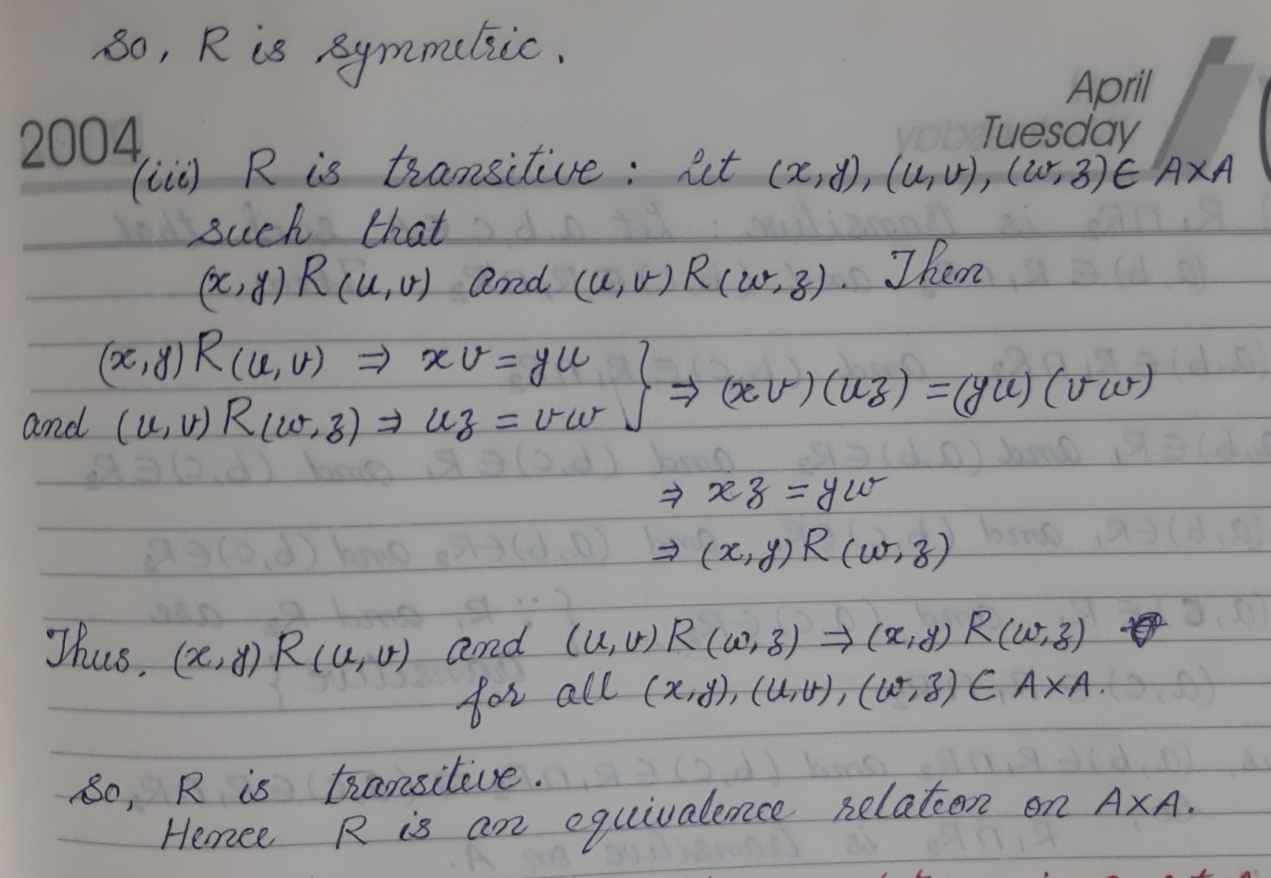

Slide 13
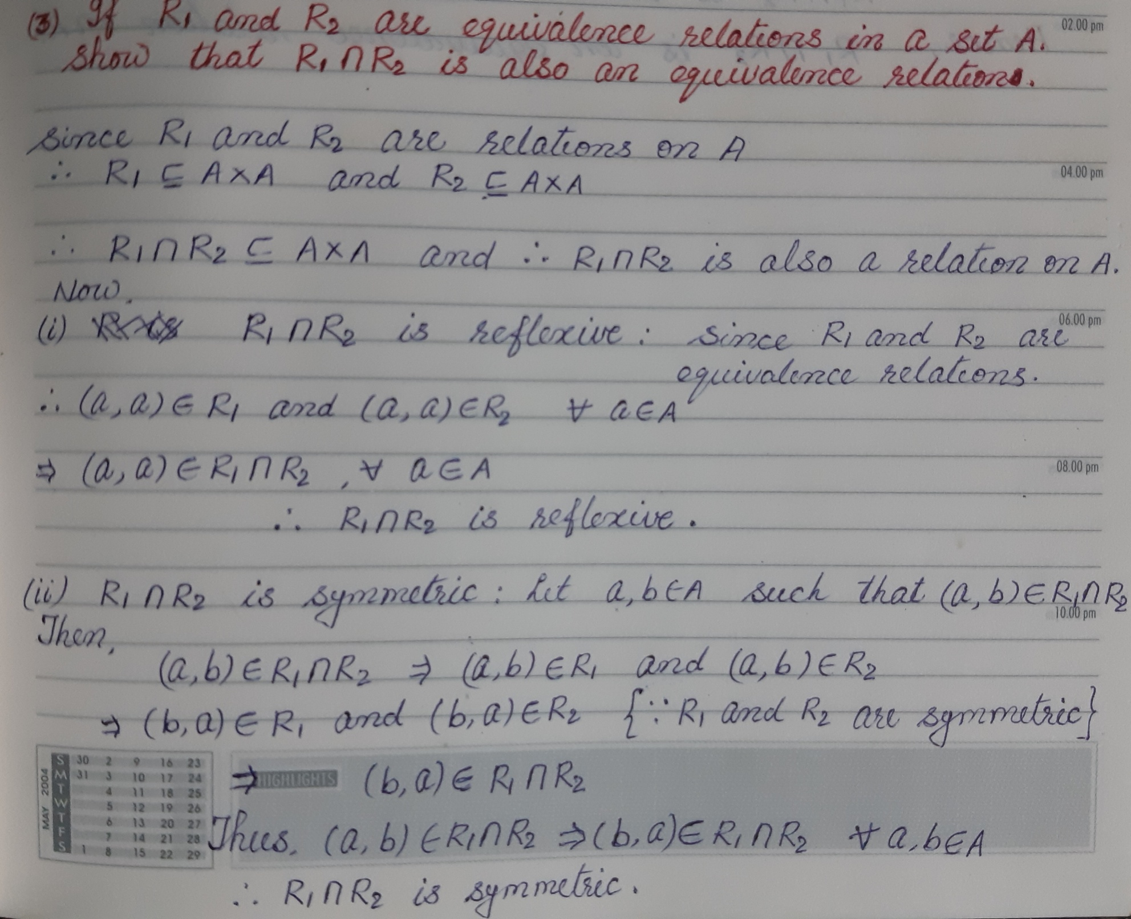

Slide 14
