Slide 1
Unit Cell
The smallest geometrical portion of the crystal lattice which can be used as repetitive unit to
build up the whole crystal is called unit cell.

Slide 2
Types of Unit Cell
Simple or primitive Unit cell In which the particles are present at the corners only.

Slide 3
Face centred unit cell
In which the particles are present at the corners as well as at the centre of each of six faces

Slide 4
Body centred unit cell In which the particles are present at the corners as well as at the centre of the unit cell.

Slide 5
End centred unit cell
In which the particles are present at the corners and at the centre of two opposite faces.

Slide 6
Density of Unit Cell
Density of Unit Cell (d)
Density of unit cell
= mass of unit cell / volume of unit cell
d = Z x M / a3
= ZM / a3 x NA
(The density of the unit cell is same as the density of the substance.)
where, d = density of unit cell
M = molecular weight
Z = no. of atoms per unit cell
NA = Avogadro number
a = edge length of unit cell.

Slide 7
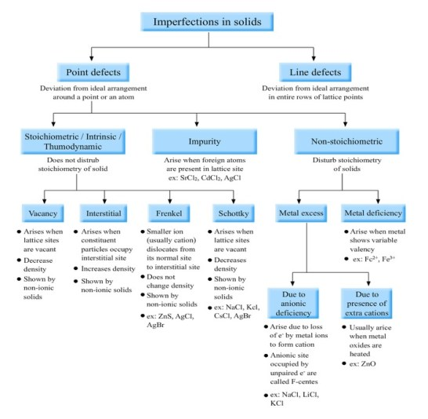

Slide 8
IMPERFECTION IN SOLIDS
Although in crystalline solid there is regular arrangement of constituent particles but yet the crystals are not perfect. There is always some king of irregularity in arrangement of constituent particles in small crystals. These irregularities are known as defects in crystal..

Slide 9
TYPES OF DEFECTS
There are 2 types of defects known in crystal lattice
POINT DEFECT
LINE DEFECT
Point defects- Point defects are the irregularities or deviations from ideal arrangement around a point or an atom in a crystalline substance.
Line defects- Line defects are the irregularities or deviations from ideal arrange ment in entire rows of lattice points.

Slide 10
POINT DEFECTS
Stoichiometric defects
Non- stoichiometric defects
Impurity defect

Slide 11
STOICHIOMETRIC DEFECTS
Vacancy defect
Interstitial defect
Frenkel defect
Schottky defect

Slide 12
Vacancy defect
It arises when some of the lattice point remains unoccupied during the crystal formation.
It occurs in non-ionic compounds
It decreases the density of solid
It can be created by heating

Slide 13
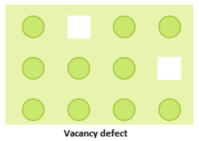
Vacancy defect

Slide 14
Interstitial defect
It arises when some of the constituent particles occupy the interstitial sites other than the lattice points. It occurs in non-ionic compounds It increases the density of solid

Slide 15
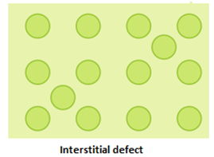
Interstitial defect

Slide 16
Frenkel defect
It is actually the combination of vacancy defect and interstitial defect in ionic compound. It arises when smaller ion is dislocated from its normal site and occupies an interstitial site. It is also known as dislocation defect.
It occurs in ionic compounds
It does not change the density of solid
Shown by ionic compound having large difference in their constituent ions.
For example: ZnS, AgBr, AgI etc.

Slide 17
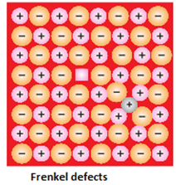
Frenkel defect

Slide 18
Schottky defect
It is actually a vacancy defect. But it causes vacancy of cation and anion both.
It occurs in ionic compounds
It decrease the density of solid
Shown by ionic compound having similar size of cation and anion
For example: NaCl, KCl, AgBr.

Slide 19
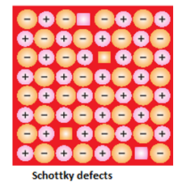
Schottky defect

Slide 20
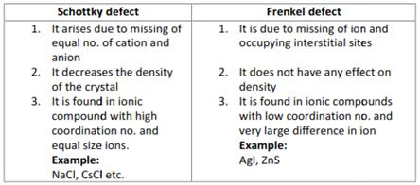
DIFFERENCE BETWEEN SCHOTTKY AND FRENKEL DEFECT

Slide 21
Non- stoichiometric defects
Metal excess defect
Metal deficiency defect

Slide 22
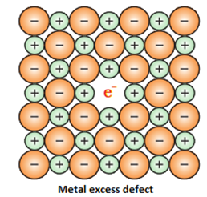
Metal excess defect

Slide 23
Reasons for the cause of metal excess defect
a) Anionic vacancies: A compound may have an extra metal ion if the negative ion is absent from its lattice site.This empty lattice site is called a hole.To maintain electrical neutrality this site is occupied by an electron. The hole occupied by an electron is called f-centre or Farbenz enter centre. The F- centre is responsible for the colour of the compound.
b) Presence of extracations: A compound is said to have extracations if a cation is present in the interstitial site. An electron is present in the interstitial site to maintain the electrical neutrality.

Slide 24
Metal deficiency
Metal deficiency: This defect arises because of absence of metal ions from its lattice sites. The electrical neutrality is maintained by an adjacention having a higher positive charge.

Slide 25
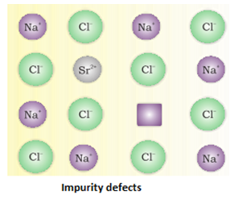
IMPURITY DEFECTS
Impurity defect is arises due to addition of small amount of impurity in ionic solid. It actually creates some kind of cationic vacancy in ionic solid. For example, if some SrCl2 is added in molten salt of NaCl it takes the position of Na+ in the crystal. But charge on Sr is 2+. After removing 2 ions of Na+, Sr2+ occupy one point only. In this way it causes vacancy of 1 point.

