Slide 1
INTERMOLECULAR FORCES
Intermolecular forces are the forces of attraction and repulsion between interacting particles (atoms and molecules). This term does not include the electrostatic forces that exist between the two oppositely charged ions and the forces that hold atoms of a molecule together.
Dispersion Forces or London Forces
Atoms and non polar molecules are electrically symmetrical and have no dipole moment because their electronic charge cloud is symmetrically distributed. But a dipole may
develop momentarily even in such atoms and molecules.

Slide 3
Dipole - Dipole Forces
Dipole-dipole forces act between the molecules possessing permanent dipole. Ends of the dipoles possess “partial charges” and these charges are shown by Greek letter delta (δ).
Partial charges are always less than the unit electronic charge (1.6×10–19 C). The polar molecules interact with neighbouring.molecules.
Molecules shows electron cloud distribution in the dipole of hydrogen chloride shows dipole-dipole interaction between two HCl molecules. This interaction is stronger than the London forces but is weaker than ion-ion interaction because only partial charges are involved

Slide 5
Dipole–Induced Dipole Forces
This type of attractive forces operate between the polar molecules having permanent dipole and the molecules lacking permanent dipole. Permanent dipole of the polar molecule induces dipole on the electrically neutral molecule by deforming its electronic cloud. Thus an induced dipole is developed in the other molecule. In this case also interaction energy is proportional to 1/r 6

Slide 7
Thermal energy
Thermal energy is the energy of a body arising from motion of its atoms or molecules. It is directly proportional to the temperature of the substance. It is the measure of average kinetic energy of the particles of the matter and is thus responsible for movement of particles This movement of particles is called thermal motion

Slide 8
Boyle’s Law
The pressure of fixed msss of gas varies inversely with the volume at constant T.
Mathematically
P α 1/V (when n & T are const.)
P₁V₁ =P ₂V ₂

Slide 9
Charle’s Law
At constant P, the volume of fixed amount of gas varies directly with its absolute temperature.
Mathematically
V α T
V=KT

Slide 10
Gay lussac’s Law
At constant V, The pressure of fixed amount of gas varies directly with its absolute temperature
Mathematically

Slide 11
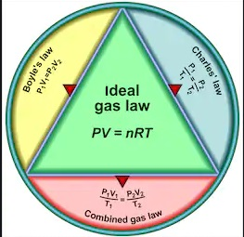

Slide 12
IDEAL GAS EQUATION
The three laws which we have learnt till now can be combined together in a single equation which is known as ideal gas equation.
At constant T and n; V ∝1/p Boyle’s Law
At constant p and n; V ∝ T Charles’ Law
At constant p and T ; V ∝ n Avogadro Law
Thus,
V∝ nT/P
where R is proportionality constant. On rearranging the equation we obtain
pV = n RT
⇒ R =pV/nT
R is called gas constant. It is same for all gases.
Therefore it is also called Universal Gas Constant.

Slide 14
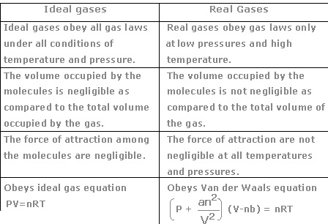

Slide 15
Avogadro’s Law
At given T and P, the volume of gasvaries directly to the amount of gas .
Mathematically
V α n ( P, T constant)

Slide 16
Dalton’s Law of partial pressure
The pressure exerted by a mixture of non reacting gases is equal to the sum of their partial pressure at constant (V,T)
Mathematically,
P (total ) = P1 + P2 + P3 + ………. (T, V, constant)

Slide 17
KINETIC MOLECULAR THEORY
a.Gases consist of large number of identical particles (atoms or molecules) that are so small that the actual volume of the molecules is negligible in comparison to the empty space between them. b. There is no force of attraction between the particles of a gas at ordinary temperature and pressure c. Particles of a gas are always in constant and random motion d. Pressure is exerted by the gas as a result of collision of the particles with the walls of the container e. Collisions of gas molecules are perfectly elastic f. At any particular time, different particles in the gas have different speeds and hence different kinetic energies g. Average kinetic energy of the gas molecules is directly proportional to the absolute temperature

Slide 18
Real Gases : The gases which deviates from Ideal behavior at higher pressure and low temperature
Compressibility factor (Z) : It determine extent of deviation of real gases from Ideal gas behavior
for Ideal gas Z=1,
For Nonideal gas Z< 1, Z > 1

Slide 19
Vander Walls equations
The constants a and b have positive values and are characteristic of the individual gas. The van der Waals equation of state approaches the ideal gas law

Slide 20
Critical Temperature : (Tc) The temperature above which a gas cannot be liquefied whatever high pressure may be
Critical Pressure : The minimum pressure required to liquity a gas at its critical temperature.
Critical Volume : The volume of 1 mole of gat at Tc, Pc.
Super cooled liquids : The liquids which are cooled to a temperature below its freezing point without freezing .
Elastic Collision : The collisions in which no loss of K.E. only there is transfer of energy.

Slide 21
Vapour pressure : The equilibrium pressure by vapour of liquid in a container at given temperature (T)
At higher altitude : The b.p. of water decreases b/c the atmospheric pressure is less than one atmosphere.
Surface Tension (V) : It is force acting per unit length perpendicular to the line drawn on the surface : (Nm⁻¹) :
It decreases with increases in T, it increases with increase in external pressure, b/c of it falling drops of liquid are spherical, liquid in capillary tube rises.

Slide 22
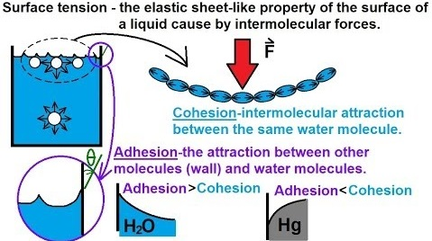

Slide 23
Viscosity (η): It is resistance offered to the flow of liquid due to friction between layers of fluids.
F=n A dv/dn
Effect of T & P on viscosity :
It decreases with increase in T, and increases with increase in P.

Slide 24
BIBLOGRAPHY
Google.com
NCERT Text Book

