Slide 1
1/05/20
INTRODUCING PYTHON PANDAS
PANDAS
Pandas or Python Pandas is Python’s library for data analysis.
Pandas has derived its name from “Panel data system”, (term used for structured data sets.
It is useful for data analysis and manipulation.
Data analysis: refers to process of evaluating big data sets using statistical tools
to discover useful information and conclusions to support business decision –making.

Slide 2
Pandas provide powerful and easy-to-use data structures, as well as the means to quickly perform operations on these structures.
WHY Pandas ?
It is capable of many tasks including
It can read or write in many different data formats( integer, float, double etc)
It can calculate in all ways data is organised i.e across rows and columns.
It can easly select subsets of data from bulky data sets and even combine multiple datasets together.
It has functionality to find and fill missing data.

Slide 3
It allows you to apply operations to independent groups within data.
It supports reshaping of data into different forms.
It supports advance time series functionality(time series forecasting is the use of a model to predict future values based on previously observed values.)
It supports data visualization.

Slide 4
2/05/20
DATA STRUCTURE IN PANDAS
DATA STRUCTURE:-
It refers to specialized way of storing and organizing data in a computer so that it can be accessed and we can apply a specific type of functionality on them as per requirements.
Pandas deals with 3 data structure
Series
Data Frame
Panel
We are having only Series and data frame in our syllabus

Slide 5
SERIES
Series :- Series is a one-dimensional array like structure with homogeneous data(meaning –of the same kind), which can be used to handle and manipulate data. It is special because of its index attribute, which has incredible(Unbelievable)
Functionality and is heavily mutable.
It has two parts:--
Data part(An array of actual data)
Associated index with data( associated array of indexes or data labels)
e.g---
Index | Data
0 | 10
1 | 15
2 | 18
3 | 22

Slide 6
Pandas data structures is enhanced versions of NumPy structured array.
FOR WORKING IN PANDAS WE GENERALLY IMPORT BOTH PANDAS AND NUMPY LIBRARIES
NumPy is used because in Pandas’ some function return result in form of NumPy arrays(Pandas library’s data manipulation capabilities have been built over NumPy library)

Slide 7
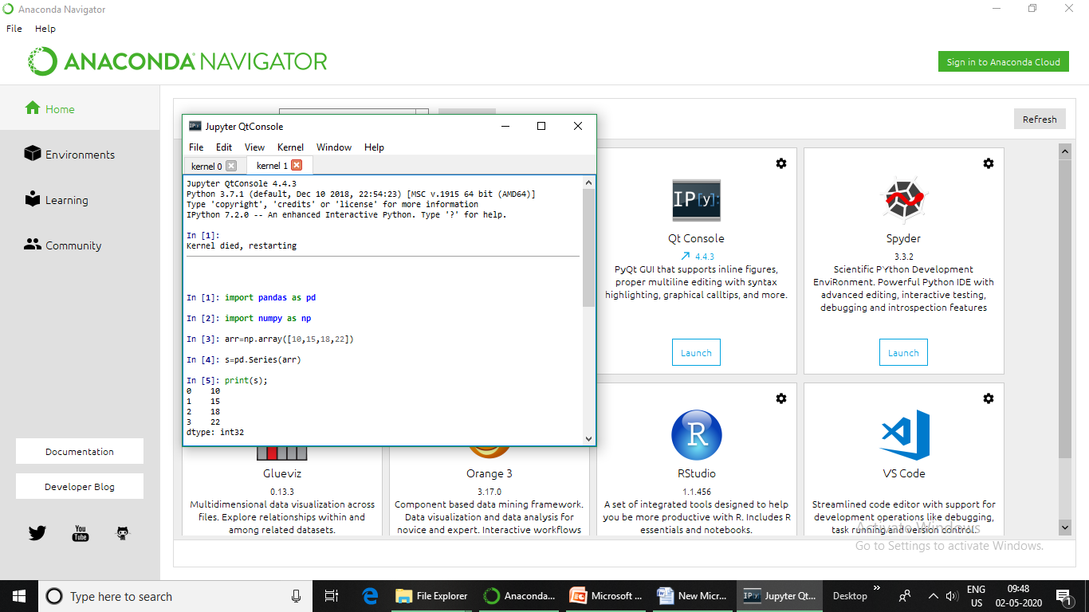

Slide 8
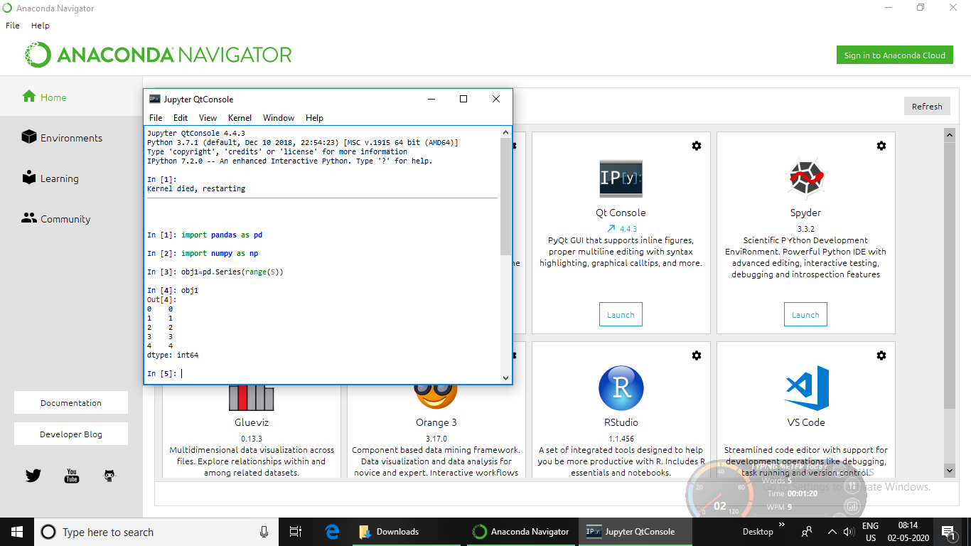

Slide 9
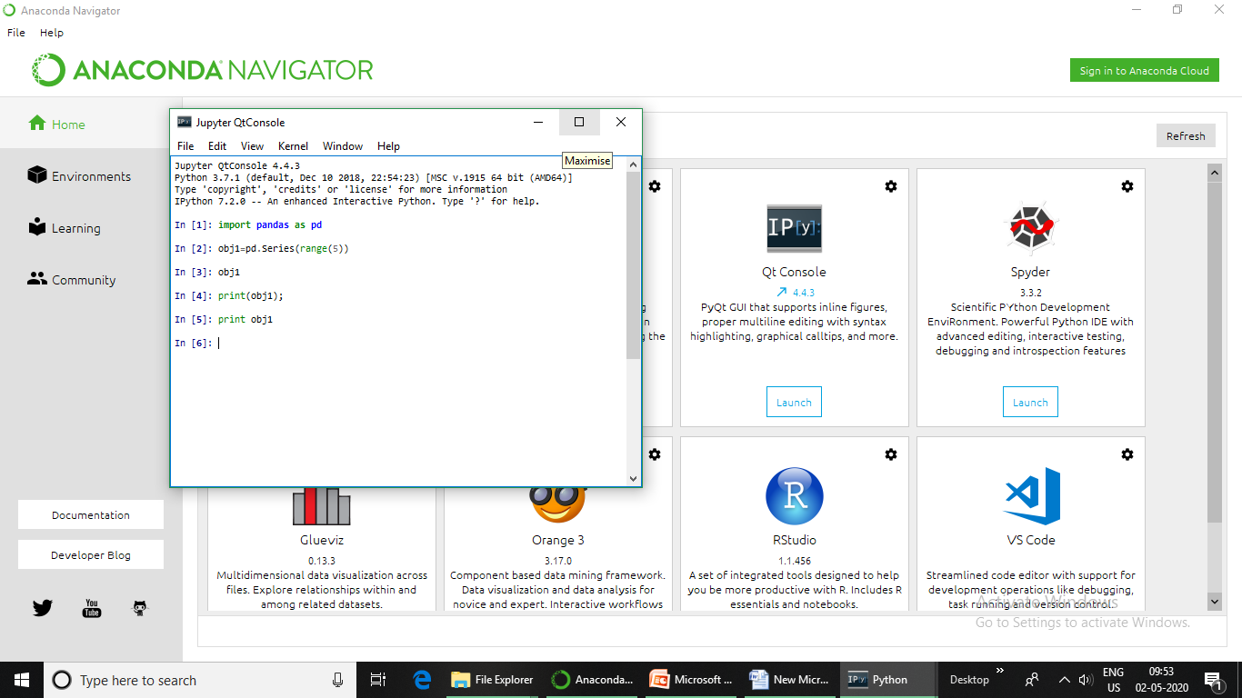

Slide 10
04/05/20
CREATION OF SERIES FROM
Ndarray
Dictionary
Scalar value

Slide 11
5/05/20
USE OF MATHEMATICAL FUNCTION TO CREATE DATA ARRAY IN Series().

Slide 12
The Series( ) allows us to define a function that can calculate values for data sequence.
eg
import pandas as pd
import numpy as np
a=np.arange(9,13)
print (a)
[ 9 10 11 12]
S=pd.Series(index=a,data=a*2)
S
Out[6]:
9 18
10 20
11 22
12 24
dtype: int32

Slide 14
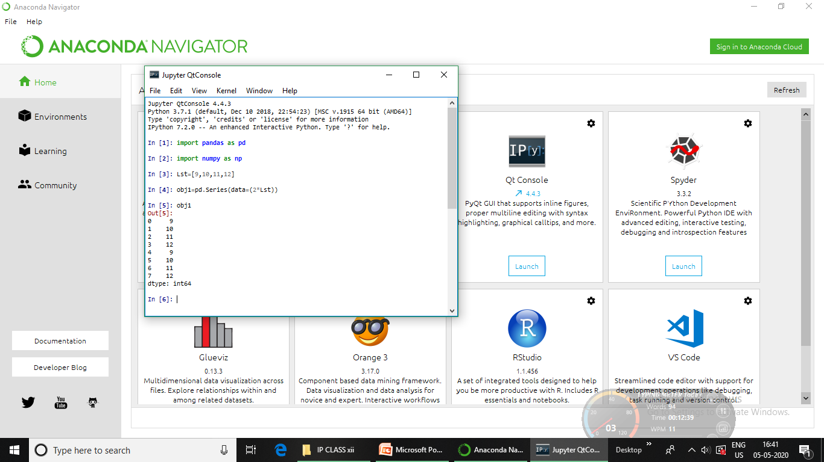

Slide 15
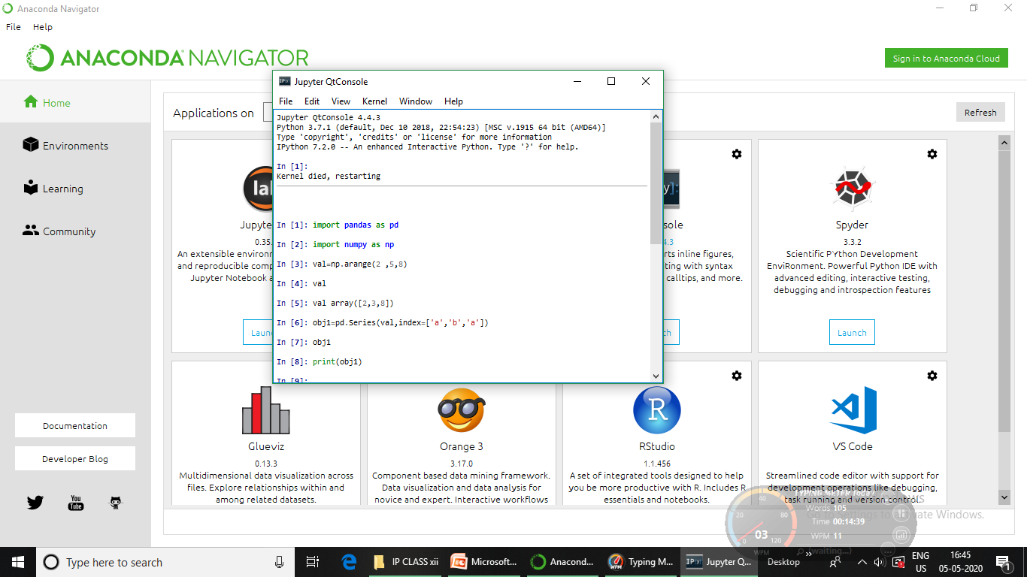

Slide 16
6/05/20
SERIES OBJECT ATTRIBUTES
SERIES ATTRIBUTES
When we create Series all information related to it (such as size, its datatype etc) is available through attributes .
We can use these attributes in the following format to get information about the Series object.
<series object>.<attribute name>

Slide 17
ATTRIBUTE | DESCRIPTION
Series.index | The index(axis labels) of the series s.index RangeIndex(start=0, stop=4, step=1)
Series.values | Return Series as ndarray ndarray-like depending on the dtype s.Values array([2, 6, 7, 9])
Series.dtype | Return the dtype object of the underlying data s.dtype dtype('int32')
Series.size | Return the number of elements in the underlying data print(s.size) 4

Slide 19
7/05/20
Series.itemsize | Return the size of the dtype of the item of the underlying data s.Itemsize 4
Series.nbytes | Return the number of bytes in the underlying data print(s.nbytes) 16 (nbytes is equal to the size*itemsize)
Series.ndim | Return the number of dimensions of the underlying data s.ndim Out[6]: 1

Slide 20
ATTRIBUTE | DESCRIPTION
Series.hasnans | Return True if there are NaN values; otherwise return False s.hasnans False
Series.empty | Return True if the Series object is empty, false otherwise s.empty Out[8]: False import pandas as pd obj1=pd.Series([]) obj1.empty Out[14]: True

Slide 21
7/05/20
Series.itemsize | Return the size of the dtype of the item of the underlying data s.Itemsize 4
Series.nbytes | Return the number of bytes in the underlying data print(s.nbytes) 16 (nbytes is equal to the size*itemsize)
Series.ndim | Return the number of dimensions of the underlying data s.ndim Out[6]: 1

Slide 22
ATTRIBUTE | DESCRIPTION
Series.hasnans | Return True if there are NaN values; otherwise return False s.hasnans False
Series.empty | Return True if the Series object is empty, false otherwise s.empty Out[8]: False import pandas as pd obj1=pd.Series([]) obj1.empty Out[14]: True

Slide 23
8/05/20
ACCESSING A SERIES OBJECT AND ITS ELEMENTS
After creating Series type object, we can access it in many ways. We can access its
indexes separately
Its data separately
Access individual elements and slices

Slide 24
Accessing individual elements
To access individual elements of a series object, we can give its index in square brackets along with its name
eg Series object name [valid index]

Slide 25
2. Extracting Slices from Series Object
We can extract slices too from a Series object .
Slicing is a powerful way to retrieve subsets of data from a pandas object.
Slicing takes place position wise and not the index wise in a series object.
Eg obj1 position
0
1
Index | Data
Feb | 28
Jan | 31

Slide 27
S[1:]
S[1:3]

Slide 28
9/05/20
OPERATIONS ON SERIES OBJECT
After creating Series type object, we can perform various types of operations on pandas SERIES OBJECTS.
Modifying Elements of Series Object
The head() and tail() functions
Vector Operations on Series Objects
Arithmetic on Series objects
Filtering Entries

Slide 29
Modifying Elements of Series Object
The data values of a Series object can be easily modified through item assignment
eg (a) Series object[index]= newvalue
above assignment will change the data value of the given index in Series object.
(b) Series object[star:stop]=newvalue
above assignment will replace all the values falling in given slice

Slide 30
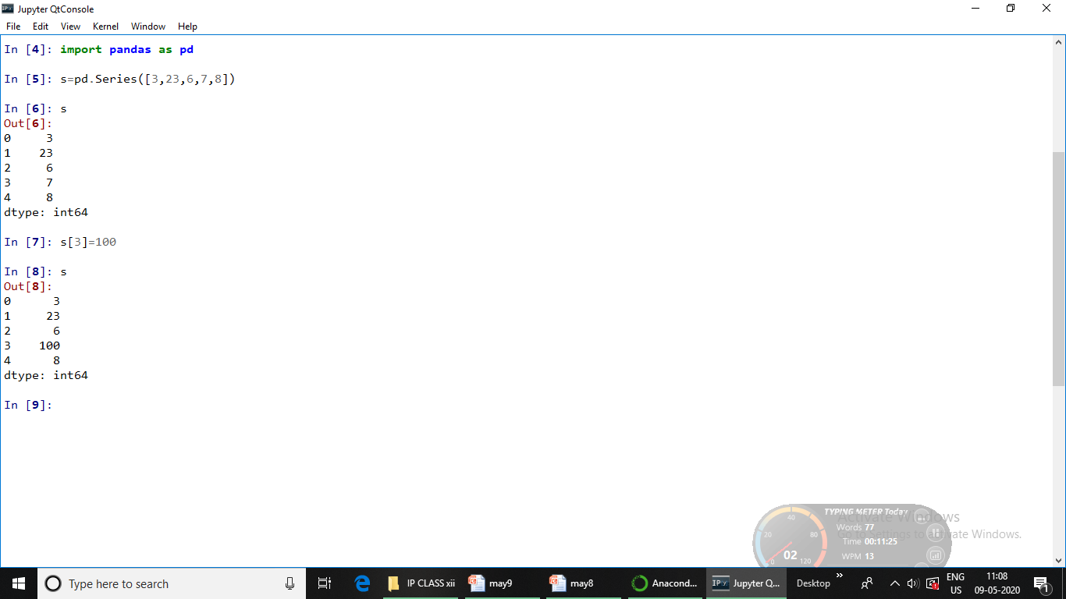

Slide 31
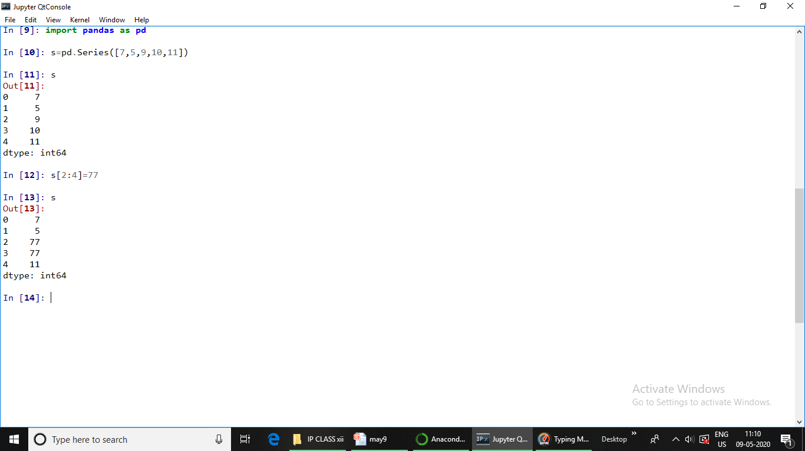

Slide 32
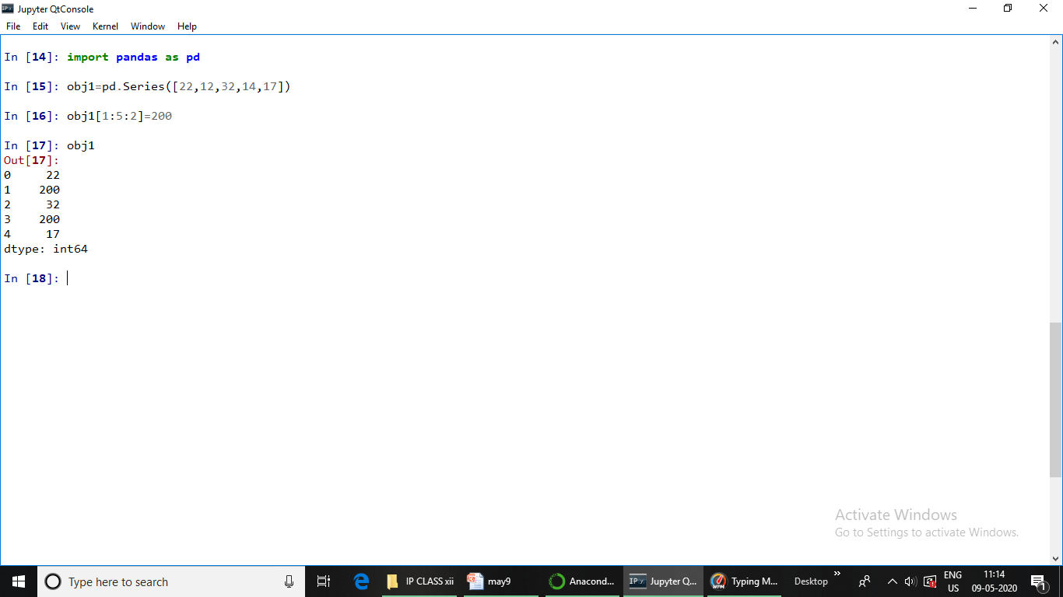

Slide 33
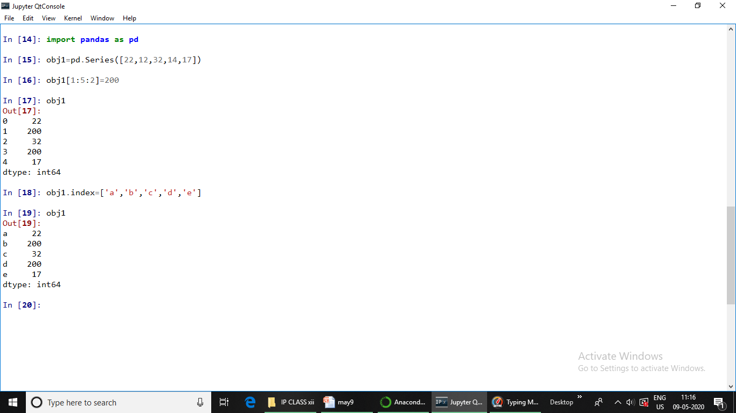

Slide 34
Please note that Series object’s values can be modified but size cannot. So we can say that Series object are value-mutable but size-immutable objects.

Slide 35
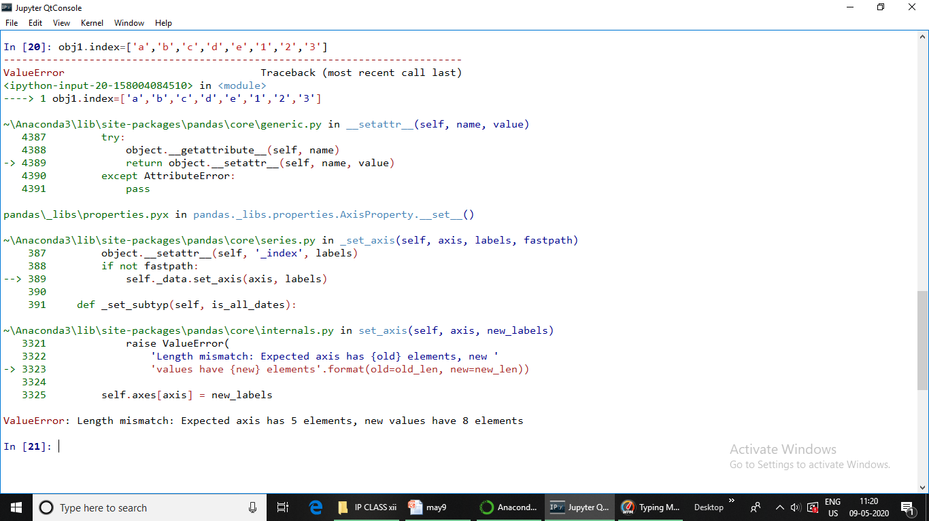

Slide 36
11/05/20
OPERATIONS ON SERIES OBJECT
After creating Series type object, we can perform various types of operations on pandas SERIES OBJECTS.
Modifying Elements of Series Object
The head() and tail() functions
Vector Operations on Series Objects
Arithmetic on Series objects
Filtering Entries

Slide 37
The head() and tail() functions
head():- It is used to access the first n rows of a Series.
pandas object.head()
tail():- returns last n rows from a pandas object.
pandas object.head()

Slide 38
import pandas as pd
s=pd.Series([2,3,21,12,31,7,8])
s
Out[3]:
0 2
1 3
2 21
3 12
4 31
5 7
6 8
dtype: int64

Slide 39
s
Out[7]:
0 2
1 3
2 21
3 12
4 31
5 7
6 8
dtype: int64
s.head(4)
Out[8]:
0 2
1 3
2 21
3 12
dtype: int64

Slide 40
import pandas as pd
s=pd.Series([2,3,21,12,31,7,8])
s
Out[3]:
0 2
1 3
2 21
3 12
4 31
5 7
6 8
dtype: int64
s.tail(3)
Out[9]:
4 31
5 7
6 8
dtype: int64

Slide 41
VECTOR OPERATIONS ON SERIES OBJECTS
import pandas as pd
s=pd.Series([2,3,21,12,31,7,8])
s
Out[3]:
0 2
1 3
2 21
3 12
4 31
5 7
6 8
dtype: int64
s+2
Out[10]:
0 4
1 5
2 23
3 14
4 33
5 9
6 10
dtype: int64
s*3
Out[11]:
0 6
1 9
2 63
3 36
4 93
5 21
6 24

Slide 42
import pandas as pd
s=pd.Series([2,3,21,12,31,7,8])
s
Out[3]:
0 2
1 3
2 21
3 12
4 31
5 7
6 8
dtype: int64
s=s**2
Out[16]:
0 4
1 9
2 441
3 144
4 961
5 49
6 64
dtype: int64

Slide 43
Filtering Entries
import pandas as pd
s=pd.Series([2,3,21,12,31,7,8])
s
Out[3]:
0 2
1 3
2 21
3 12
4 31
5 7
6 8
dtype: int64
s>15
Out[12]:
0 False
1 False
2 True
3 False
4 True
5 False
6 False
dtype: bool
s[s>15]
Out[17]:
2 441
3 144
4 961
5 49
6 64
dtype: int64

Slide 44
Arithmetic on Series objects
We can perform arithmetic like addition, subtraction, division, etc
import pandas as pd
s=pd.Series([2,3,4,1])
s2=pd.Series([6,7,8,9])
s+s2
Out[25]:
0 8
1 10
2 12
3 10
dtype: int64

Slide 45
11/05/20
OPERATIONS ON SERIES OBJECT
After creating Series type object, we can perform various types of operations on pandas SERIES OBJECTS.
Modifying Elements of Series Object
The head() and tail() functions
Vector Operations on Series Objects
Arithmetic on Series objects
Filtering Entries

Slide 46
The head() and tail() functions
head():- It is used to access the first n rows of a Series.
pandas object.head()
tail():- returns last n rows from a pandas object.
pandas object.head()

Slide 47
import pandas as pd
s=pd.Series([2,3,21,12,31,7,8])
s
Out[3]:
0 2
1 3
2 21
3 12
4 31
5 7
6 8
dtype: int64

Slide 48
s
Out[7]:
0 2
1 3
2 21
3 12
4 31
5 7
6 8
dtype: int64
s.head(4)
Out[8]:
0 2
1 3
2 21
3 12
dtype: int64

Slide 49
import pandas as pd
s=pd.Series([2,3,21,12,31,7,8])
s
Out[3]:
0 2
1 3
2 21
3 12
4 31
5 7
6 8
dtype: int64
s.tail(3)
Out[9]:
4 31
5 7
6 8
dtype: int64

Slide 50
VECTOR OPERATIONS ON SERIES OBJECTS
import pandas as pd
s=pd.Series([2,3,21,12,31,7,8])
s
Out[3]:
0 2
1 3
2 21
3 12
4 31
5 7
6 8
dtype: int64
s+2
Out[10]:
0 4
1 5
2 23
3 14
4 33
5 9
6 10
dtype: int64
s*3
Out[11]:
0 6
1 9
2 63
3 36
4 93
5 21
6 24

Slide 51
import pandas as pd
s=pd.Series([2,3,21,12,31,7,8])
s
Out[3]:
0 2
1 3
2 21
3 12
4 31
5 7
6 8
dtype: int64
s=s**2
Out[16]:
0 4
1 9
2 441
3 144
4 961
5 49
6 64
dtype: int64

Slide 52
Filtering Entries
import pandas as pd
s=pd.Series([2,3,21,12,31,7,8])
s
Out[3]:
0 2
1 3
2 21
3 12
4 31
5 7
6 8
dtype: int64
s>15
Out[12]:
0 False
1 False
2 True
3 False
4 True
5 False
6 False
dtype: bool
s[s>15]
Out[17]:
2 441
3 144
4 961
5 49
6 64
dtype: int64

Slide 53
Arithmetic on Series objects
We can perform arithmetic like addition, subtraction, division, etc
import pandas as pd
s=pd.Series([2,3,4,1])
s2=pd.Series([6,7,8,9])
s+s2
Out[25]:
0 8
1 10
2 12
3 10
dtype: int64

Slide 54
Q :- What is Pandas Library of Python ? What is its significance?
Solution:- Pandas is a python Data Analysis library that provides data structure and functions for data manipulation and analysis. It provides fast, flexible, and expressive data structures designed to make working with labeled data in an easy and intuitive manner. It is capable of handling huge amounts od data and at the same time it provides multiple ways to handle missing data thereby making data analysis more accurate and reliable.
12/05/20

