Slide 1
STONE AGE

Slide 2
Early Humans
Humans evolved gradually on Earth over a million years. The process of evolution started in Africa and spread slowly across the continents.
They modified natural conditions to suit their requirements . By 48,000 BCE, they had populated all parts of the world except North and South America.
Early humans lived simple lives. They were hunters and gatherers. They hunted animals and gathered fruits, nuts and roots to eat.
They lived in caves or tree tops and wore clothing made from the bark of trees , animal skin or fur.
They used simple tools and weapons made of stone and bone.

Slide 3
Stone Age
The period of human history from around 500,000 BCE to 4,000 BCE, when humans used mainly stone tools, is known as the Stone Age. It is further divided into Old stone age(Palaeolithic), Middle Stone age( Mesolithic) and New Stone age( Neolithic).
The period of transition, or change, from the use of stone to the use of metals is known as Copper- Stone Age or Chalcolithic Age. Humans used both stone and metal during the Chalcolithic age.
Our knowledge of this period comes from artefacts – bones, tools, weapons, cave paintings and pottery. These remains are unearthed and studied by archaeologists.

Slide 4
THE OLD STONE AGE(500,000-10,000)
It is also called the Palaeolithic Age. Palaios in Greek means “old” and lithos means “stone”.
During the old stone age , human beings were mainly nomads, i.e. wonderers or people without a permanent home. They moved in groups, hunted and had a diet of raw meat along with vegetables and fruits. They moved over great distances.
Around 40,000 to 35,000 BCE there was a change in human behaviour. There was a marked increase in new forms of stone and bone tools, expressive and beautiful cave paintings, different burial methods etc. In other words , they started showing many habits of modern humans.

Slide 5
TOOLS AND WEAPONS
In order to protect themselves, and to make their lives easier, they made simple and crude stone tools and weapons ( axe- heads, hammers and choppers)
In the beginning, the tools were mainly stone flakes that had been struck off from bigger stones. The other type of weapon used was the spheroids- a stone ball that might have been used to bring down animals from a distance.
In course of time, more complex tools like hand axes and large flakes were made for cutting animals or scraping their skins.

Slide 6
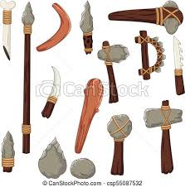

Slide 7
Shelter and Clothing: They used animal skins, barks of trees and leaves to make their clothing. They lived in caves, trees or natural rock shelters.

Slide 8
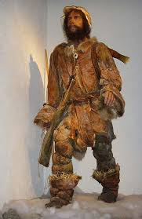

Slide 9
Art
Towards the end of the old stone age, vivid and beautiful cave paintings started appearing in various sites around the world, like Altamira in Spain and Lascaux in France.
Most of the cave paintings, which are about 20,000 years old, focus on the animals that the people hunted.
In India, more than 450 painted rock shelters ranging from the Palaeolithic to Mesolithic period have been found in Bhimbetka,( Near Bhopal). Life- like sculptures of animals and figures of mother goddesses have also been found.

Slide 10
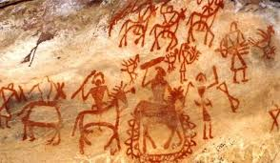
Art in Bhimbetka

Slide 11
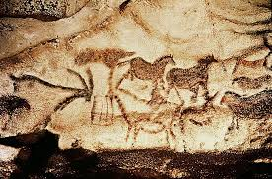
Cave paintings of Altamira of Spain

Slide 12
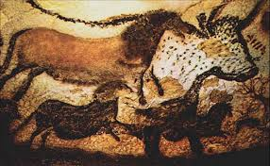
Cave paintings of Lascaux in France

Slide 13
Discovery of Fire
In all probability, at the end of the Old stone age , humans accidentally discovered how to control and use fire. This turned out to be one of the most important discoveries made by humans.
Fire could protect them from wild animals and cold. They must also have found cooked food softer and easier to eat, and may be tastier.

Slide 14
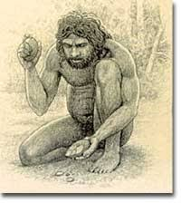

Slide 15
Invention of the Wheel
The wheel, which is believed to have been invented during the old stone age , was one of the most important invention in history. Early wheels were not like the smoothly rounded ones used today. They were much more uneven in shape with rough edges, having been cut out of tree trunks.

Slide 16
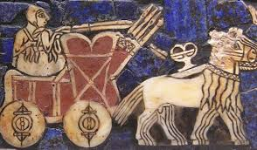

Slide 17
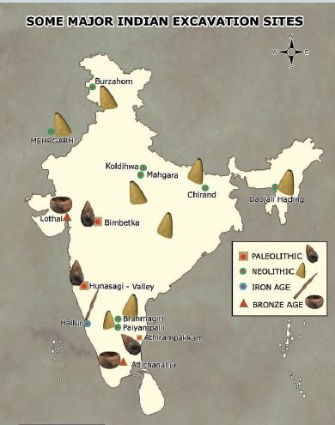
Palaeolithic sites in India

Slide 18
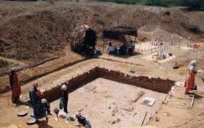
Attirampokkam in Tamil Nadu

Slide 19
Hunsgi in Karnataka

Slide 20
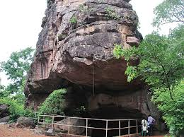
Bhimbetka in MP

Slide 21
THE MIDDLE STONE AGE OR THE MESOLITHIC AGE(10,000-8000 BEC)
It was a period of transition between the Palaeolithic and the Neolithic Age.
Mesolithic sites in India are located in Rajasthan, Southern UP, North Eastern India, Andhra Pradesh, MP and Karnataka.
We know about the Mesolithic people from three sources, namely tools, cave and rock paintings, and burial sites.

Slide 22
Changing Lifestyles
By around 9000 BCE, the climate became warmer and drier. It brought changes in fauna(animal life) and flora(plant life). A greater variety of plants and animals now became easier. The people continued to hunt, fish and gather food.
Human also learnt to tame animals and grow crops during this period. They probably discovered the value of the seeds of some grasses like barley and wheat. The dog was the first animal to be tamed.

Slide 23
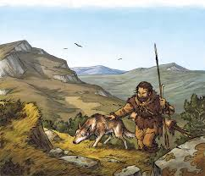

Slide 25
Though many humans continued to live in rock shelters, some built their own houses of sticks, twigs and mud.
Rock paintings from the Mesolithic period have been found in Rajasthan, UP, Bihar, Andhra Pradesh, MP and Karnataka.
Remains of human burial have also been found .There are evidences of food and ornaments at these burial sites.

Slide 28
Tools and Implements
Microliths or very small stone tools, are the main type of tools found at Mesolithic sites along with large hand axes and spheroids.
It had sharp edges and were typically less than 3 cm in size. They were probably used as the barbs( backward-facing points) of arrows and spears.
The new lighter tools helped quicker movement, and hunting became easier. The bow and arrow made it easy to hunt fast moving animals. Hooks and baits improved fishing.

Slide 29
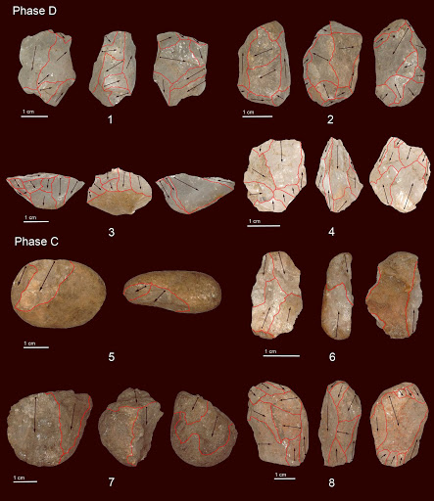

Slide 30
The New Stone age or The Neolithic Age( 8000-4000 BCE)
Around 8000 BCE, the Mesolithic Age anded and the New Stone Age or the Neolithic Age started. (Neos means new in Greek). This was an extremely important period in the history of human society with several vital discoveries and inventions being made, which brought about great changes in the lives of human being. Humans evolved from being hunters and gatherers to being farmers and herders.

Slide 33
CHALCOLITHIC AGE(4000-2000 BEC)
Chalkos means copper and lithos means stone; so Chalcolithic Age is also called the Copper –Stone Age. Implements made of both stone and copper were used during this period. People invented the plough, the wheeled cart and the sail boat. They discovered how to mix metals and get stronger tools, vessels and weapons.

