Slide 1
SAINIK SCHOOL GOALPARA
CHAPTER-6
TOPIC-MAJOR LANDFORMS OF THE EARTH
GEOGRAPHY
CLASS-VI

Slide 2
LAND FORCES LITHOSPHERE
Internal forces
Internal or tectonic forces
Sudden changes
Plates
Magma
Plate tectonics
Converge (move towards each other)
Diverge(move away)
Transverse movement
(move away)
All known as endogenetic
External forces
a.k.a gradational forces
Leads to slow and steady changes on the face of the earth.
Exogenetic forces or denudational forces.
Eroding(washing away)
Rain water, wind, and rivers erode the mountains and highlands
The eroded particles are carried away to form plains.

Slide 3
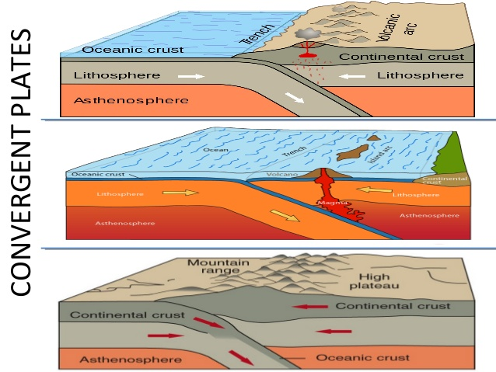

Slide 4
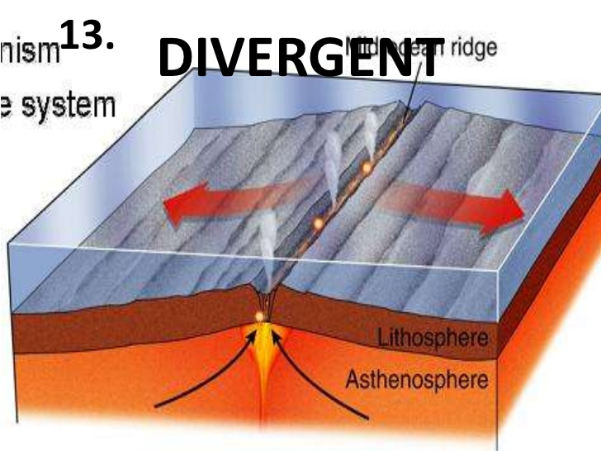

Slide 5
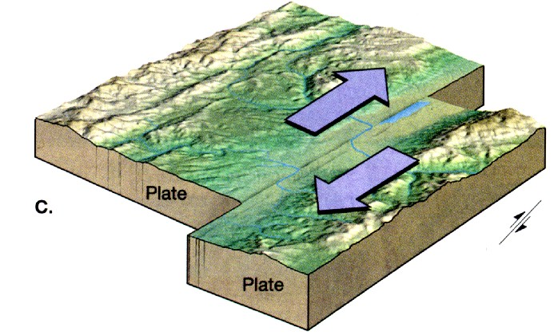

Slide 6
DIFFERENT TYPES OF LANDFORMS
MOUNTAINS
Fold mountains
Block mountains
Volcanic mountains

Slide 7
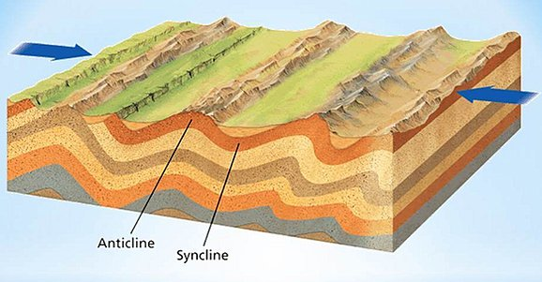

Slide 8
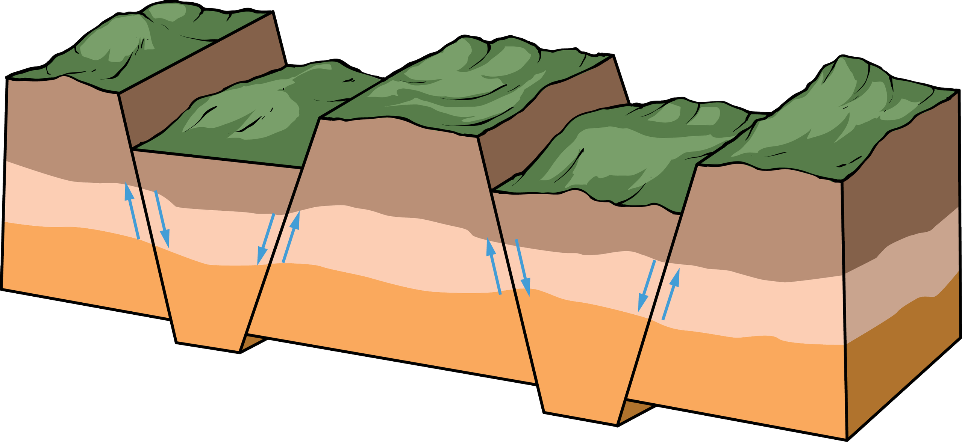

Slide 9
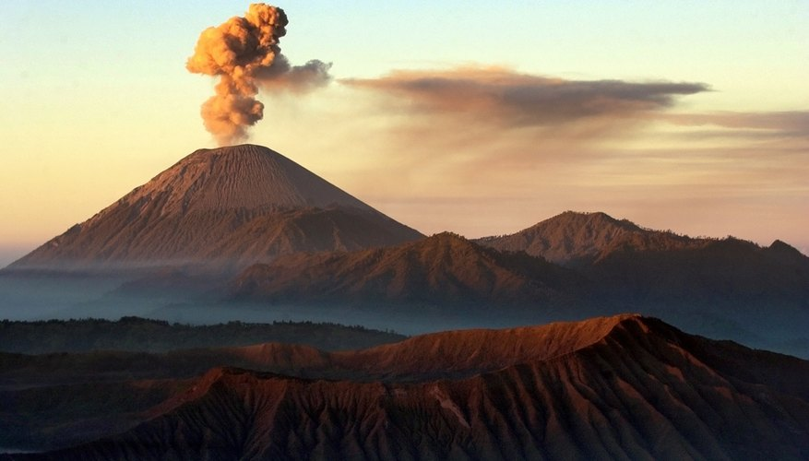

Slide 10
The importance of mountains
Importance of mountains (bullet points only) :
Source of freshwater
Habitat for numerous flora and fauna
Recreation centre
Source of fertile sediments
Availability of Mineral resources
Source of Timber products
Source of Non timber products like medicinal plants, aromatic plants, etc
Acts as barrier of high magnitude winds
Helps the moisture loaded winds to precipitates
Hydro-electric power house

Slide 11
Plateau-an area of fairly level high ground.synonyms upland, tableland, elevated,plain.

Slide 14
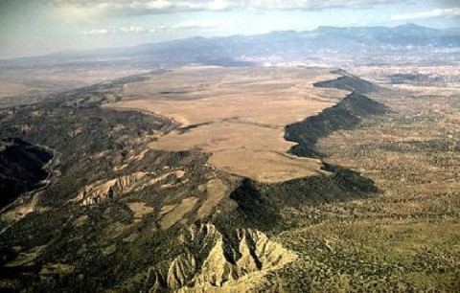

Slide 15
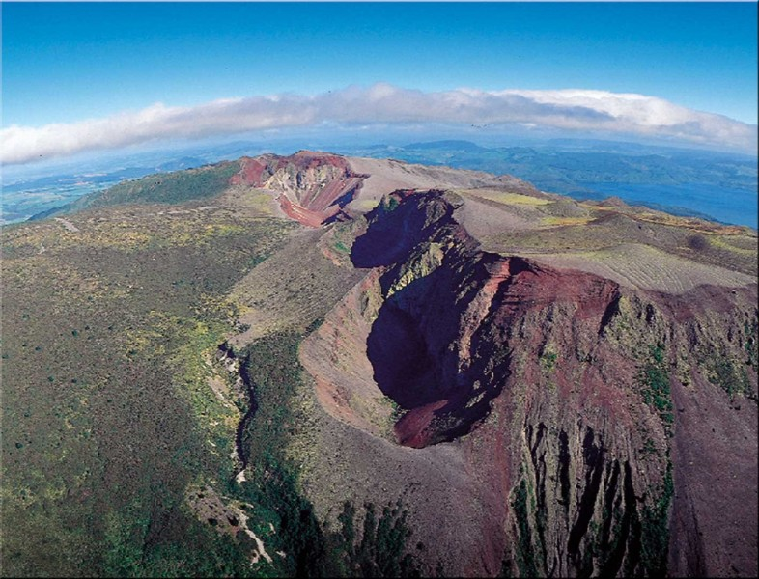

Slide 16
Importance of plateaus
Plateaus are rich in mineral deposits. Many mining belts in the world are located in the plateau areas.
Most of the mining areas in India are in the Chhotanagpur Plateau in Jharkhand, Orissa and Chhattisgarh.
The African plateau is famous for mines of gold and diamond.
Many waterfalls are present in plateau areas. For example; the Hundru falls in the Chhotanagpur and Jog falls in Karnataka.
The lava plateaus are rich in black soil. Black soil is fertile and is good for cultivation.
Plateau areas are great tourist attractions because of lot of scenic spots.

Slide 17
Plains
A LOW LYING VAST FLAT LAND IS CALLED A PLAIN.
People tend to live in plains more than in mountainous regions. Plains are more comfortable for agriculture, transport, Climate, development, City growth. Mountains are rigid, difficult in laying rail and roadways. Airports need huge flats top of a mountain with no near obstructions.

Slide 18
