Slide 1
MAJOR SEA PORTS

Slide 2
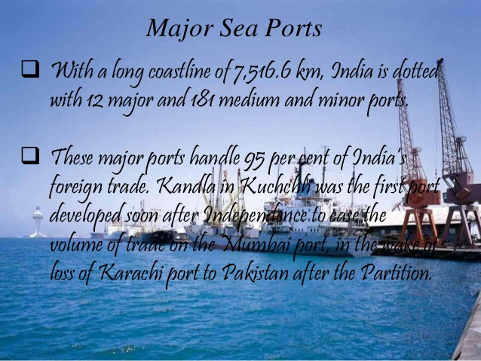

Slide 3
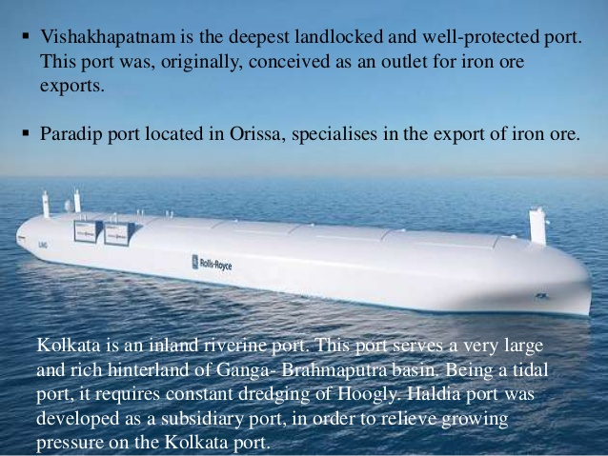

Slide 4
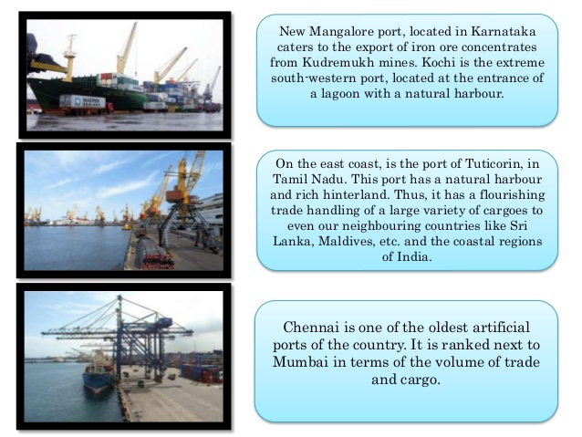

Slide 5
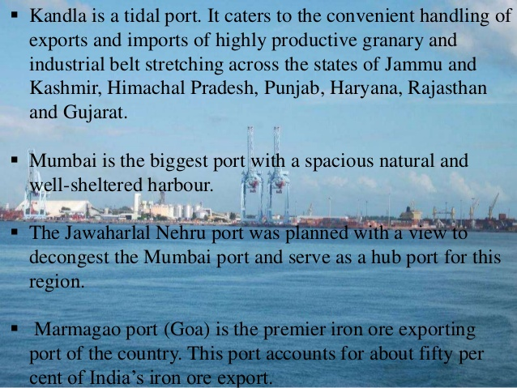

Slide 6


Slide 7
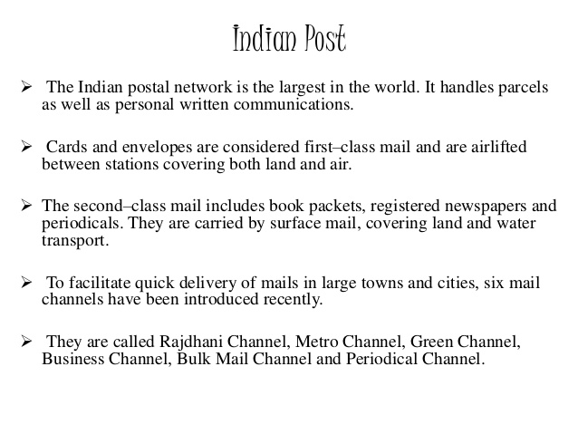

Slide 8
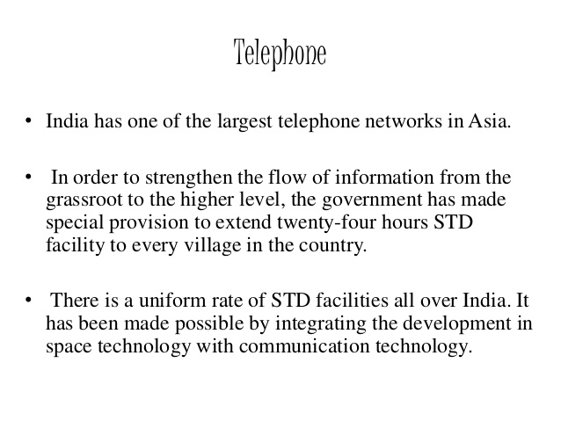

Slide 9


Slide 10
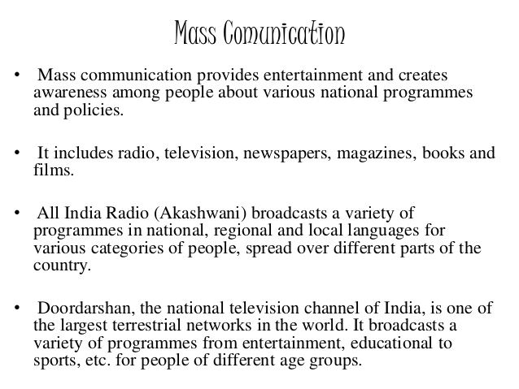

Slide 11
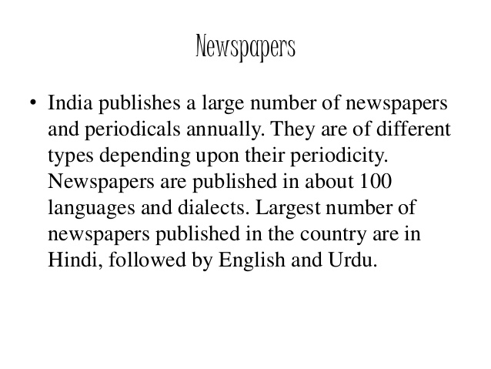

Slide 12


Slide 13
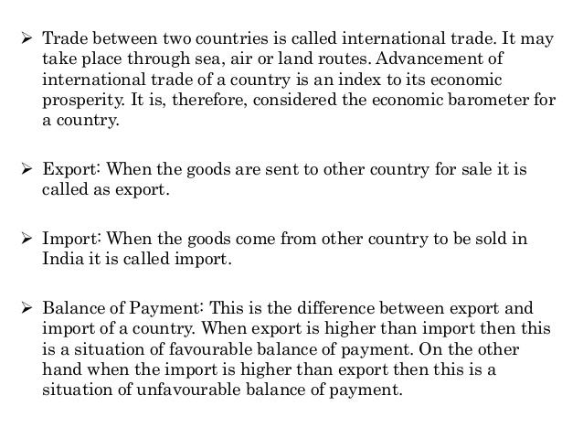

Slide 14
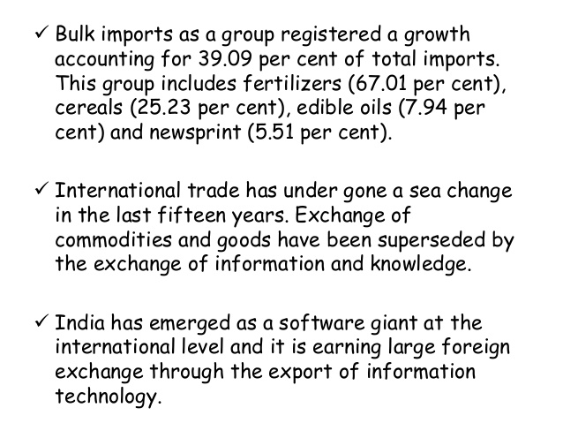

Slide 15


Slide 16
Significance of tourism as a trade in India:
(i) Tourism in India has grown substantially over the last three decades.
(ii) Foreign tourist’s arrival has witnessed an increase, thus contributing to foreign exchange.
(iii) More than 15 million people are directly engaged in the tourism industry.
(iv) It provides support to local handicrafts and cultural pursuits.
(v) Tourism also promotes national integration.
(vi) It helps in development of international understanding about our culture and heritage.
(vii) Foreign tourists visit India for heritage tourism, eco-tourism, adventure tourism, cultural tourism, medical and business tourism.

Slide 17
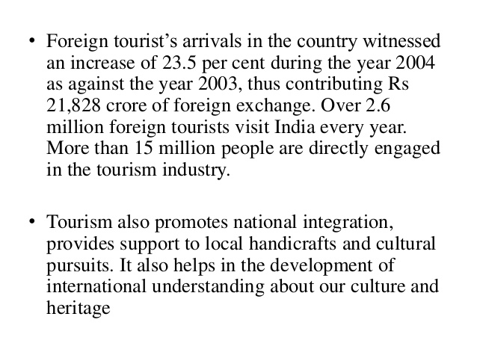

Slide 18
THANK YOU

