Slide 1
p BLOCK ELEMENTS

Slide 2
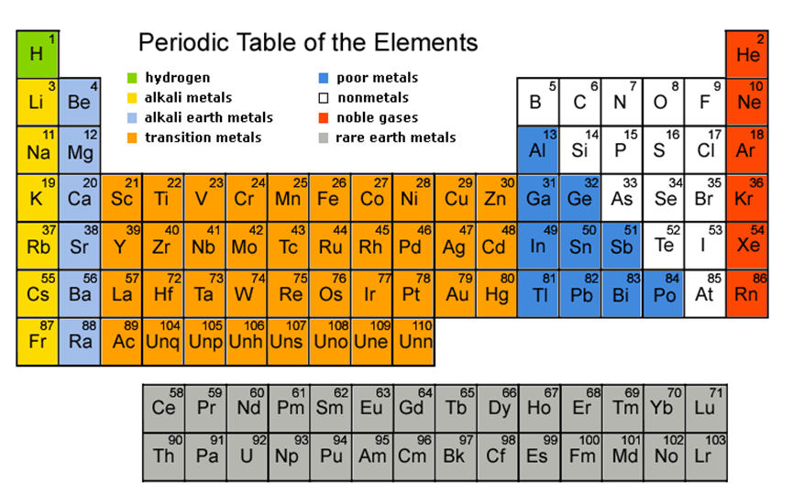

Slide 3
p-block elements
The group number 13 to 18, in which the last electrons or the valence electrons enter in the p-orbital are called the p-block elements. The general electronic configuration of p-block elements is ns² np^{1 ‒ 6}

Slide 4
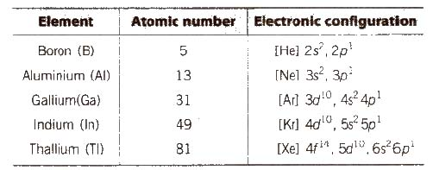
GROUP-13 BORON FAMILY

Slide 5
Atomic radii and ionic radii
Group 13 elements have smaller size than those of alkaline earth metals due to greater effective nuclear charge, Z_{eff’}
Atomic radii increases on going down the group with an anomaly at gallium (Ga). Unexpected decrease in the atomic size of Ga is due to the presence of electrons in d-orbitals which do not screen the attraction of nucleus effectively.
The ionic radii regularly increases from B³⁺ to TI³⁺.

Slide 6
DENSITY
It increases regularly on moving down the group from B to Tl.

Slide 7
MELTING AND BOILING POINTS
Melting point and boiling point of group 13 elements are much higher than those of group 2 elements. The melting point decreases from B to Ga and then increases, due to structural changes in the elements.
Boron has a very high melting point because of its three dimensional structure in which B atoms are held together by strong covalent bonds.
Low melting point of Ga is due to the fact that it consists of Ga₂ molecules, and Ga remains liquid upto 2276 K.
Hence, it is used in high temperature thermometer.

Slide 8
IONISATION ENTHALPY
(IE) The first ionisation enthalpy values of group 13 elements are lower than the corresponding alkaline earth metals, due to the fact that removal of electron is easy. [ns² npl configuration] .
On moving down the group, IE decreases from B to Al, but the next element Ga has slightly higher ionisation enthalpy due to the poor shielding of intervening d-electrons. It again decreases in In and then increases in the last element Tl

Slide 9
OXIDATION STATES
B and Al show an oxidation state of +3 only while Ga, In and Tl exhibit oxidation states of both +1 and +3.
As we move down in the group 13. due to inert pair effect, the tendency to exhibit +3 oxidation state decreases and the tendency to attain +1 oxidation state increases.
Stability of +1 oxidation state follows the order Ga < In < Tl.

Slide 10
ELECTROPOSITIVE (METALLIC) CHARACTER
These elements are less electropositive than the alkaline earth metals due to their smaller size and higher ionisation enthalpies.
On moving down the group, the electropositive character first increases from B to Al and then decreases from Ga to TI, due to the presence of d orbitals which causes poor shielding.

Slide 11
Complex formation
Due to their smaller size and greater charge, these elements have greater tendency to form complexes than the s-block elements.

Slide 12
Nature of compounds
The tendency of the formation of ionic compounds increases from B to Tl. Boron forms only covalent compounds whereas AI can form both covalent as well as ionic compounds. Gallium forms mainly ionic compounds, although anhydrous Ga CI₃ is covalent

Slide 13
CHEMICAL PROPERTIES OF 13 GROUP ELEMENTS
(i) Action of air Crystalline boron is unreactive whereas amorphous boron is reactive. It reacts with air at 700°C as follows
4B + 3O₂ → 2B₂O₃
AI is stable in air due to the formation of protective oxide film.
4Al + 3O₂ → 2Al₂O₃
Thallium is more reactive than Ga and In due to the formation of unipositive ion, TI⁺.
4Tl + O₂ → 2Tl₂0

Slide 14
Action of water
Both B and AI do: not react with water but amalgamated aluminium react with H₂O evolving H₂.
2Al(Hg) + 6H₂O )→ 2AI(OH)₃ + 3H₂ + 2Hg
Ga and In do not react with pure cold or hot water but Tl forms an oxide layer on the surface.

Slide 15
CHEMICAL PROPERTIES OF 13 GROUP ELEMENTS
Reaction with alkalies Boron dissolves in alkalies and gives sodium borates.
Hydrides Elements of group 13 do not combine directly with H₂ to form hydrides, therefore their hydrides have been prepared by indirect methods. Boron forms a number of hydrides, they are known as boranes. Boranes catch fire in the presence of oxygen.
B₂H₆ + 3O₂ → B₂O₃ + 3H₂O; &Delat;_{c}H° = – 1976 kJ mol^{-l}
Boranes are hydrolysed by water.
B₂H₆ + 6H₂O → 2H₃BO₃ + 6H₂
Boranes are stable but the stability of hydrides of AI, Ga, In, and Tl decreases on moving down the group because the strength of the M-H bond decreases.

Slide 16
Nature of oxides and hydroxides
B(OH)₃ or H₃BO₃ is soluble in water, while other hydroxides are insoluble in water.
On moving down the group. there is a change from acidic to amphoteric and then to basic character of oxides and hydroxides or group 13 elements.

Slide 17
Halides of Group-13
All the elements of boron family (except Tl) form trihalides of type MX₃.
All the boron trihalides [BX₃) and aluminium trihalides AlX₃ (except AIF₃ which is ionic) are covalent compounds. AlX₃ exists as dimer while BX₃ is monomer because boron atom is too small to coordinate with four large halide ions. The energy released during the formation of the bridge structure is not sufficient for the cleavage of the typical pπ – pπ bond in BF₃.
BF₃ is a colourless gas, BCl₃ and BBr₃ are colourless fuming liquids and BI₃ is a white solid at room temperature.

Slide 18
Halides of Group-13
Trihalides of group 13 elements behave as Lewis acids because of their strong tendency to accept a pair of electrons. The relative strength of Lewis acids of boron trihalides is
BF₃ < BCI₃, < BBr₃, < BI₃.
This is due to pπ – pπ backbonding in BF₃ which makes it less electron deficient.
The halides of group 13 elements behave as Lewis acids and the acidic character is
BX₃ > AIX₃ > GaX₃ > InX₃ (where, X = Cl, Br or 1)
TICI₃ decomposes to TICl and C1₂ and hence acts as an oxidising agent.

Slide 19
Anomalous Behaviour of Boron
Boron shows anomalous behaviour with the other members of the group, due to the following reasons:
(i) Smallest size in the group. (ii) High ionisation energy. (iii) Highest electronegativity in the group. (iv) Absence of vacant d-orbital.

Slide 20
Diagonal Relationship between Boron and Silicon
Boron exhibit resemblance with its diagonal element silicon of group 14.
1. Both Band Si are non-metals. 2. Both arc semi-conductors. 3. Both Band Si form covalent hydrides, i.e.. boranes and silanes respectively. 4. Both form covalent, and volatile halides which fume in moist air due to release of HCI gas.

Slide 21
Group 14,CARBON FAMILY
General Physical Properties of Group 14 Elements
(i) Electronic configuration Their valence shell electronic configuration is ns² np²
(ii) Metallic character C and Si are non-metals, Ge is a metalloid and Sn and Pb are metals.
(iii) Appearance C is black. Si is light-brown, Ge is greyish, Sn and Pb are silvery white.
(iv) Density Density increases with increase in atomic number due to increase in mass per unit volume down the group.
(v) Melting points and boiling points The melting points and boiling points decrease from carbon to lead but carbon and silicon have very high melting and boiling points due to their giant structure.

Slide 22
General Physical Properties of Group 14 Elements
Oxidation state They exhibit +2 and +4 oxidation state. The compounds of Pb in +4 oxidation state are powerful oxidising agents since, +2 oxidation state of Pb is more stable due to inert pair effect.
The compounds in +2 oxidation state are ionic in nature and in + 4 oxidation state are covalent in nature (According to Fajan’s rule).
(vii) Ionisation enthalpy It decreases from C to So. For Pb. it ie slightly higher than Sn.
(viii) Electronegativity values The value decreases from C to Pb but not in a regular manner probably due to filling of d-orbitals III and Sn and f- orbitals In Pb.
(ix) Catenation The greater the strength of element-element bond. the greater is the strength of catenation.
C >> Si > Ge = Sn > Pb (catenation).

Slide 23
General Physical Properties of Group 14 Elements
Allotropy All the elements of this group except Pb exhibit allotropy.
In cold countries white tin changes to grey tin and results in decrease in density. This is called tin disease or tin plague.
(xi) Valency All elements exhibit tetra valency. In case of carbon, 406 kJ mol⁻¹ of energy is required for promotion of 2s – electron to 2p.
Formation of two extra bonds provide this energy.
(xii) Atomic and ionic radii Both increase from C to Pb.
(xiii) Multiple bonding Carbon forms pπ – pπ bonds with itself and with S, N and O. Other clements show negligible tendency of this type due to their large size. Others form dπ – pπ multiple bonds.

Slide 24
Chemical Properties of Group 14 Elements
(a) Hydrides All members of the group form covalent hydrides. Their number and ease of formation decreases down the group.
Hydrides of carbon are called hydrocarbons (alkanes, alkenes or alkynes).
Hydrides of Si and Ge are known as silanes and germanes.
The only hydrides of Sn and Pb are SnH4 (stannane) and PbH₄ (plumbane),
Their thermal stability decrease down the group.
Their reducing character increases down the group.

Slide 25
HALIDES FORMATION OF GROUP-14
Halides All the elements give tetrahedral and covalent halides of the type MX₄ except PbBr₄, and PbI₄.
Thermal stability
CX₄ > SiX₄ > GeX₄ > SnX₄ > PbX₄
Order of thermal stability with common metals
MF₄ > MCl₄ > MBr₄ > MI₄
Except CX₄ other tetrahalides can hydrolysed due to the presence of vacant d-orbitals.
SiX₄ + 2H₂O → SiO₂ + 4Hx.
ease of hydrolysis: SiX₄ > GeX₄ > SnX₄ > PbX₄

Slide 26
OXIDES FORMATION OF GROUP-14
Oxides They form two types of oxides. mono-oxides of the type MO. e.g.,
CO (neutral) and SiO, GeO. SnO. PbO(all basic) and dioxides of the type MO₂
CO₂ is linear gas at ordinary temperature. Solid CO₂ is known as dry ice or drikold.
SiO₂ is a solid with three dimensional network in which Si is bonded to four oxygen atoms tetrahedrally and covalently. A mass of hydrated silica (SiO₂) formed from skeletons of minute plants, known as diatoms, is called kieselguhr. It is a highly parous material and is used in the manufacture of dynamite.

Slide 27
Allotropic Forms of Carbon
Carbon
Free states (diamond. graphite, coal etc.) and combined states (oxides, carbonates, hydrocarbons etc.)
Allotropic Forms of Carbon
The crystalline forms include
(i) Diamond It is the hardest and has three dimensional polymeric structure in which hybridisation of C is sp³. It is covalent solid. melting point 3650°C. density 3.51 g/cm³ and bad conductor of heat and electricity.
(ii) Graphite It is dark grey. having hexagonal plates, hybridisation of each C is sp². It is good conductor of heat and electricity due to the presence of free electrons. It was also known as black lead. It is a very good lubricant

Slide 28
Allotropic Forms of Carbon
Fullerenes These are the only pure form of carbon. C₆₀ molecule contains 12 five membered rings and 20 six membered rings. The five membered rings are connected to six membered rings while six membered rings are connected to both five and six membered rings. These are used in microscopic ball bearings, light weight batteries, in synthesis of new plastics and new drugs.

Slide 29
Amorphous forms of carbon
Amorphous forms of carbon are
(i) Coal The different forms of coal are peat (60 % C), lignite (70 % C), Bituminous (78 % C), Semi Bituminous (83 % C) and anthracite (90 % C). Bituminous is most common variety of coal.
(ii) Coke It is obtained by destructive distillation of coal
(iii) Charcoal or wood charcoal It is obtained by heating wood strongly in absence of air. When heated with steam, it becomes more activated. It is used to remove colouring matters and odoriferous gases.
(iv) Bone black or animal charcoal It is obtained by destructive distillation of bones in iron retort. By products are bone oil or pyridine. It is used as adsorbent. On burning, it gives bone ash which is calcium phosphate and used in the manufacture of phosphorous and phosphoric acid.

Slide 30
Amorphous forms of carbon
v) Lamp-black It is obtained by burning vegetable oils in limited supply of air. It is used in the manufacture of printing ink, black paint, varnish and carbon paper.
(vi) Carbon-black It is obtained by burning natural gas in limited supply of air. It is added to rubber mixture for making automobile tyres.

Slide 31
Coal Gas
Preparation By destructive distillation of coal.
Composition
H₂ = 45 – 55 % N₂ = 2 – 12 % CH₄ = 25 – 35 % CO₂ = 0 – 3 % CO = 4 – 11 % O₂ = 1 – 1.5 %
Ethylene, acetylene, benzene, etc. = 3 – 5 %
Uses It is used as illuminant, as fuel and to provide inert atmosphere in the metallurgical processes.

Slide 32
Natural Gas
It is found along with petroleum below the surface of earth.
Composition CH₄ = 60 – 80 %
Higher hydrocarbons = 2 – 12%
C₂H₆ = 5 – 10 %, C₃H₈ = 3 – 18 %
Uses It is used as a fuel.Its partial combustion yields carbon black (reinforcing agent for rubber).

Slide 33
Wood Gas
Preparation Destructive distillation of wood gives wood gas (CH₄, C₂H₆ H₂)
Uses It is used as fuel.
Liquified Petroleum Gas (LPG)
Composition n-butane + Iso-butane
Uses It is used as domestic fuel.

Slide 34
Carbon Monoxide (CO)
Preparation
2C + O₂ → 2CO
Properties
It is colourless, odourless and almost water insoluble gas. It is a powerful reducing agent. CO is used in the extraction of many metals from their oxide ores.

Slide 35
Carbon Dioxide (CO₂)
Preparation
C + O₂ → CO₂

Slide 36
Compounds of Silicon
Silicates are metal derivatives of silicic acid, H₂SiO₃ and can be obtained by fusing metal oxides or metal carbonates with sand. The basic structural unit of silicates is SiO^{– 4}₄.
Talc consists of planar sheets which can slip over one another due to weak forces of attraction, and is a constituent of talcum powder. That’s Why talcum powder has a slippery touch.
Mica (abrak) is naturally occurring aluminium silicate [KH₂AI₃(SiO₄]₃ or KAI₃Si₃O₁₀(OH)₂.

Slide 37
Silicones
The linear, cyclic or cross linked polymeric compounds containing (R₂SiO) as a repeating units, are known as silicones. They are manufactured from alkyl substituted chlorosilanes.
Silicones are chemically inert, water repellent, heat resistant, good electrical insulators. These are used as lubricants (vaseline), insulators etc.

