Slide 1
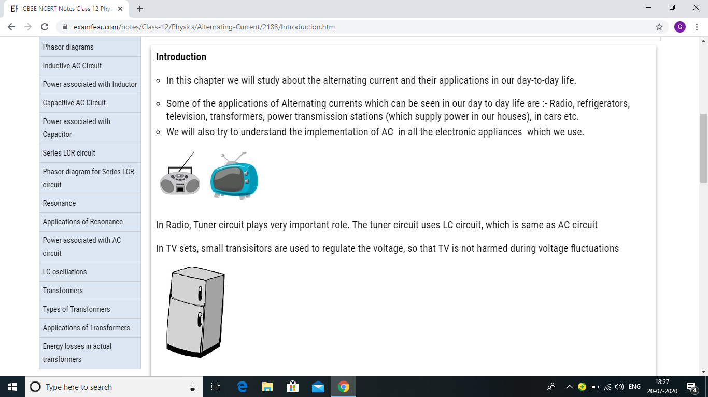
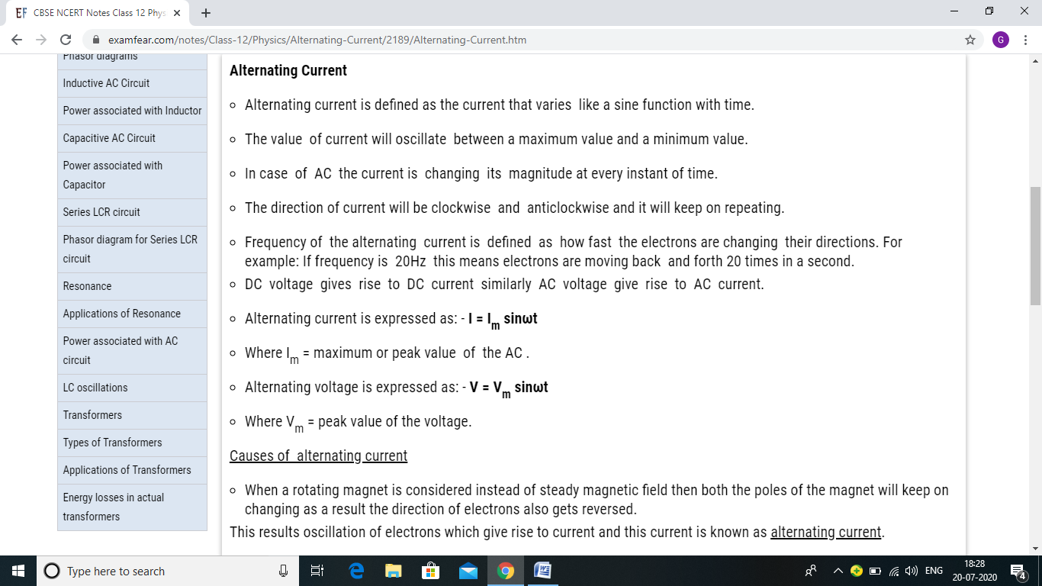
ALTERNATING CURRENT

Slide 3
COMPARISON BETWEEN AC AND DC

Slide 5
RESISTIVE CIRCUIT

Slide 6
RESISTIVE CIRCUIT

Slide 7
RESISTIVE CIRCUIT

Slide 8
NUMERICAL

Slide 10
RMS VOLTAGE

Slide 12
RMS VOLTAGE

Slide 15
INDUCTIVE CIRCUIT

Slide 23
SERIES LCR CIRCUIT

Slide 24
SERIES LCR CIRCUIT

Slide 25
SERIES LCR CIRCUIT

Slide 26
SERIES LCR CIRCUIT

Slide 36
TRANSFORMER

Slide 37
TRANSFORMER

Slide 38
TRANSFORMER

Slide 39
TRANSFORMER

Slide 43
Bibliography
NCERT BOOKS
EXAMFEAR.COM
SL ARRORA

