Slide 1
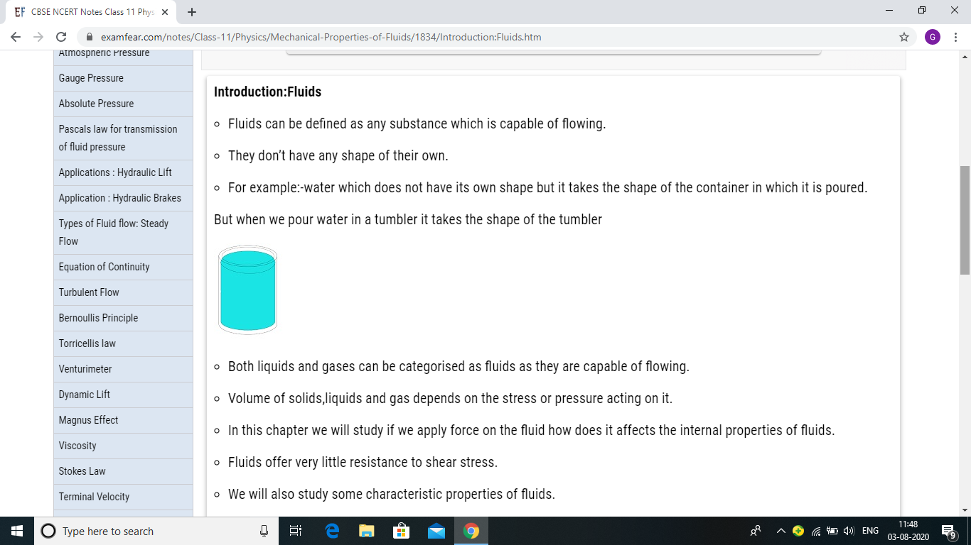
MECHANICAL PROPERTIES OF LIQUID

Slide 17
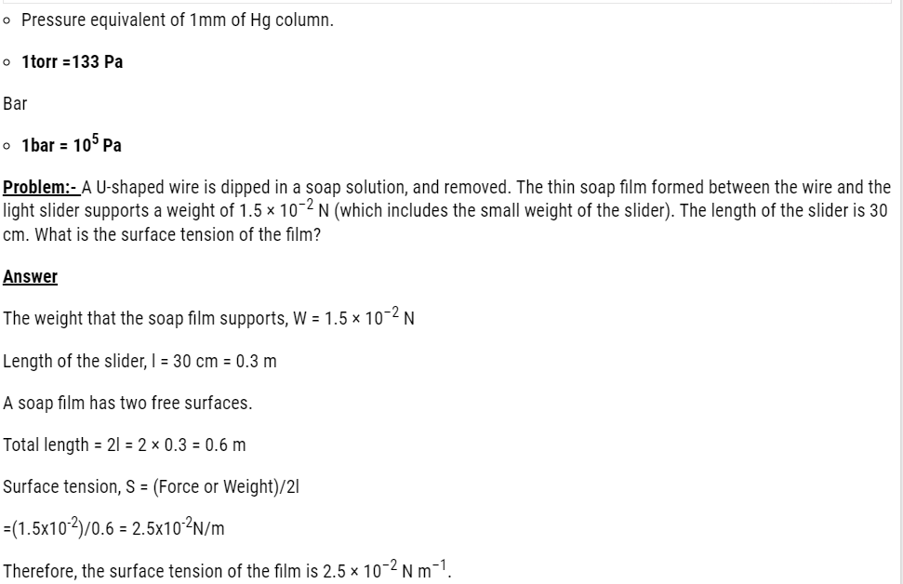

Slide 28
Strramline flow and turbulent flow

Slide 32
