Slide 1
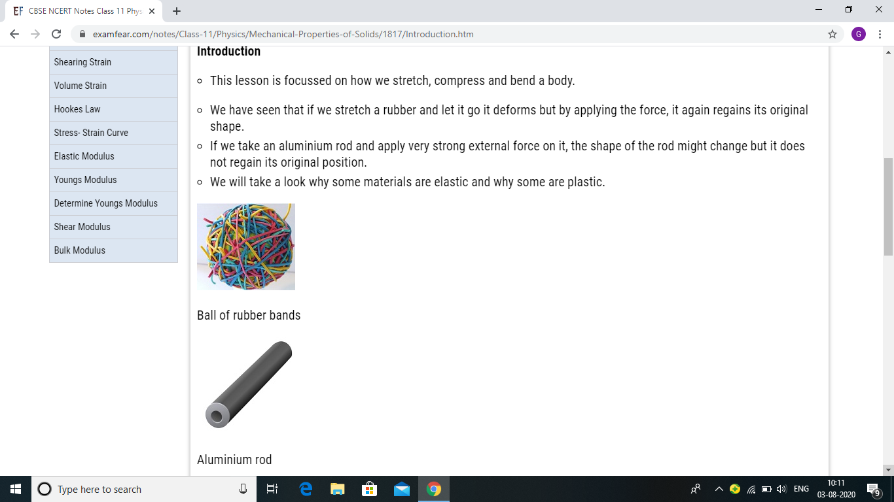
PROPERTIES OF SOLIDS

Slide 28
POISSON’S RATIO

Slide 30
Application of elasticity

