Slide 1
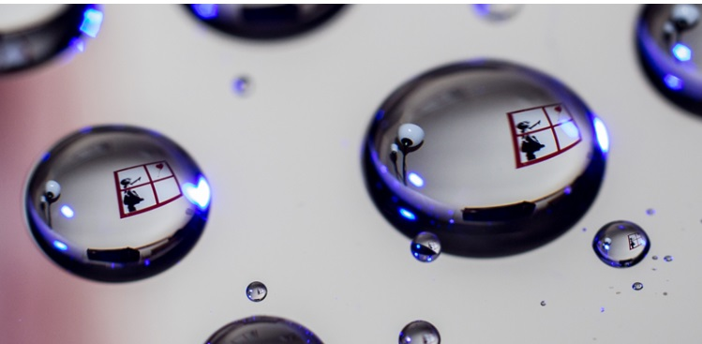
SURFACE CHEMISTRY

Slide 2
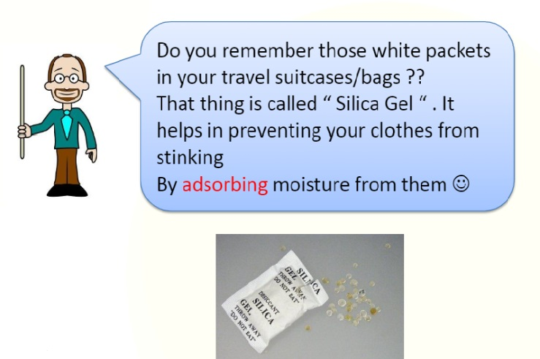

Slide 3
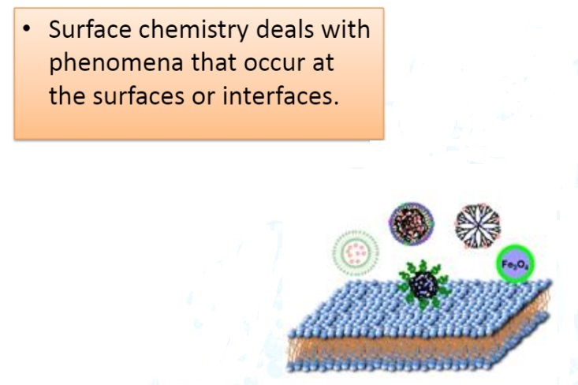

Slide 4
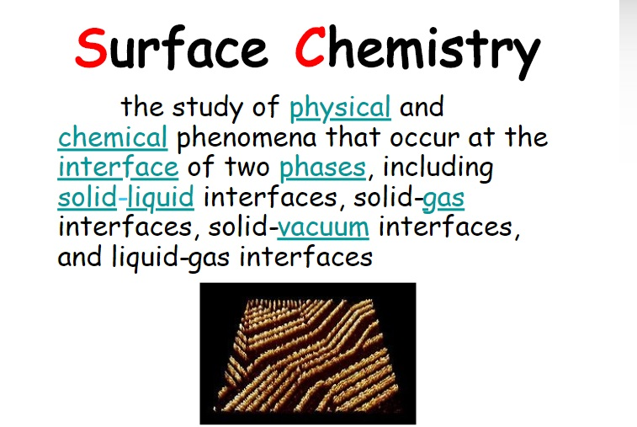

Slide 5
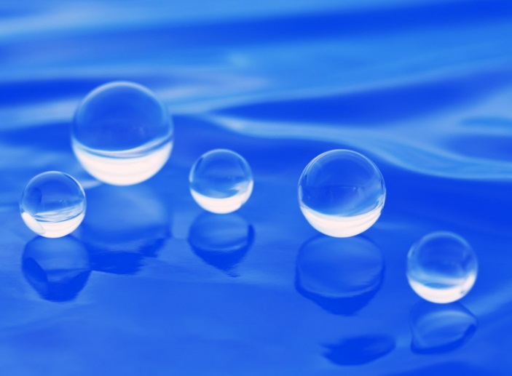
The phenomenon of attracting and retaining the molecules of a substance on the surface of a solid or liquid, resulting in a higher concentration of the molecules on the surface, is known as ADSORPTION

Slide 6
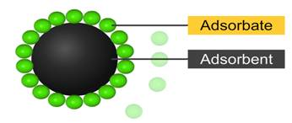
The substance on the surface of which adsorption takes place is called the ADSORBENT, while the substance thus adsorbed is called the ADSORBATE.

Slide 7
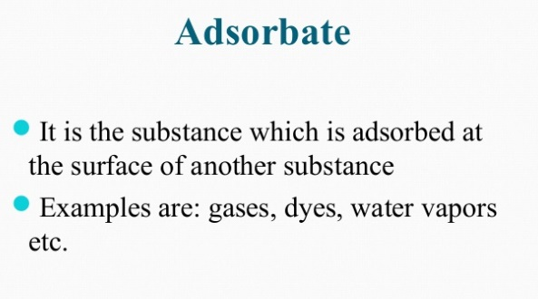

Slide 8
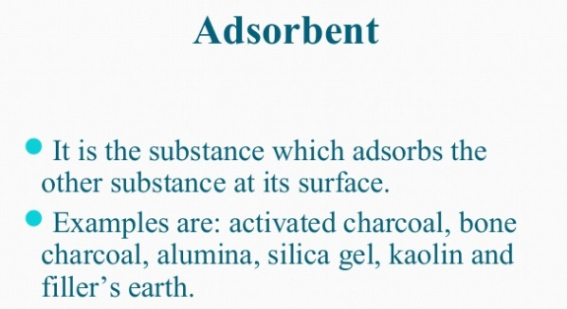

Slide 9
EXTENT OF ADSORPTION
If x = the mass of adsorbate
m= mass of adsorbent
Extent of adsorption = x/m

Slide 10
Desorption:
The removal of the adsorbed substance from the surface, is called desorption.
It can be brought about by heating or by reducing the pressure.
Occlusion:
The adsorption of a gas on the surface of a metal is called occlusion.
EX: Hydrogen is adsorbed on the surface of nickel or palladium.

Slide 11
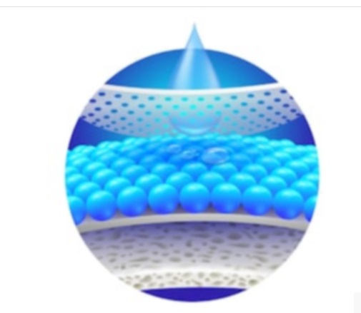
Absorption is a condition in which something takes in another substance. It is a physical or chemical phenomenon or process, in which atoms, molecules, or ions enter in the inner part (called "bulk") of a gas, liquid, or solid material

Slide 12
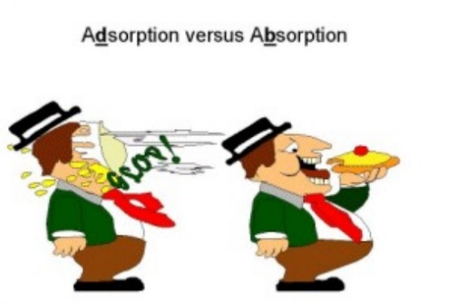

Slide 13
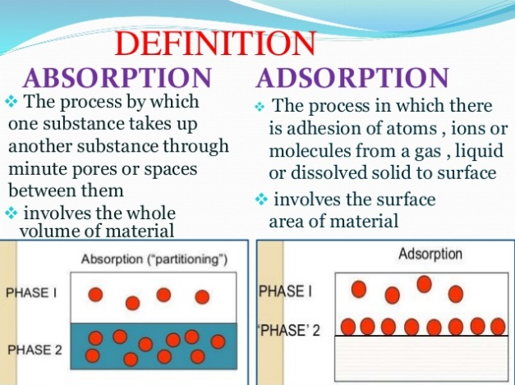

Slide 14
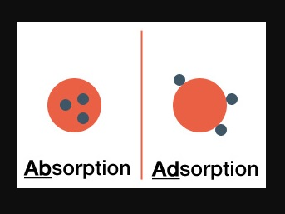

Slide 15
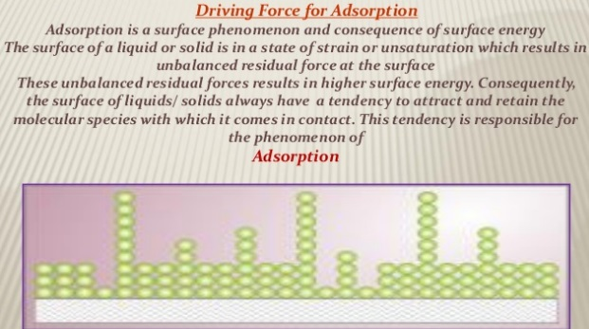

Slide 16
EXTENT OF ADSORPTION
If x = the mass of adsorbate
m= mass of adsorbent
Extent of adsorption = x/m

Slide 17
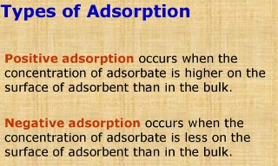

Slide 18
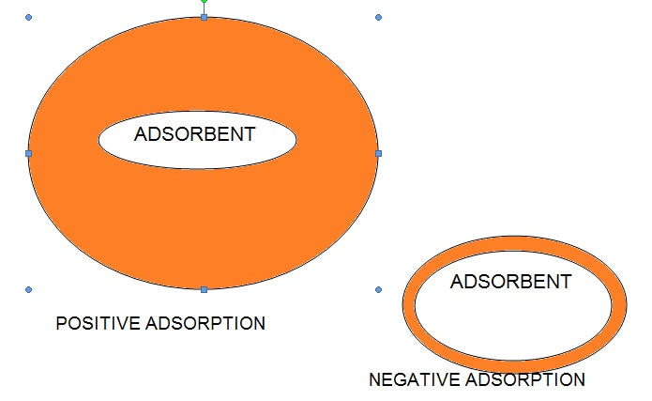

Slide 19
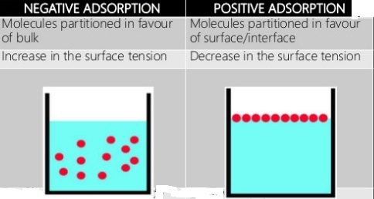

Slide 20
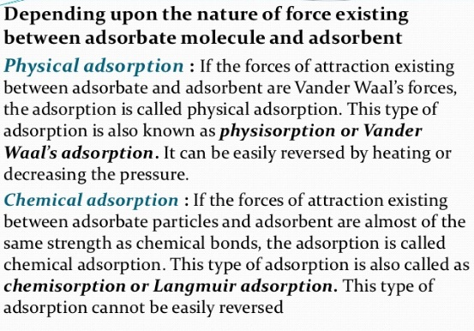
CLASSIFICATION OF ADSORPTION

Slide 21
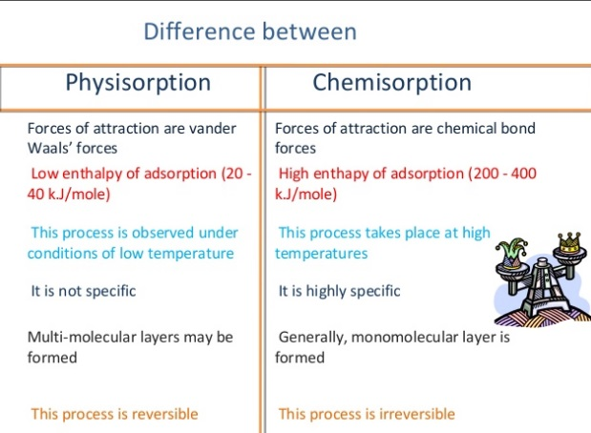

Slide 22
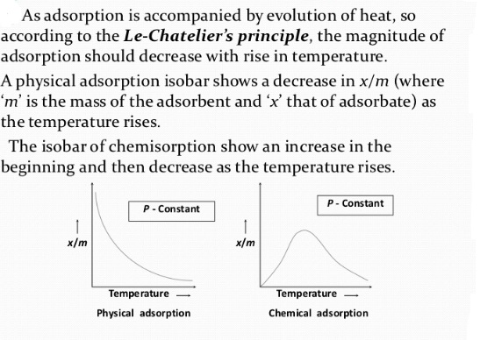
EFFECT OF TEMPERATURE ON ADSORPTION

Slide 23
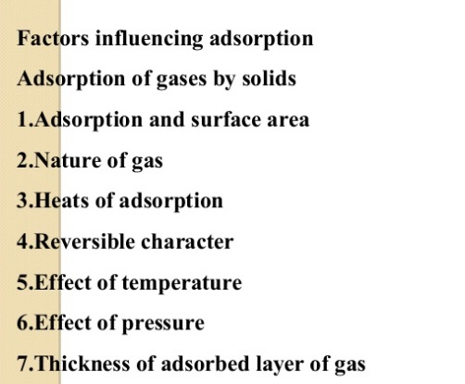

Slide 24
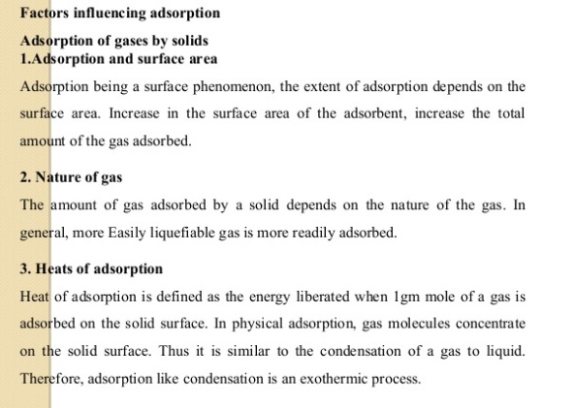

Slide 25
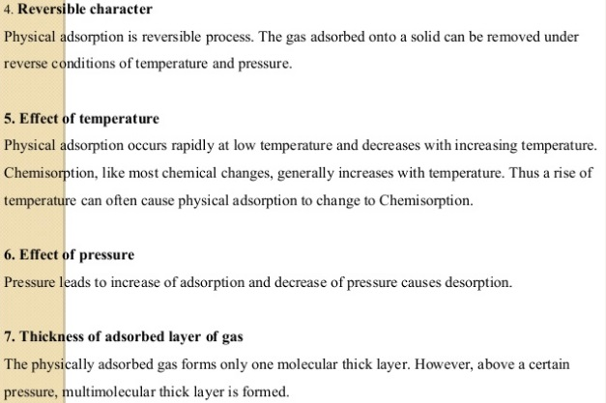

Slide 26
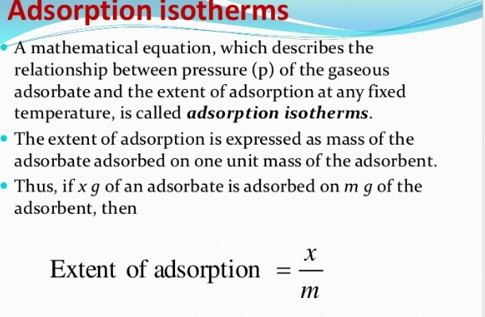

Slide 27
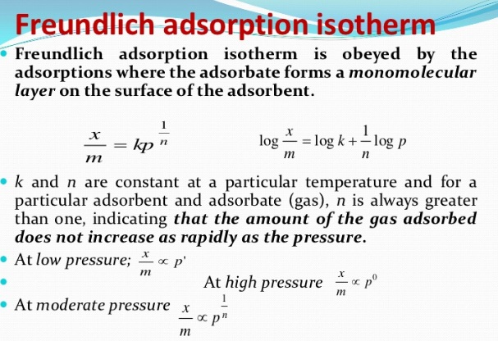

Slide 28
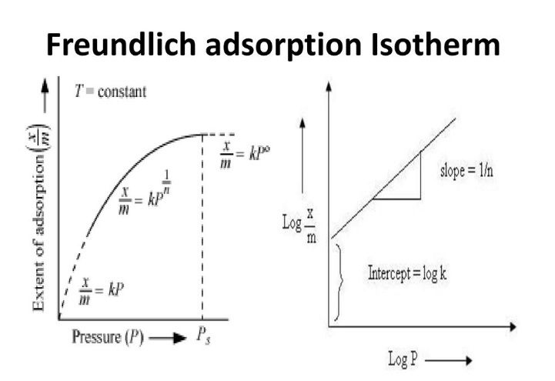

Slide 29
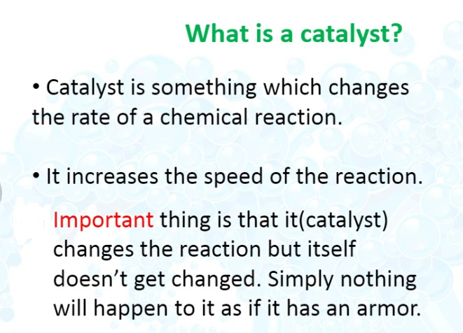
CATALYST

Slide 30
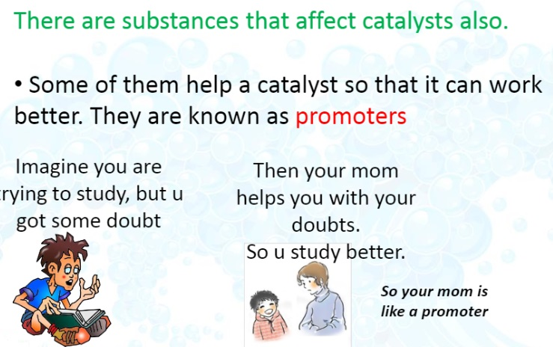

Slide 31
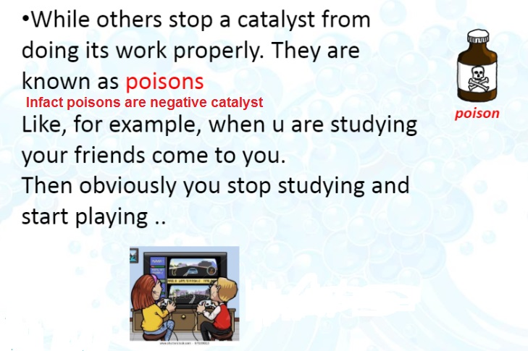

Slide 32
TYPES OF CATALYSIS
Homogeneous catalysis
In this catalysis,the catalyst ,reactants and product are in the same physical state [phase], e.g.,

Slide 33
Heterogeneous catalysis
In heterogeneous catalysis, catalyst is present in a different phase than that of reactants, e.g.,

Slide 34
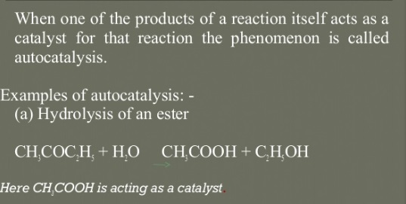
AUTOCATALYSIS

Slide 35
Important Features of Solid Catalysts
Activity
The activity of a catalyst depends upon the strength of chemisorption to a large extent. The adsorption should be reasonably strong but not so strong that they become immobile and no space is available for other reactants to get adsorbed.

Slide 36
Selectivity
The selectivity of a catalyst is its ability to direct a reaction to yield a particular product, e.g., starting with H₂ and CO using different catalysts, we get different products

Slide 37
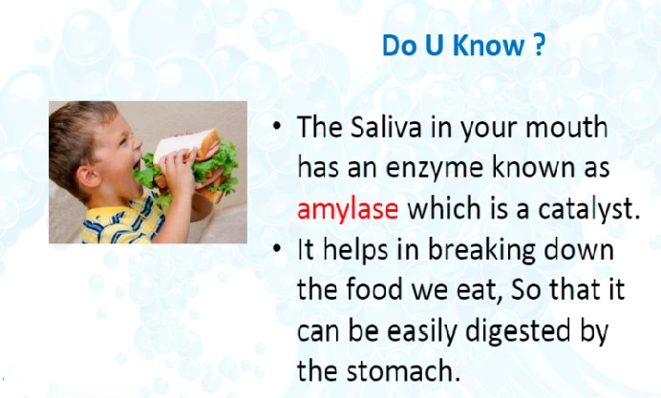

Slide 38
ENZYMES
Enzymes are complex nitrogenous organic compounds which are produced by living plants and animals.
They are actually protein molecules of high molecular mass and form colloidal solutions in water.
They are also known as biochemical catalysis.
In stomach, the pepsin enzyme converts proteins into peptides while in intestine, the pancreatic trypsin converts proteins into amino acids by hydrolysis. Lactobacilli is used to convert milk into curd.

Slide 39
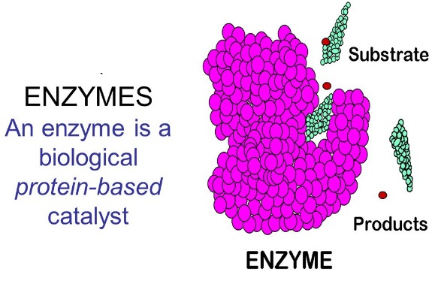

Slide 40
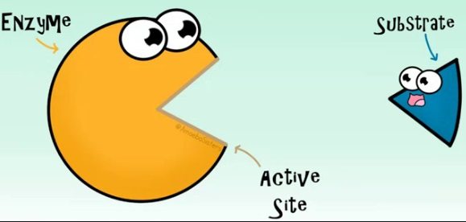

Slide 41
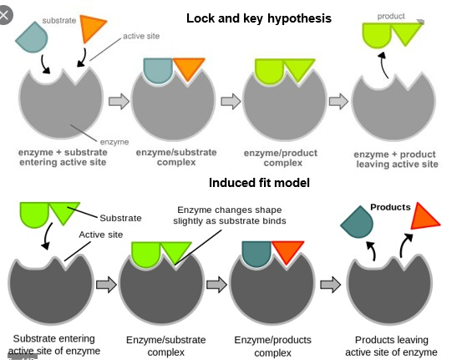

Slide 42
The lock and key model
also called Fisher's theory is one of two models which describe the enzyme-substrate interaction.
The lock and key model assumes that the active site of the enzyme and the substrate are equal shaped. It supposes that the substrate fits perfectly into the active site of the enzyme.
As, these active sites (can be called locks) are very specific and only few molecules (can be called keys) can bind them, this model of enzyme working is called Lock and Key mechanism

Slide 43
Induced-fit model:
Proposed by Daniel Koshland in 1958, attempts to explain how this is accomplished.
His theory asserts that when the active site on the enzymes makes contact with the proper substrate, the enzyme moulds itself to the shape of the molecule

Slide 44
Characteristics of Enzyme Catalysis
· High efficiency One molecule of an enzyme may transform one million molecule of reactant per minute.
· Highly specific nature Each enzyme catalyst cannot catalyse more than one reaction.
· Optimum temperature Enzyme catalyst gives higher yield at optimum temperature i.e.,
at 298-310 K. Human body temperature, i.e., at being 310 K is suited for enzyme
catalysed reactions

Slide 45
· Optimum pH The rate of an enzyme catalysed reaction is maximum at optimum pH range 5 to 7.
· Activators Activators like ions such as Na+ ,Ca 2+, Mn2+ help in the activation of enzymes which cannot act on their own strength.
· Co-enzyme Co-enzymes are the substance having nature similar to the enzyme and their presence increases the enzyme activity. Mostly vitamins act as co-enzymes.
· Effect of Inhibitors Inhibitors slow down the rate of enzymatic reaction

Slide 46
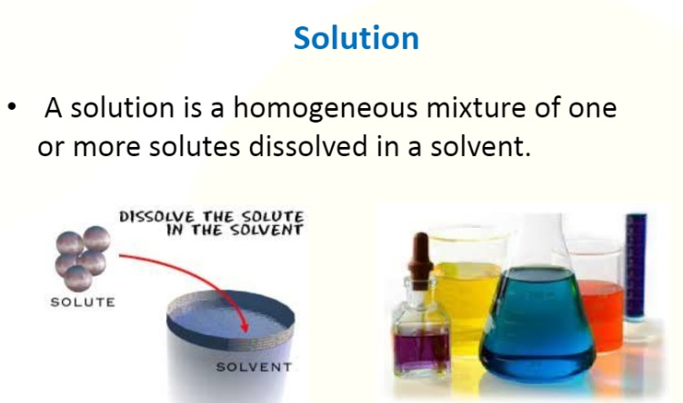

Slide 47
Depending upon the size of paticles solutions are divided into true solutions, colloids and suspension
True solutions:
True solution particles size less than 1nm
Colloidal solution:
a colloid is a heterogeneous system in which one substance is dispersed(dispersed phase)in another substance called dispersion medium and size of dispersed phase is from 1nm-1000 nm.
Suspension: size of dispersed phase is greater than 1000 nm

Slide 48
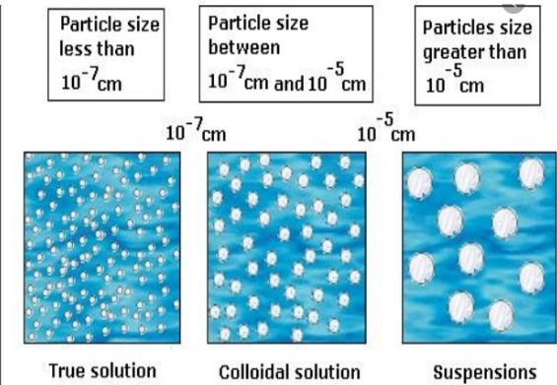

Slide 49
Depending upon the size of paticles solutions are divided into true solutions, colloids and suspension
True solutions:
True solution particles size less than 1nm
Colloid-
a colloid is a heterogeneous system in which one substance is dispersed(dispersed phase)in another substance called dispersion medium and size of dispersed phase is from 1nm-1000 nm.
Suspension:
size of dispersed phase is greater than 1000 nm

Slide 50
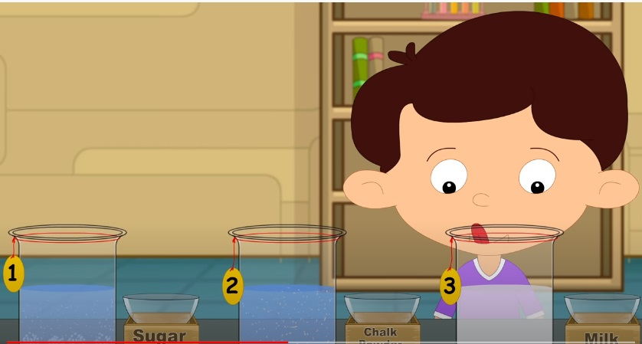
Which is true solution, suspension and colloidal solution

Slide 51
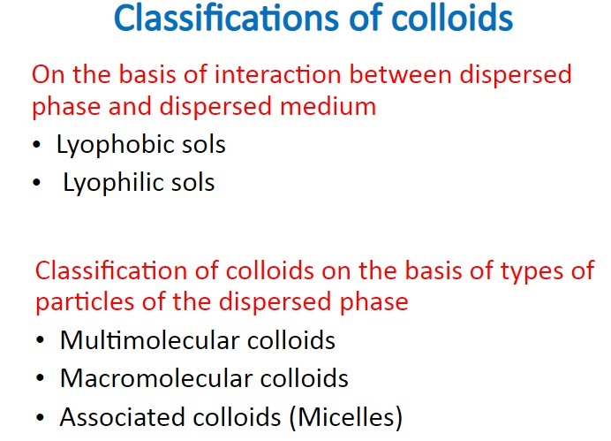

Slide 52
TYPES OF COLLOIDS
On the basis of nature of interaction between dispersed phase and dispersion medium.
(a) Lyophobic (colloid-solvent , hating colloid)
These colloids cannot be prepared by simply mixing of dispersed phase into dispersion medium.
e.g. metallic sols.
(b) Lyophillic (colloid-solvent loving colloids) these colloids can be prepared by simply mixing of dispersion phase into dispersion medium.
e.g. Starch sol.

Slide 53
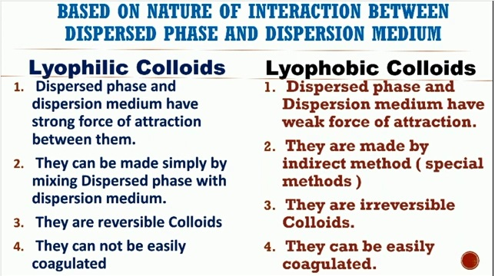

Slide 54
On the basis of types of particles of the dispersed phase
(a) Multimolecular colloid- on dissolution, a large number of atoms or smaller molecules of a substance aggregate together to form species having size in colloidal range. The species thus formed are called Multimolecular colloids.
e.g. Sulphur sol.
(b) Macromolecular colloids -macromolecules are suitable solvent from solution in which size of the particles are in range of colloidal range.
e.g. starch sol.
(c) Associated colloids (micelles)-some substances in law concentration behaves as normal strong electrolyte but at higher concentration exhibit colloidal behaviour due to formation of aggregates. The aggregated particles are called micelles and also known as associated colloids.

Slide 55
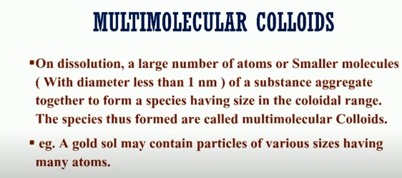

Slide 56
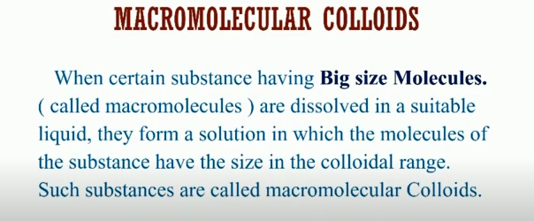

Slide 57
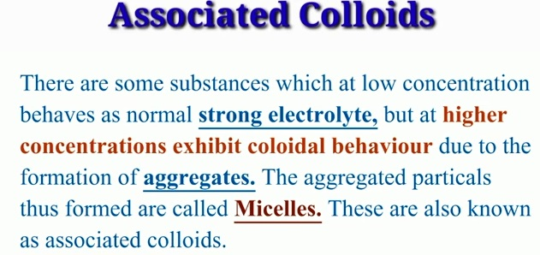

Slide 58
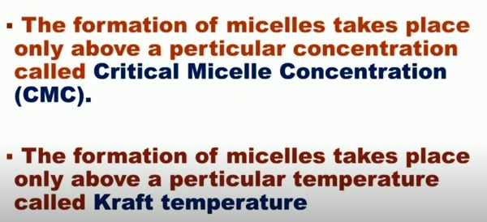

Slide 59
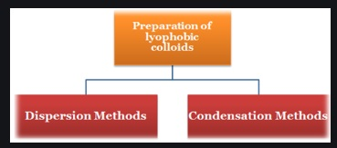

Slide 60
PREPARATION OF COLLOIDS
(a) Chemical methods- By double decomposition, oxidation reaction or hydrolysis
OXIDATION
e.g. SO₂ +2H₂ S → 3S (SOL)+2H₂ O
HYDROLYSIS
e.g. FeCl₃ +3H₂O → Fe (OH) ₃+3HCl

Slide 61
(b) Bredig’s arc method-
For preparation of metallic sol. It involves dispersion as well as condensation.
(c) Peptization- Process of converting a precipitate into colloidal sol. By shaking it with dispersion medium in the presence of a small amount of electrolyte.

Slide 62
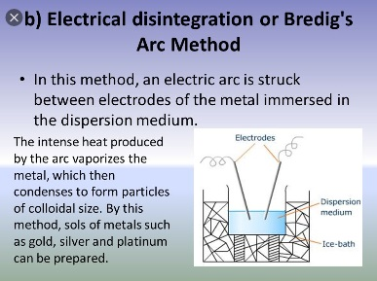

Slide 63
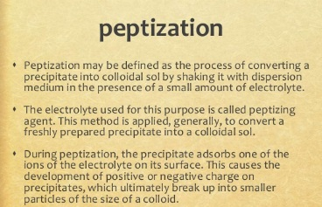

Slide 64
PURIFICATION OF COLLIODAL SOLUTION
(a) Dialysis-it is a process of removing a dissolved substance from a colloidal solution by membrane.
(b) Electro dialysis-when dialysis is carried out with an electric field applied around the membrane.
(c) Ultra filtration- Use of special filters which are permeable to all ionic substances except colloidal particles

Slide 65
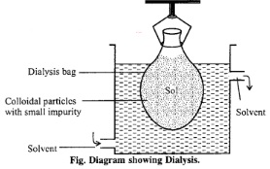
Dialysis, in chemistry, separation of suspended colloidal particles from dissolved ions or molecules of small dimensions (crystalloids) by means of their unequal rates of diffusion through the pores of semipermeable membranes

Slide 66
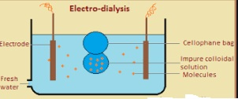

Slide 67
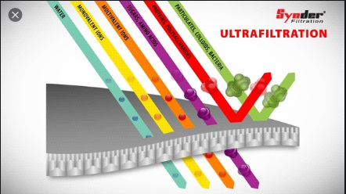

Slide 68
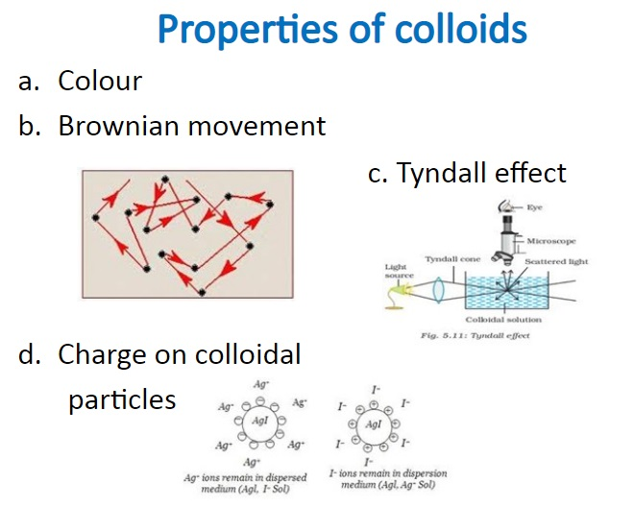

Slide 69
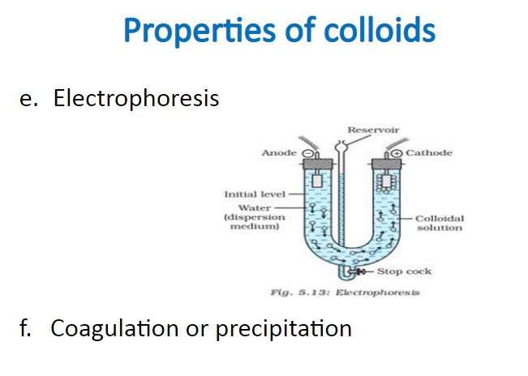

Slide 70
Coagulation and Floculation
The process of forming aggregates from colloidal particles by the addition of suitable electrolyte is called coagulation.
The addition of an electrolyte to a lyophobic colloid results in its coagulation.
At lower concentration of electrolyte, the aggregation of particles is called flocculation. Flocculation is reversible while coagulation is irreversible.

Slide 71


Slide 72


Slide 73
Emulsion:
Emulsions are colloids in which both the dispersed phase and the dispersion medium are in the liquid states.
Types of Emulsion:
• Oil in water: It is the emulsion in which dispersed phase is oil and dispersion medium is water. For example: Milk, vanishing cream.
• Water in oil: It is the emulsion in which dispersed phase is water and dispersion medium is oil. For example: Cold cream. butter, cod liver oil.

Slide 74
Emulsification:
The process of making emulsion is called emulsification.
Emulsifier or Emulsifying agent:
The emulsions are generally prepared by shaking strongly the mixture of two colloids these emulsions are generally unstable, e.g., oil and water are immiscible and form unstable emulsions. Thus a substance is added to stabilize the emulsions which named as emulsifiers or emulsifying agents.
For example: Protein casein is present in milk as an emulsifying agent.
Demulsification:
The process of converting the emulsion back into two distinct components, oil and water is called demulsification

Slide 75
Application of colloids:
• Sewage disposal: Colloidal particles of the dirt, mud etc. carry electric charge, hence when sewage water is passed through the plates kept at a high potential, the colloidal particles are coagulated due to electrophoresis and the suspended matter gets removed.
• Cleansimg action of soap: Soap solution is colloidal in nature. It removes the dirt particles either by adsorption or by emulsifying the greasy matter sticking to the cloth.
• Rubber plating: Rubber plated articles are prepared by depositing negatively charged rubber particles over the article to be rubber plated by making that article an anode in a rubber plating bath.
• Medicines: Number of medicines are emulsions. Actually, medicines in colloidal form are easily adsorbed by the body tissues and hence are more effective.

Slide 76
• Disinfectant: Certain disinfectants like Dettol and Lysol are formed of oil-in-water type emulsions.
• Froth floatation process: In the metallurgical processes, the concentration of ore by forth floatation process is based upon the treatment of the powdered ore with oil emulsion. The valuable particles of the ore form foam which comes to the surface and is skimmed off.

